Slide 1



Three Group, Heterogeneous $S_{n}$ Transport Equation Solver in Slab Geometry
Sunday Agbo
Zach Condon

Slide 2
Summary
Introduction
Results
Comparison to diffusion

Slide 3
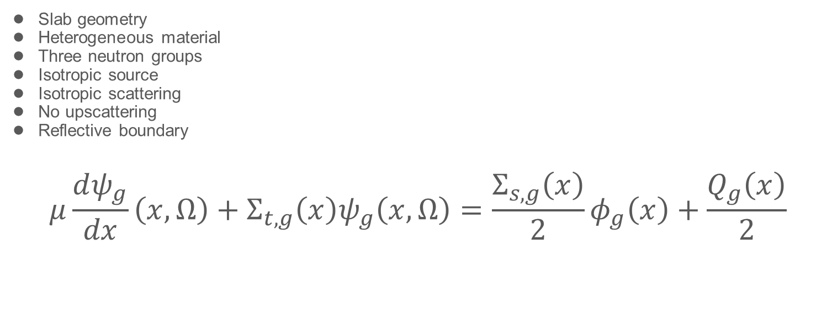
Introduction – the characteristics
Slab geometry
Heterogeneous material
Three neutron groups
Isotropic source
Isotropic scattering
No upscattering
Reflective boundary
$$μ\frac{dψ_{g}}{dx}\left(x,Ω\right)+Σ_{t,g}\left(x\right)ψ_{g}\left(x,Ω\right)=\frac{Σ_{s,g}\left(x\right)}{2}φ_{g}\left(x\right)+\frac{Q_{g}\left(x\right)}{2}$$

Slide 4

Introduction – the scattering term:
$$Σ_{s,g}=\sum_{g^{′}= 1}^{G}{Σ_{s,g^{′}→g}}$$

Slide 5
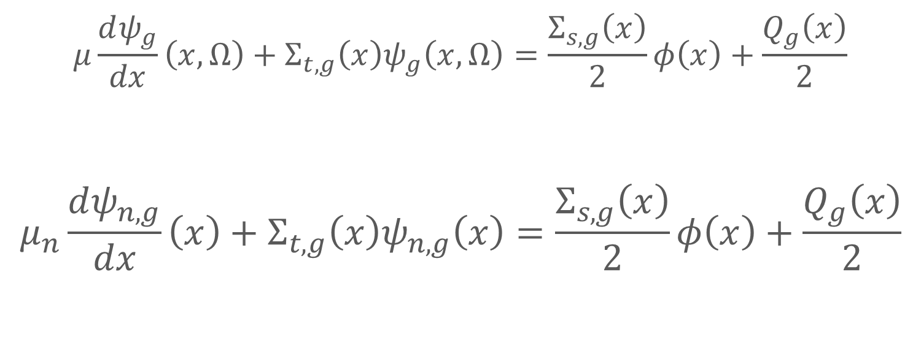
Angular discretization
$$μ\frac{dψ_{g}}{dx}\left(x,Ω\right)+Σ_{t,g}\left(x\right)ψ_{g}\left(x,Ω\right)=\frac{Σ_{s,g}\left(x\right)}{2}φ\left(x\right)+\frac{Q_{g}\left(x\right)}{2}$$
$$μ_{n}\frac{dψ_{n,g}}{dx}\left(x\right)+Σ_{t,g}\left(x\right)ψ_{n,g}\left(x\right)=\frac{Σ_{s,g}\left(x\right)}{2}φ\left(x\right)+\frac{Q_{g}\left(x\right)}{2}$$

Slide 6
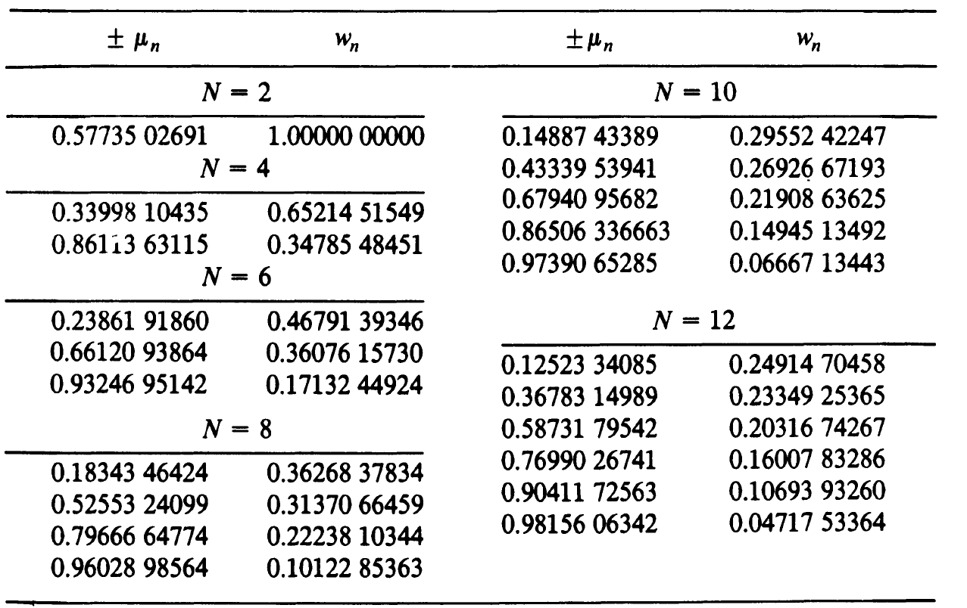

Gauss-Legendre quadrature
$$μ_{n}\frac{dψ_{n,g}}{dx}\left(x\right)+Σ_{t,g}\left(x\right)ψ_{n,g}\left(x\right)=\frac{Σ_{s,g}\left(x\right)}{2}φ\left(x\right)+\frac{Q_{g}\left(x\right)}{2}$$

Slide 7




Spatial discretization:
$ψ_{in}=\frac{1}{2}∗\left(ψ_{i+\frac{1}{2},n}+ψ_{i−\frac{1}{2},n}\right)$
$$μ_{n}\frac{ψ_{n,g,i+\frac{1}{2}}−ψ_{n,g,i−\frac{1}{2}}}{h_{i}}\left(x\right)+Σ_{t,g,i}ψ_{n,g,i}=\frac{Σ_{s,g,i}}{2}φ_{i}+\frac{Q_{g,i}}{2}$$
$$x_{i−1/2}$$
$$x_{i}$$
$$x_{i+1/2}$$

Slide 8

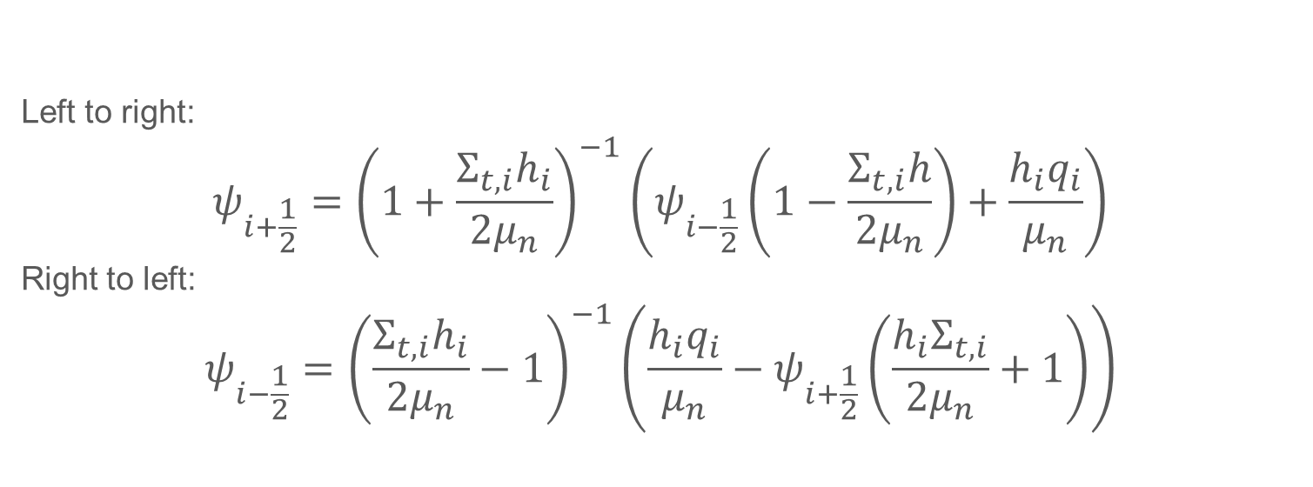


Transport sweep:
Left to right:
$$ψ_{i+\frac{1}{2}}={\left(1+\frac{Σ_{t,i}h_{i}}{2μ_{n}}\right)}^{−1}\left(ψ_{i−\frac{1}{2}}\left(1−\frac{Σ_{t,i}h}{2μ_{n}}\right)+\frac{h_{i}q_{i}}{μ_{n}}\right)$$
Right to left:
$$ψ_{i−\frac{1}{2}}={\left(\frac{Σ_{t,i}h_{i}}{2μ_{n}}−1\right)}^{−1}\left(\frac{h_{i}q_{i}}{μ_{n}}−ψ_{i+\frac{1}{2}}\left(\frac{h_{i}Σ_{t,i}}{2μ_{n}}+1\right)\right)$$
$$x_{i−1/2}$$
$$x_{i}$$
$$x_{i+1/2}$$

Slide 9

Source Iteration:
$$μ_{n}\frac{ψ_{n,g,i+\frac{1}{2}}^{m+1}−ψ_{n,g,i−\frac{1}{2}}^{m+1}}{h_{i}}+Σ_{t,g,i}ψ_{n,g,i}^{m+1}=q_{g,i}^{m}$$
where
$$q_{g,i}^{m}=\frac{Σ_{s,g,i}}{2}φ_{g,i}^{m}+\frac{Q_{g,i}}{2}$$

Slide 10
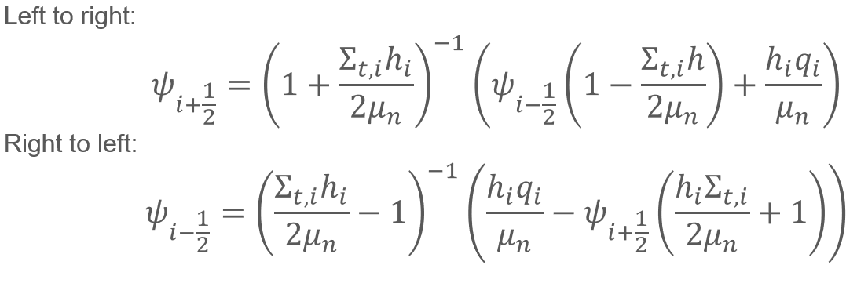
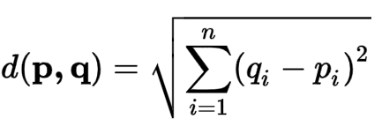
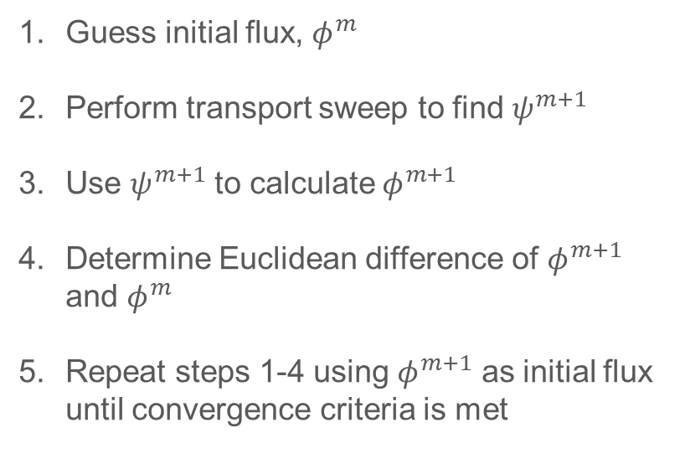

Solving algorithm:
Transport sweep:
Guess initial flux, $φ^{m}$
Perform transport sweep to find $ψ^{m+1}$
Use $ψ^{m+1}$ to calculate $φ^{m+1}$
Determine Euclidean difference of $φ^{m+1}$ and $φ^{m}$
Repeat steps 1-4 using $φ^{m+1}$ as initial flux until convergence criteria is met
Flux calculation:
$$φ=\frac{1}{2}\sum_{n=1}^{N}{w_{n}ψ_{n}}$$
Euclidean difference:

Slide 11
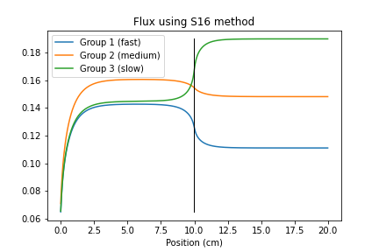
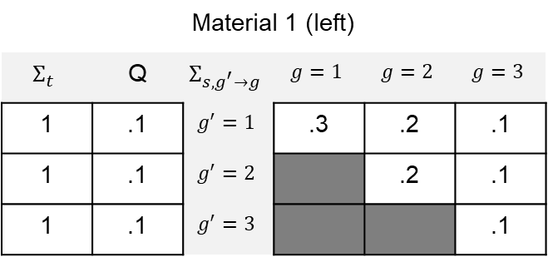

Example 1 Results:
Material 1 (left)
$$Σ_{t}$$ | Q | $$Σ_{s,g^{′}→g}$$ | $$g=1$$ | $$g=2$$ | $$g=3$$
1 | .1 | $$g^{′}=1$$ | .3 | .2 | .1
1 | .1 | $$g^{′}=2$$ |  | .2 | .1
1 | .1 | $$g^{′}=3$$ |  |  | .1
Material 2 (right)
$$Σ_{t}$$ | Q | $$Σ_{s,g^{′}→g}$$ | $$g=1$$ | $$g=2$$ | $$g=3$$
1 | .1 | $$g^{′}=1$$ | .1 | .3 | .2
1 | .1 | $$g^{′}=2$$ |  | .1 | .2
1 | .1 | $$g^{′}=3$$ |  |  | .2

Slide 12
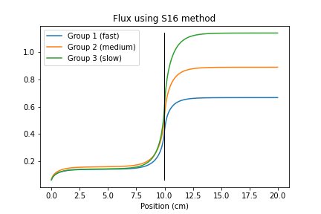

Example 2 Results:
Material 1 (left)
$$Σ_{t}$$ | Q | $$Σ_{s,g^{′}→g}$$ | $$g=1$$ | $$g=2$$ | $$g=3$$
1 | .1 | $$g^{′}=1$$ | .3 | .2 | .1
1 | .1 | $$g^{′}=2$$ |  | .2 | .1
1 | .1 | $$g^{′}=3$$ |  |  | .1
Material 2 (right)
$$Σ_{t}$$ | Q | $$Σ_{s,g^{′}→g}$$ | $$g=1$$ | $$g=2$$ | $$g=3$$
1 | .6 | $$g^{′}=1$$ | .1 | .3 | .2
1 | .6 | $$g^{′}=2$$ |  | .1 | .2
1 | .6 | $$g^{′}=3$$ |  |  | .2

Slide 13
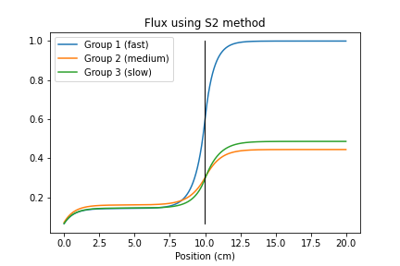

Example 3 – Sn comparison:
Material 1 (left)
$$Σ_{t}$$ | Q | $$Σ_{s,g^{′}→g}$$ | $$g=1$$ | $$g=2$$ | $$g=3$$
1 | .1 | $$g^{′}=1$$ | .3 | .2 | .1
1 | .1 | $$g^{′}=2$$ |  | .2 | .1
1 | .1 | $$g^{′}=3$$ |  |  | .1
Material 2 (right)
$$Σ_{t}$$ | Q | $$Σ_{s,g^{′}→g}$$ | $$g=1$$ | $$g=2$$ | $$g=3$$
1 | .9 | $$g^{′}=1$$ | .1 | .3 | .2
1 | .1 | $$g^{′}=2$$ |  | .1 | .2
1 | .1 | $$g^{′}=3$$ |  |  | .2

Slide 14

Example 3 – Sn comparison:
Material 1 (left)
$$Σ_{t}$$ | Q | $$Σ_{s,g^{′}→g}$$ | $$g=1$$ | $$g=2$$ | $$g=3$$
1 | .1 | $$g^{′}=1$$ | .3 | .2 | .1
1 | .1 | $$g^{′}=2$$ |  | .2 | .1
1 | .1 | $$g^{′}=3$$ |  |  | .1
Material 2 (right)
$$Σ_{t}$$ | Q | $$Σ_{s,g^{′}→g}$$ | $$g=1$$ | $$g=2$$ | $$g=3$$
1 | .9 | $$g^{′}=1$$ | .1 | .3 | .2
1 | .1 | $$g^{′}=2$$ |  | .1 | .2
1 | .1 | $$g^{′}=3$$ |  |  | .2

Slide 15

Example 3 – Sn comparison:
Material 1 (left)
$$Σ_{t}$$ | Q | $$Σ_{s,g^{′}→g}$$ | $$g=1$$ | $$g=2$$ | $$g=3$$
1 | .1 | $$g^{′}=1$$ | .3 | .2 | .1
1 | .1 | $$g^{′}=2$$ |  | .2 | .1
1 | .1 | $$g^{′}=3$$ |  |  | .1
Material 2 (right)
$$Σ_{t}$$ | Q | $$Σ_{s,g^{′}→g}$$ | $$g=1$$ | $$g=2$$ | $$g=3$$
1 | .9 | $$g^{′}=1$$ | .1 | .3 | .2
1 | .1 | $$g^{′}=2$$ |  | .1 | .2
1 | .1 | $$g^{′}=3$$ |  |  | .2

Slide 16

Example 3 – Sn comparison:
Material 1 (left)
$$Σ_{t}$$ | Q | $$Σ_{s,g^{′}→g}$$ | $$g=1$$ | $$g=2$$ | $$g=3$$
1 | .1 | $$g^{′}=1$$ | .3 | .2 | .1
1 | .1 | $$g^{′}=2$$ |  | .2 | .1
1 | .1 | $$g^{′}=3$$ |  |  | .1
Material 2 (right)
$$Σ_{t}$$ | Q | $$Σ_{s,g^{′}→g}$$ | $$g=1$$ | $$g=2$$ | $$g=3$$
1 | .9 | $$g^{′}=1$$ | .1 | .3 | .2
1 | .1 | $$g^{′}=2$$ |  | .1 | .2
1 | .1 | $$g^{′}=3$$ |  |  | .2

Slide 17
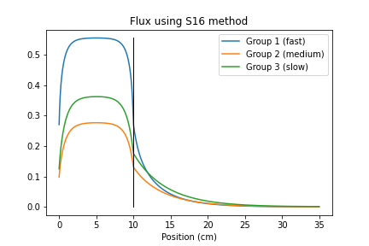


Example 4 – Fission example:
Material 1 (left)
$$Σ_{t}$$ | Q | $$Σ_{s,g^{′}→g}$$ | $$g=1$$ | $$g=2$$ | $$g=3$$
1 | .5 | $$g^{′}=1$$ | .1 | .44 | .4
1 | 0 | $$g^{′}=2$$ |  | .2 | .3
1 | 0 | $$g^{′}=3$$ |  |  | .1
Material 2 (right)
$$Σ_{t}$$ | Q | $$Σ_{s,g^{′}→g}$$ | $$g=1$$ | $$g=2$$ | $$g=3$$
.2 | 0 | $$g^{′}=1$$ | .05 | .4 | .4
.2 | 0 | $$g^{′}=2$$ |  | .1 | .2
.2 | 0 | $$g^{′}=3$$ |  |  | .2

Slide 18
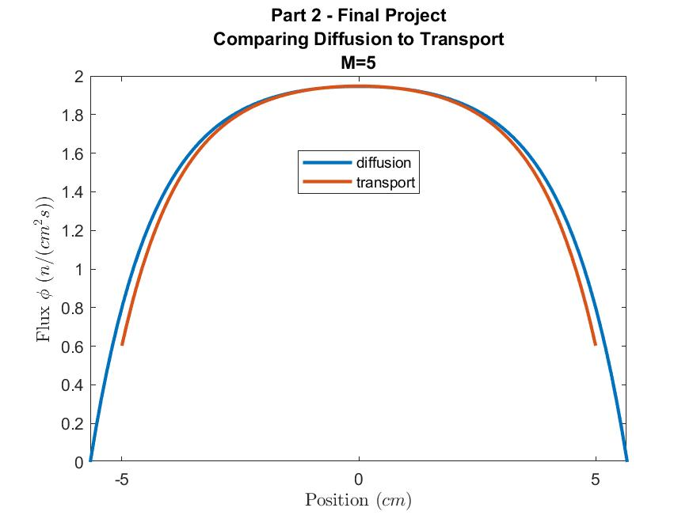
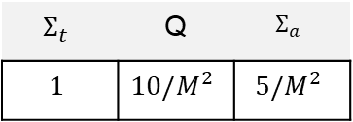
Part 2 – Comparing transport and diffusion
$$Σ_{t}$$ | Q | $$Σ_{a}$$
$$1$$ | $$10/M^{2}$$ | $$5/M^{2}$$

Slide 19
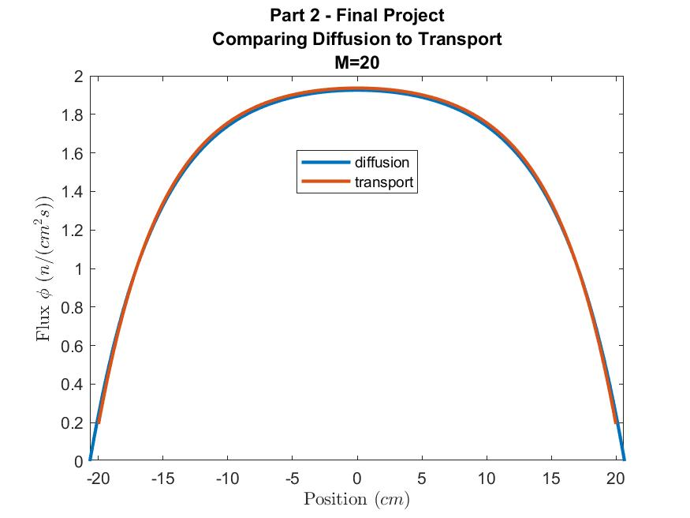
Part 2 – Comparing transport and diffusion
$$Σ_{t}$$ | Q | $$Σ_{a}$$
$$1$$ | $$10/M^{2}$$ | $$5/M^{2}$$

Slide 20
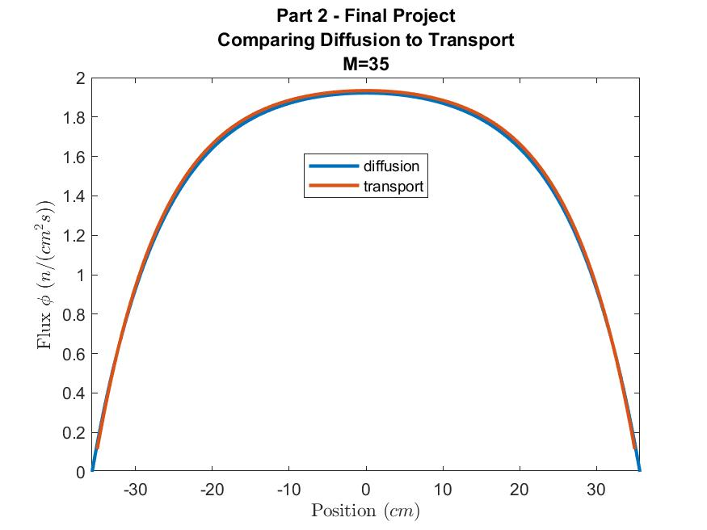
Part 2 – Comparing transport and diffusion
$$Σ_{t}$$ | Q | $$Σ_{a}$$
$$1$$ | $$10/M^{2}$$ | $$5/M^{2}$$

Slide 21
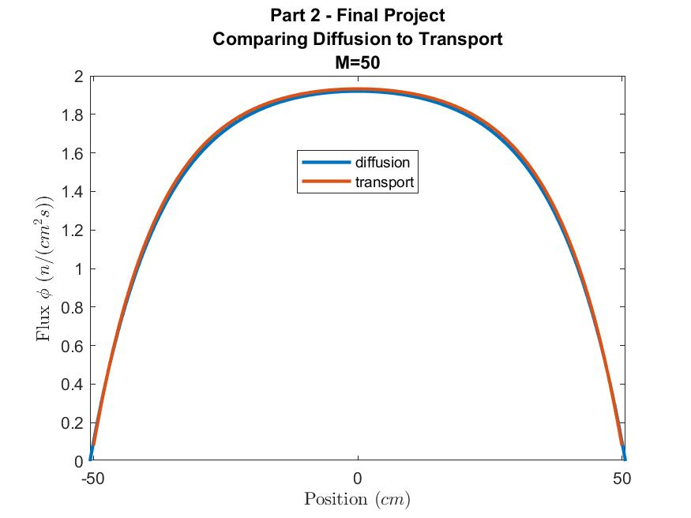
Part 2 – Comparing transport and diffusion
$$Σ_{t}$$ | Q | $$Σ_{a}$$
$$1$$ | $$10/M^{2}$$ | $$5/M^{2}$$

Slide 22
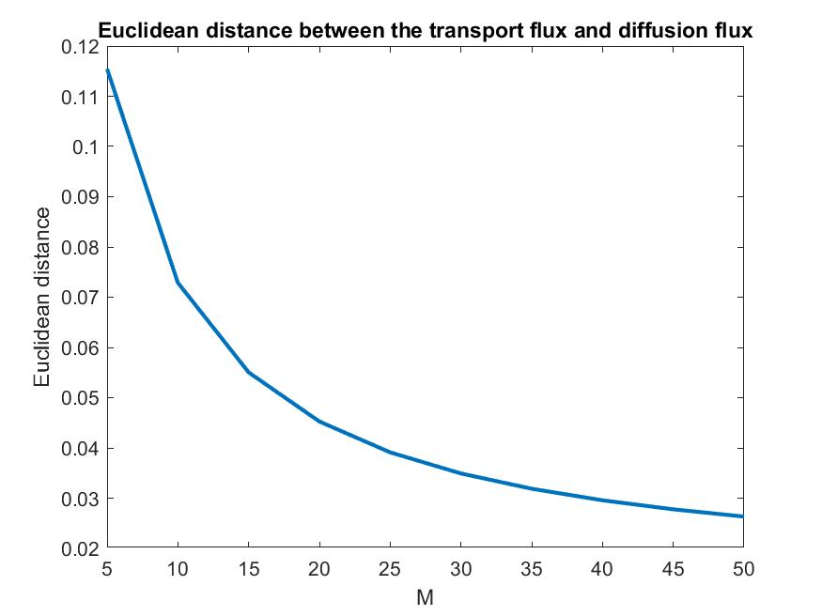
Part 2 – Comparing transport and diffusion
$$Σ_{t}$$ | Q | $$Σ_{a}$$
$$1$$ | $$10/M^{2}$$ | $$5/M^{2}$$

Slide 23
Summary
Introduction
Results
Comparison to diffusion

Slide 24
Questions?

