Slide 1
Zemax Data Import: Excel Format
2025/Sept
DISCLAIMER: verify all data imported with this tool

Slide 2
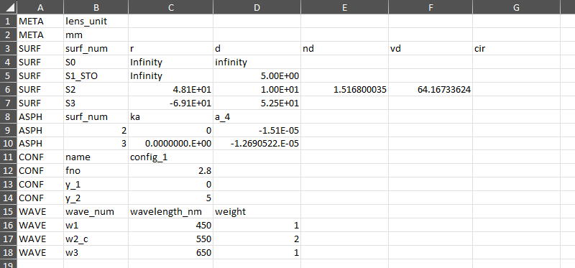
Column A contains meta-data used for the data import
There are 5 keys (META, SURF, ASPH, CONF, WAVE), corresponding to 5 blocks of data; each data block (table) has its own size and headers.
Each key is used to create a pandas dataframe for the data block.
The formatting for each of these 5 data blocks is explained in the following pages.

Slide 3
META
This is meta-data about the system.
The column headers are as follows:
lens_unit = the system lens units (i.e. “mm”, “cm”, “in”, or “m”)
to do: add support here for field type, aperture type, etc.

Slide 4
SURF
This is the surface data.
The column headers are as follows:
surf_num = surface comment (“_STO” indicates stop surface)
r = radius of curvature (lens units)
d = thickness (lens units)
nd = index of refraction (for model glass), or glass name (string)
vd = abbe number (for model glass), or catalog name (string)
cir = semi-diameter (and mechanical semi-diameter); can be blank (automatic)
notes:
“_STO” suffix is required on exactly one surf_num value
include s0 (object), but not image surf
any string is accepted as “infinity” for r and d

Slide 5
ASPH
This is the surface aspheric data; this key/data block is optional.
The column headers are as follows:
surfnum = the surface which will be made aspheric
ka = conic constant
a_1 = coefficient on asphere term 1
a_2 = coefficient on asphere term 2
…
notes:
import supports asphere terms 1~240
Add more columns to apply additional asphere terms
asphere terms which are not set will be left as zero; the order is flexible, but they should all follow the format “a_n”

Slide 6
CONF
This is the multi-config data.
The column headers are as follows:
name = keys for multi-config operands
config_n = data for configuration #n
…
configuration keys are as follows:
fno = system image space f/#
y_n = y image height value for field #n
d_n = thickness for surface #n
notes:
config_1 is required for setting system fno and field data
there should be exactly one “fno” entry
import currently assumes field type of Real Image Height

Slide 7
WAVE
This is the wavelength data.
The column headers are as follows:
wave_num = the wavelength number (“_c” indicates primary wave)
wavelength_nm = the wavelength in nanometers
weight = the wavelength weight
notes:
the “_c” suffix is required on exactly one wave_num value

