Slide 1
ETSYPULSE · AUTONOMOUS MARKET DESK
Market signals,
not market noise.
BRIEF
Judge 82%
Refresh gift positioning on
'personalized necklace'
— act this week
Actionability
88%
Urgency
74%
Set the shop once. Agents monitor.
Only actionable briefs land.
Evidence
84%
EtsyPulse: Autonomous Market Intelligence for Etsy Sellers
RECOMMENDED ACTIONS
→ Update listing titles with gift-occasion keywords
→ Refresh hero photos with gift-ready styling
→ Create a curated gift bundle collection
Powered by Bright Data
7 AI Agents
FastAPI + React
View full brief →

Slide 2
THE PROBLEM
Etsy sellers are swimming in signals, drowning in tabs.
Competitor repricing
Search intent shifts
Social trend spikes
Your competitors change prices and listings daily.
You find out too late.
Buyer keywords evolve with trends.
Manual SERP checks don't scale.
TikTok, Reddit, Instagram drive Etsy demand.
Most sellers miss the window.
1
2
3
5.6M active Etsy sellers. Zero of them have an always-on market analyst.

Slide 3
THE SOLUTION
One shop URL. Seven agents. Only actionable briefs.
Shop URL
Bootstrap Profile
SERP · Competitor · Social
Market Pulse
Judge Agent
Seller Brief
one input
Bright Data
parallel agents
normalized
filtered
actionable
The Judge Agent filters 100% of signals. Only those that cross the actionability threshold reach the seller.
✓
No credentials needed for demo — DEMO_MODE=true out of the box
⚡
Live Bright Data path available — Web Unlocker + all tool abstractions
Architecture: React/Vite → FastAPI → Scheduler → Agent Pipeline → Bright Data + LLM

Slide 4
BRIGHT DATA
Real web data powers every signal.
web_data_etsy_products
search_engine
scrape_as_markdown
discover
scrape_batch
web_data_tiktok_posts
web_data_reddit_posts
web_data_instagram_reels
web_data_google_shopping
Demo Mode
Live Mode
Deterministic cached fixtures
→ no credentials required
→ every run is reproducible
Bright Data Web Unlocker
→ real markdown scraping
→ structured product adapters
Debug panel shows every call: tool name · latency · cache/live mode · redacted request shape · response summary

Slide 5
AGENT PIPELINE
Seven typed agents. One actionable brief.
NVIDIA NIM · OpenRouter
OpenClaw (optional)
1
Shop Bootstrap
etsy_products · scrape_markdown
Profiles listings, seed keywords, and competitors
2
Keyword / SERP
search_engine · discover
Tracks search intent and SERP position changes
3
Competitor Watch
etsy_products · scrape_batch
Monitors pricing, listings, and positioning shifts
4
Trend Scout
tiktok · reddit · instagram · shopping
Scans TikTok, Reddit, Instagram, Google Shopping
5
Market Pulse
Normalizes and deduplicates signals into market events
6
Judge Agent
NIM → OpenRouter
Scores: actionability · urgency · confidence · novelty · impact · evidence
7
Brief Delivery
Formats seller-ready action with evidence and why-now

Slide 6
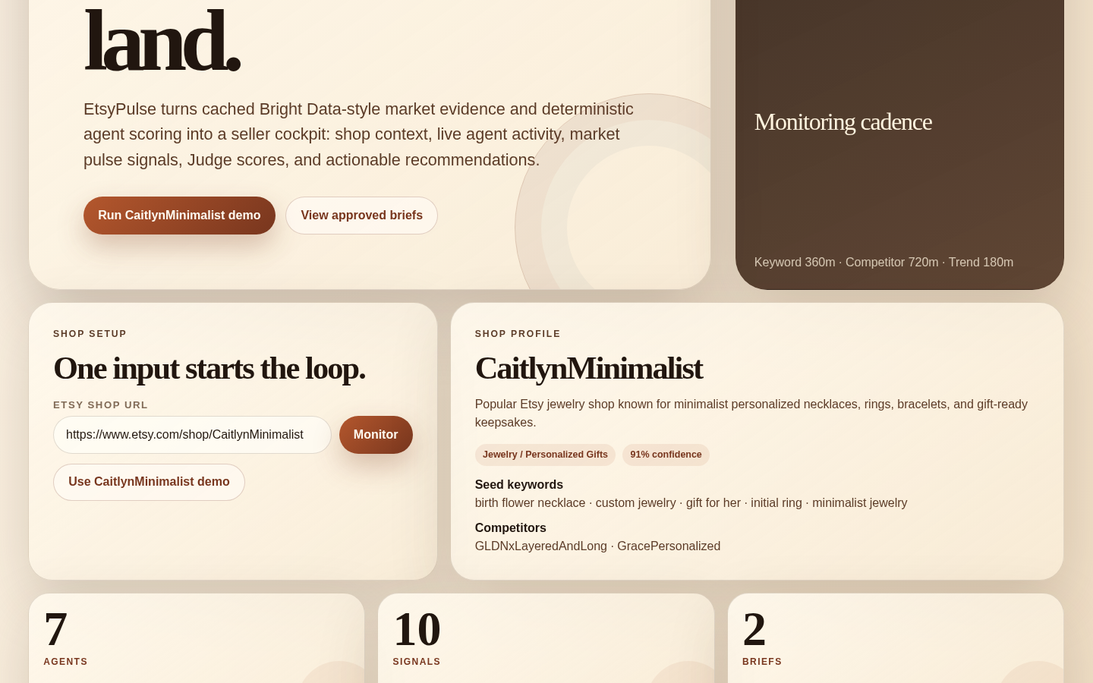
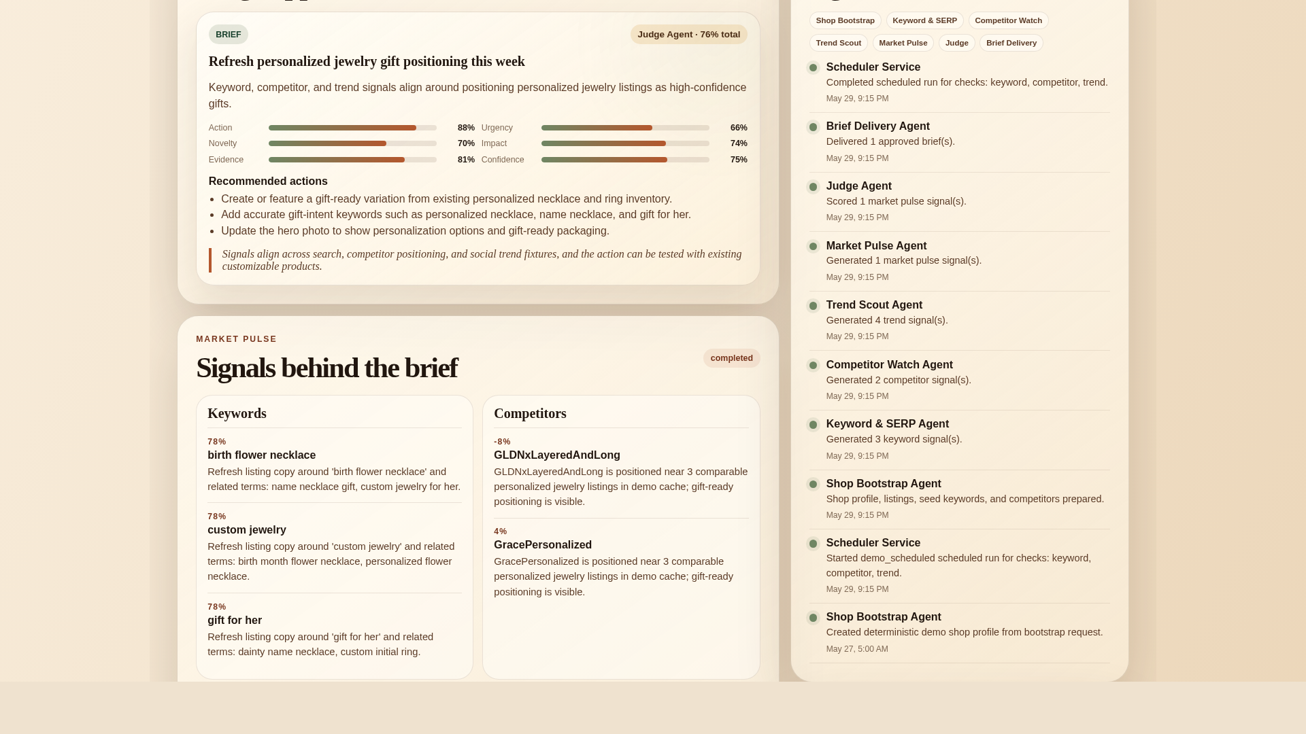
LIVE DEMO
A dashboard that tells the story in 30 seconds.
One URL. Instant shop intelligence profile.
Only actionable signals become briefs.
Shop profile · 7-agent metric strip · Workflow ribbon
Judge scores · Recommended actions · Evidence · Why-now
Demo live at etsypulse.vercel.app · DEMO_MODE=true · No credentials required · 48 tests passing

Slide 7
MARKET OPPORTUNITY
A $1.28B addressable market with proven willingness to pay.
5.6M
$876M
Active Etsy marketplace sellers
Etsy services revenue 2025
as of December 31, 2025 (Etsy 10-K)
Sellers already pay for growth tools
TAM → $1.28B ARR
Solo Seller
$19–29/mo
One shop, daily monitoring
5.6M sellers × $19/month subscription
Power Seller
$49–99/mo
Multi-shop, live mode
SAM → $191M–$319M ARR
15–25% of sellers already paying for growth tools
Agency
$199+/mo
Multiple shops, white-label
eRank, Marmalead, EverBee give dashboards. EtsyPulse gives decisions.
Source: Etsy Inc. Fourth Quarter and Full Year 2025 Results

Slide 8
ROADMAP
Built for the hackathon. Designed for production.
NOW
NEAR TERM
FUTURE
Live Vercel + Render deployment
Live BD adapters for all tools
Shopify, Amazon, Faire, Depop
7-agent demo pipeline
Email / Slack / OpenClaw notifications
Multi-shop agency dashboard
Bright Data Web Unlocker live path
Playwright demo test suite
Historical trend + experiment tracking
Judge Agent with NVIDIA NIM
Seller brief feedback loop
OpenClaw agentToAgent coordination
48 backend tests passing
Holiday & seasonal opportunity packs
SaaS subscription launch
EtsyPulse is the market intelligence layer small ecommerce sellers have always needed.
GitHub: ZachDolph/etsypulse · Demo: etsypulse.vercel.app · Powered by Bright Data

