Slide 1
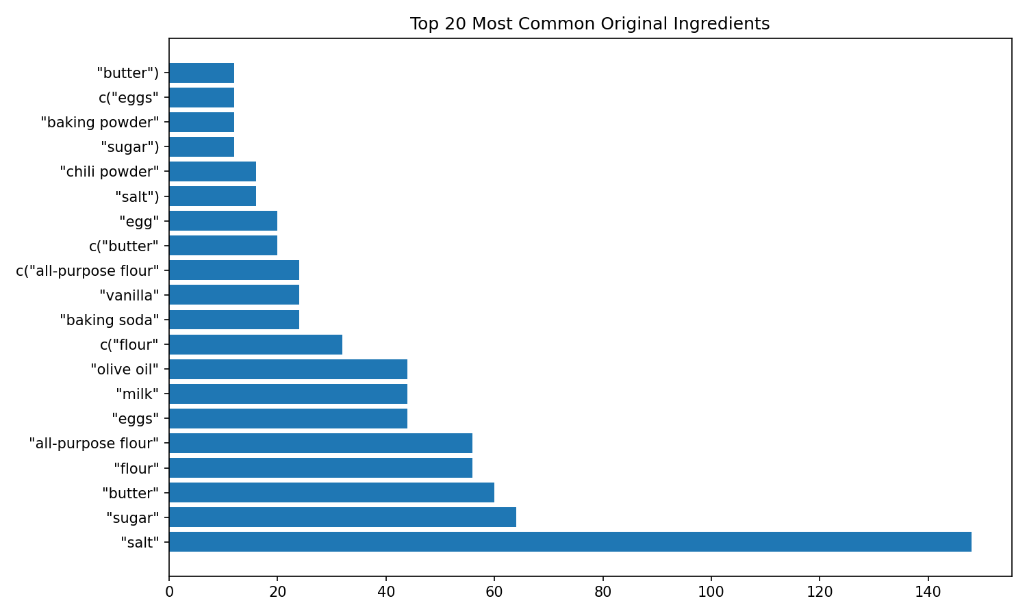
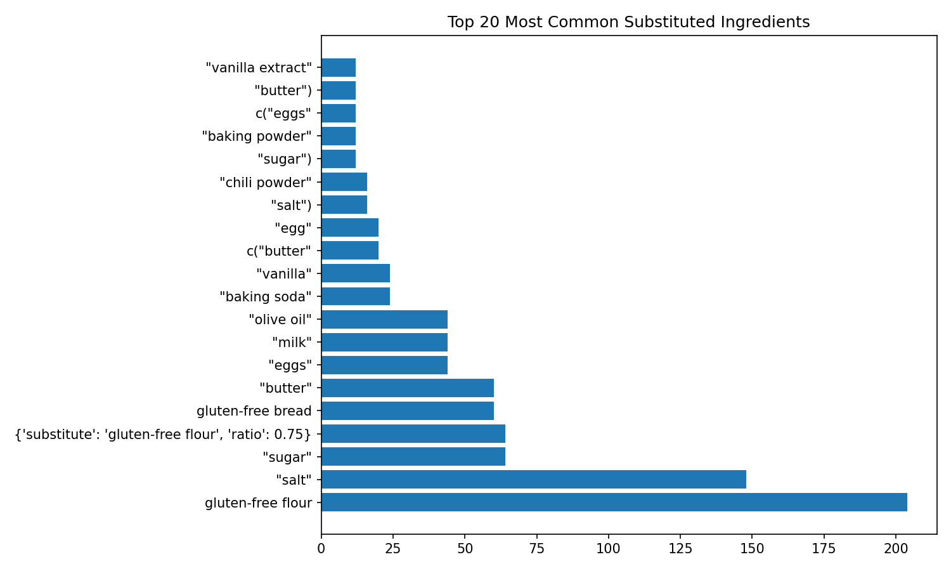
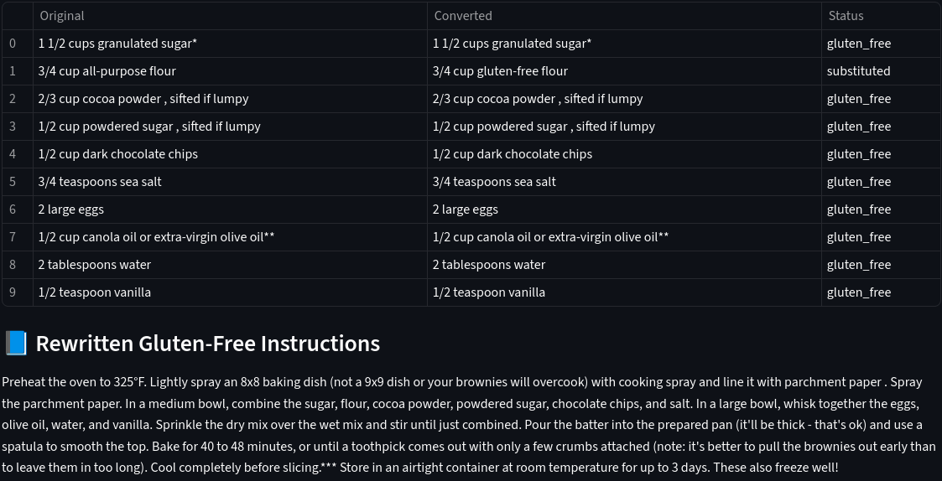
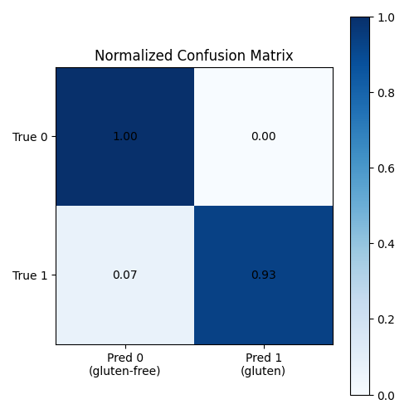
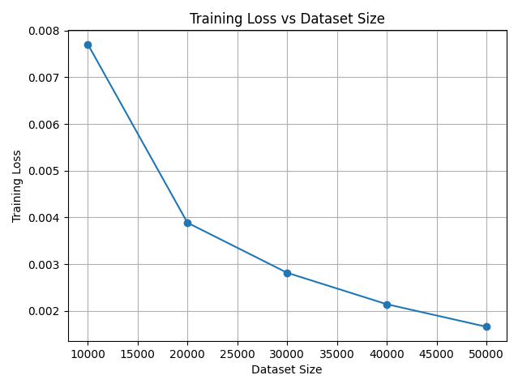

AI Converts Recipes to Gluten-Free
Figure 2
Introduction
Traditional recipe conversion is error-prone. This AI-Guided Model transforms any recipe to be gluten free. It must:
Parse messy ingredient text,
Never miss gluten (recall ≈1.0),
Suggest only gluten-free, culinary-appropriate replacements,
Adjust any quantity changes, and
Keep all instructions consistent.
This prototype transforms any recipe into a fully gluten-free version using advanced NLP models, ingredient classification, semantic substitution, and intelligent rewriting.
System Design
Figure 3
Key components of this multi-model integration (implemented in Python/PyTorch):
Preprocessing & Parsing (Attention-based Ingredient Parser)
Gluten Classifier (Fine-tuned BERT-based classifier)
Substitution Engine (BERT semantic embedder guided by GISMo graph)
Recipe Rewriter (SHARE-inspired model)
Rule-Based Fallback (Simple heuristics)
Results
Figure 4
The full pipeline (ingredient parsing → classification → gluten detection → semantic substitution → recipe rewriting) functions reliably end-to-end, smoothly handling different recipe text formats.
A simple Streamlit-based web UI demonstrates the system. Users input recipe URL or text and then the substituted ingredients with the gluten-free recipe is displayed. (Figure 1)
The Top-20 ingredient frequency plots show gluten-dense items drop while gluten-free replacements rise in the post-transformation distribution. (Figures 2 & 3)
The confusion matrix reveals strong classification accuracy for common ingredient categories. (Figure 4)
Training curves across dataset versions show a decrease in training loss as more labeled ingredient data is added, indicating improved representation learning and model generalization. (Figure 5)
Figure 1
Figure 5
Scan Here for My
Research Paper! ->

Slide 2
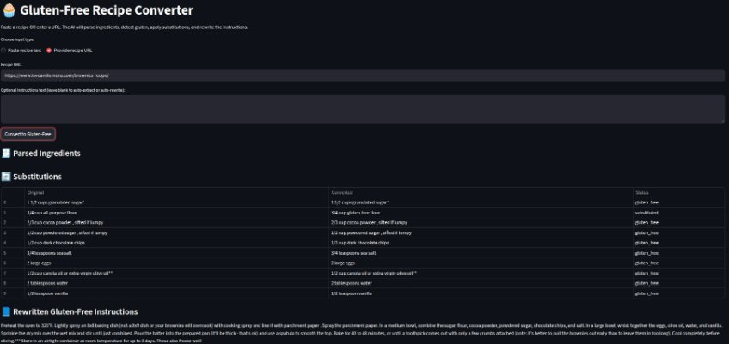
AI Converts Recipes to Gluten-Free
Figure 2
Introduction
Traditional recipe conversion is error-prone. This AI-Guided Model transforms any recipe to be gluten free. It must:
Parse messy ingredient text,
Never miss gluten (recall ≈1.0),
Suggest only gluten-free, culinary-appropriate replacements,
Adjust any quantity changes, and
Keep all instructions consistent.
This prototype transforms any recipe into a fully gluten-free version using advanced NLP models, ingredient classification, semantic substitution, and intelligent rewriting.
System Design
Figure 3
Key components of this multi-model integration (implemented in Python/PyTorch):
Preprocessing & Parsing (Attention-based Ingredient Parser)
Gluten Classifier (Fine-tuned BERT-based classifier)
Substitution Engine (BERT semantic embedder guided by GISMo graph)
Recipe Rewriter (SHARE-inspired model)
Rule-Based Fallback (Simple heuristics)
Results
Figure 4
The full pipeline (ingredient parsing → classification → gluten detection → semantic substitution → recipe rewriting) functions reliably end-to-end, smoothly handling different recipe text formats.
A simple Streamlit-based web UI demonstrates the system. Users input recipe URL or text and then the substituted ingredients with the gluten-free recipe is displayed. (Figure 1)
The Top-20 ingredient frequency plots show gluten-dense items drop while gluten-free replacements rise in the post-transformation distribution. (Figures 2 & 3)
The confusion matrix reveals strong classification accuracy for common ingredient categories. (Figure 4)
Training curves across dataset versions show a decrease in training loss as more labeled ingredient data is added, indicating improved representation learning and model generalization. (Figure 5)
Figure 5
Figure 1

