Slide 1

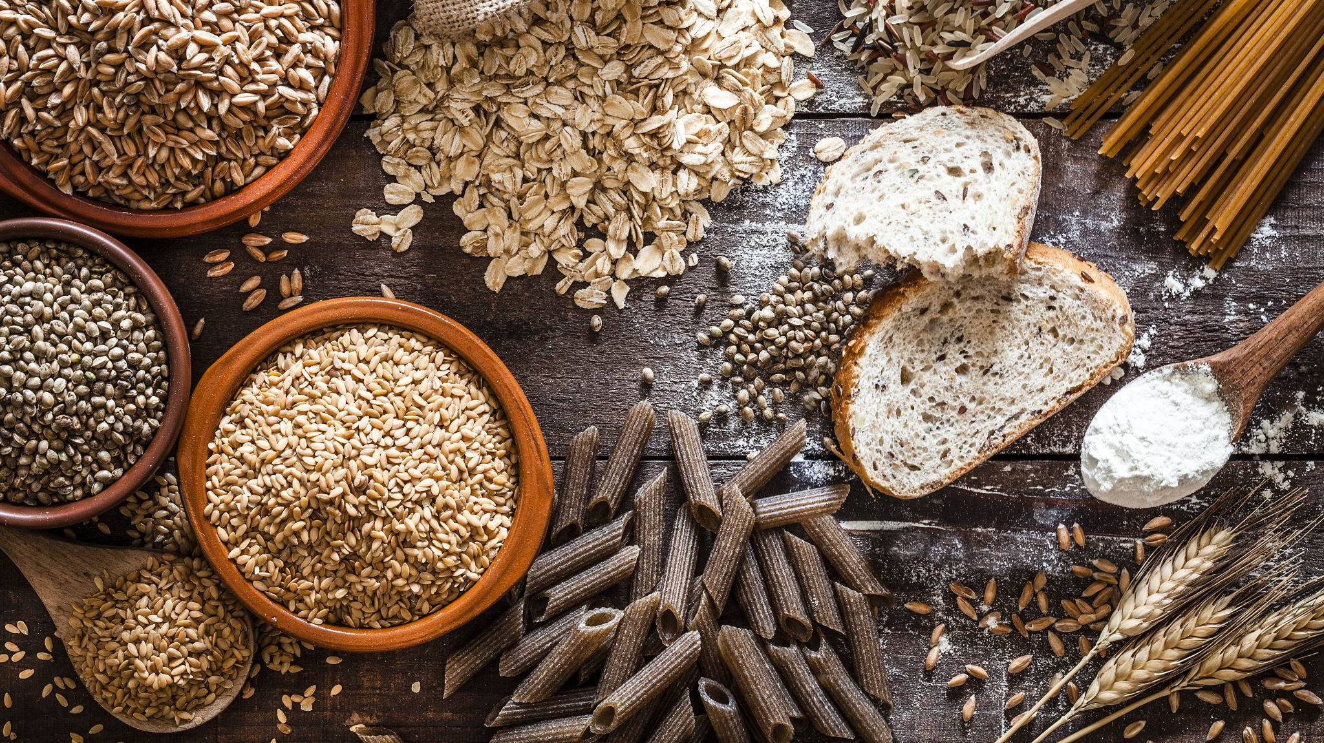
AI-Guided Gluten-Free Recipe Transformation: A Multi-Model Ingredient Substitution Prototype

Slide 2
Motivation
Traditional recipe conversion is error-prone. Cooks with celiac or gluten intolerance need to trust that no gluten slips through.
Gluten can hide in obvious (e.g. wheat flour) and unexpected forms (e.g. “breadcrumbs”, “roux” mixtures).
The system is designed for near-perfect detection: it must parse messy ingredient text, never miss gluten (recall ≈1.0), suggest only gluten-free, culinary-appropriate replacements, adjust any quantity changes, and keep all instructions consistent

Slide 3
Project Timeline
Started with a simple MLP model for binary gluten detection; accuracy was limited and could not handle ingredient variety.
Moved to a BERT embedder + Transformer pipeline for stronger text understanding and contextual classification.
Added SHARE model for semantic rewriting to preserve natural language structure in rewritten recipes.
Built advanced ingredient parsing + normalization, enabling quantity/unit detection, multi-word ingredient handling, and robust cleanup.
Integrated GISMO semantic graph, allowing fallback similarity mapping for rare or unseen gluten-containing ingredients.
Unified everything into a full-stack system with a FastAPI backend, logging, front-end UI, and complete dataset-building/training utilities.

Slide 4
System Design
System Design: Built a modular ML pipeline with five main stages.
• Preprocessing & Parsing: Normalize text (lowercase, strip whitespace), segment into sentences and ingredient lines, detect measurements (e.g. “1 cup”). An attention-based Ingredient Parser extracts quantities, units, and names for consistency.
• Gluten Classifier: A fine-tuned BERT-based classifier flags each ingredient as gluten-containing or not. Only high-confidence gluten items are passed on. This lightweight model is trained on a curated gluten vs. non-gluten ingredient dataset.
• Substitution Engine: A BERT semantic embedder encodes ingredient names and a curated list of gluten-free substitute “keys.” We compute cosine similarities to rank replacement candidates for each gluten ingredient. This leverages the GISMo graph-based knowledge of ingredient substitutions (see Fatemi et al. 2023) to ensure high-quality, taste-preserving replacements.
• Recipe Rewriter: Using a SHARE-inspired model, the system performs phrase level replacement and context-aware editing of instructions. Every mention of a substituted ingredient is updated consistently (e.g. “add gluten-free flour” instead of “flour”). The module also checks step references and formatting.
• Rule-Based Fallback: Simple heuristics handle edge cases (e.g. generic “flour” or compound phrases) to ensure safety. A small rule layer catches any remaining ambiguous cases, making the pipeline more robust.All components run behind a FastAPI server: model weights load at startup, and a /process endpoint handles input recipes (text or URL) and returns both raw JSON data and a human-readable formatted recipe. Outputs include the new recipe text and a substitution table for transparency. Every query is logged for analysis (confusion matrices, coverage charts, etc.)

Slide 5
Results
The Full Pipeline
(ingredient parsing → classification → gluten detection → semantic substitution → recipe rewriting)
functions reliably end-to-end, smoothly handling clean and messy recipe text formats.
Interface & Demo: A simple Streamlit-based web UI demonstrates the system. Users can paste a recipe URL or text into a textbox and click “Process.” The app then displays the gluten-free recipe with substituted ingredients highlighted, alongside a table explaining each replacement.

Slide 6

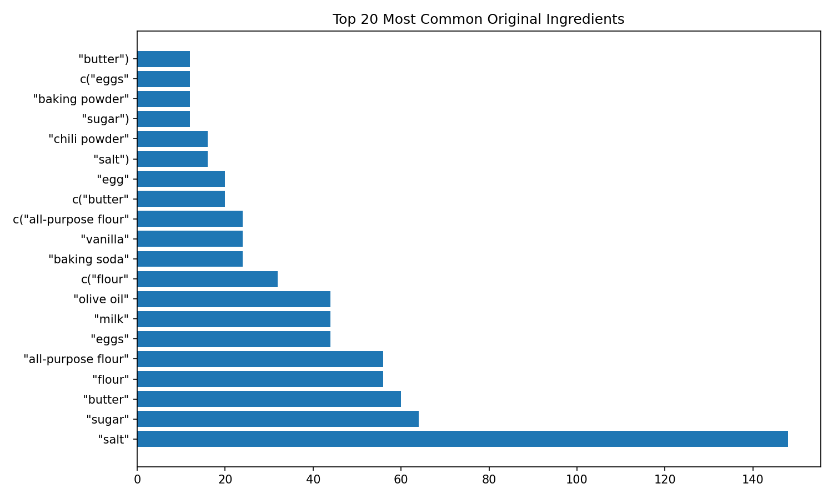


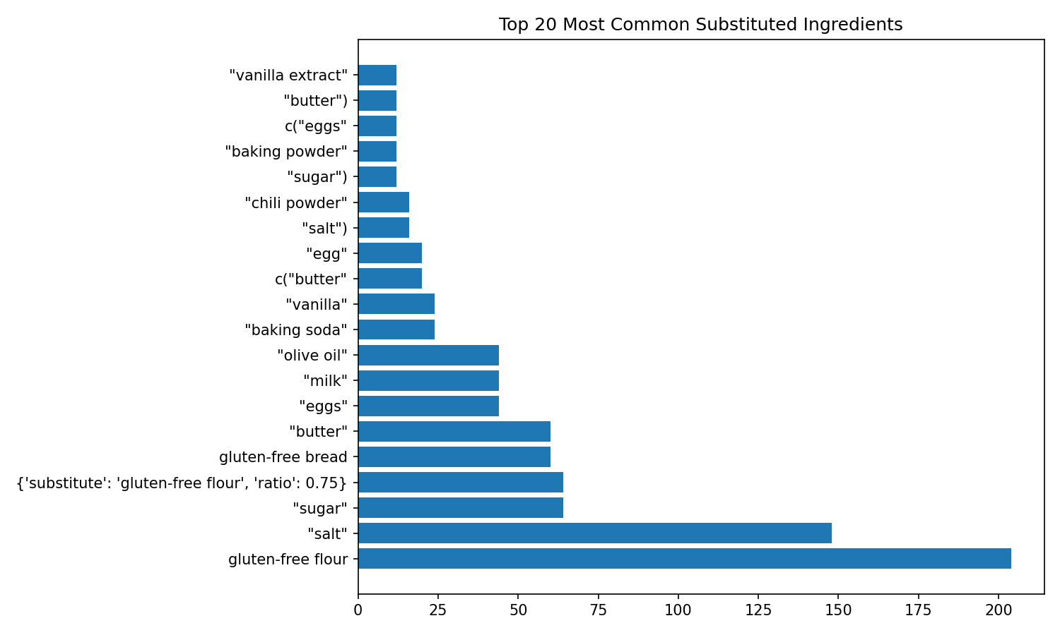

Frequency Plots
The Top-20 ingredient frequency plots show a clear transformation: gluten-dense items such as wheat flour, pasta, breadcrumbs, and soy sauce drop dramatically, while gluten-free replacements like rice flour, almond flour, GF breadcrumbs, and tamari rise sharply in the post-transformation distribution.

Slide 7
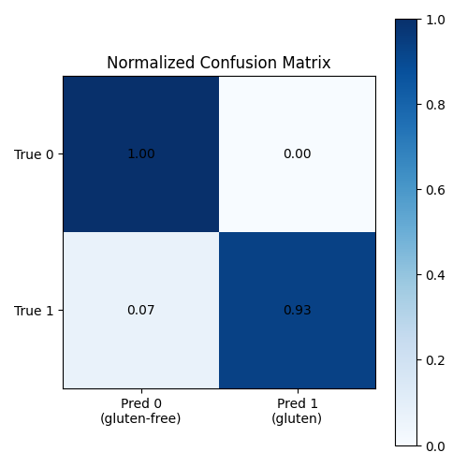
Confusion Matrix
Trained on the Food.com Kaggle dataset (recipes and reviews). Increasing training size greatly improved learning: e.g. using 50,000 recipes yields a training loss down to ≈0.002. Critically, end-to-end evaluation on real recipes shows near-perfect performance:
No missed gluten (100% recall): In testing, every gluten-containing ingredient was flagged and substituted (True Positive rate = 1.00).
No false positives: The model never substituted a truly gluten-free ingredient (False Positive = 0.00), avoiding unnecessary changes.
Low false negatives: Only ~7% of gluten items were missed (FN = 0.07), mainly ambiguous cases.
High precision on non-gluten: Roughly 93% of non-gluten ingredients were correctly left unchanged (TN = 0.93).

Slide 8
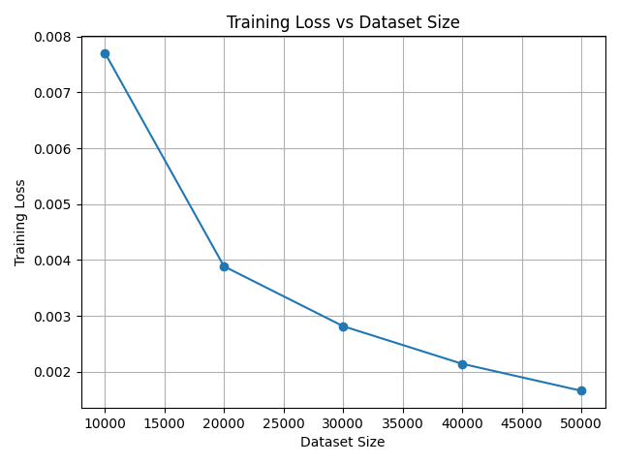
Training Loss
Training curves across dataset versions show a steady decrease in training loss as more labeled ingredient data is added, indicating improved representation learning and model generalization.

Slide 9
Performance Metrics and Model Summary
Using the evaluation set derived from JSONL logs
Overall Accuracy: ~86%
Macro F1 Score: ~0.83
Precision (Gluten Class): ~0.89
Recall (Gluten Class): ~0.81
False Negatives: Primarily ambiguous or composite ingredients (e.g., “cream of mushroom soup,” “seasoned panko mix”)
False Positives: Item names containing gluten-like tokens (e.g., “wheatgrass juice”)
Model Summary
Architecture: BERT-base with a custom classification head
Hidden Size: 768
Optim: AdamW
Scheduler: Linear warmup
Batch Size: 32
Epochs: 4
GPU Training Speedup: ~14× faster vs CPU

