Slide 1
Production NISAR, ISCE3, NISAR Pytools Interferogram Comparisons
Zachary Hoppinen
May 8, 2026

Slide 2
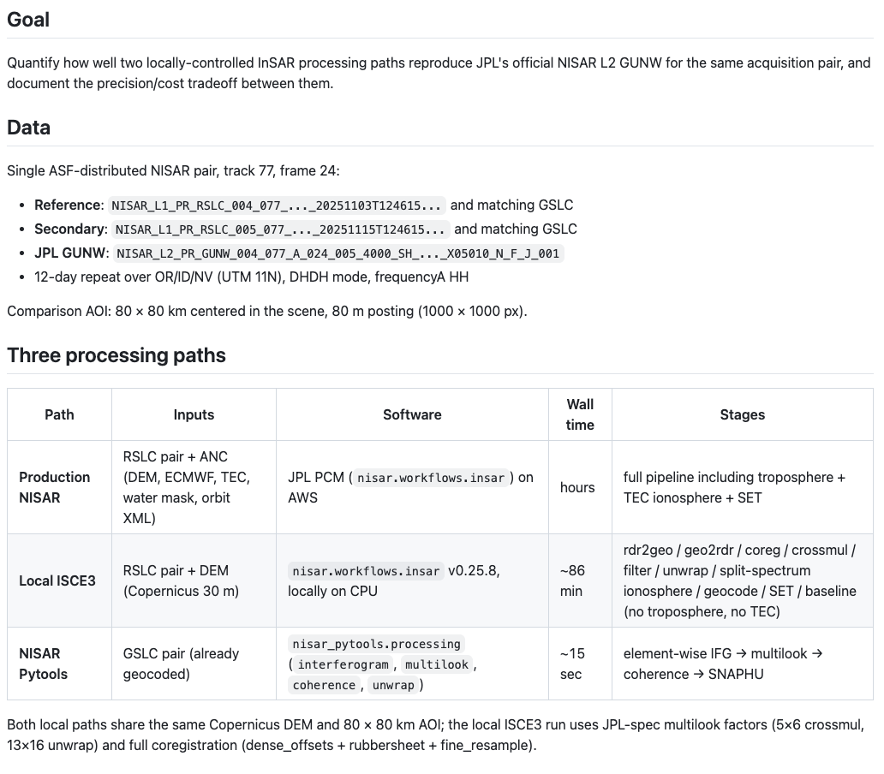

Slide 3
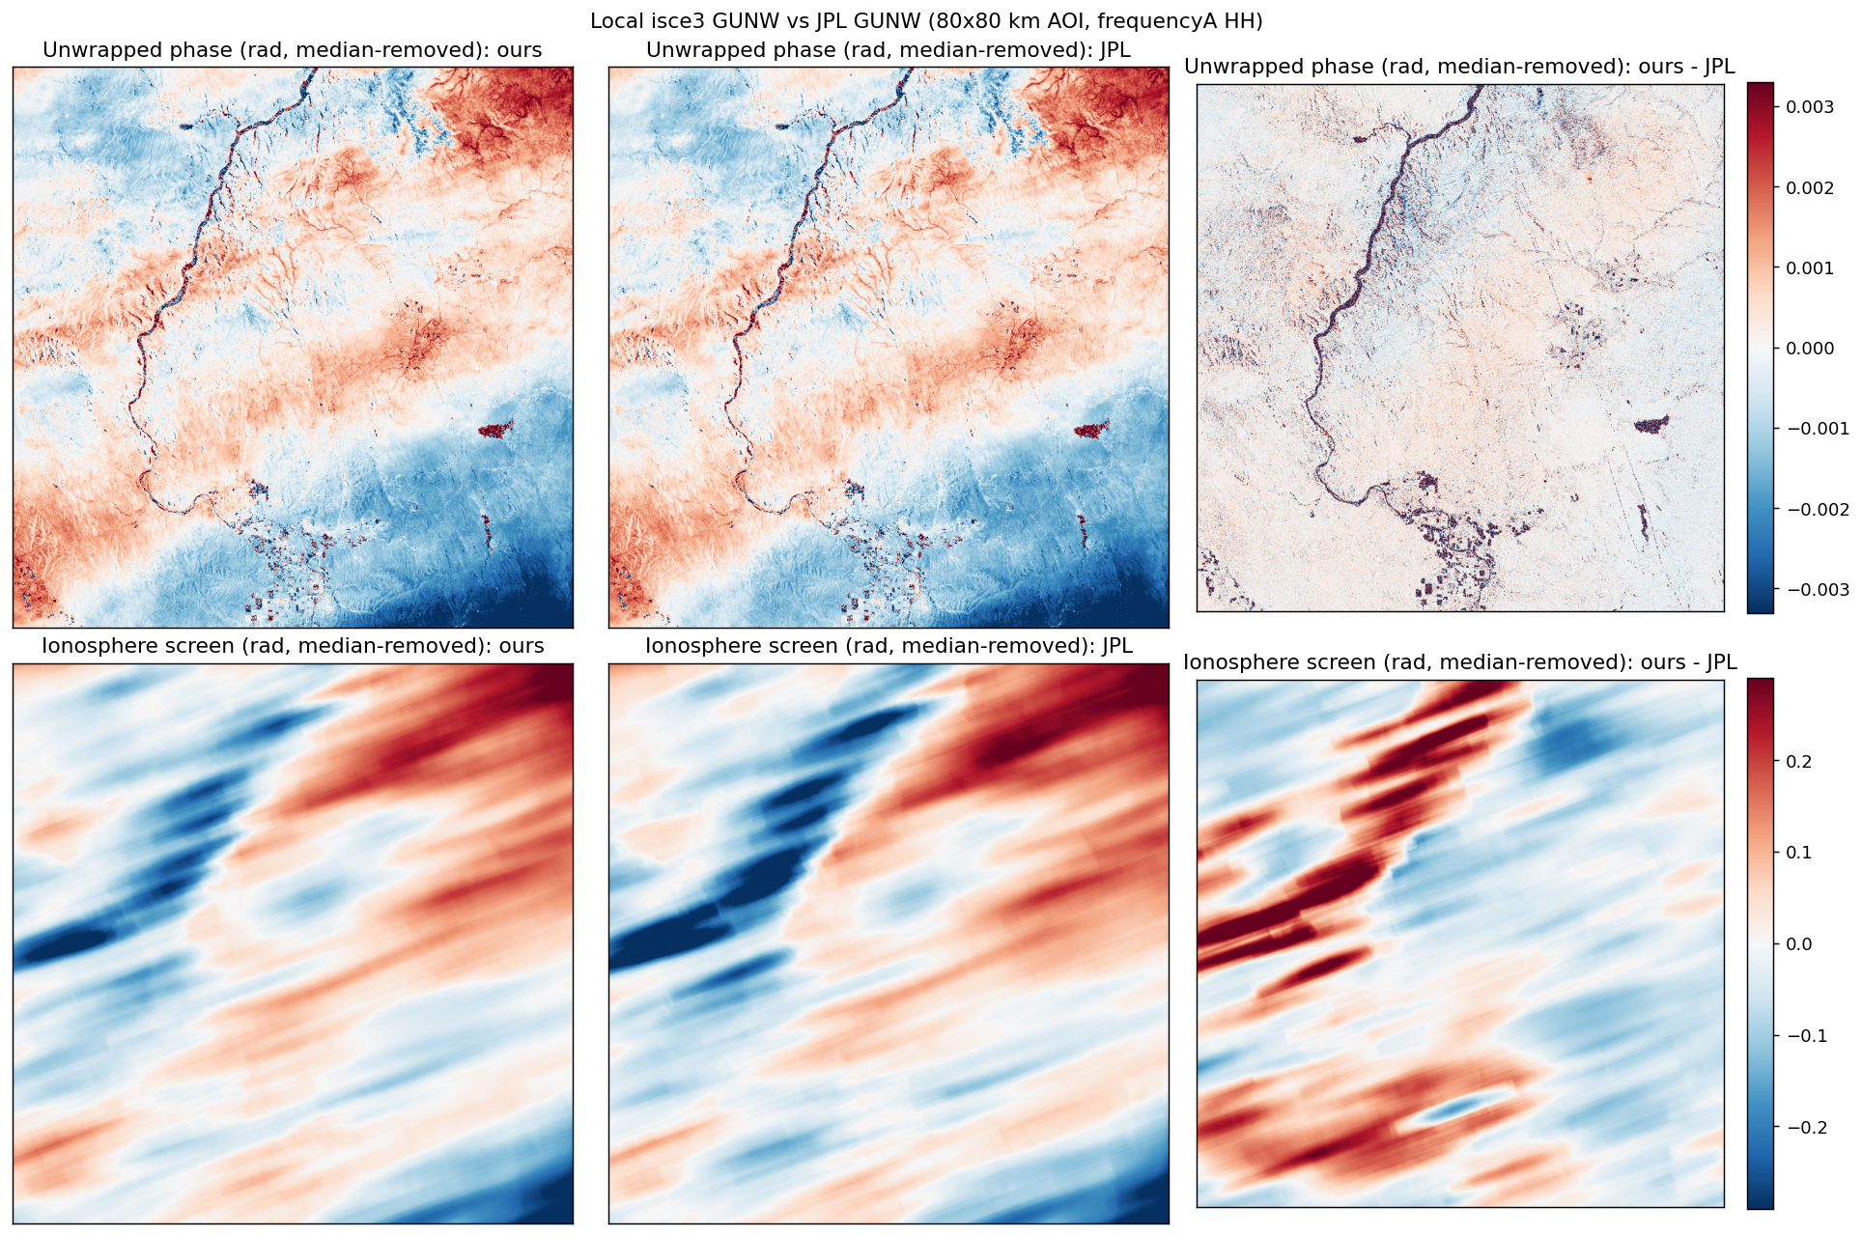
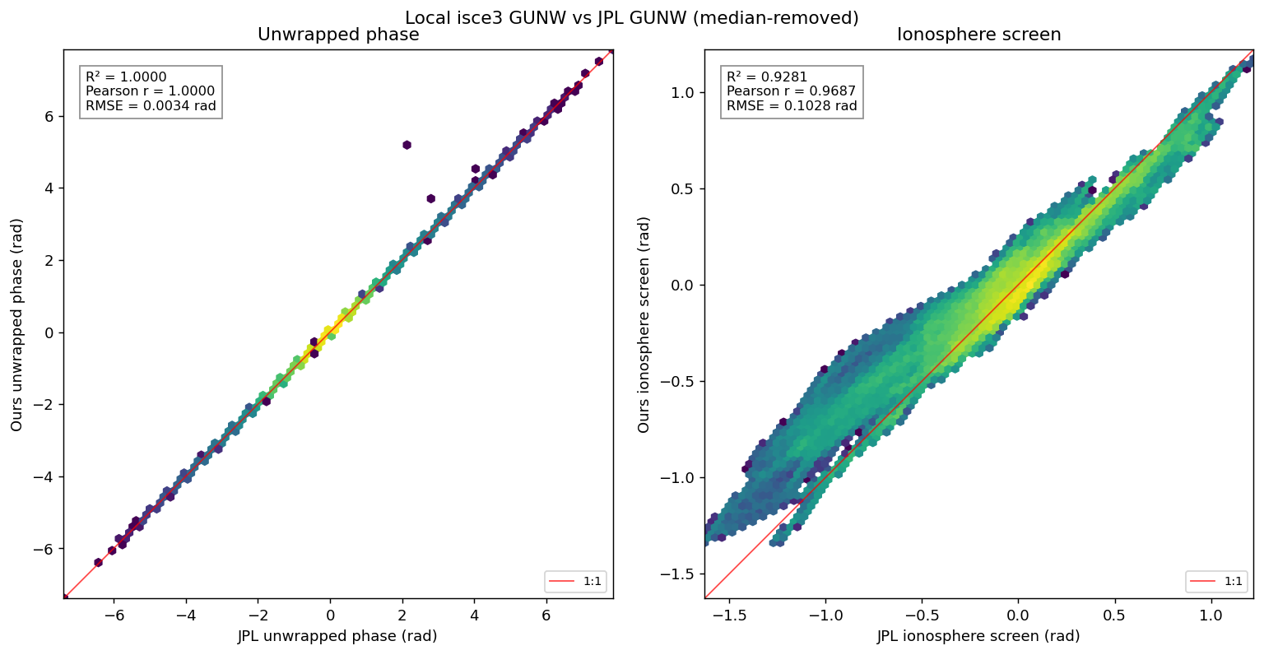
First confirm ISCE3 run recreates JPL production Run time ~ 2 hours on my local mac
Note residual colorbar is -0.003 to 0.003 radians
Identical phase but ionosphere has variance (r2 – 0.92 though)

