Slide 1

Does CEO Pay Ratio Matter?
Qinghua Feng, Zachary Ingram

Slide 2
Objectives
A debate about income inequality in the United States which has been growing for some years
CEO pay ratio is a social concern that motivates us to answer the call from investors, employees, and regulators
Firms were required to disclose CEO-to-median employee compensation(CEO Pay Ratio) in 2018, a first-time event that allows us to do research related to CEO Pay Ratio

Slide 3
Significance
Understanding the extent of the impact of a CEO pay ratio disclosure is important for jurisdictions’ which may be considering implementing such a CEO tax
Policymakers need to understand the tradeoffs in implementing such a policy and the magnitude of the potential positive and negative effects

Slide 4
Hypotheses
The market reaction is more negative for firms with a higher pay ratio relative to firms with a lower pay ratio, and
There is no significant relationship between CEO pay ratio and firms’ performance.

Slide 5
Data Sources
Firms: S&P 100
Pay ratio data:14A proxy statements which companies had filed with the SEC (10-Ks)
The stock return: CRSP
Book-to-market and market capitalization: CompuStat

Slide 6
Methodology
CAR [-1, +5]: cumulative abnormal return between event days -1 and +5, with an abnormal return representing the difference between a firm’s daily return and the value-weighted CRSP market return, with both returns excluding dividends. Day 0 in event time is identified as the earliest filing date in 2018 of either the preliminary or the definitive proxy statement.
LN Pay Ratio: ln(CEO Pay/Worker Pay), logarithm of the reported CEO pay over reported median worker pay
LN MktCap: the natural logarithm of the firm’s market capitalization
Average prc: Firm’s yealy average stock price

Slide 7
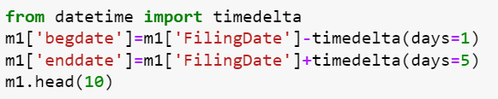
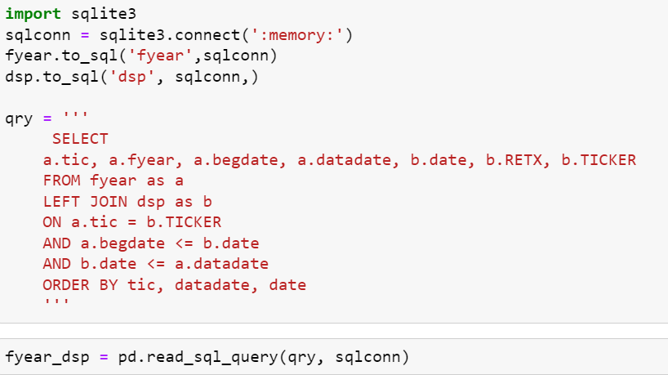
Main syntax
Timedelta
Use the filing date to find the dates one day before the filing date and 5 days after the filing date
Merge
Merge two tables using the “left” merge method to keep the left table and “on” identifier to find variables in the right table
OLS Regression
Sql_query
Plot
Read/head/tail/shape/describe/info/dropna

Slide 8
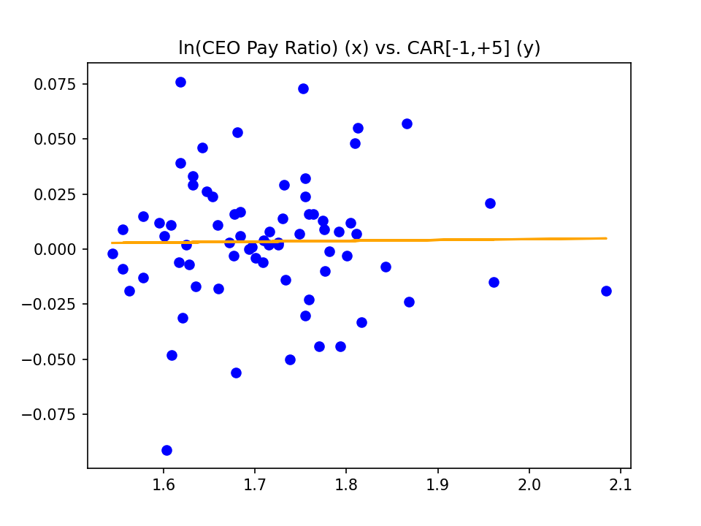
Results
Model 1
The natural logarithm of CEO-to-median-employee pay ratio as compared to CAR[-1,+5]. The r² value for this regression was 1.71e-4, with a slope of 3.78e-3.
The results of this regression suggest no strong correlation between CEO pay ratio and CAR[-1,+5].

Slide 9
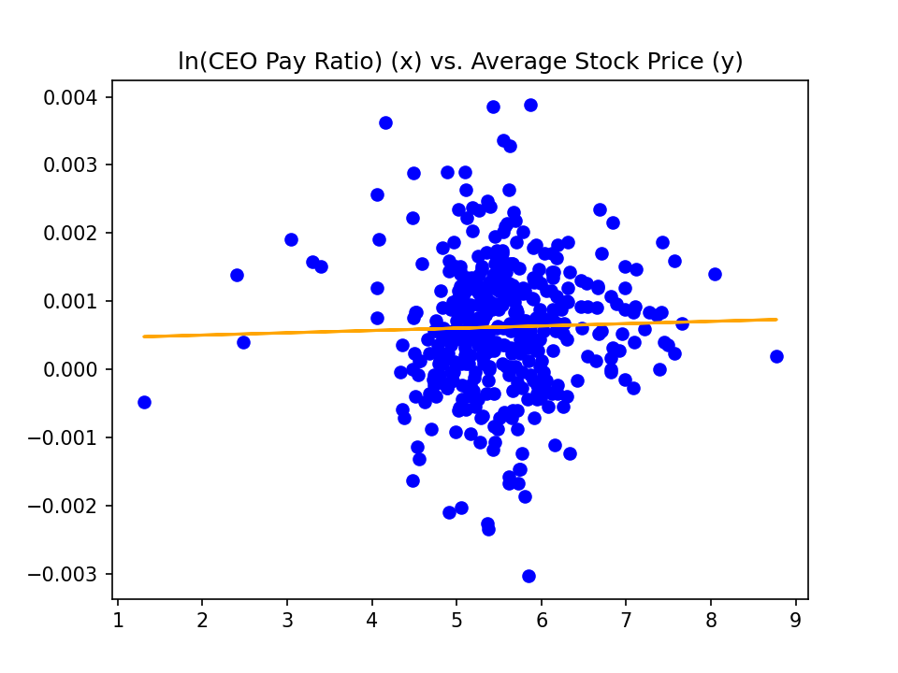
Results
Model 2
The natural logarithm of CEO-to-median-employee pay ratio as compared to the firms’ average stock price.
The r² value for this regression was 7.31e-4, with a slope of 3.37e-3.
For Model 2,the results appeared to be consistent with our expectations: although the market reaction is negatively correlated with higher CEO pay ratio in the short term after the initial disclosure, according to Pan et al. (1), it does not appear to have significant influence on or correlation with the firms’ performance in the long-term

Slide 10
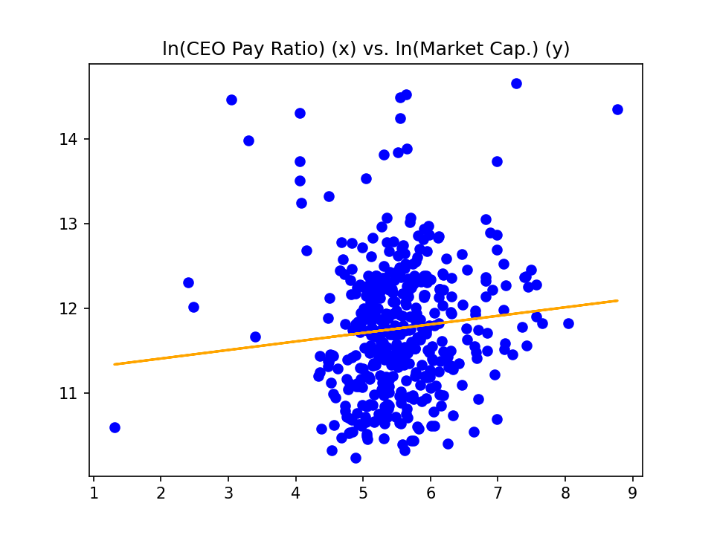
Results
Model 2
The natural logarithm of CEO-to-median-employee pay ratio as compared to the natural logarithm of the firms’ market capitalization.
The r² value for this regression was 1.00e-2, with a slope of 1.01e-1.

Slide 11
Results
Model 2
The natural logarithm of CEO-to-median-employee pay ratio as compared to the firms’ book-to-market.
The r² value for this regression was 1.86e-2, with a slope of -5.73e-2.

Slide 12
Future Work
We will exploit the new tax regulation enacted in San Francisco, which levies additional tax on gross receipts tax if the pay ratio of the highest-paid managerial over the median San Francisco-based employees is higher than 100.
To test these competing predictions, we employ a difference-in-difference (DiD) approach using a sample of San Francisco-based businesses in 2022-2023. For each firm, we would manually collect its proxy statement DEF 14A. We define treated and control groups as firms CEO pay ratio greater than and less than 100. Our primary sample comprises 672 (IPOs) treated firms based in San Francisco.
To measure a firm’s behavior change, we use compensations of CEO and workers, the turnover rate of CEO, relocation of firms, middle-and low-wage jobs hiring.

Slide 13
Thanks for Your Time!

