Slide 1

IntelliTabler Secondary School Timetabling with Smart Features
Zachary J Larsen

Slide 2
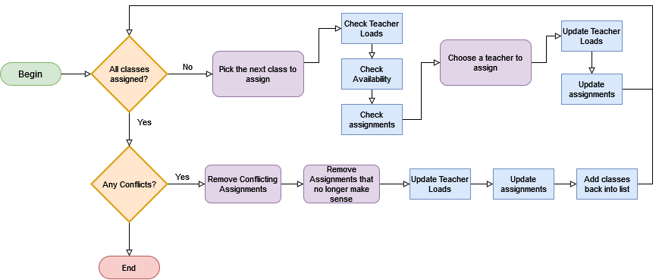
The problem with manual timetabling
Scheduling multiple teachers to many classes becomes complicated very quickly.
Manually tracking teacher workload, availability, class timeslots, and avoid splitting classes is time-consuming
Multiple constraints mean that the number of viable schedules is relatively small.
Issues are sometimes not seen until the schedule is near completion, requiring a complete re-work.
Notes:
All classes must be staffed.
Teachers cannot be assigned more classes than they are contracted to work.
Some teachers are required to teach a specific class, which can conflict with another, which requires splitting the class between two teachers, which is undesirable.
Teachers may have specific availability requirements due to flexible working.
If possible, teachers should be assigned to the same class throughout the week to ensure consistency.

Slide 3

Aims and Objectives
Aims of the project
Self proposed project with a real-world client
Simplify the process of teacher scheduling for the client
Provide graphical tools for visualizing timetables for quick visualization of conflicts
Add experimental smart features to help assignments
Personal Objectives
Expand knowledge of web applications and database design
Design and develop algorithms
Deploy application using cloud technologies

Slide 4

Client Requirements
Required Features
Teacher and Class management
Manual assignments of class timeslots and teacher assignments
Calendar visualization for teacher and timetable schedules
A combing chart to visualize teacher assignments and conflicts
Extra Features
Smart assignment and scheduling verification using algorithms
Teacher preferences for smart assignment
Exporting data to excel
*All requirements have been implemented in the project

Slide 5
Technical Achievements of the Project
Fully functional scheduling application
Visual tools to help see scheduling conflicts early
Real-time data updates
Automatic teacher assignment using CSP algorithms
Schedule validation using algorithms. Allows the user to check current teacher assignments against the constraints.

Slide 6

Architecture
Django – A high-level Python web framework. Uses Python to build web applications
Bootstrap – JavaScript and CSS Libraries for styling web pages
jQuery – JavaScript library that simplifies accessing HTML elements
HTMX – A JavaScript library that provides access to AJAX operations inside HTML. Allows for dynamic swapping of HTML elements.
Celery – A python module that allows for Asynchronous Tasks to be performed

Slide 7
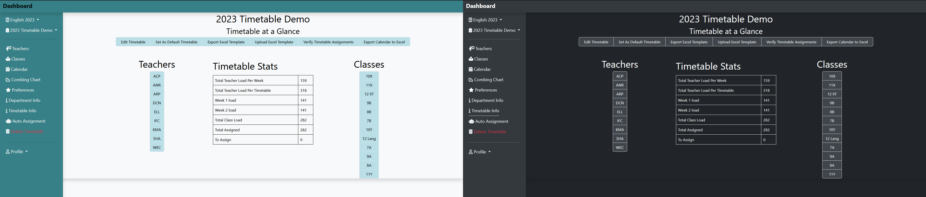
UI Design
A dashboard design with dynamic element swapping allows for a single point of access
Messaging feedback and tool tips to guide the user when needed
Dark and Light themes
Colour coded classes for visualizing on Calendar and Combing Charts

Slide 8
Visualization – Calendar and Combing
Self created JavaScript libraries were implemented to create the Calendar and Combing Chart pages.
Calendar
Provides a quick way to see how classes are scheduled across the week
Allows for changing class period timeslots with drag and drop features.
Combing Chart
The Combing Chart gives a visual representation of teacher assignments.
Used for visualizing teacher load and scheduling conflicts.

Slide 9
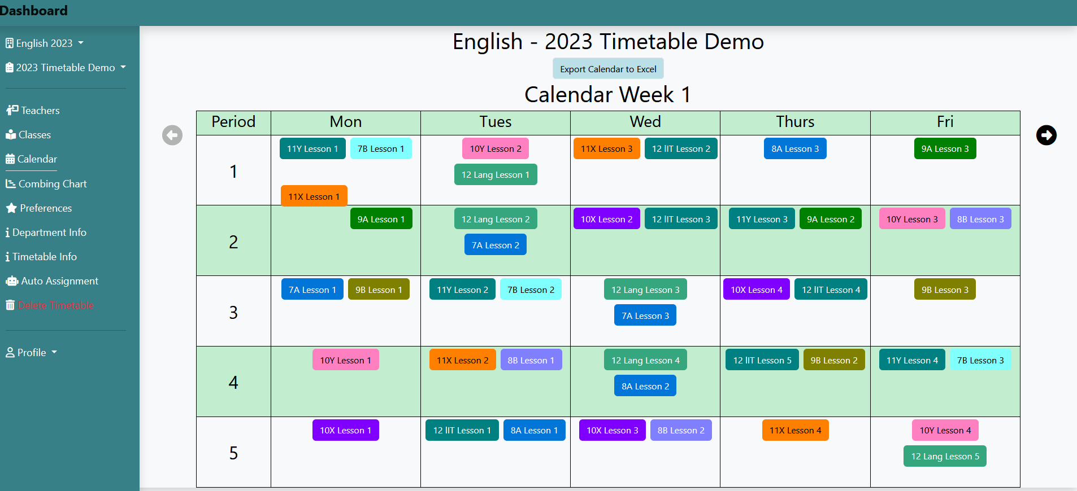
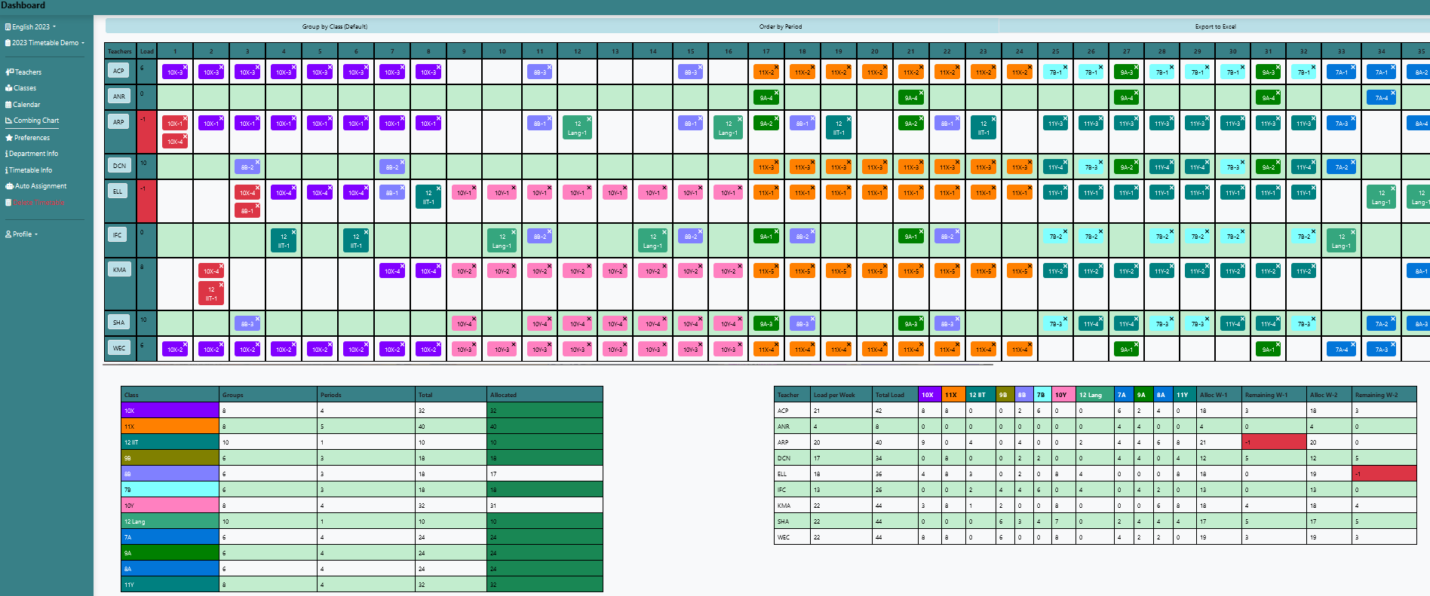
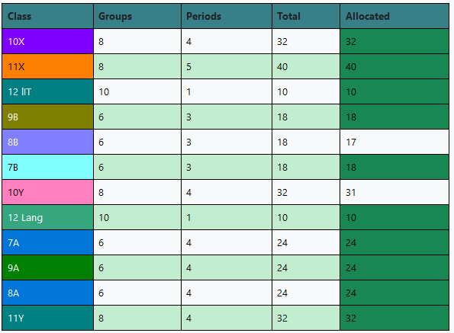
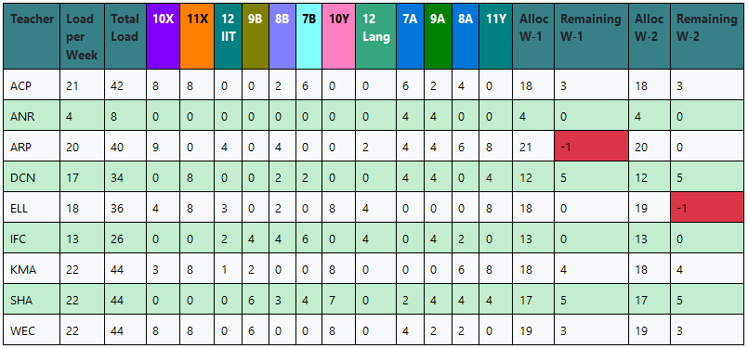
Visualization – Calendar and Combing

Slide 10
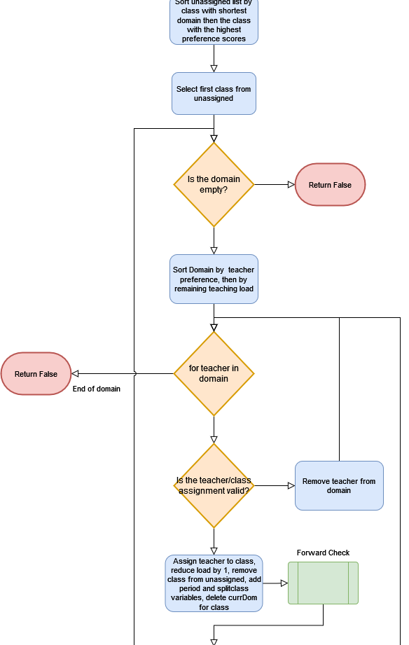

Auto Assignment
Using a CSP, solutions are tried until all assignments are filled.
CSP’s have a worst-case time cost of O($d^{n}$) where d is the size of the domain, and n is the number of variables.
To mitigate worst-case scenarios, several techniques have been implemented.
Asynchronous tasks have been implemented so that the CSP can run in the background
Constraint Propagation using Forward Checking
Domain and Variable sorting using soft constraints to pick the best assignments

Slide 11
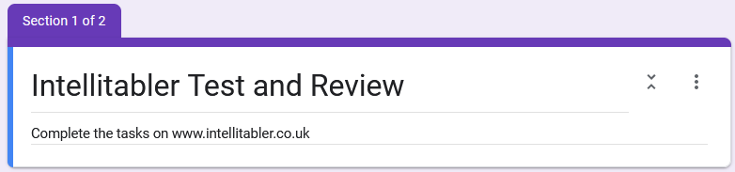
Project Testing
Testing was done directly with the client
Multiple rounds to test features when completed
A final system test was done with the client and their colleague in order to test the system as a whole
The Client was satisfied with the system as delivered

Slide 12
Project Summary
All requirements agreed with the client were met
Smart features provide valid Timetables with soft constraints providing optimized solutions
A working demo was deployed using AWS Cloud technologies
Client testing was successful with the client satisfied with the end result

Slide 13
Limitations and Future Work
CSP assignment could be adapted for broader use with more options.
Excel sheets need more work as the current implementation was confusing for users.
More customization and accessibility features should be added.
Integration of verification techniques into real-time checking.
When assigning teachers, the system could check the validity of the assignment automatically.
Archiving data functionality. Allowing the user to archive a timetable or year so that changes to the department don’t affect previous work.

Slide 14
User Scenarios – Manual Timetabling
As a Secondary School Head of Faculty,
I want to easily manage classes and teachers’ schedules,
So that I can quickly create valid timetables
User: Sarah
Demographic: 30’s Secondary School Head of Faculty
Sarah is a Secondary School Head of Faculty who has many responsibilities at work. One of her duties is assigning each classes to the teachers in her department. Each year, she receives the class schedule from the head of the school which requires allocation of teachers. This task has become increasingly stressful for Sarah, as she spends hours manually tinkering with the schedule to ensure there are no conflicts.
Amid her other responsibilities like lesson planning, marking, and leadership meetings, Sarah begins working on the schedule. She juggles multiple documents, with one containing the class schedule and another Excel sheet to track teacher assignments. Assigning a class involves adjusting a teacher's overall workload, considering class timings to avoid conflicts, and attempting to keep classes under a single teacher's supervision. She refers to a third sheet with teacher information, including workload, availability, and preferences.
As Sarah nears completion of the schedule, she realizes it won't work as multiple classes are scheduled simultaneously, and the available teachers are already overloaded. She faces the daunting task of reassigning teachers, manually adjusting their workloads to reflect changes, and attempting to find viable alternative assignments. The process is time-consuming, and she doesn’t know how many changes need to be made before a viable solution may appear.
This process of creating and revising a schedule is repeated until a viable solution is found. Sarah must manually verify each assignment to ensure no issues remain. By the end, she is stressed and significantly behind on her other tasks. She wishes for some sort of software solution that can manage and organize all the relevant information, identify conflicts, and provide insights to avoid spending excessive time on manual assignments.

Slide 15
User Scenario – Using IntelliTabler
Sarah has just received the class schedule from the Head of the school. She logs into IntelliTabler and opens her department, creating a new year for the schedule. In the new timetable that is created, she checks that the teacher information is correct, adding the new hire to the teacher list. She updates several teachers' availability and workloads before moving on to the classes.
Using the class schedule provided, Sarah adds this year's classes and times to the timetable, selecting different colours for each class. Once the classes have been added, she goes to the calendar view to ensure all classes have been scheduled correctly.
While reviewing the calendar, Sarah realizes she skipped several classes. She clicks on the period and adds these classes to their timeslots. She also notices she made a mistake with another class and drags it to the correct period. Now that she is satisfied with the schedule, she moves to the combing chart to begin assigning teachers.
Sarah starts assigning teachers to classes within the combing chart. She enjoys watching the classes snap into place in the combing chart view as it makes it easy for her to visualize each teacher’s workload. She observes the allocation totals changing for each class and ensures that no teachers are overloaded. She notices that she has assigned a teacher to two classes at the same time as the classes turn red in the table. She will need to split one of the classes and drags it to another teacher.
After a few minutes of scheduling, Sarah decides to try the automatic assignment feature to see what it comes up with. As she enters the auto assignment wizard, she checks the schedule and teacher information. She knows that some teachers prefer certain classes, and some teachers are required to teach specific classes. She clicks on the preferences page and sets the preferences accordingly. Once she is satisfied, she clicks to generate a new timetable. Returning to the dashboard, a notice informs her that the assignments are taking place. She goes back to the previous timetable she was working on and continues.
After a few minutes, she receives a notice that the timetable has finished auto assignment. Clicking on the assignment, she is taken to the timetable and decides to check the assignments listed on the combing chart. She is pleased to see that all classes have been scheduled without conflicts. She notices that one class would be better taught by another teacher, but she can quickly drag those classes to the appropriate teacher, and the combing chart shows that the new assignments are still valid. After making a few more adjustments, she is happy with the outcome.
She returns to the timetable information page to rename the table. She also performs a quick verification to ensure that there are no issues. The message confirms that the timetable is valid, and she sets it as the default timetable for the year. Finally, she wants a copy of her personal schedule in excel sheet she can print out. She navigates to her teacher page and exports the calendar to excel. She downloads the workbook and logs out of the system.

