Slide 1

PLC Tracking • Revision Management • Auditing • Comparison • Evaluation
Final Project | Zach Lawver | IT Pathways
Notes:
Introduce TRACE as a proposed industrial IT solution to make PLC program changes visible and reviewable.

Slide 2
The problem and who uses TRACE
The operational issue: PLC code can change without a clear, accessible record of what changed.
Maintenance and controls technicians
Need to find the last known program and quickly identify logic changes.
Without a controlled process
Unknown version
→ Time spent investigating
→ Risk of restoring the wrong file
→ Limited accountability
Engineering and plant IT
Need a consistent controller inventory, backup history, and traceability.
Plant operations
Need reduced troubleshooting delays and fewer undocumented changes.
TRACE • Zach Lawver • IT Pathways • 02
Notes:
Explain the problem in plain terms: a PLC may be changed during troubleshooting, but the next technician may not know what was changed or why.

Slide 3
The solution: TRACE
A single web-based workflow connects controller identity, backup files, program comparison, and human approval.
Discover and register
Identify controllers on the industrial network and associate them with records.
Capture and compare
Use L5X program files to compare against the accepted baseline or previous backup.
Review before retention
Show highlighted ladder differences and queue changes for technician approval.
Design principle: the system identifies changes; a technician decides what becomes the accepted version.
TRACE • Zach Lawver • IT Pathways • 03
Notes:
Clarify that the demonstration is functional for manual L5X upload and comparison. Scheduled direct PLC retrieval is a planned workflow in the architecture, not yet validated in the prototype.

Slide 4
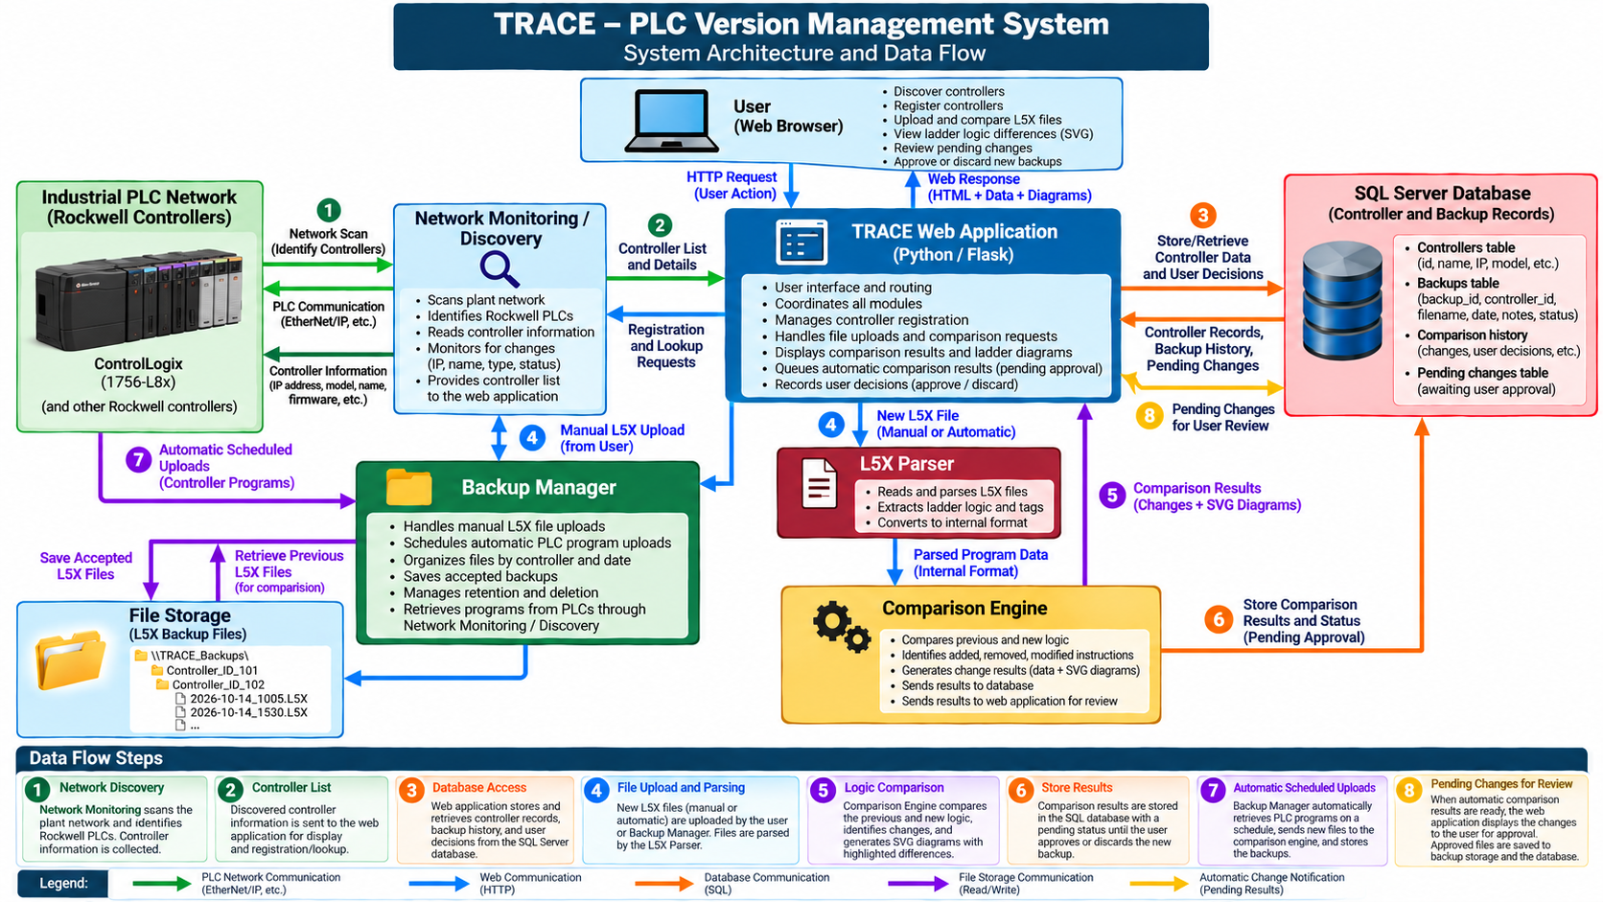
Complete system architecture and data flow
TRACE • Zach Lawver • IT Pathways • 04
Notes:
Walk left to right: industrial network to monitoring to web app; backup manager and L5X parsing feed comparison; SQL records metadata; file storage keeps L5X; pending changes return to the web app. Automatic scheduled retrieval is conceptual, not implemented.

Slide 5
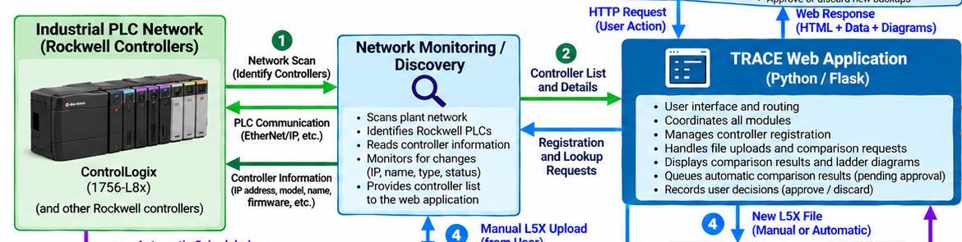
Data flow 1–2 | Discover and identify
Where controller information originates and which module retrieves it.
1
Network discovery
Network Monitoring / Discovery scans the existing PLC network and reads controller identity.
2
Controller list
The monitor sends controller details to the web application for registration and display.
Data: IP address • model • firmware • controller identity → Web application
TRACE • Zach Lawver • IT Pathways • 05
Notes:
Explain that the monitor reads PLC identity over EtherNet/IP and sends it to the web application. Do not claim full legacy compatibility is already validated.

Slide 6
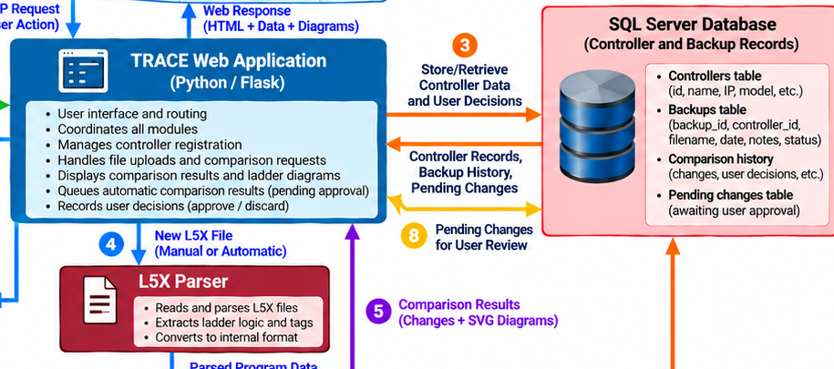
Data flow 3–4 | Register and ingest
How records are stored and how a new program file enters TRACE.
3
Database access
The web application reads and updates controller records and backup metadata in SQL Server.
4
L5X upload and parsing
When the system automatically detects changes or is manually instructed, the web application initiates an upload of an L5X file; the parser extracts logic and tags for the comparison engine.
Data: Controller Metadata → SQL | Uploaded L5X → Parsed Program Structure
TRACE • Zach Lawver • IT Pathways • 06
Notes:
Describe the separation between metadata in SQL and L5X program files on disk. Note that the actual prototype uses manual uploads.

Slide 7
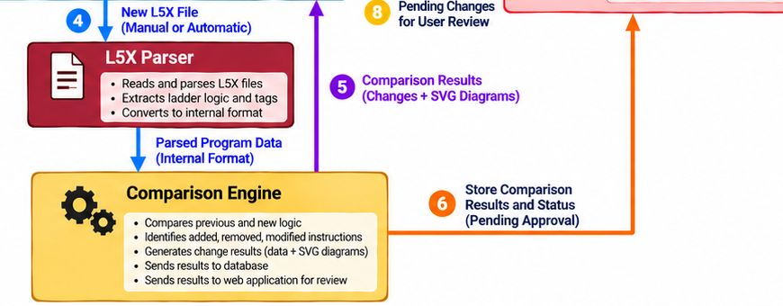
Data flow 5–6 | Compare and record
How two versions become a reviewable change record.
5
Comparison engine
Reads current backup logic and new upload logic, identifies differences, and produces highlighted ladder diagrams using an SVG engine to simulate Rockwell graphics.
6
Store comparison results
Sends change details and review status back to the web application and SQL records.
Data: Backed up Logic + New Uploaded Logic → Change Results + SVG Diagrams → Web App / SQL
TRACE • Zach Lawver • IT Pathways • 07
Notes:
Explain that the SQL database records the comparison history while program files remain in file storage. Do not imply a validated permanent pending-change table exists unless verified.

Slide 8
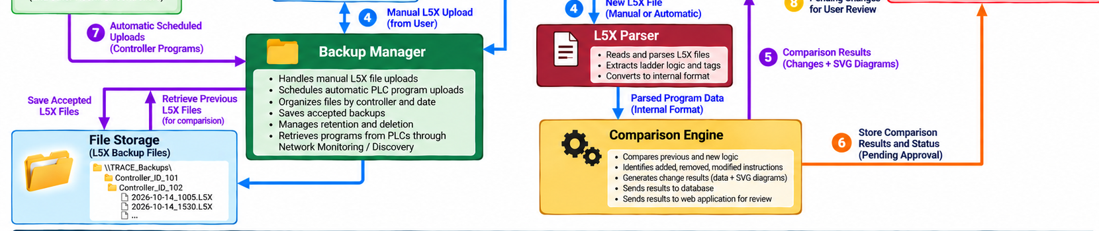
Data flow 7–8 | Scheduled checks and approval
The intended automated operating loop and technician decision point.
7
Scheduled uploads
Backup Manager requests PLC program retrieval through network polling on a schedule, checking AuditValue tags through CIPdriver.
8
Pending review
Changed files are compared; the web app queues differences for technician approval or discard.
Data: Scheduled Program → Comparison → Pending Result → Technician Decision
TRACE • Zach Lawver • IT Pathways • 08
Notes:
Be transparent: scheduled controller uploads and automatic change detection are the target architecture, not completed prototype functionality. Manual L5X comparison and retain/discard flow have been demonstrated.

Slide 9
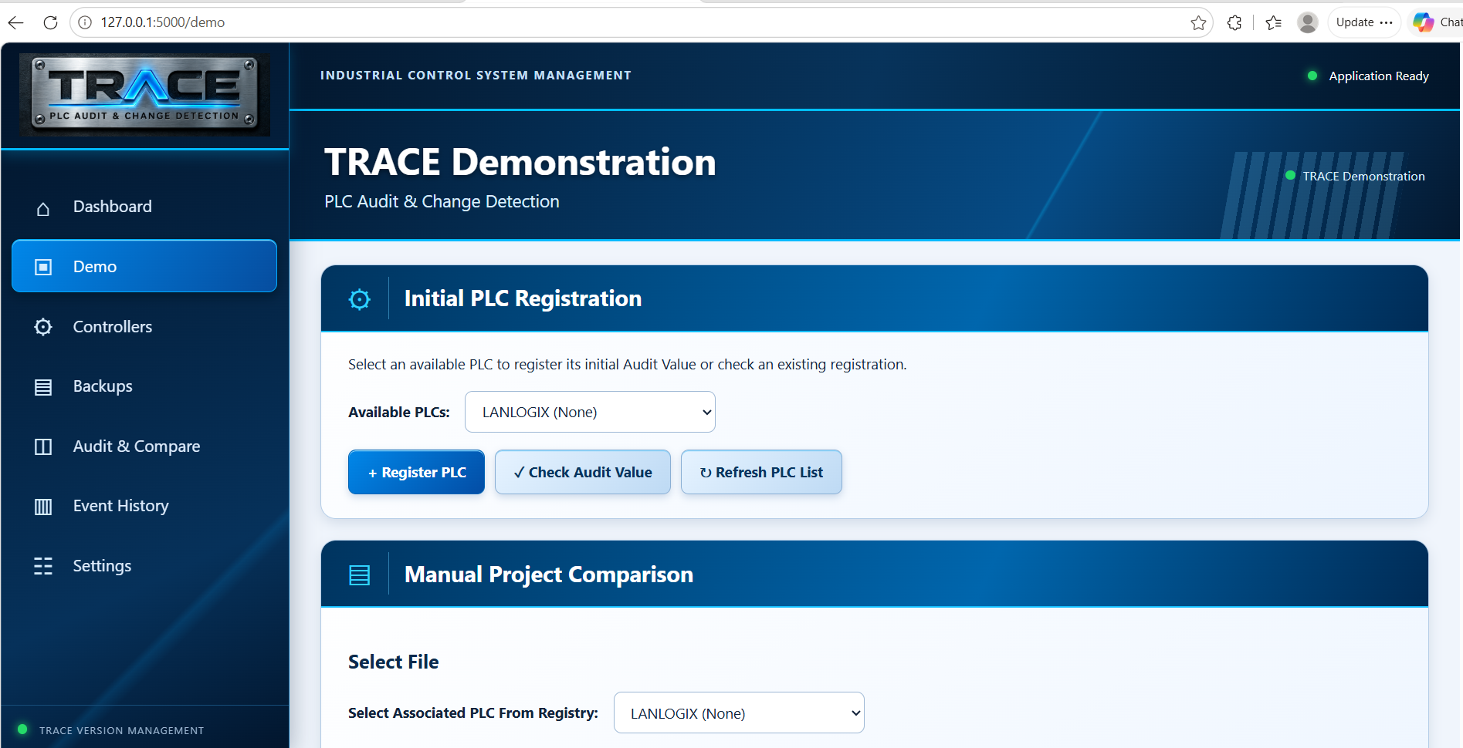
Working demonstration | What TRACE shows today
Step By Step Demo
TRACE • Zach Lawver • IT Pathways • 09
Notes:
Screenshot is an earlier comparison capture; current renderer now highlights changed instructions in the SVG. Demonstrate current live app for the highlighting and retention decision.

Slide 10
Design decisions, tradeoffs, and risks
The cheapest software stack is not necessarily the cheapest system to maintain.
Python / Flask + SQL Server Express
Low licensing cost and flexible development; requires internal support and testing.
SQL records + separate L5X file storage
Easy searchable metadata without bloating the database; files and records must stay synchronized.
Human approval of detected changes
Prevents silent acceptance of an unintended edit; creates a review workload.
Industrial-network access and reliability
Limit approved subnets and permissions; protect backups and validate recovery procedures.
TRACE • Zach Lawver • IT Pathways • 10
Notes:
Mention risks: cybersecurity, missed or incorrect comparisons, corrupt files, loss of SQL/file synchronization, and unvalidated automatic uploads. Explain the controls needed before production deployment.

Slide 11
Estimated commercial implementation cost
Estimates reflect single manufacturing facility • Using existing plant network and existing network server.
Software development
120 hr × $100
$12,000
Network and database integration
24 hr × $100
$2,400
Testing and validation
20 hr × $100
$2,000
Deployment and training
12 hr × $100
$1,200
Python / Flask / SQL Express licenses
No new licenses
$0
Contingency
Approx. 12.5% of labor
$2,200
INITIAL ESTIMATE
$19,800
Ongoing support estimate: $2,400/year (24 hours at $100/hour). Automatic PLC uploads and production hardening require separate validation and may increase cost.
TRACE • Zach Lawver • IT Pathways • 11
Notes:
This is a planning estimate, not a vendor quote. Software license costs are zero but engineering labor dominates. Development assumes the existing prototype scope. Larger deployments, security hardening and automatic PLC upload capability add cost.

Slide 12
Q&A
Q&A
TRACE • Zach Lawver • IT Pathways • 12
Notes:
This is a planning estimate, not a vendor quote. Software license costs are zero but engineering labor dominates. Development assumes the existing prototype scope. Larger deployments, security hardening and automatic PLC upload capability add cost.

