Slide 1
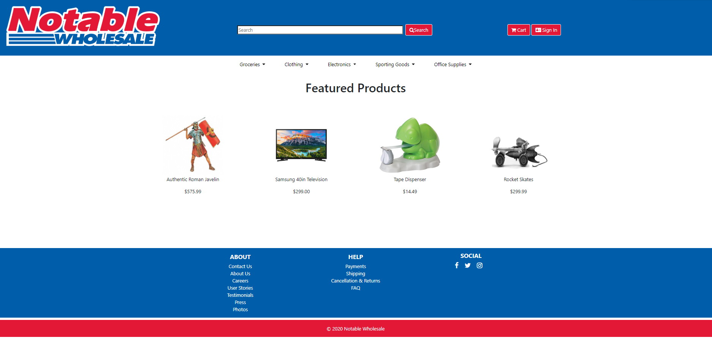
User clicks on Electronics tab
Key:
CLICK

Slide 2
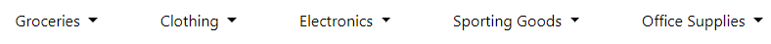
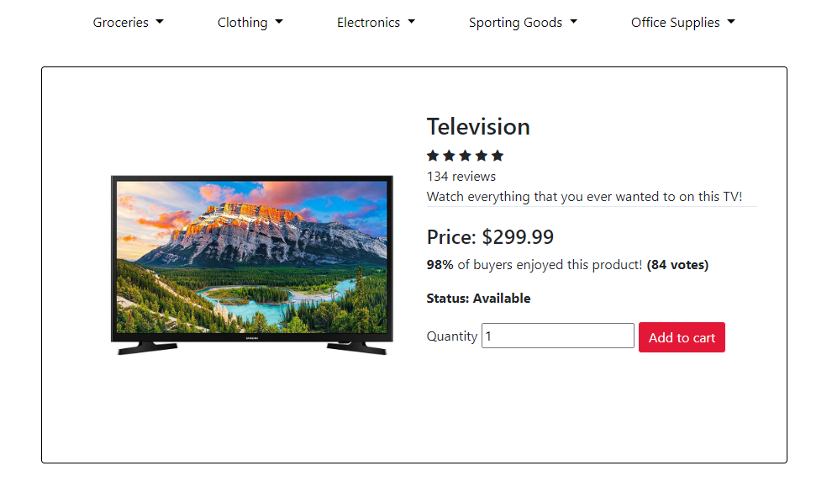
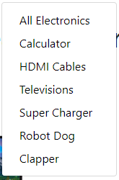
Product Categories
Television Page
Goes to Cart Page
Key:
CLICK

Slide 3
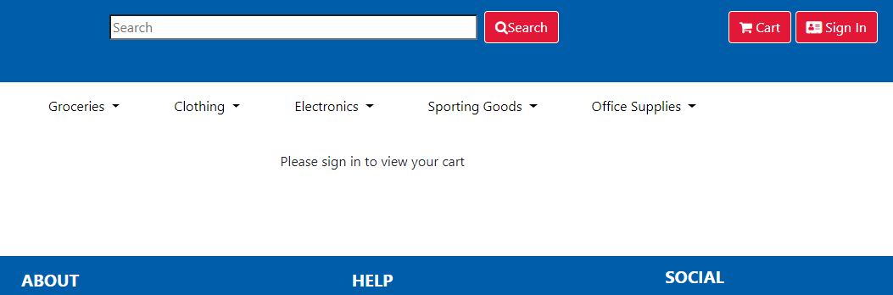
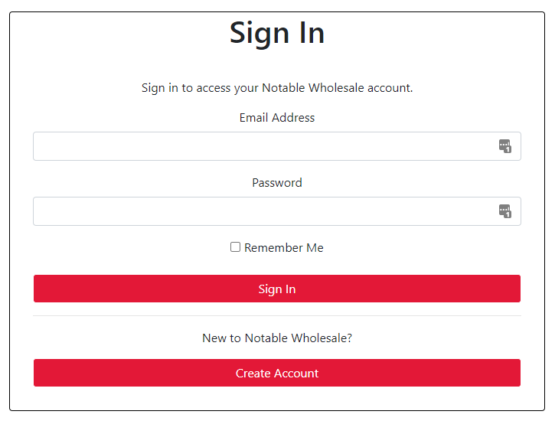
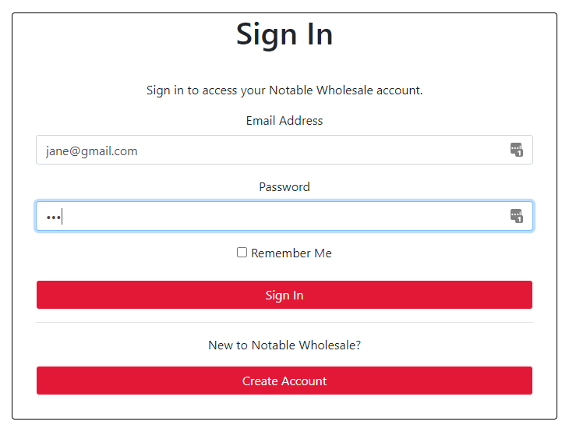
Key:
CLICK
INPUT
Existing Customer
New Customer
Goes to back to Homepage
Goes to Registration

Slide 4
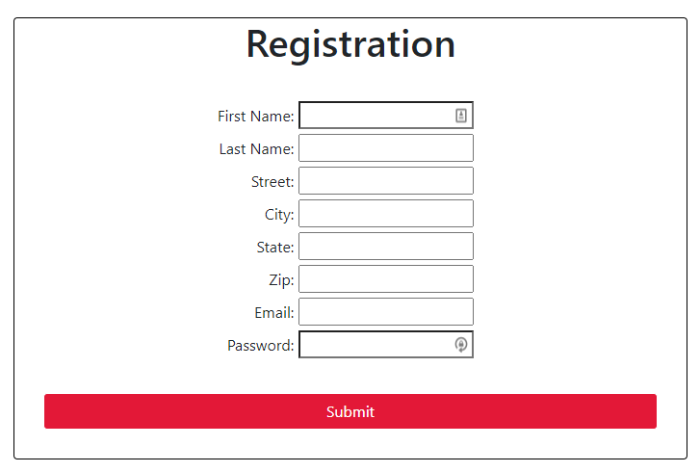
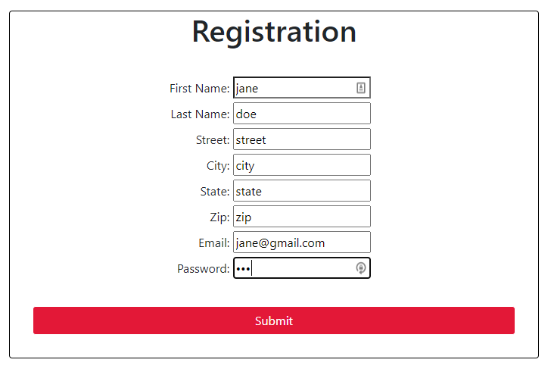
Goes to Homepage
User logs in
Goes to back to Sign In Page
Key:
CLICK
INPUT

Slide 5
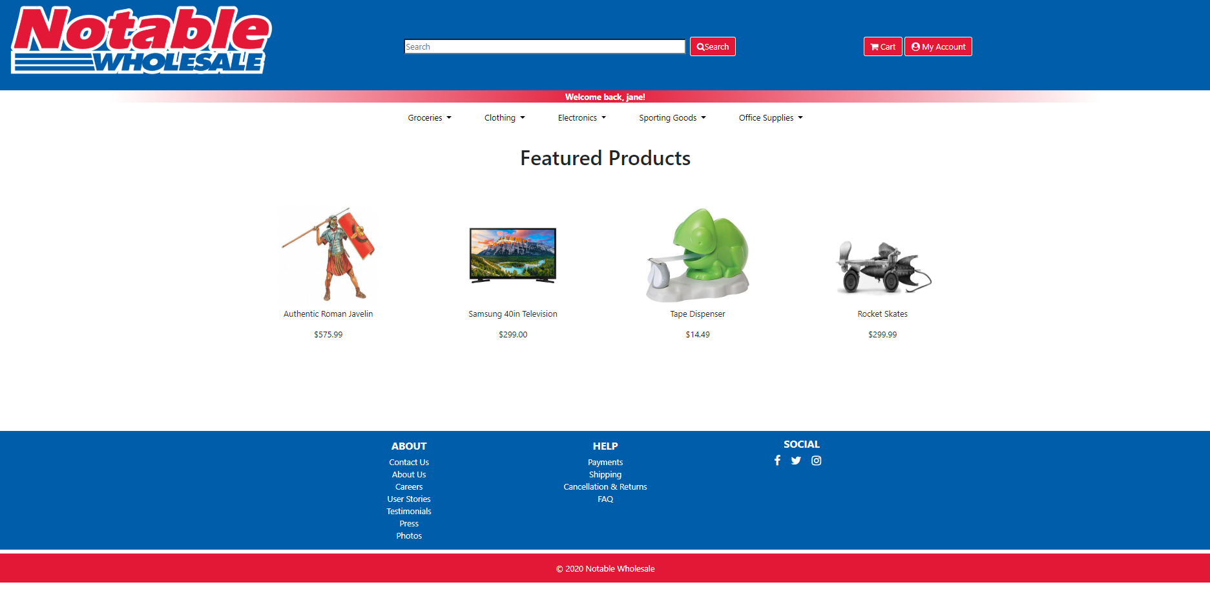
User clicks on Cart button
Key:
CLICK

Slide 6

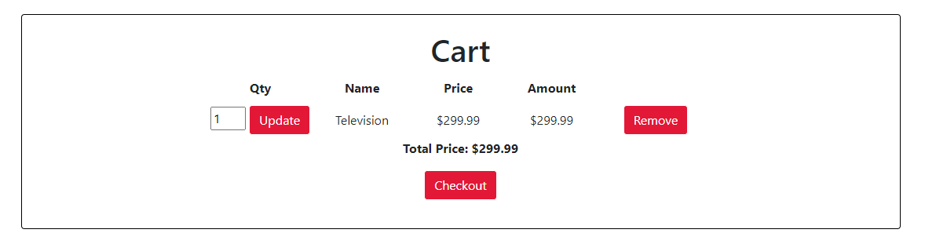
Goes to back to Checkout Page
Key:
CLICK
INPUT

Slide 7
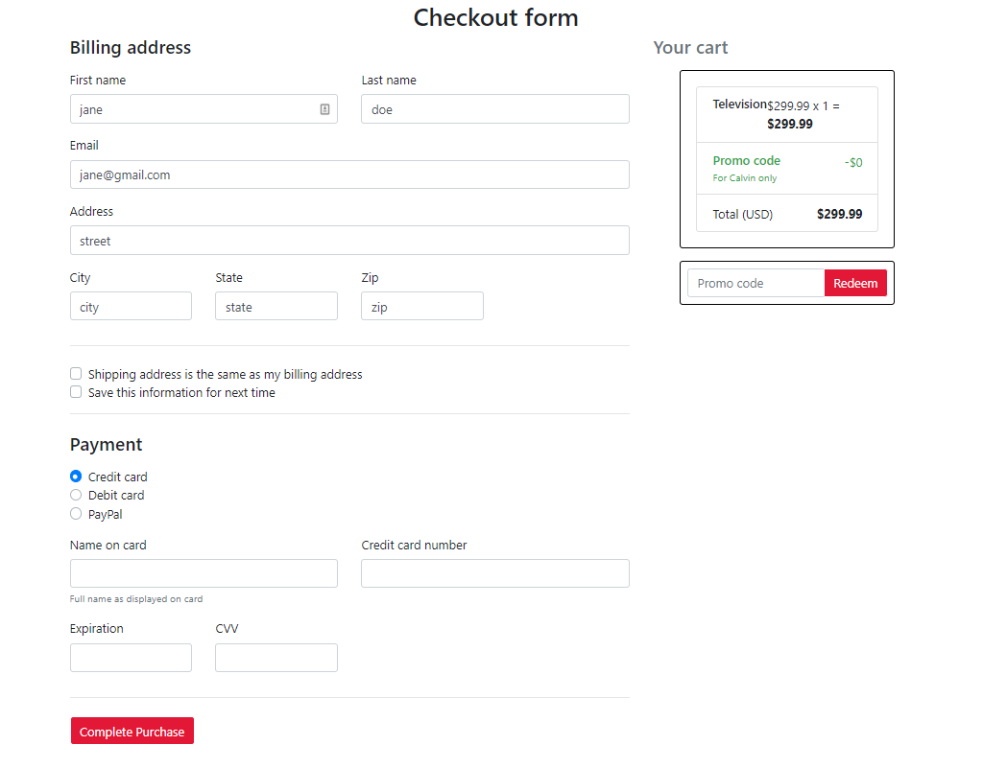
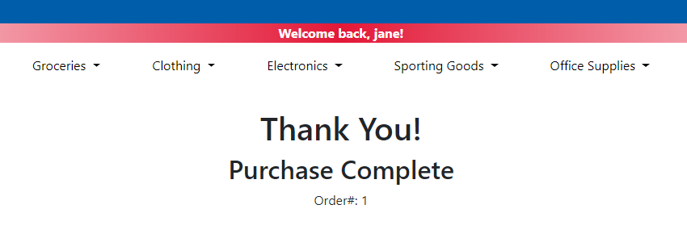
Key:
CLICK
INPUT
User fills out payment information
User has placed an order

