Slide 1
Otto Pilot
Developed by Zach Montgomery

Slide 2
Full 12 state LQR controller
User can choose to control either climb angle or altitude
User can choose to control either bank angle or heading
These options are combined giving 4 different control scenarios

Slide 3
Full 12 state LQR controller
Aircraft controllers usually consist of two separate controllers
One for longitudinal motion and the other for lateral motion
Aerodynamic coupling from the two modes are simple treated as disturbances
Full 12 state controllers are uncommon
This accounts for any aerodynamic coupling that may happen
More robust method, allowing for more states

Slide 4
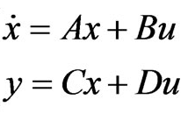
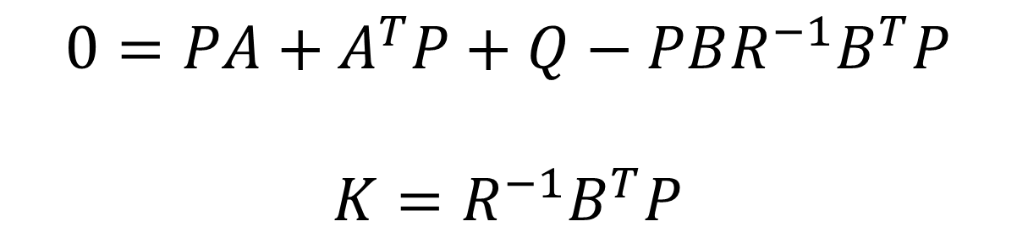
Algebraic Riccati Equation

Slide 5
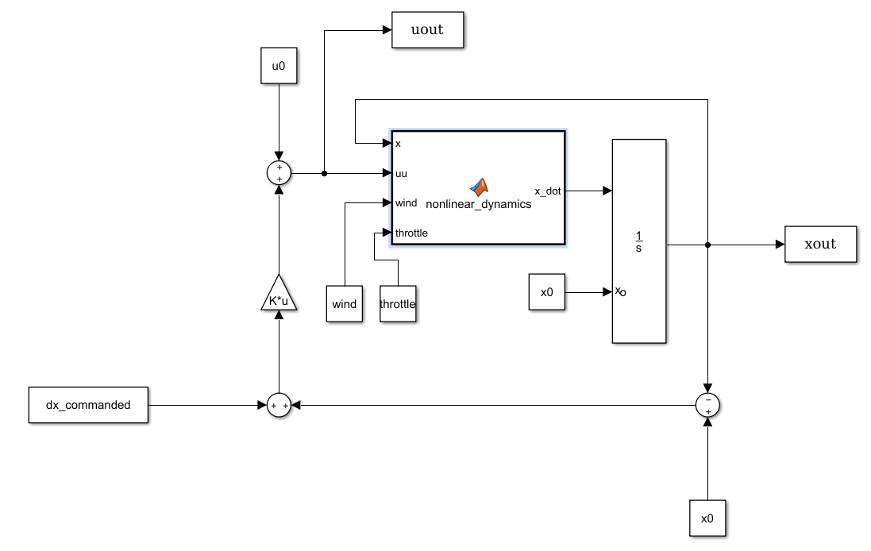
Block Diagram

