Slide 1

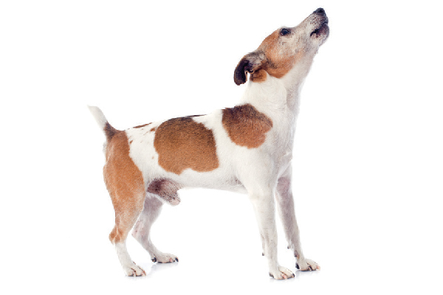
WoofShare
Connection App

Slide 2
What is WoofShare?
WoofShare solves issues for people and dogs:
Dog Lovers benefit from loving and caring for the pet they cannot have themselves.
Dog Owners benefit by having other dog lovers spend time with their pet when they are unable to.
Dog Shelters and Fosters benefit by allowing dog lovers to exercise and provided much-needed human interaction with their dogs, possibly leading to adoption.
WoofShare connects people to dogs and dogs to people providing innovative solutions for dogs, dog lovers and dog owners.

Slide 3
Design Process
Communication
Trello
Slack
Division of Tasks
UI – Trent and Penny
Back End – Chandni, Zach, Jaspreet
High-Level Project Scope
Project Overview outlined each feature, defined functionality, and established basic requirements.
Created functional workflow for each feature and established development method.
Building Process
Added Json packages and initiated local host.
Designed UI, set up database, connection and route files.
Created back-end functions to activate features.
Continuously pushed and pulled to and from GitHub; discovered issues and applied fixes.
Created migration strategy and deployed to Heroku.

Slide 4
Technologies Utilized
Node and Express Web Server
MySQL Database/Sequelize ORM
GET and POST routes
Heroku Deployment including data
sass-loader node-sass webpack
MVC Paradigm folder structure
API keys protected in Node with environment variables
Handlebars - Server-Side Templating
Google User Authentication - Passport
Google API external autocomplete
Migration strategy – seeds/schema files

Slide 5
WoofShare Demonstration https://polar-basin-98786.herokuapp.com/filter

Slide 6
Questions?

