Slide 1
Lifestyle & Diabetes Prediction Group#7
Katana Jade Taylor
Matthew Chico
Matthew Saint Victor
Mohemmad Asif Azhar
Zachary Skiba

Slide 2
Lifestyle & Diabetes Prediction
Summary
Research Issue: Predict diabetes using lifestyle features
Key Finding: Class imbalance significantly impacts performance
Baseline: Logistic Regression provides interpretability
Best Models: XGBoost, Random Forest outperform baseline
Limitation: Missing biomarkers (HbA1c, glucose)

Slide 3
Lifestyle & Diabetes Prediction
Objective
Datasets: Binary (0/1) and Multiclass (0/1/2)
21 lifestyle-based features (BRFSS dataset)
Team-based ML pipeline with shared preprocessing
Goal: Compare multiple ML models under same conditions

Slide 4
Lifestyle & Diabetes Prediction
Team and Responsibilities
Person 1:
Logistic Regression (baseline, interpretation)
Add few point
Person 2:
Random Forest (feature importance)
Add few points
Person 3:
XGBoost (top performer, SHAP)
Mohemmad:
SVM (kernel comparison, ROC-AUC)
Person 5:
Naive Bayes + KNN (contrast models)
.

Slide 5
Lifestyle & Diabetes Prediction
Timeline & Deliverables
Week 1:
EDA, dataset understanding, setup
Week 2:
Preprocessing, PCA, K-Means
Week 3:
Modeling, tuning, evaluation
Week 4:
Results, report, presentation

Slide 6
Lifestyle & Diabetes Prediction
Methodology
Single 80/20 train-test split (no leakage)
Add few point if applicable
Scaling applied only on training data
Add few point if applicable
SMOTE used only inside training pipeline
Add few point if applicable
Consistent preprocessing across all models
Add few point if applicable

Slide 7
Lifestyle & Diabetes Prediction
Data Processing Pipeline
Input → Clean → Split → Scale → Train → Evaluate
Binary vs Multiclass handled separately
No test data used during training
Reusable preprocessing scripts developed

Slide 8
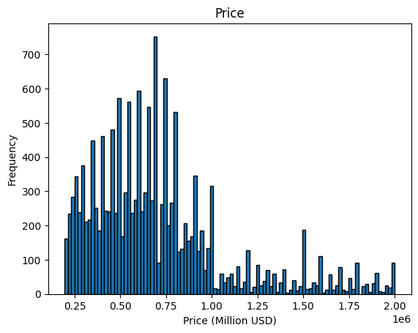
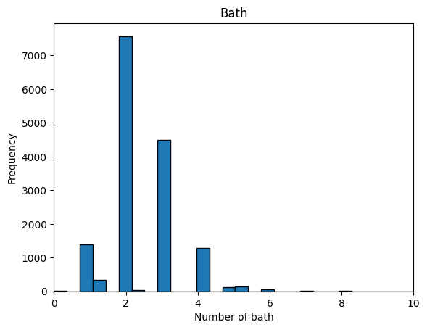
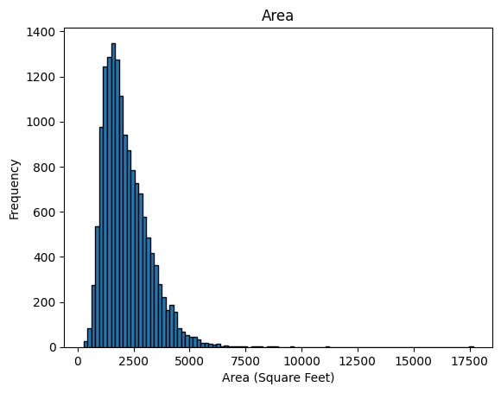
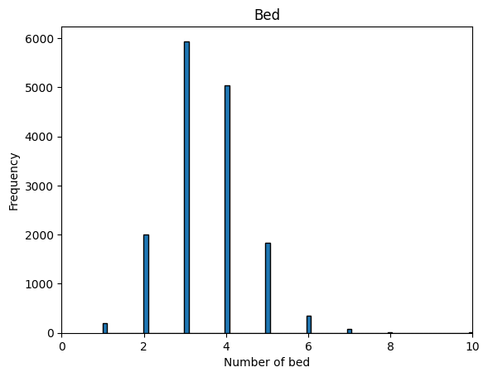
Lifestyle & Diabetes Prediction
Exploratory Data Analysis
Class imbalance identified (severe in multiclass)
Feature correlations analyzed
Distribution plots and heatmaps generated
Insights: Lifestyle factors partially predictive
Add visuals [I’ve attached just for the reference]

Slide 9
Lifestyle & Diabetes Prediction
Processing and Transformation
Input → Clean → Split → Scale → Train → Evaluate
Binary vs Multiclass handled separately
No test data used during training
Reusable preprocessing scripts developed

Slide 10
Lifestyle & Diabetes Prediction
Unsupervised Learning
PCA used for dimensionality reduction
Explained variance analyzed via scree plot
K-Means clustering (k=2, k=3)
Observation: weak natural class separation

Slide 11
Lifestyle & Diabetes Prediction
Modelling Approach
Baseline: Logistic Regression
Tree Models: Random Forest
Boosting: XGBoost / LightGBM
Other Models: SVM, Naive Bayes, KNN

Slide 12
Lifestyle & Diabetes Prediction
Evaluation Metrics
Accuracy
Precision, Recall
F1 Score (primary metric)
ROC-AUC (binary)
Confusion Matrix

Slide 13
Lifestyle & Diabetes Prediction
Results & Benchmarking
Baseline established using Logistic Regression
Tree-based models improved performance
XGBoost achieved best F1 and ROC-AUC
Prediabetes detection remains weak

Slide 14
Lifestyle & Diabetes Prediction
Future Work & Recommendations
Lifestyle data alone is insufficient
Imbalance handling critical for performance
Feature engineering improves results
Model complexity increases accuracy

Slide 15
Lifestyle & Diabetes Prediction
Key Insights
Include clinical biomarkers
Advanced feature engineering
Deep learning exploration
Deploy real-time prediction system

Slide 16
Housing Price Prediction
Conclusion
ML models can predict diabetes risk moderately well
Data limitations restrict performance ceiling
Best results from ensemble methods
Further improvements require better data

