Slide 1
Housing Price Prediction Team#10
Gulam Mahfuz Chowdhury
Hamza Tahir A Bu Obaid
Mohammed Aftaab Bin Usman
Mohemmad Asif Azhar
Yi-Ning Tseng

Slide 2
Housing Price Prediction
Objective:
Develop a machine learning model to predict house prices accurately.
Utilize features such as location, square footage, bedrooms and more.
Assist buyers, sellers, and real estate professionals with data-driven insights.
Reduce reliance on traditional valuation methods through predictive analytics.
Help individuals and businesses understand market trends & optimize pricing.
Experiment with multiple ML models.
Compare models using evaluation metrics to select the best performer.

Slide 3
Housing Price Prediction
Background Information
Traditional pricing methods rely on manual assessments and historical data, leading to subjectivity and inconsistency.
Machine learning enables more precise and adaptable pricing models by analyzing large datasets.
The real estate market is complex, influenced by economic, social, and environmental factors.
This project explores multiple machine learning models for better generalization.
Deep learning techniques will help capture non-linear relationships in the data.
Using a Kaggle dataset with property images, location, built-up area, bathrooms, bedrooms etc.
Aims to bridge the gap between market fluctuations and real estate valuation, offering valuable insights to stakeholders.

Slide 4
Housing Price Prediction
Project Timeline Blueprint
Proposal (Due: 02/09) 1-2 weeks
5 slides: Objectives, methodology, timeline, and tools.
Mid-Semester Update (Due: 03/16) 2-3 weeks
Add ~10 slides: Progress, data preprocessing, and initial analysis.
Final Update (Due: 04/20) 3-6 weeks
Add ~10 slides: Results, evaluation, and conclusion.
Demo & Report (04/21 – 05/02) 1-2 weeks
Present the project and submit the final report.

Slide 5
Housing Price Prediction
Background Research
Dataset Collection
The dataset includes information about real estate trends, prices, locations, and property details.
Data Preprocessing
Techniques include handling missing data(mean , mode), encoding categorical variables, and standardizing numeric features.
Feature Selection : remove irrelevant features .
Tools: Python (Pandas, NumPy), maybe Power BI for visualization.
Challenges and Considerations
Ensuring data consistency across states.
Incorporating additional features such as historical trends and demographic data.

Slide 6
Housing Price Prediction
Biggest Challenge and Overcome
Ensuring data consistency across states.
Incorporating additional features such as historical trends and demographic data.
Addressing conflicting feature formats, outliers, and missing values.
Solution
Excluded outliers, standardized features for machine learning compatibility, and regenerated missing values.
A clean and ready dataset, improving model training quality and consistency.
Plot or Table for clarification
Determining the most impactful features for housing price prediction while removing irrelevant ones.
Solution
Identified important predictors by using domain knowledge and correlation analysis.
Showing the most relevant feature using table

Slide 7
Housing Price Prediction
Next Immediate Steps
Data Analysis, normalize data, extract new features, and use feature importance analysis to find important predictors.
Compare models using RMSE and R², ensuring robustness with cross-validation.
Linear Regression, Random Forest, Decision Tree and XGBoost.
Choose the optimal model for deployment and adjust the hyperparameters.

Slide 8
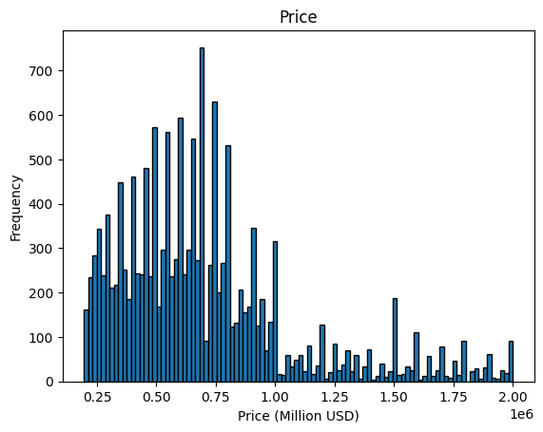
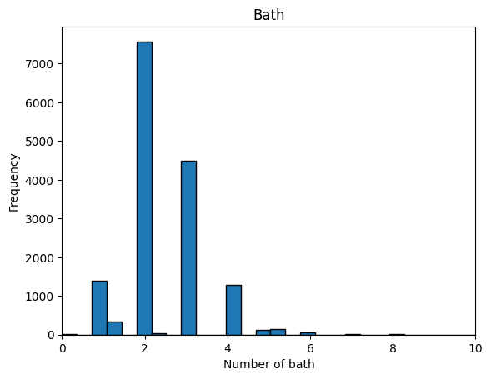
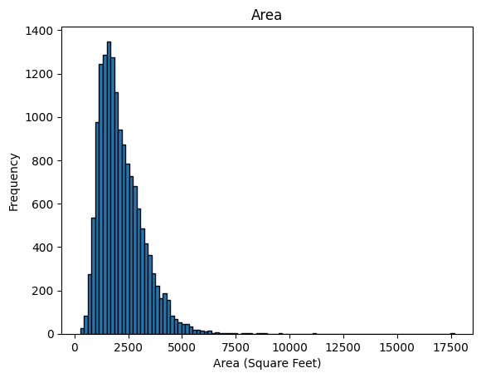
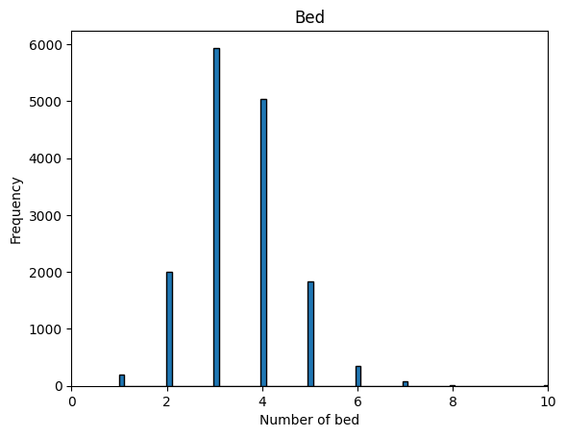
Housing Price Prediction
Data Analysis
Data source: Kaggle
Number of Data: 15474
Data type:
Image (415*311*96 3D Images)
Features (Street Name, City, Number of Bed, Number of Bath, Area)
Prediction: Price

Slide 9
Housing Price Prediction
Dataset Processing Steps
Remove data with empty values.
1
Convert City and Street to categorical values.
2
Normalize area and price.
3
Convert images into necessary dimension.
4
Split the data into training and testing portions.
5

Slide 10
Housing Price Prediction
Phase-II continue…..
Our project focuses on predicting housing prices using machine learning models. In Phase I, we proposed utilizing Multiple Linear Regression as the primary algorithm.
Since housing prices are continuous numerical values, Multiple Linear Regression was a natural choice due to its ability to predict values based on multiple independent variables and compared its performance with other models to determine the best fit.
In phase-II we will discusses our experimental setup, model choices, evaluation metrics, visualizations, challenges faced, and plans for the final phase.

Slide 11
Housing Price Prediction
Experiment setup, Data preparation steps and model selection
Experimental Setup
We used the dataset from Kaggle containing 15474 samples and 7 features such as, Image Id, Number of bedrooms, Number of bathrooms, Sqft Area , Location, Street, City
Data preparation
We drop the image id as the multiple image id mapped to same address and creating duplicate record, after dropping duplicate entries, data size = 12417
Derived new feature from address to ensure unique identification and facilitate easy search, we mergerd "City" and "Address" to create unique house indicator
Feature scaling using minmax scalar for sqft and price
Location encoding to transform the strings into numeric data ( we are using Label Encoding)
Split data into 80% into training and 20% into testing

Slide 12
Housing Price Prediction
Model selection and intension
Model Selection(team dicided to work on below models and each of us is working on one model)
Linear regression
Lasso regression
Ridge regression
Random forest
XG boost
Linear Regression
Works Well for Continuous Target Variables
It provides a straightforward equation that explains how each features that affects house prices
It trains the model quickly and does not require high computational power and works great for large datasets.
The model assigns coefficients to each predictor, that helps to identify the most influential factors in determining prices

Slide 13
Housing Price Prediction
Model selection and intension
Lasso
It automatically selected the feature by removing irrelevant or redundant features by setting their coefficients to zero.
It keens only most relevant fearure if there are feature (in our case we have just 7 feature)
Even after eliminating some features, it results in a simpler model, making it easier to explain
It works well when Some Features have no impact
Ridge
Handles multicollinearity effectively by reducing the effect of highly correlated features
Ridge shrinks feature coefficients instead of removing them completely and prevnets overfitting without eleminating features
Works well when data has noise or small variations, providing consistent predictions and improves model stability
Performs better than Linear Regression when the dataset contains thousands to millions of records.

Slide 14
Housing Price Prediction
Model selection and intension
Randomforest
Handles non-linearity and complex patterns
Reduces overfitting via ensemble learning
Works well with numerical and categorical data
XGBoost
Compared to linear models, gradient boosting is more adept at handling complex interactions.
Complex interactions are better handled by gradient boosting than by linear models
Can handle millions of records efficiently, making it ideal for real estate markets with large amounts of historical data
Provides feature importance scores, helping you understand which factors influence house prices the most.

Slide 15
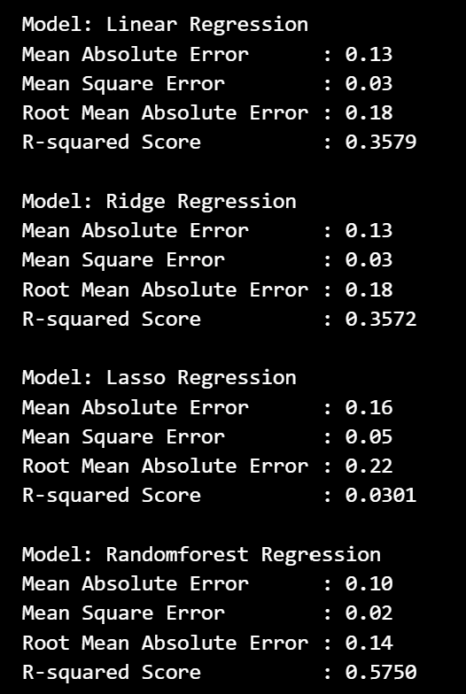
Housing Price Prediction
Multiple Linear Regression Results (MAE,MSE,RMSE,R square)

Slide 16
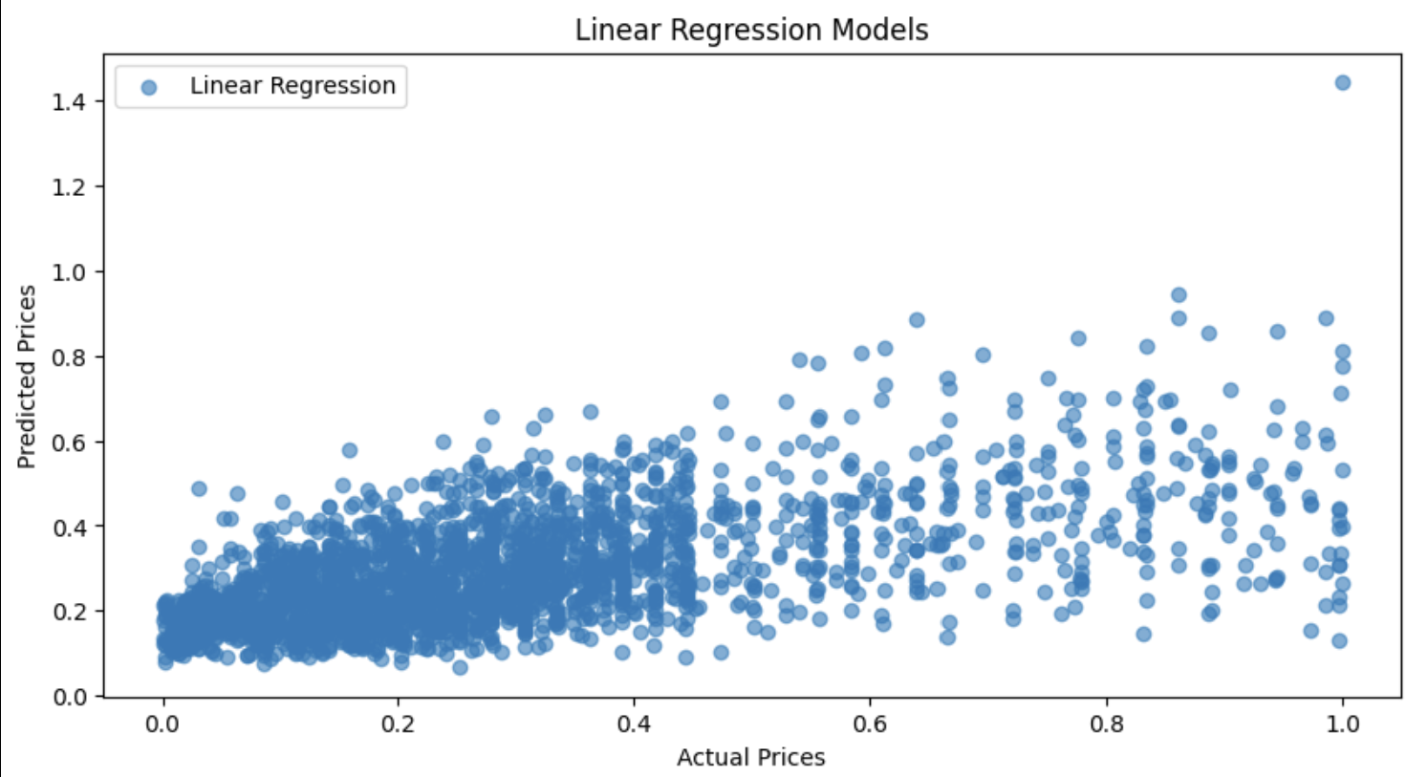
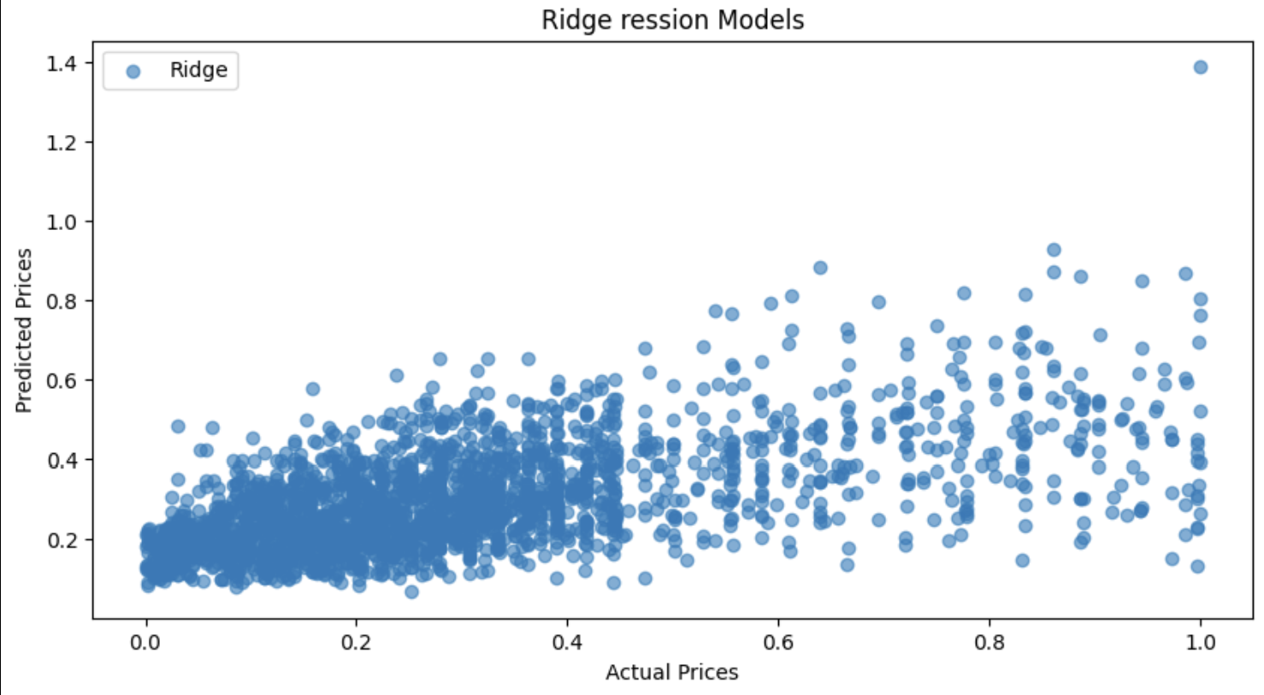
Housing Price Prediction
Multiple Linear Regression Results (plots)

Slide 17
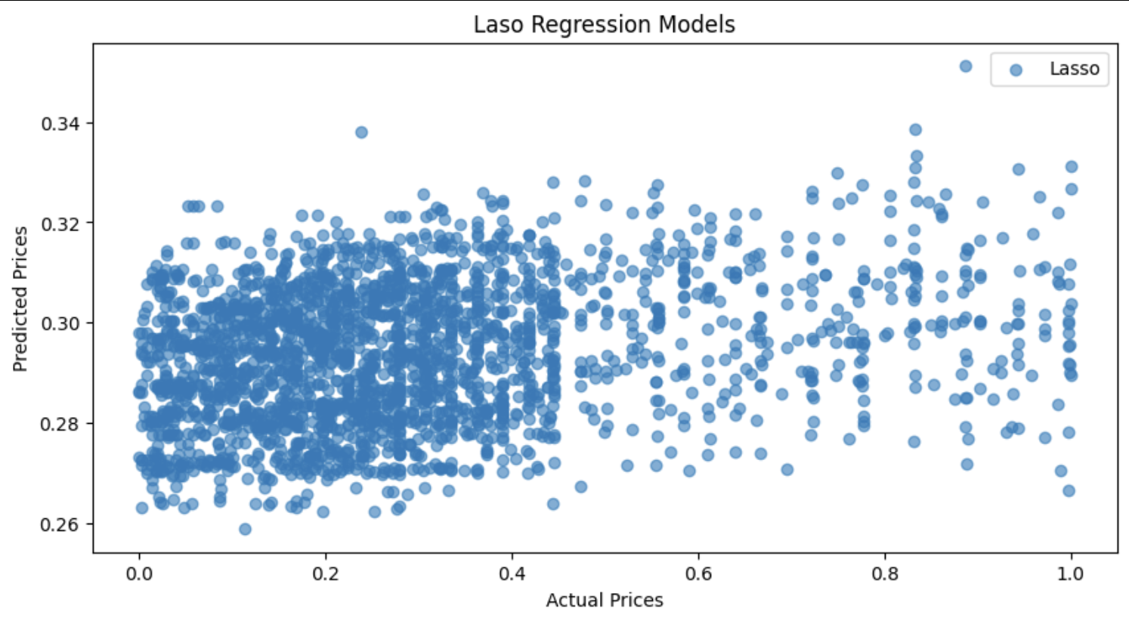
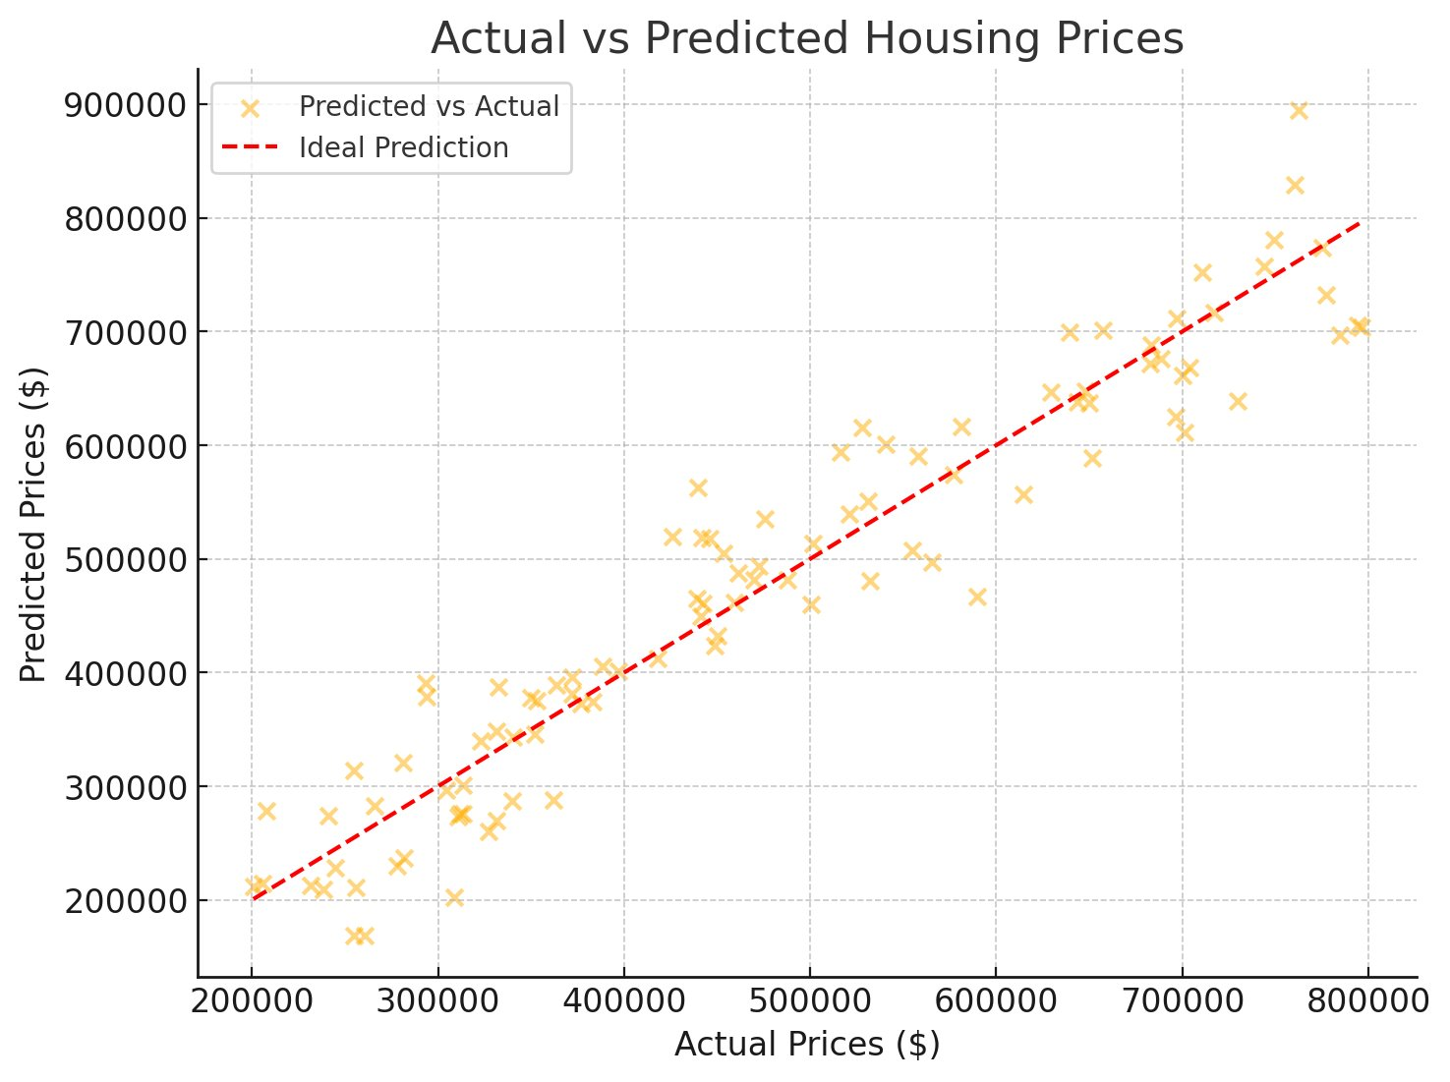
Housing Price Prediction
Multiple Linear Regression Results (plots)

Slide 18
Housing Price Prediction
Challenges faced and solutions
Some properties have extremely high or low bedroom/bathroom counts (e.g., 30 bedrooms or 0 bathrooms), which may distort model predictions.
Solution: Use outlier detection techniques (IQR, Z-score, or Isolation Forest) to filter unrealistic values and drop the the data for the bedroom size more than 10
Apply log transformation for highly skewed variables like lot size to reduce impact
Lot size (0-15000 acres) has a much larger scale than bedroom/bathroom count (0-30), leading to unequal weightage in ML models.
Solution:Use feature scaling (MinMax scalar ) to bring all numerical features to a comparable range.
Lot size may not have a linear relationship with price (e.g., a 15,000-acre land might not be priced proportionally to a 5,000-acre land).
Solution: Compare Linear Regression vs. XGBoost to check which model handles these variations better( that will perform when we start our XGBoost model)

Slide 19
Housing Price Prediction
Challenges faced and solutions
Some listings have 0 bedrooms or bathrooms, which may indicate missing values or misentries rather than actual studio apartments.
Solution: we are considering those recors as missing value and dropped it.
Standard regression models was giving excessive weight to extreme high-bedroom or high-acreage value
Solution: we are simple dropped those records.

Slide 20
Blueprint for our final phase
Implement XGBoost to improve model performance.
Perform K-Fold Cross-Validation for more robust evaluation.
Build a Dashboard Visualization Tool to present insights interactively.
Conduct further Feature Engineering to extract more meaningful data patterns.

