Slide 1

Streamline Building, Deploying, and Maintaining Your (Higher-Ed) Websites with WordPress
Zachary Watkins, Hassan Abbasi, and Steven Word

Slide 2
AgriLife Communications
We build modern, accessible websites which meet the needs of our users and the organization.
We have approximately 3,764 unique users across 20 installations with 1,060 sites.

Slide 3
AgriLife Communications
Building, deploying, and maintaining WordPress at this scale benefits from automation wherever possible.
CLI tools and development frameworks can help separate concerns and improve developer sanity.

Slide 4
AgriLife Communications
Our plugins and themes are open source and on Github, so anyone can view and repurpose it as needed.

Slide 5
Building Websites
Plugin and theme development using tools, frameworks, and services.

Slide 6
Tools
Local dev environment
Composer
GruntJS
SASS
Node Package Manager (NPM)

Slide 7
Frameworks
WordPress
Advanced Custom Fields Plugin
Genesis Theme Framework
Foundation 6 by Zurb

Slide 8
Services
Github
WP Engine
Codeship
Slack
Basecamp

Slide 9
Process
Start my local dev environment.
grunt watch rebuilds css when sass files are saved.
Develop with Sublime Text.
PHP changes just need a browser refresh.

Slide 10
Process
Before committing a PHP change to Github I npm run checkwp to make sure it adheres to WordPress coding standards.
Update the version in package.json.
Commit changes to Github, which notifies our team via Slack – and deploys to our servers!

Slide 11
Deploying and Releasing
Using Codeship and Github to distribute our plugins and themes

Slide 12
Overview
Automating deployment frees my time and expedites pushing fixes and features.
It typically takes 2.5 – 7min based on how many servers we’re deploying to.

Slide 13
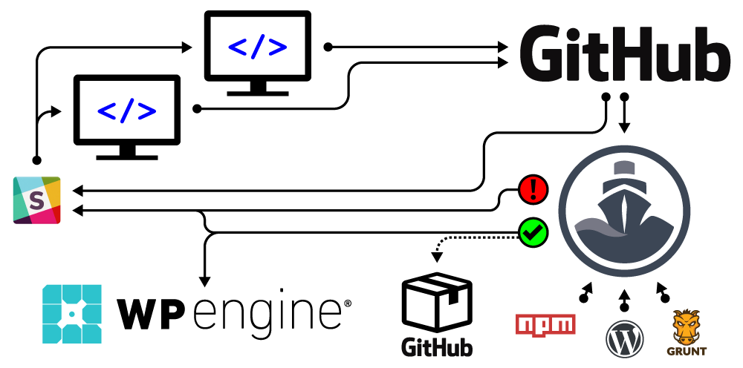
Workflow

Slide 14
Releasing to Github
The release *.zip file can be downloaded by anyone and then uploaded through the WordPress dashboard to install it on a site.
The release notes include commit messages for each commit that has happened since the last Github release.

Slide 15
Codeship
Requires about an hour of setup.
Uses a set of cli commands to configure the virtual machine, build files, release, and deploy.
Video tutorial on YouTube.

Slide 16
WP Engine
Their Git Push feature allows us to automate deployments.
Staging and Production environments help test code if local testing isn’t enough.

Slide 17
Slack
Notifies us when Codeship starts, and when it fails or succeeds.
Notifies us when Github repositories are pushed to or get a new release.

Slide 18
Maintaining Websites
Updating third party code and supporting users

Slide 19
Common tasks
Update core, third party plugins and themes.
User training.
Install commonly used plugins on new sites.
Manage user access.

Slide 20
Updates
Back up servers.
wp core update --ssh=sshlogin
wp plugin update --all --ssh=sshlogin
wp theme update --all --ssh=sshlogin

Slide 21
Training
WP101 videos embedded in the dashboard.
https://firstcallhelp.tamu.edu/

Slide 22
Common plugins
Advanced Custom Fields Pro (premium or free)
Gravity Forms (premium)
CAS Maestro
Soliloquy Slider
Google Analytics for WordPress
Really Simple SSL
The Events Calendar
WP101 (premium)
Yoast SEO

Slide 23
User access
User roles define access.
wp role create role_slug Name
wp cap add “role_slug” “capability_slug”
Optional: wp user set-role username role_slug

Slide 24
Our approach
Allows us to support a large number of sites and users with a relatively small team.
Helps provide our users with secure and accessible plugins, themes, and websites which are easy for all of us to modify.

Slide 25
Our approach
Reduces the amount of time and effort it takes to make and upload a change to our code.
Our plugins and themes are open source and on Github, so you can view and repurpose it for your own needs.

Slide 26
Resources
Our latest Genesis child theme: https://github.com/agrilife/agriflex4
Our latest plugin: https://github.com/agrilife/af4-agrilife-org
Codeship custom script to initialize a project: https://gist.github.com/ZachWatkins/1c30f2b5847fcbfee1c72cc5f3fc57cf

Slide 27
Resources
https://wp-cli.org/
Foundation 6 documentation: https://foundation.zurb.com/sites/docs/
My Codeship video tutorial: https://youtu.be/iNOaUyDPHDQ

Slide 28
Questions?

