Slide 1

Streamline Building, Deploying, and Maintaining Your (Higher-Ed) Websites with WordPress
Zachary Watkins, Hassan Abbasi, and Steven Word

Slide 2
AgriLife Communications
We build modern, accessible websites which meet the needs of our users and the organization.
We have approximately 3,764 unique users across 20 installations with 1,060 sites.

Slide 3
AgriLife Communications
Building, deploying, and maintaining WordPress at this scale greatly benefits from automation wherever possible.
CLI tools and frameworks can help preserve developer sanity.

Slide 4
AgriLife Communications
Our plugins and themes are open source and on Github, so you can view and repurpose it for your own needs.

Slide 5
Building Websites
Plugin and theme development using tools, frameworks, and services.

Slide 6
Tools
Local by Flywheel
Composer
GruntJS
SASS
Node Package Manager

Slide 7
Frameworks
WordPress
Advanced Custom Fields Plugin
Genesis Theme Framework
Foundation 6 by Zurb

Slide 8
Services
Github
WP Engine
Codeship
Slack
Basecamp
Node Package Manager

Slide 9
Deploying and Releasing
Using Codeship and Github to distribute our plugins and themes

Slide 10
Overview
Automating deployment frees my time and expedites pushing fixes and features.
It typically takes 2.5 - 7 minutes to deploy, depending on how many servers we’re deploying to

Slide 11
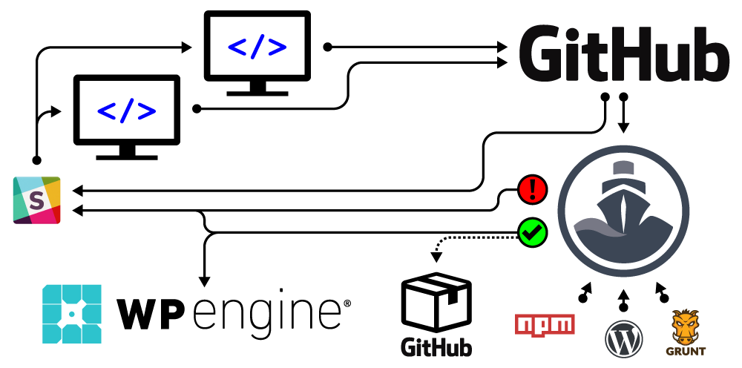
Workflow

Slide 12
Releasing to Github
The release *.zip file can be downloaded by anyone and then uploaded through the WordPress dashboard to install it on a site.
The release notes include commit messages for each commit that has happened since the last Github release.

Slide 13
Codeship
Requires about an hour of setup
Uses a set of cli commands to configure the virtual machine, build files, release, and deploy.
Video tutorial on YouTube

Slide 14
WP Engine
Their Git Push feature allows us to automate deployments
Staging and Production environments help test code if local testing isn’t enough

Slide 15
Slack
Notifies us when Codeship starts, and when it fails or succeeds
Notifies us when Github repositories are pushed to or get a new release

Slide 16
Maintaining Websites
Updating third party code and supporting users

Slide 17
Common tasks
Update core, third party plugins and themes
User training
Install commonly used plugins on new sites
Manage user access

Slide 18
Updates
Back up servers
wp core update --ssh=sshlogin
wp plugin update –all --ssh=sshlogin
wp theme update –all --ssh=sshlogin

Slide 19
Training
WP101 videos embedded in the dashboard
https://firstcallhelp.tamu.edu/

Slide 20
Common plugins
Advanced Custom Fields Pro (premium or free)
Gravity Forms (premium)
CAS Maestro
Soliloquy Slider
Google Analytics for WordPress
Really Simple SSL
The Events Calendar
WP101 (premium)
Yoast SEO

Slide 21
User access
User roles define access
wp role create role_slug Name
wp cap add “role_slug” “capability_slug”
Optional: wp user set-role username role_slug

Slide 22
Our approach
Allows us to support a large number of sites and users with a relatively small team
Helps provide our users with secure and accessible plugins, themes, and websites which are easy for all of us to modify

Slide 23
Our approach
Reduces the amount of time and effort it takes to make and upload a change to our code.

Slide 24
Questions?

