Slide 1
Data Bootcamp Final Project
Presented By: Jok Aleu and Zachary Xue

Slide 2

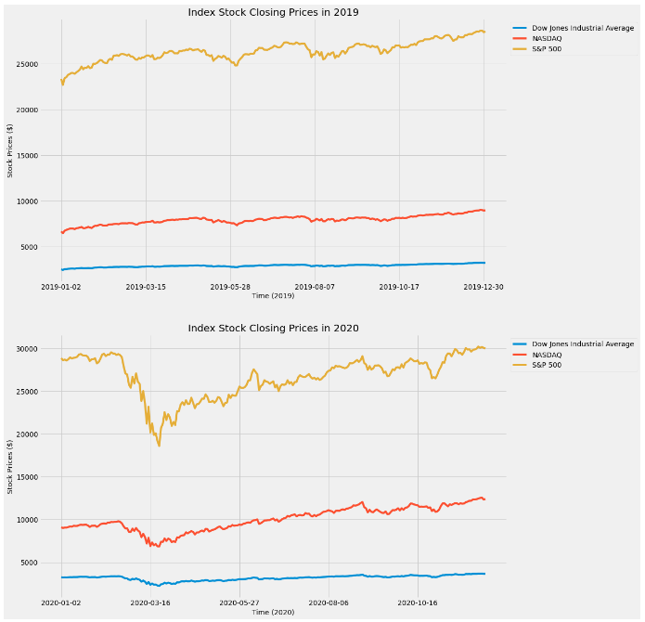
The Pitfalls of Coronavirus
Coronavirus has affected society politically, economically, and socially throughout all of 2020.
Many corporations faced financial setbacks, the graph here shows the economic pitfalls in the time period between 2019 and 2020.
Some of the indices changed more than others, such as the S&P 500 for example.

Slide 3
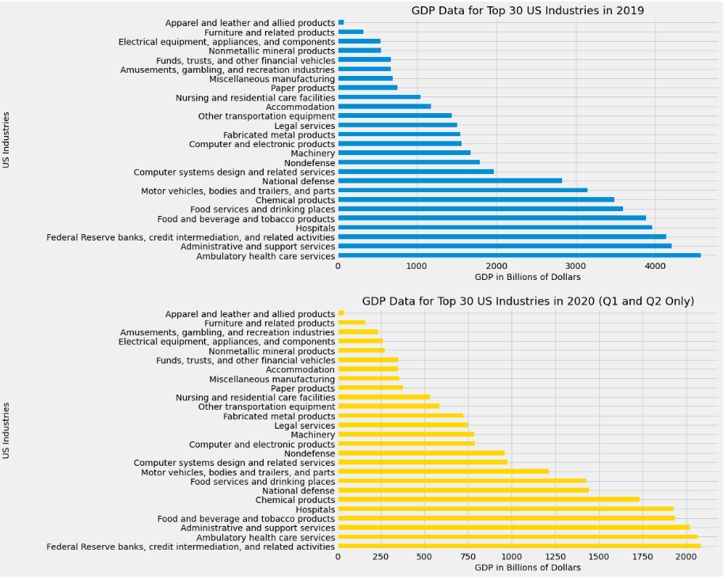
How Does GDP Contribute?
Coronavirus had an adamant impact on which were the most profitable industries and sectors in terms of gross output
The graph shows us that the Federal Reserve banks and credit intermediation jumped to the top sector in 2020, likely because of its stimulus packages to help the stock market and the overall economy as a whole

Slide 4
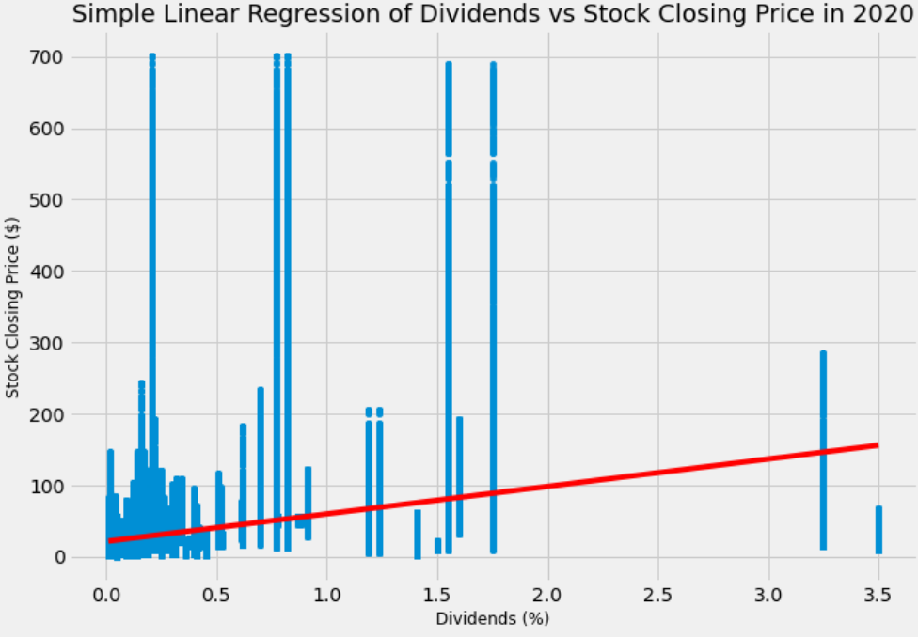
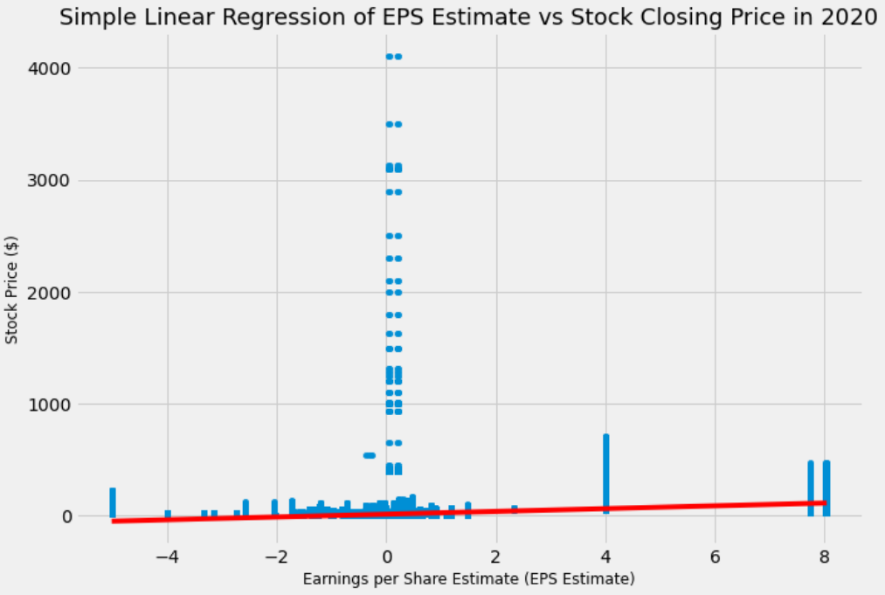
The Factors Affecting Stock Market Growth
Now that we understood how coronavirus and GDP affected one another, we now look to see how GDP and other potential factors might have an influence on stock market growth.
We decided to investigate several independent variables, including estimated earnings per share (EPS) and company dividends rates
These variables exhibited a slight positive trend. However, the statistical analyses showed insignificant correlations in the data.

Slide 5
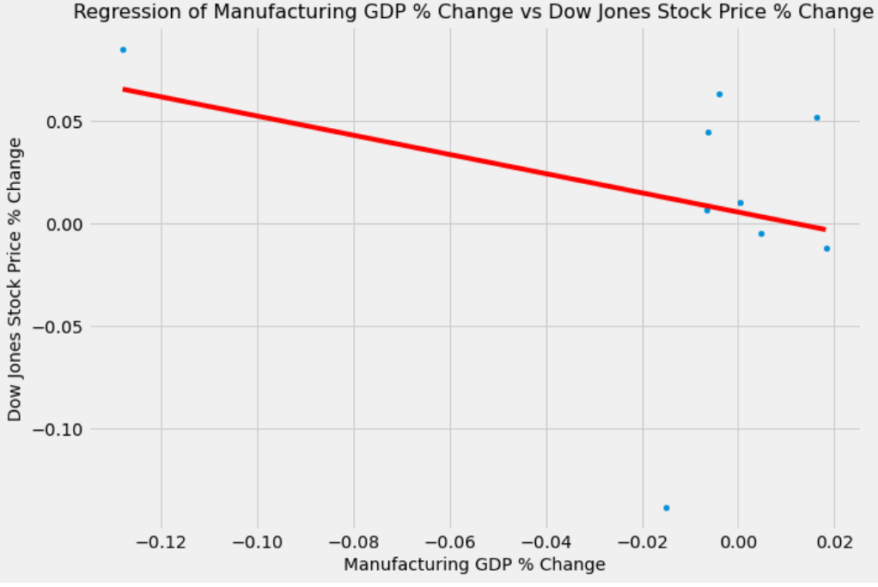
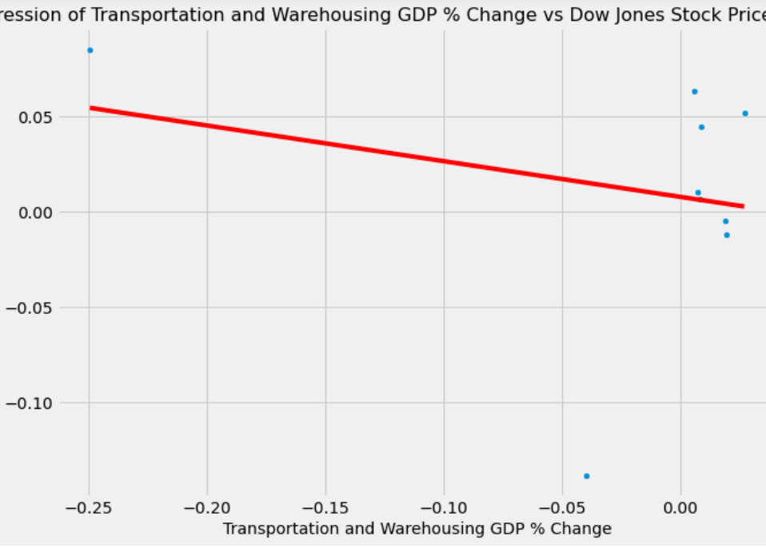
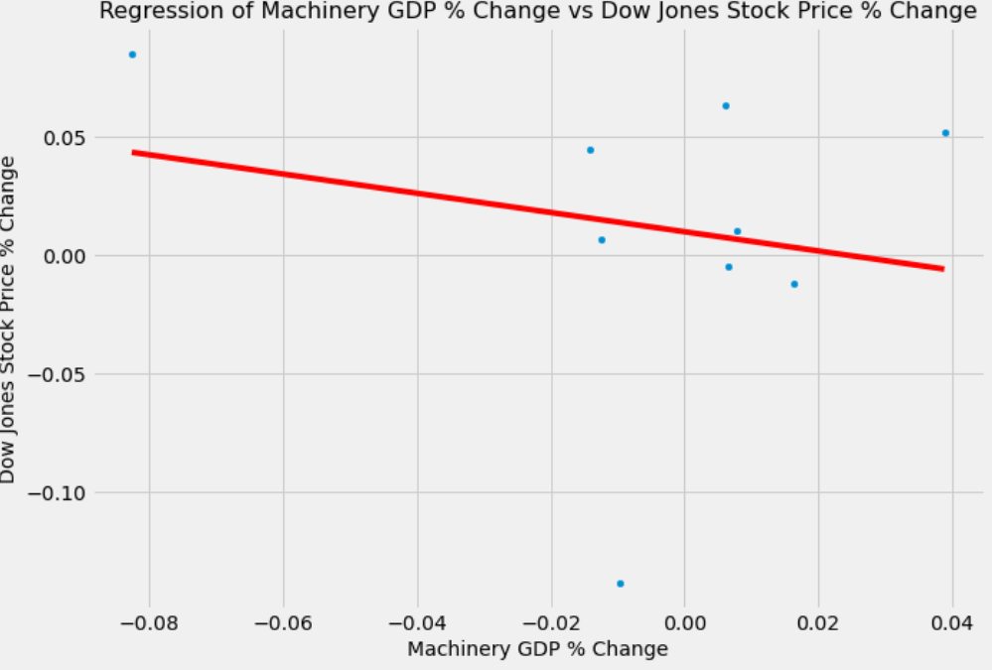
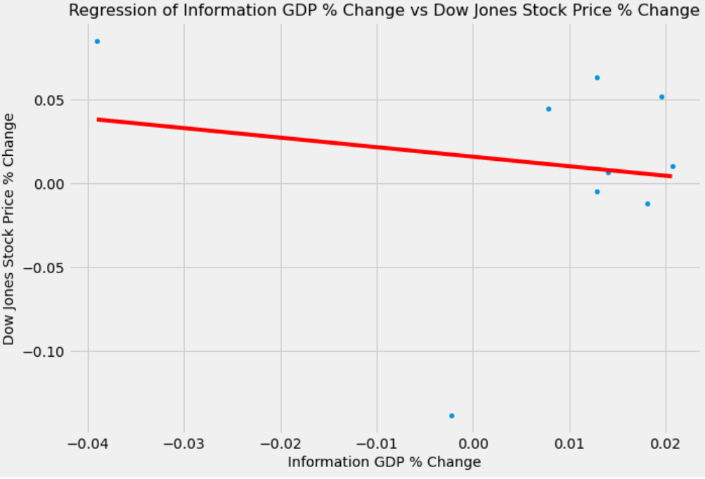
The Factors Affecting Stock Market Growth
The other factors we decided to investigate were specific sectors in the economy sorted by percent change in the annual GDP vs the percent change in the Dow’s stock prices.
All the selected sectors had a slight, negative relationship in their regression analyses. But very few of the sectors provided any significant correlations.
In conclusion:
The coronavirus had a major impact on the world economy, in terms of its GDP and the stock market.
When looking at how specific GDP sectors affected the stock market, there was not much correlation to be found between these two variables.

