Slide 1
UNCC_WORK Prototype Review Presentation
Damian Hupka, Zachary Zaleski, Nathan Pecoraro, William Clampett, Duncan Tennant
Notes:
(Zach)

Slide 2
Project Overview:
This project consists of two major objectives:
Develop a scalable backend communication system that will alert short-duration work zone employees of potential oncoming threats through generated risk scores.
Develop a digital twin, mobile application to collect GPS information (such as when a worker has left a designated workzone), short-term weather data, alert history, and heart rate variability.
Purpose to summarize data in a meaningful way for managerial analysis, store some of the mentioned information to a database, and provide means of updating risk scale of the server by communicating aforementioned metrics.
Notes:
(Zach)
Here is a quick summary of the overall project
There are two main objectives involved in the development of this project:
The first part is for the team to develop a scalable backend communication system that will send an alert message to workers. The alerts will change based on a risk-score system.
The second part being the team will develop a digital twin, mobile application that will collect the GPS data from each of the workers. Weather data, heart rate, and alert history will also be included in the app development. This data will be summarized for analysis and stored in a database in order to update the risk-score generation criteria.

Slide 3
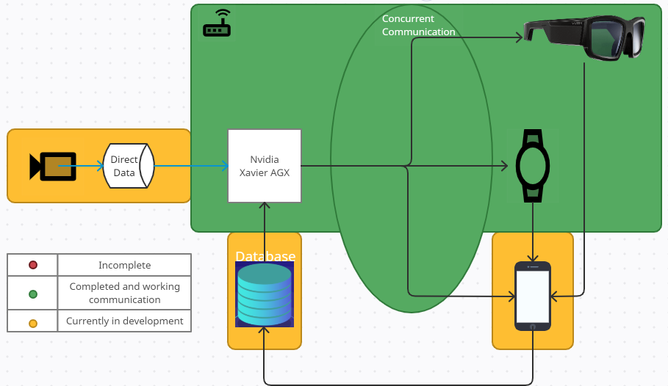
Current progress
Notes:
(Zach)
Digital twin application is still currently in progress. The team has the application updating the map in real-time with a number of markers (representing clients). Furthermore, as shown in the following demo, a boundary box is drawn across the workzone and the markers are being handled to determine if they are outside of the boundary. The team is still in the process of implementing a weather API to display short-term weather warnings, to update the server’s risk score generation, risk score alert history, and implementation of the heart rate API on the smart watch to communicate with the application. (PROBABLY WANT TO CLEAN THIS UP)
Server side: Implementing error handling, through way of signaling to ensure seamless communication. Furthermore, improve the robustness of the server to not just be sending risk scores, but to be sending risk scores to the clients,
receiving GPS coordinates back from the clients as an acknowledgement, then sending these GPS coordinates to the digital twin to be displayed on the map in real time. Nathan will touch more on this when discussing the topology.
Camera AI detection is in progress as in accordance with the Real-Time Machine Learning course which is taught by Dr. Tabkhi. We will be developing a vehicle detection system that will identify vehicles and group them into certain classes based on they’re shape and size (sedan, van, suv, truck, bus, etc.) and use that information to generate a risk score. We will also be implementing vehicle reidentifaction and trajectory calculation which will also be taken into account to generate the risk score.
Up next is Nathan to discuss the design schematics of our prototype.

Slide 4
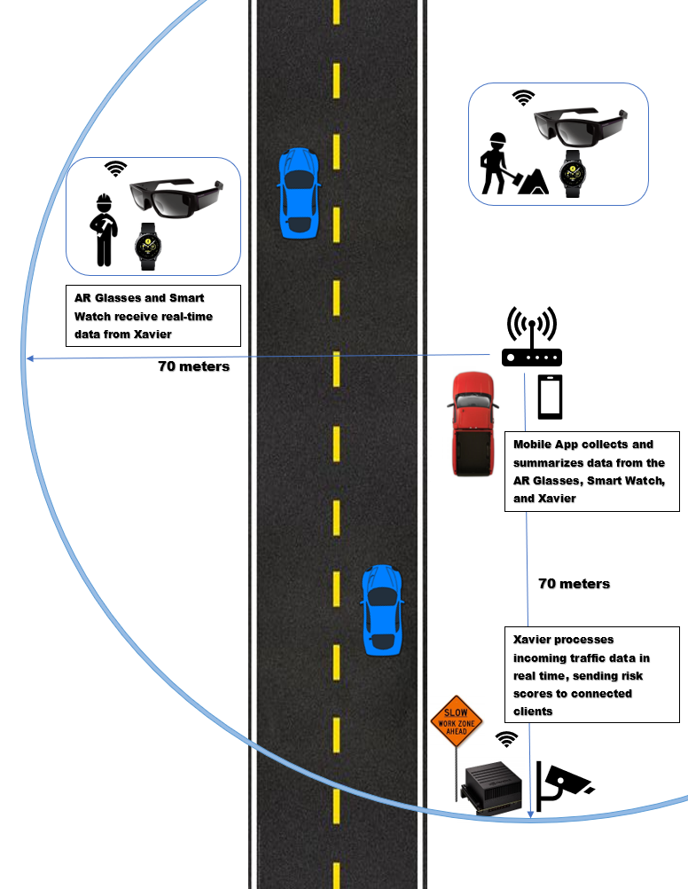
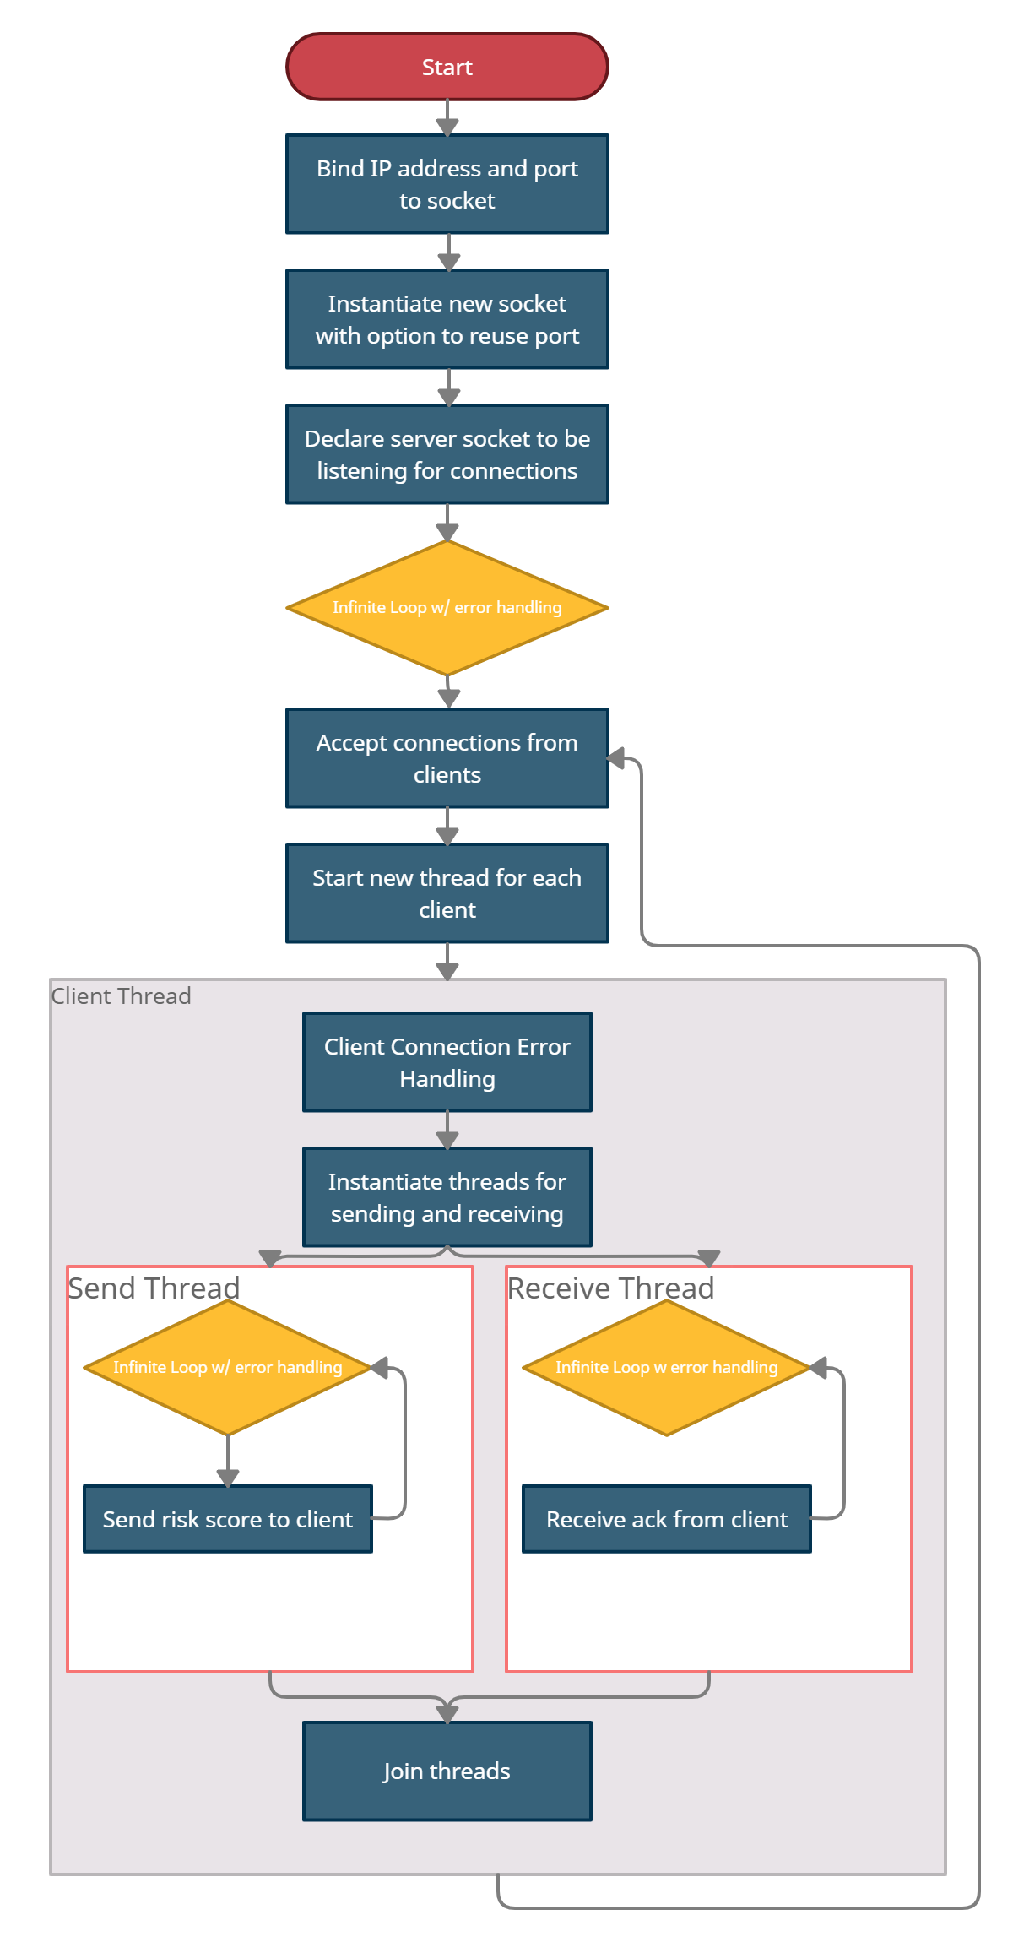
Prototype design schematic
Overall Design:
Multi-threaded concurrent server:
Notes:
Stress that multi-threaded server is working, want to implement error handling going forward

Slide 5
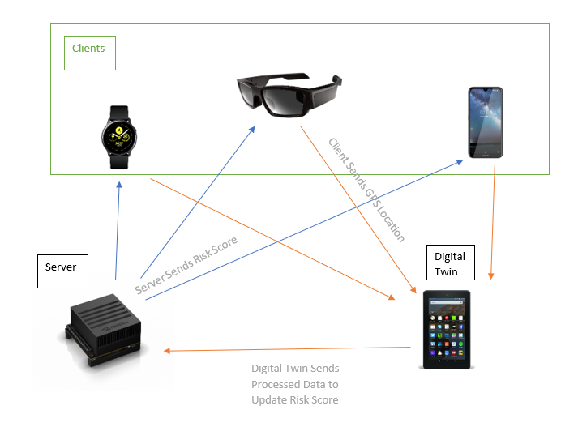
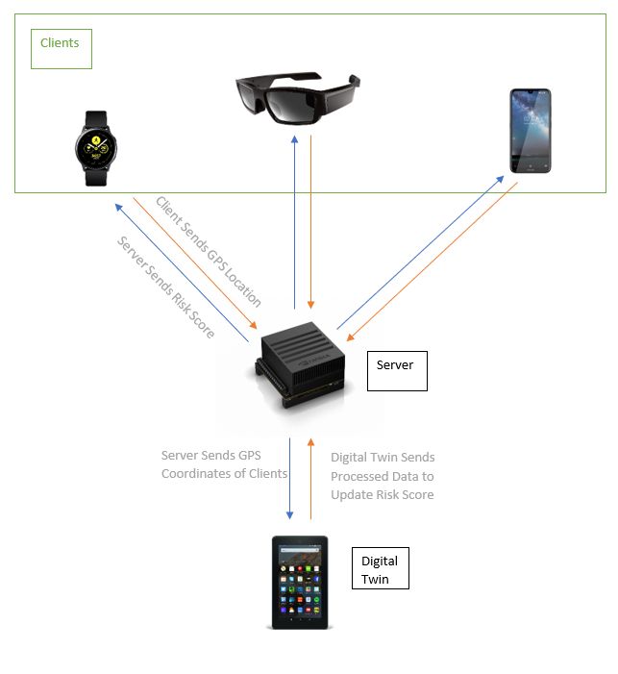
GPS Communication Flow
Original Topology:
Implemented Topology:
Notes:
Speak on the how this is not a full representation of the functionality of each of the clients. (such as heartbeat data from the watch not represented here)
Benefit of right being GPS coords act as an acknowledgement, while also not having to instantiate any new connections.

Slide 6
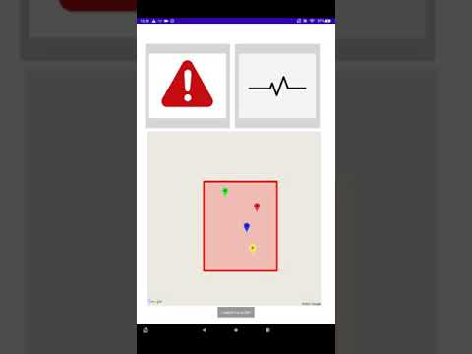
Mobile Application Demo:
Notes:
(Cole damian, duncan)
Pause at homepage to discuss that the homepage we see here will likely act as a login screen where a manager can enter the IP address and port one time and connect to the server, then will go into the main homepage which we see here -> unpause show gps stuff.
The current buttons for the alerts and the heart rate monitoring will likely be included as fragments on the application UI to ensure that the end-user can visualize all pertinent information on one screen. Internally, the team is discussing what information these fragments will be display, but as a baseline the alerts will display the average alerts received of every/individual (unsure) client, and any increased heart rate anomalies of any of the clients.
Discussion into what the GPS boundary checking will be doing for us. (Used to update the scale of the risk score generation) and if possible, modifying the scale for an INDIVIDUAL client and sending to an INDIVIDUAL client.

Slide 7
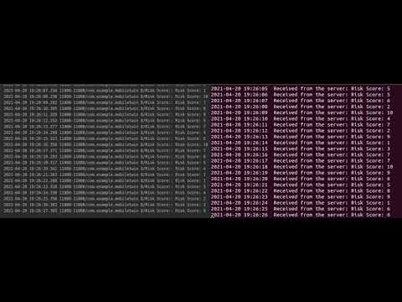
Server Demo:
Notes:
(Zach, Nathan, Damian)
As we can see that the two clients are receiving messages at very nearly the same time, this shows the multithreaded-concurrent approach we want to have with our server
This can be scaled to many more clients, only two are shown here for ease of demonstration. Furthermore, this is just showing the concurrently sending messages to our clients, but now the final approach with multiple receives/sends going to varying clients.

Slide 8
Roadblocks (Server):
Threading
Sending and Receiving message threads, running within an overarching Client Thread.
Error handling/Signaling
Topological Handshake
Handling individual message transmissions to clients (i.e. sending GPS information just to digital twin application, but not end-user clients.)
Message communication on interval/time based system consideration.
Notes:
(Damian)
Issue is with passing the correct connection argument between functions, currently only the most recent client will receive messages while the original clients do not operate as intended.
We know we want to close/end/kill threads, but we aren’t entirely sure where we will go from there -> probably just try to send again. We need a topological handshake between the server and the client structure to ensure either end is not hanging on a thread that is closed .
Internal discussion as to how the server will handle specific message transmission between certain clients. For example, if a client is out of the workzone as reported from the digital twin application the server may want to just send an updated risk score to this individual client.

Slide 9
Roadblocks (Digital Twin):
Implementing the GPS location services accurately.
Issue with implementing the map as a real time fragment
Receiving real-time gps markers and displaying on map
Blocking the UI when displaying continuously updating markers
Implementing Asynctask
Allowing user defined work area
Potential solution in polygon function
Current implementation only has work area definition in java code
User defined points to create polygon
Notes:
Map as real time fragment :
first implementation was map on a second activity but instead used a fragment to optimize efficiency in app.
Solved using android documentation for google api once fragment was created successfully
Updating map markers:
map markers were able to be added if an individual marker was used with a known latitude and longitude
Placing more than one proved to be an issue as trying to run any loop in our onMapReady function that created the map caused the main UI thread to be blocked until all markers were placed and updated.
Wasn’t providing current location as UI was blocked until loop finished. With this implementation they needed to be added when the map was created because we had no Onprogress or doInBackground
Feeds into learning variable and data passing. Help from Sep in understanding how Android Studios runs data continuously using onPreExecute, doInBackground, onProgressUpdate, onPostExecute
Asynctask
Allowing user defined work area:
Issue is how to easily let users define an area on google maps that can be used with gps location to see if workers are leaving the work site.
Current implementation uses polygon in the google map api to define coordinates of a polygon to show work area.
Only in java code solution at moment is to allow user to click on map to select points for polygon to draw.
Open for discussion

Slide 10
Future Development Plan
Server
Signaling
Further Error Handling
Robust Implementation
App
Ability to define workspaces with current GPS location
Receive current Heart Rate and Stress from smart watch
Implementation of digital twin in system
Testing receiving all data including threat levels and haptic data in the system design
Notes:
Server
Finish comprehensive implementation; wherein, the server is sending a message to the clients, receiving an ack from the clients, primarily being the GPS coordinates, then sending these GPS coordinates just to the digital twin application. Also, being able to receive data from the digital twin application in risk scale updating.
App:
Database will be used to store some of the more important information that is collected within the digital twin to be analyzed from a managerial standpoint later. For example, with the previously seen GPS markers and boundary checking we are able to see when a user leaves the boundary. Using this information, the digital twin could store not the GPS coordinates of the user when they exited the work zone, but a simple boolean for the fact that they were out of the work zone at all and this data could be used to see potentially more prone to danger users.
Use Tizen to request heart rate or stress level and display any levels above the alert level on the homepage.
Set up communication between twin and server so that it is aggregating and displaying the data we need it to
Final prototype set up and app implementation that we will test outside with the goggles to receive latency data and accurate display of haptic information with gps location

Slide 11
Test Plan
The team is planning over the next few weeks to wrap up a robust implementation of the server and finalizing any functionality of the digital twin.
With a comprehensive prototype completed the team will be moving the system outdoors to initially test latency between each and all of the devices using the improved multithreading approach. Furthermore, the team will be attempting to use a webcam attached to the NVIDIA Xavier AGX to analyze traffic data with a real-time AI inference model to generate a risk score to be communicated to clients.
Notes:
Damian

Slide 12
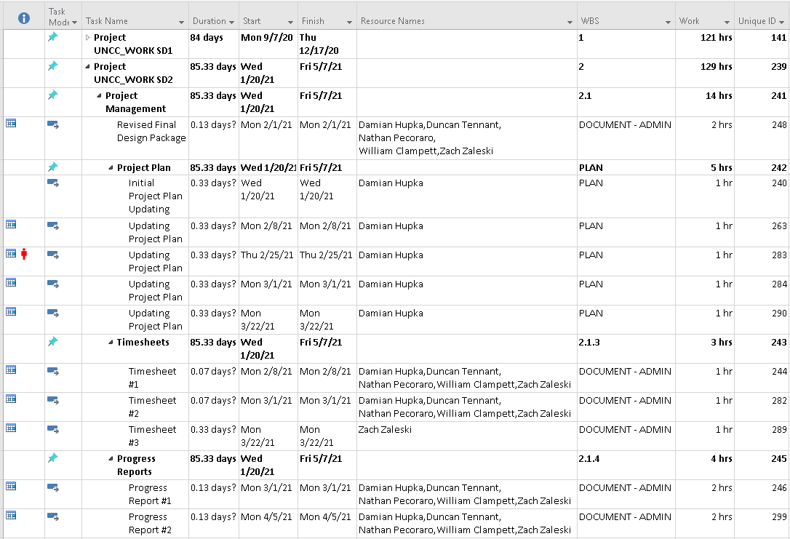
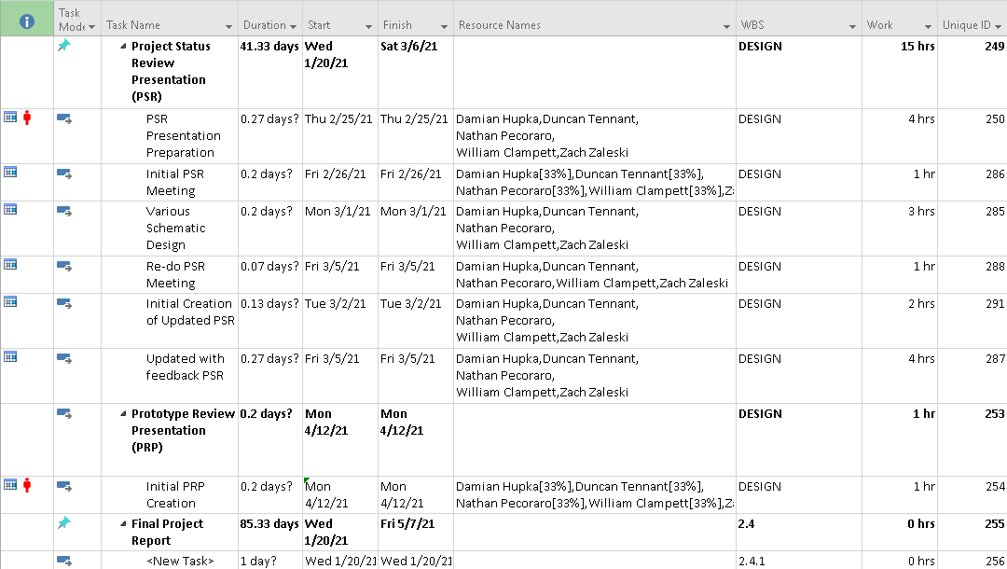
Project Plan
Notes:
This is the current project plan. Note: This project plan is actually one update behind as posting the last couple updates to the project plan has not been possible as attempts have been made to login to varying mosaic anywhere devices but they do not have microsoft project installed it appears.
What we may not be able to complete by the expo and video deliverables, but ideally by the end (probably AI stuff). Also, what things we will likely struggle with finishing implementation. (I definitely think sending messages to individual clients within our multithreaded server may be tough.)
We think that these things may be difficult to complete by Project Video and Expo time, but will be completed by the end of this course.

Slide 13
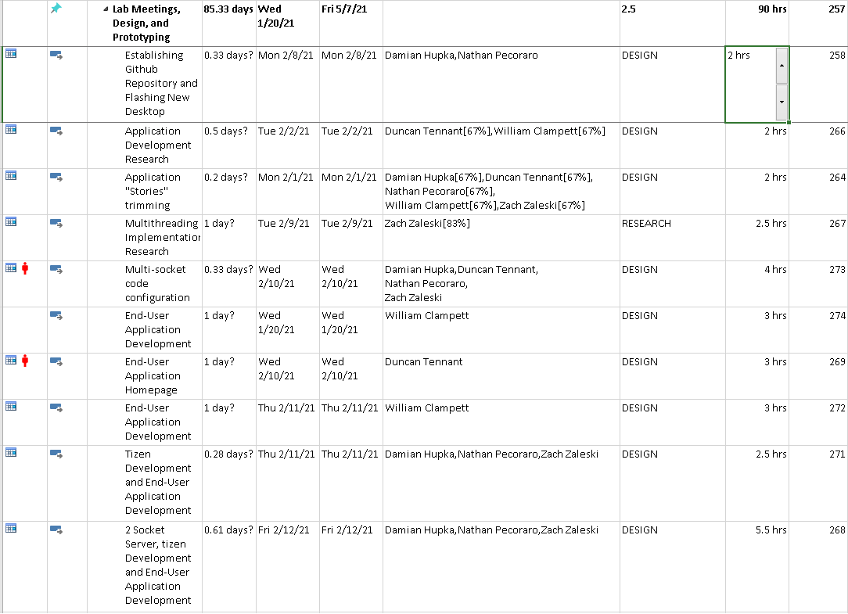
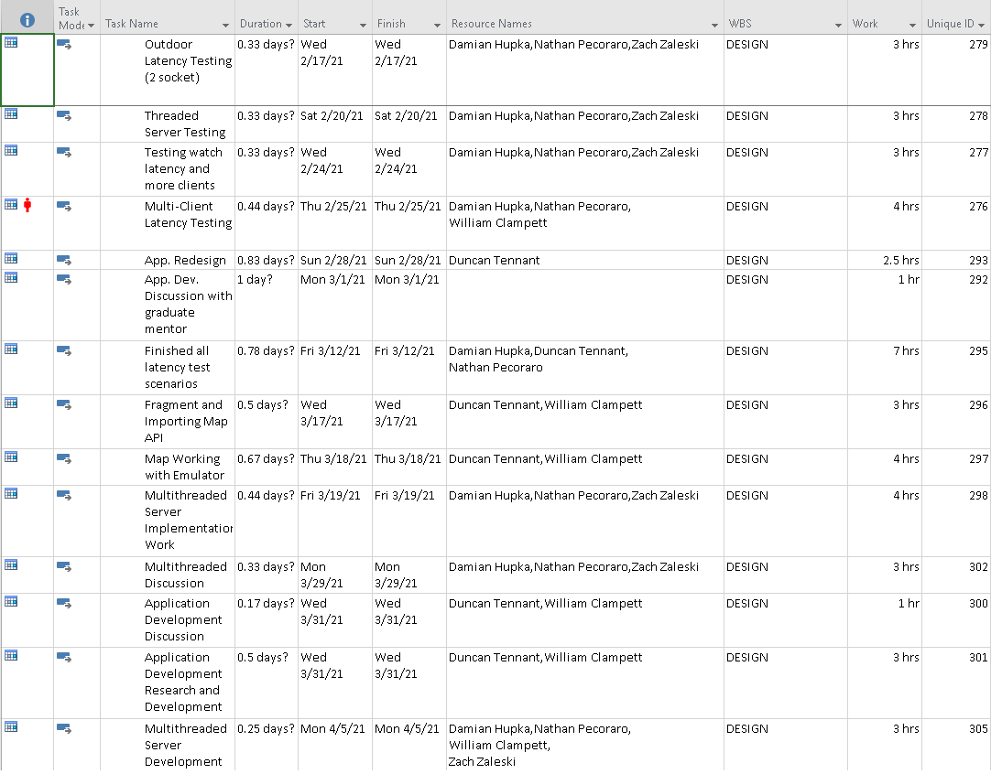
Project Plan Continued

Slide 14
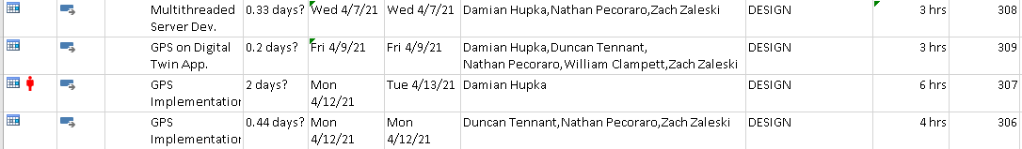
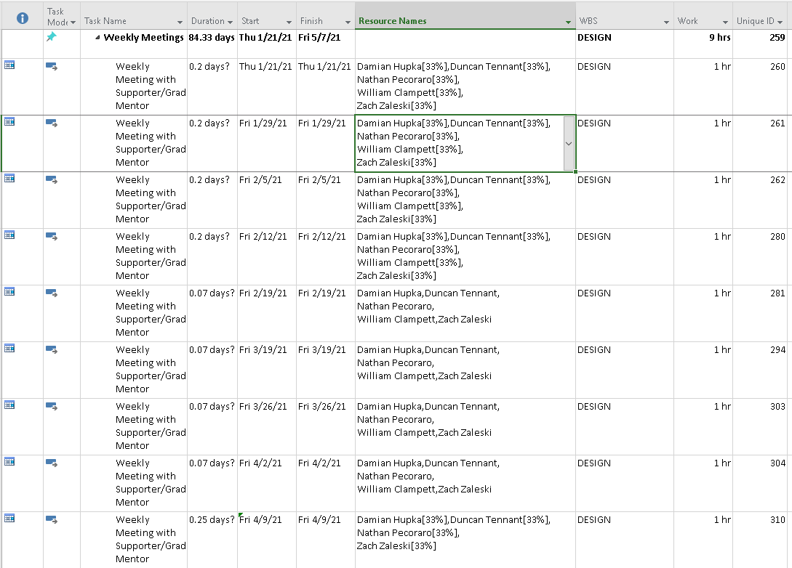
Project Plan Continued

Slide 15
Questions?

