Slide 1
Self Organizing Maps for Corvid 19 Articles:
Understanding the Topology of Corona Literature

Slide 2
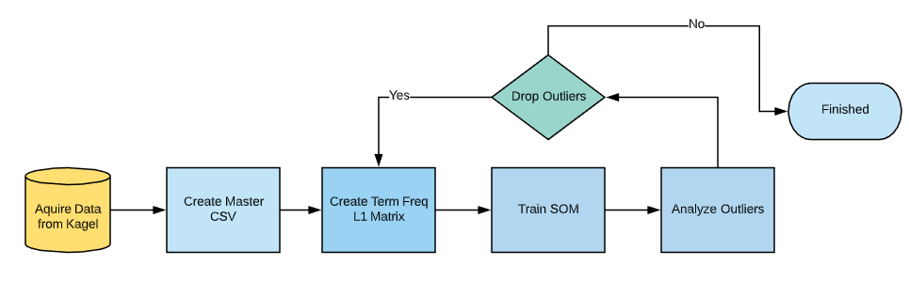
SOM Training Process Map

Slide 3
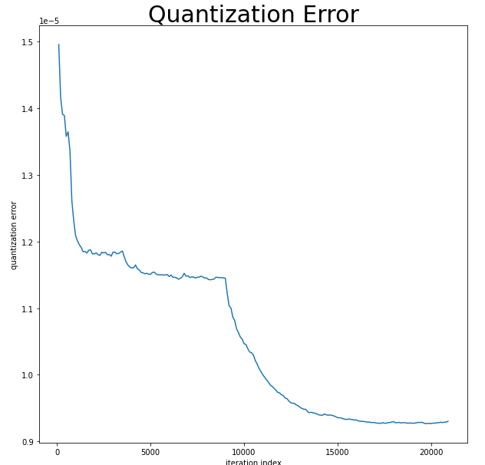
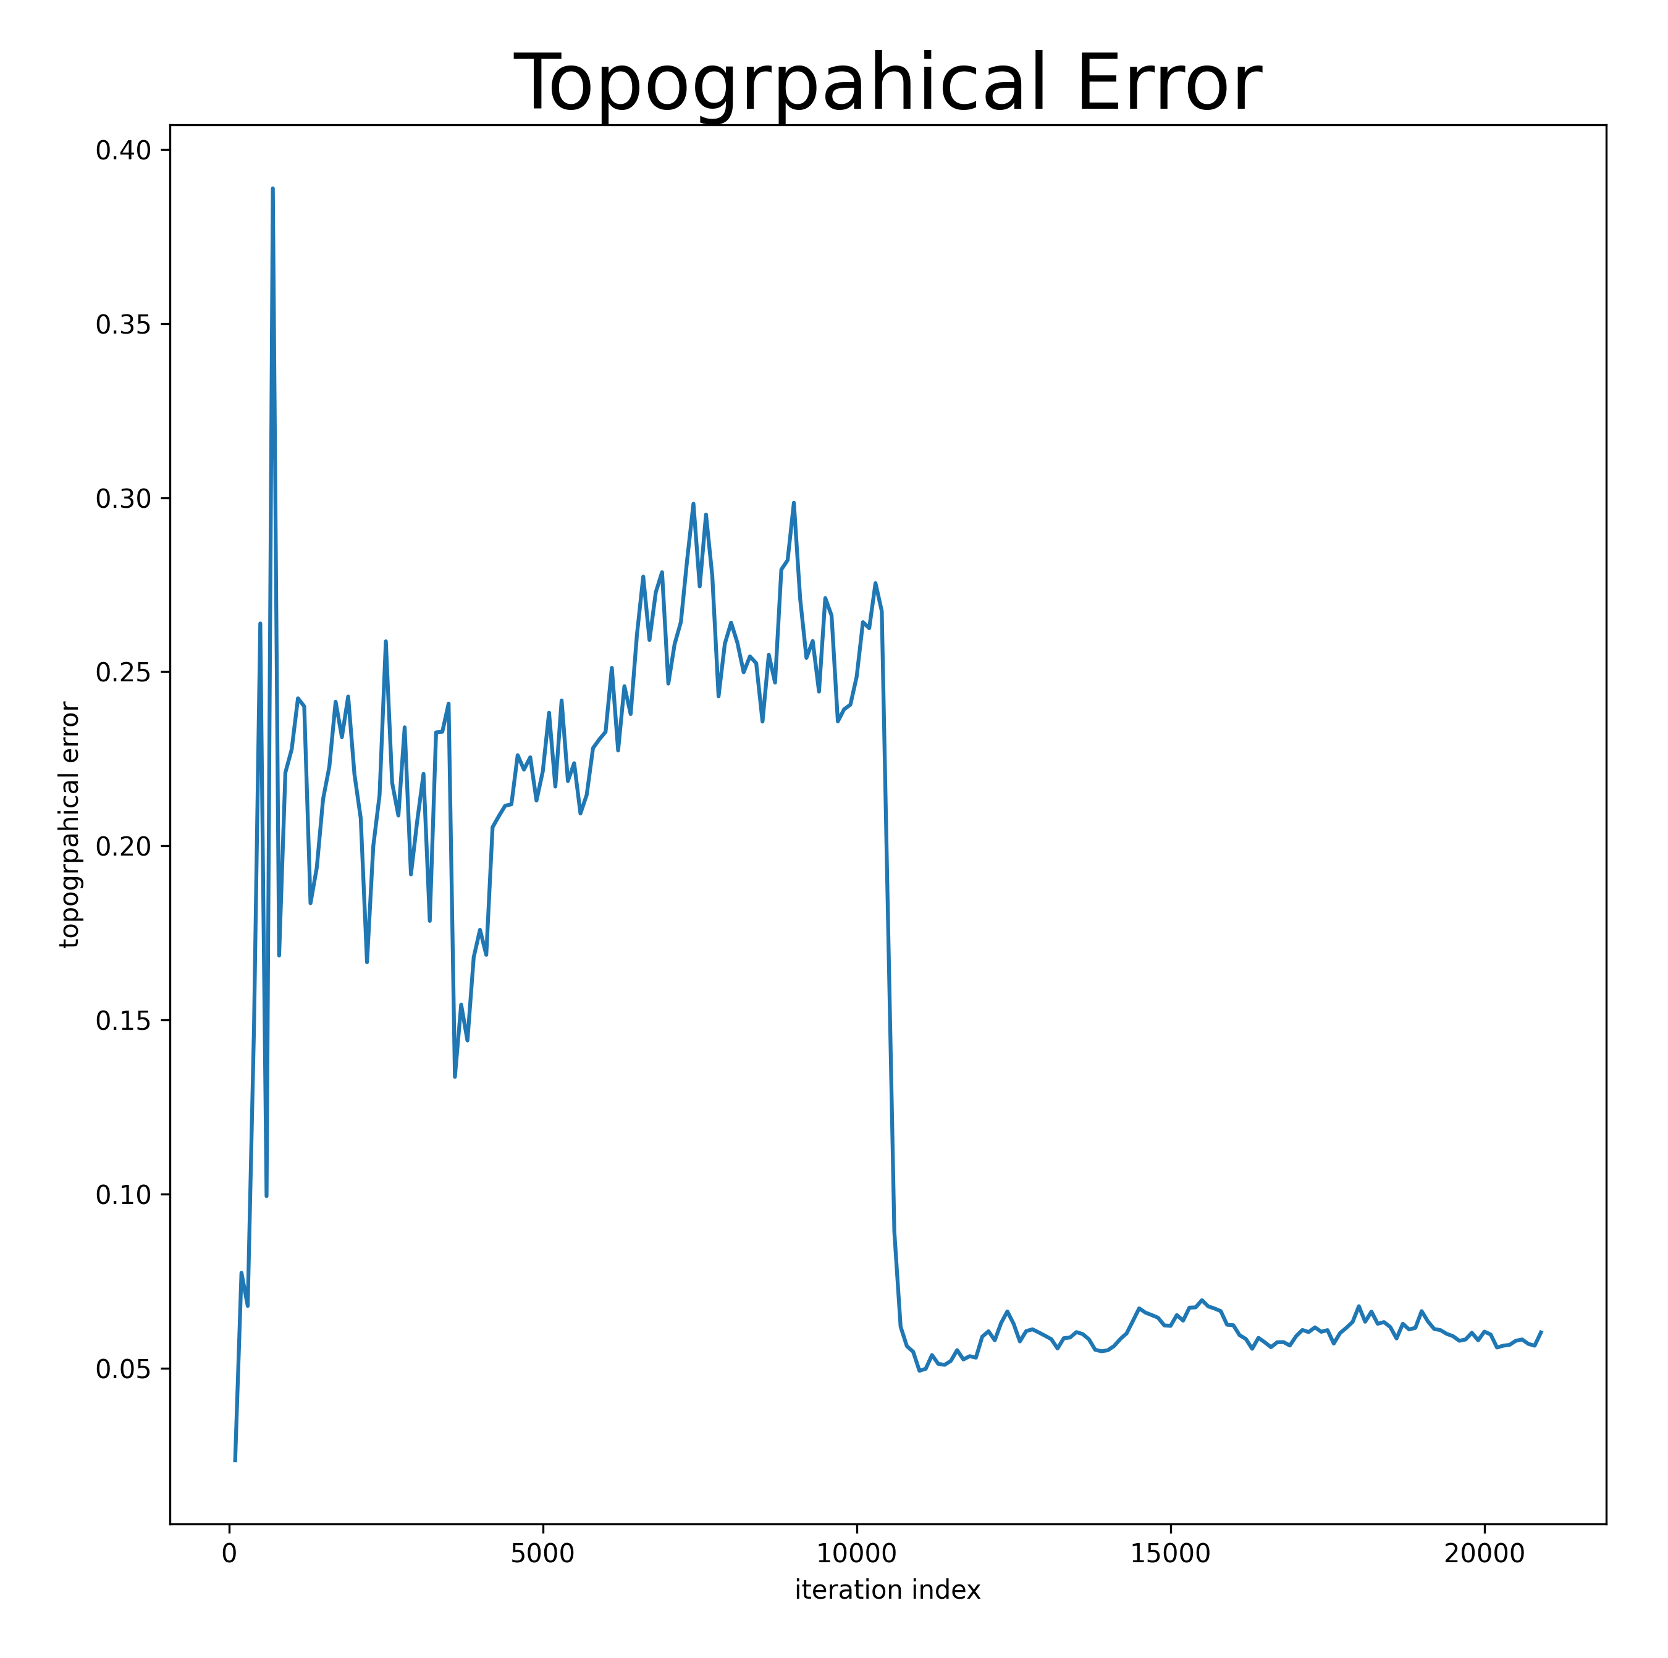
SOM Training Error
Topographical Error
Quantized Error:
Average distance between each data vector and its BMU. Measures map resolution
Topographical Error:
The proportion of all data vectors for which first and second BMUs are not adjacent units. Measures topology preservation.

Slide 4
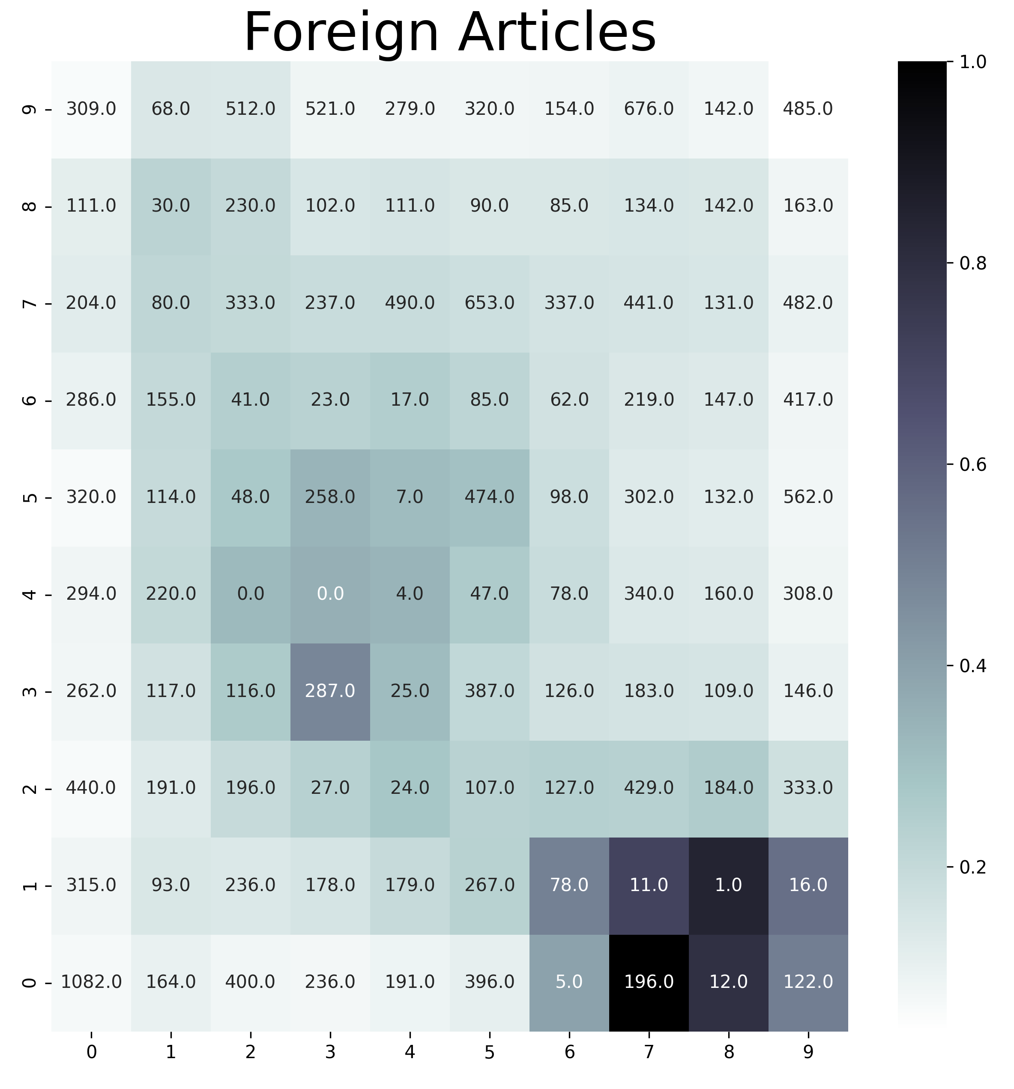
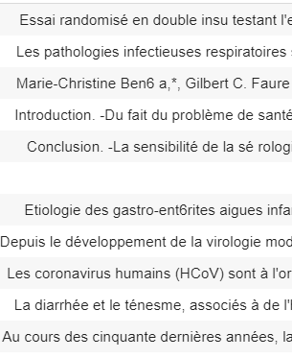
Foreign Articles:
Main Text
Top Words:
de 40.763569
le 35.359557
la 20.164921
une 13.750135
en 12.454713
est 8.842858
un 8.269632

Slide 5
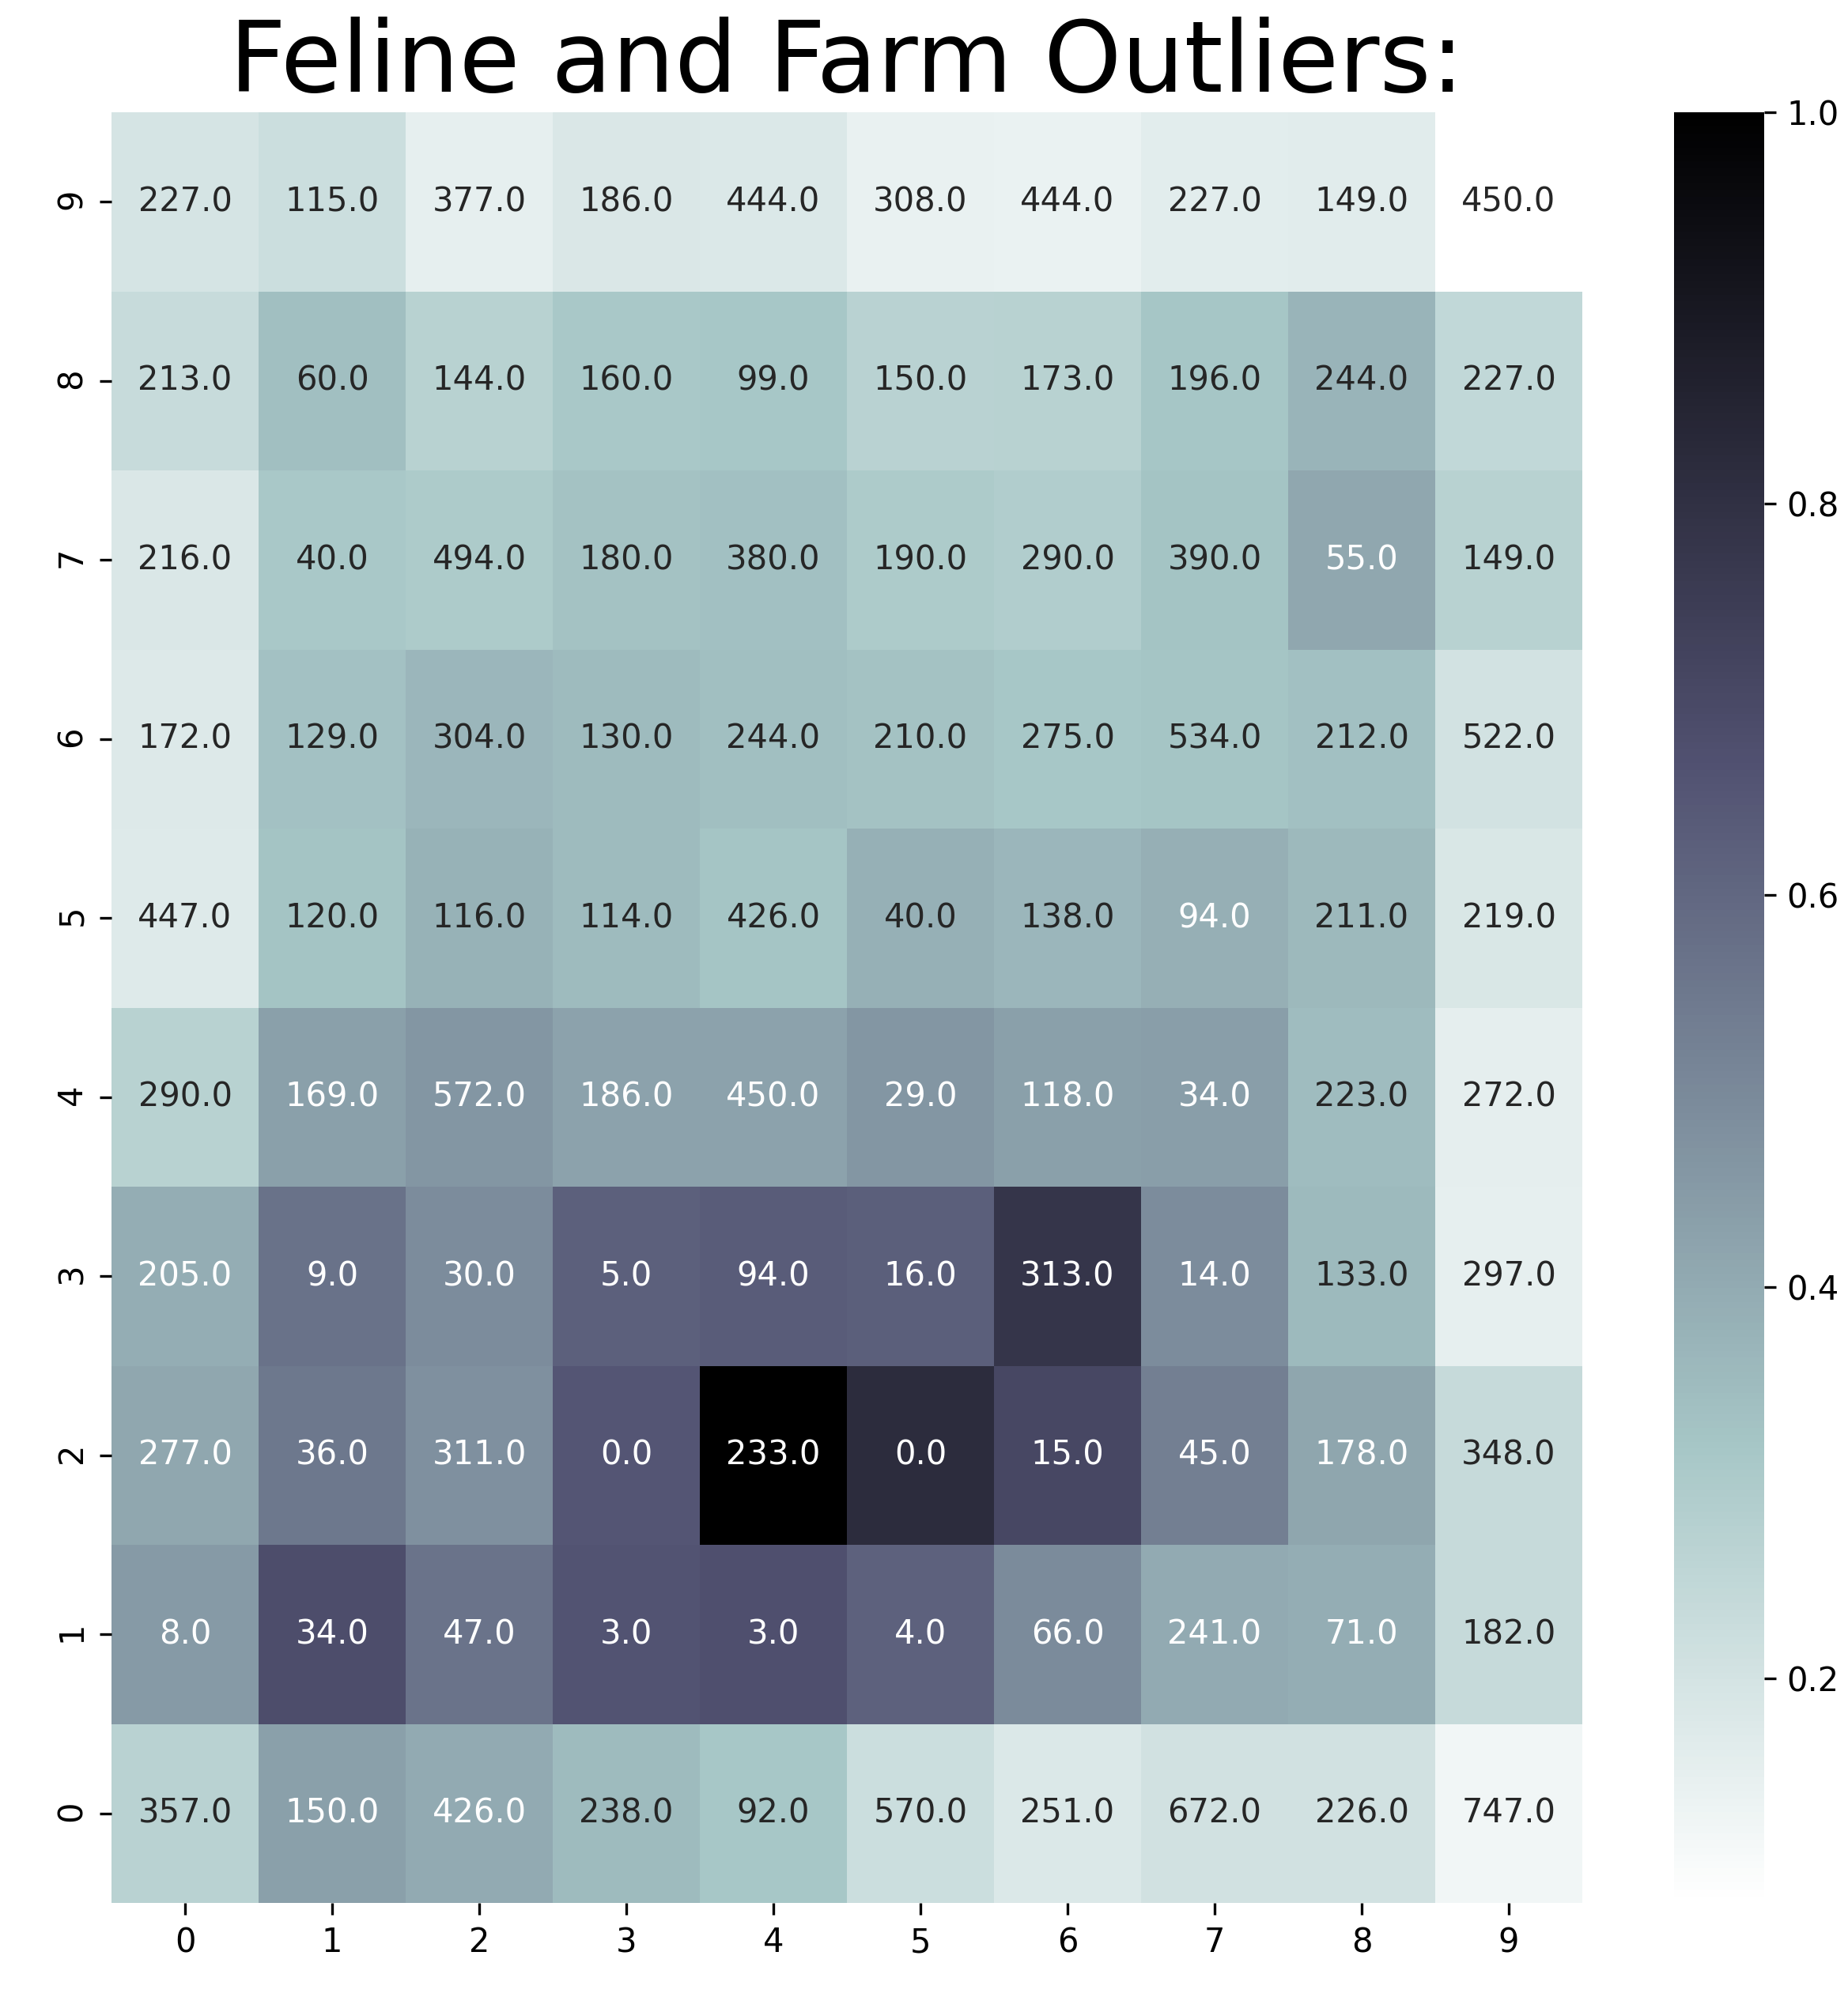
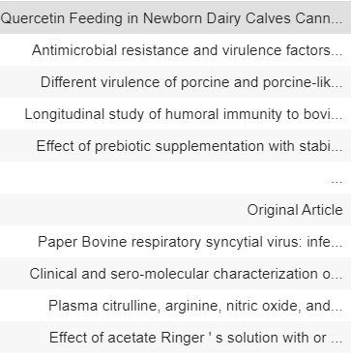
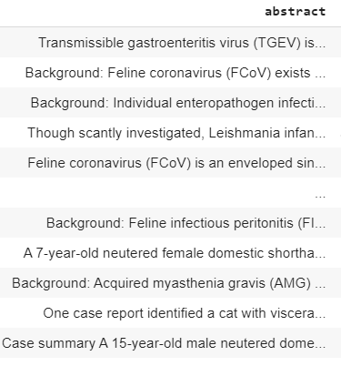
Feline
Farm
Title
Abstract
Top Words:
calv 31.184002
wa 5.876789
diarrhea 3.573408
farm 3.321499
day 2.773152
sampl 2.467682
studi 2.413066
infect 2.393480
anim 2.371733
Top Words:
cat 24.208439
wa 3.876159
infect 2.513393
thi 1.615182
studi 1.593770
sign 1.518701
diseas 1.490582

