Slide 1
Am I a Good on the Ball Defender?: Examining and Accounting for the Impact of Dribble Penetration in the NBA
Running Through the Six with my Woes (Team 6)

Slide 2
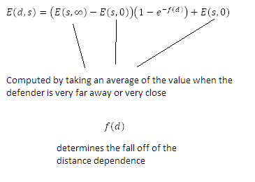

Chosen prompt: Develop a new method or tool for evaluation of defensive performance in the NBA. One of the most important things for an NBA defender is to prevent dribble penetration.
Therefore, a very natural measure for the efficacy of the defense of an NBA defender is the distance an offensive player is allowed to travel towards the hoop
[SLIDE 1]
Notes:
Theoretical Underpinnings:
One of the most important things for an NBA defender is to prevent dribble penetration so a very natural measure for the efficacy of the defense of an NBA defender is the distance an offensive player is allowed to travel towards the hoop while the NBA defender is serving as the primary defender. We can further extend this by indexing the distances from the hoop according to an expected value from a shot at each distance from the hoop. What is the intrinsic value at each position on the court to each expected value of a shot taken at a general location
Theoretical Underpinnings:
One of the most important things for an NBA defender is to prevent dribble penetration so a very natural measure for the efficacy of the defense of an NBA defender is the distance an offensive player is allowed to travel towards the hoop while the NBA defender is serving as the primary defender. We can further extend this by indexing the distances from the hoop according to an expected value from a shot at each distance from the hoop. What is the intrinsic value at each position on the court to each expected value of a shot taken at a general location

Slide 3
[SLIDE 2]
Consider a bin of size dx for shot distance and of size dy for defender distance;
As x varies from 0 to maximum shot distance:
As y varies from 0 to maximum defender distance:
Consider shots taken at distance x and x+dx and defenders at distance y and y+dy
Gradient = Number of points scored from this situation divided by total number of shots taken from this situation. Gradient represents the average number of points scored from a situation. It is calculated for all possible situations.
Boundary Conditions: We consider the expected value when defender distance 0 and the expected value when the defender distance goes to infinity.
After some empirical fitting, we obtain a working model that roughly agrees with intuition.

Slide 4
[SLIDE 3]
Predictions for Expected Values:
Shot Distance | Defender Distance | Expected Value
1 foot | 1 foot | 1.16 points
1 foot | 3 feet | 1.83 points
7 feet | 1 foot | 0.788 points
7 feet | 3 feet | 0.957 points
22 feet | 1 foot | 0.878 points
22 feet | 3 feet | 1.23 points
Predictions for Defensive Player Values:

Slide 5
[SLIDE 4]
What our model does not show:
Our model does not consider situations where a point guard or perimeter player is told to be aggressive on the perimeter, and allow the interior defender to worry about the paint.
How we can further this research:
Analytically fit the exponential function and eliminate free parameters.
Determine a curve for unguarded shots that can be represented mathematically.

