Slide 1
Dan's Frappuccino Paradise Creating a Website as a Team
Group 10
Keldon Boehmer – Scrum Master/Back-end Developer
Zachary Harrison – Project Manager
Jensen Judkins – Tester
Noah Knight – Front-end Developer

Slide 2
Design Decisions
The most significant design decision we made as a team was to use Django as the framework to host our database, server, and hook up our webpages.
We chose this framework because we all had previous experience using it.
This allowed us to have an easier time getting started in the development stage because we only needed to refamiliarize ourselves with the technology, rather than needing to learn an entirely new one.
Additionally, Django allowed us to easily implement user authentication and security via password encryption, as these are implemented in Django's official user model.

Slide 3
Improving Productivity
As our work on this project progressed, we took scrum practices more seriously. By the beginning of Sprint 3, we had a structure for our standup meetings, which allowed for shorter meetings with equal or more information delivered to the group.
We also began to plan our sprints by creating stories, dividing them into tasks, and assigning them to a specific team member to complete. This improved productivity because it allowed us to know specifically what we needed to work on. The division of stories into tasks helped us make steady progress day by day rather than cramming a large amount of work into a single session.
By the end of development, we had a solid system for communicating when tasks were completed by each member between using Discord and increasing descriptiveness of our Git commits. This helped us better understand the progress made by each team member outside of standup meetings.

Slide 4
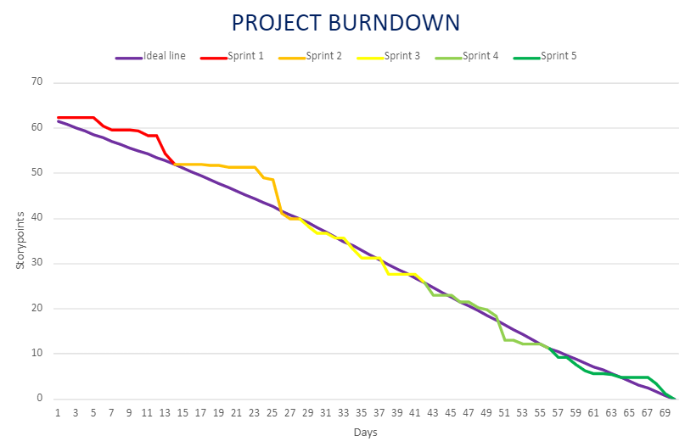
Final Burndown Chart

Slide 5
Project Deployment
All requirements of the application have been developed and tested for accuracy. They have all been committed to our Git repository, and the website is fully functional and ready for deployment.
The code for our application is correct and functions as intended. This is shown by all of our unit tests passing, as well as the videos we have made showcasing the functionality of some of the requirements of the application.
Our testing phase at the end of development was significantly shortened by our team's tendency to test our code as it was being written, rather than waiting until the end. The testing phase, included writing and executing unit tests to ensure accuracy. Because of our testing during development, there were only a handful of failures in the unit tests that were easily fixed.

Slide 6
Requirement 1 – Server and backend
Requirements:
Serve web-files and handle requests
Allow for login functionality
Handle Database
Bonus points but not required:
Ease of use
Ease of development
Unit testing features

Slide 7
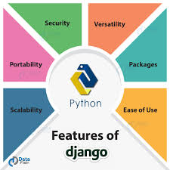
Requirement 1 –Server and Backend
Decision: Django – Python server project manager
Satisfies all project requirements as well as all bonus problems

Slide 8
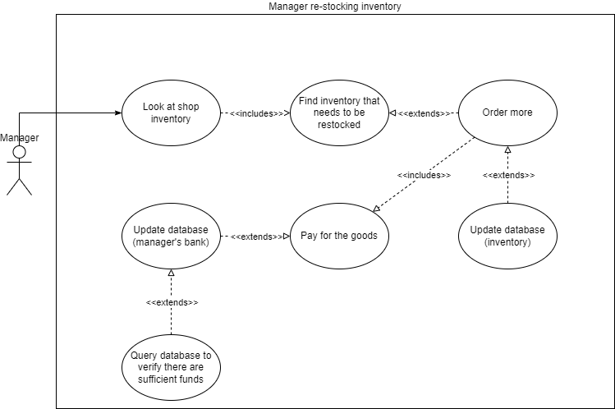
Requirement 1 –Server and Backend
Development and testing:
Server was set up on one of the first development phases by Noah with the low fidelity prototype
https://github.com/Zachary-Harrison/cs3450-group10/blob/main/docs/LowFidelityProtoInstructions.md

Slide 9
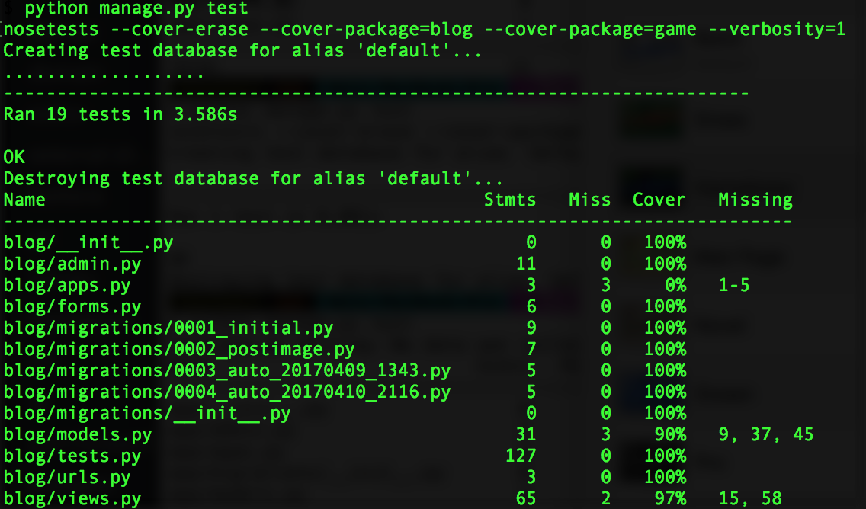
Requirement 1 –Server and Backend
Final product and testing:
Server successfully serves all web-files, accepts and processes POST requests for sending data, updates database items such as inventory and user passwords, and handles security by using clickjacking protection and password encryption.
Testing of the server and object handling with regards to the DB was done using the built in unit testing documentation in one of our last sprints. Unit testing creates data objects and saves them to DB, then tests all methods pertaining to that object, and finally scrubs the object from the DB when it is finished.
Example of unit testing

Slide 10
Requirement 2 – User classes and permissions
Requirements:
Users can create a login somewhere on the site
User login classes are one of three types: manager, employee, customer
Pages display different content depending on the User's role
Managers have full read and write access to User roles
Passwords should be encrypted when stored

Slide 11
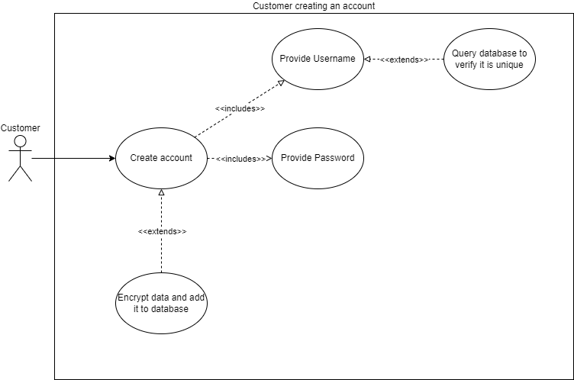
Requirement 2 - User classes and permissions
Design:
Use case diagram for creating an account
Once a user has created and account the manager can "promote" or "hire" that customer into Dan's Shop. This just changes their role in the DB from customer to employee.

Slide 12
Requirement 2 – User class and permissions
Development/Prototypes:
First working prototype code was pushed in pull request #58 Oct 6th.
Included registration page
Included login page
Encrypted passwords stored in DB
Missing a clean UI
Missing new pages to present once logged in
The only way to tell that you were logged in was if it didn't spit back an error that the password was wrong
Logout function missing
(ADD PICTURE OF OLD VERSION)

Slide 13
Requirement 2 –User class and permissions
Final development:
Testing:
Using Django's built in unit testing tools, we are able to test for all of the following remotely through a simple python script
User creation and DB saving
User login
Username changes
Logging actions taken by the user (I.E. creating an order, making a drink, logging hours, etc)

Slide 14
Requirement 3 - Taking and fulfilling drink orders
Requirements:
Be able to add ingredient stock through buying in manager portal
Create order objects attached to customer ID's
Add order to queue visible to employees
Employees see order objects and can fulfill them
Subtract from ingredient stock after making a drink
When drink is made, mark it as complete and remove it from queue

Slide 15
Requirement 3 - Taking and fulfilling drink orders
Design:
Use case diagram for checking and restocking inventory of ingredients

Slide 16
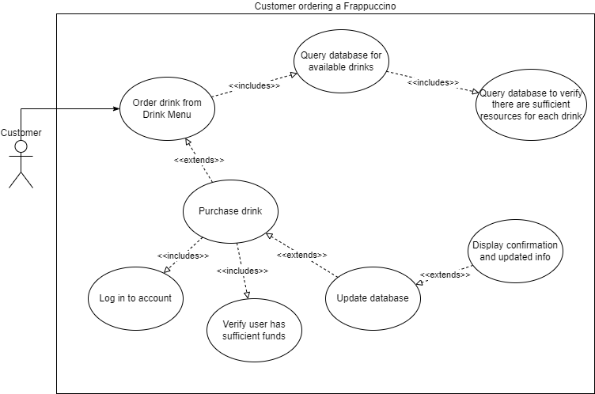
Requirement 3 - Taking and fulfilling drink orders
Design:
Use case diagram for a customer ordering a drink

Slide 17
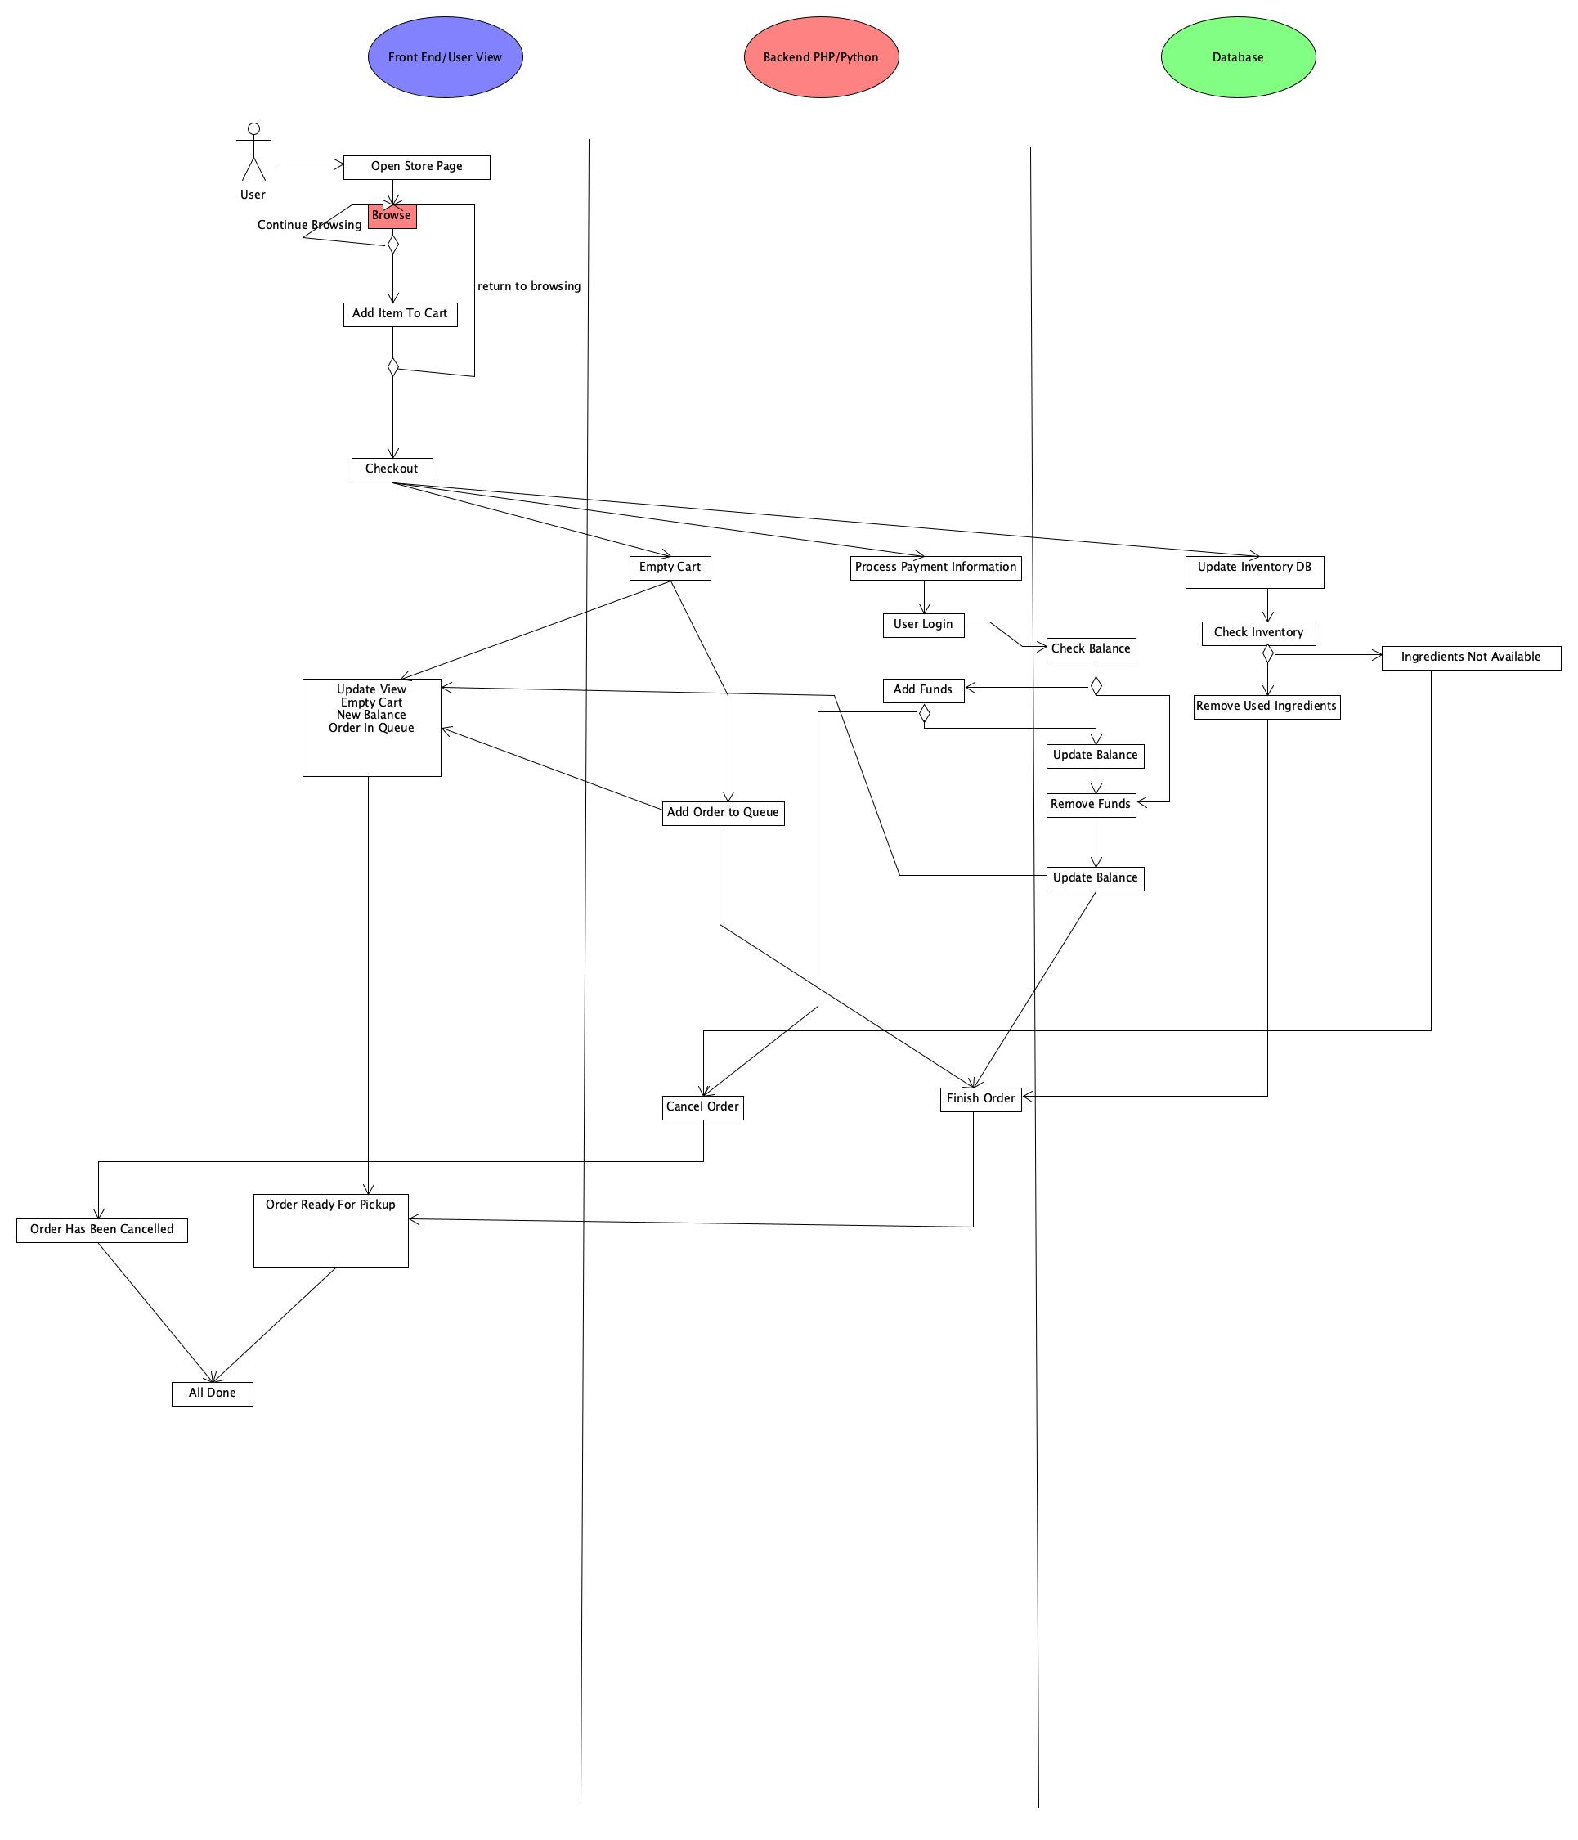
Requirement 3 - Taking and fulfilling drink orders
Design:
Complete activity diagram for a user ordering a drink. Includes interactions between front end, backend, and DB

Slide 18
Requirement 3 - Taking and fulfilling drink orders
Development:
We developed this in the last 2 sprints that we had as many of the functionalities were dependent on other factors.
Development for this portion was pretty easy as all the puzzle pieces were pretty much there it was just a matter of referencing our designs and placing those pieces into a working order.
See Milestone 3 for commits and pull requests referencing the finishing of this requirement.

Slide 19
References
https://docs.djangoproject.com/en/4.1/ref/models/fields/
https://docs.djangoproject.com/en/4.1/topics/auth/customizing/
https://docs.djangoproject.com/en/4.1/topics/db/queries/
https://www.geeksforgeeks.org/
https://www.w3schools.com/

Slide 20
QUESTIONS?

