Slide 1
DSA5205 / GROUP 18
Three signals. One monthly rotation rule.
Can simple price signals improve industry allocation?
An interpretable Ridge model, tested after costs against investable benchmarks.
Data
Features
Model
Portfolio
Evaluate
Daily prices
›
Known at signal
›
Fit + validate
›
Trade + fees
›
Compare OOS
Research question and workflow • Code: src/combined_momentum/
01
Notes:
Presenter: Member A. Explain question and economic intuition. A–C explain existing work; only D executes. See script A opening. Do not claim predictive superiority.

Slide 2
DSA5205 / GROUP 18
From daily prices to three monthly inputs
20 candidate ETFs | SPY benchmark only | Monthly decisions | USD
01 Recent trend
02 Relative strength
03 Realised risk
21 trading days
Log-price slope × 252
Percentile rank − 0.5
6-month price return
Clip at 1% / 99%
Percentile rank − 0.5
126 daily returns
Sample volatility × √252
Absolute units before scaling
Checks: unique records • positive prices • ≥95% coverage • ≥18 complete candidates
SMH before 21 Dec 2011 includes Semiconductor HOLDRS predecessor history.
Sources: Yahoo Finance snapshot; configs/final_us_industry_project.yaml; data.py; features.py
02
Notes:
Member A: show YAML, raw CSV, data.py validate_daily_prices and _annualized_log_price_slope; features.py build_model_table active branch. Raw dates 2007-01-03 to 2026-10-20; 104,601 rows, 21 symbols. Minimum 24-month history is full-sample eligibility, not a rolling wait. No commands. Return to slide 2.

Slide 3
DSA5205 / GROUP 18
Information first. Execution later.
31 Jan 2019
1 Feb 2019
1 Mar 2019
›
›
Signal after close
Enter at next close
Holding return ends
Target = next execution price / current execution price − 1
TRAIN
VALIDATE
TEST
Jul 2007–Dec 2014
Jan 2015–Dec 2018
Jan 2019–Dec 2025
Boundary rule: use a label only after its return is complete.
Dec 2014 excluded initially; Dec 2018 excluded before testing.
Source: data.py:to_monthly_prices • split.py:assign_splits • model.py:_available_model_samples
03
Notes:
Member A explains the first signal/entry/endpoint and shows saved model-table row. Member B reuses lower split strip: 1,780 candidate train, 940 validation, 2,740 final refit; Dec 2014 re-enters refit once known. Code checks return_date <= first validation/test signal.

Slide 4
DSA5205 / GROUP 18
Ridge controls complexity; validation chooses α
Scale
Ridge
Forecast
SELECTED α
›
›
0.1
Fit on past data
Shrink coefficients
Common ETF model
α grid: 0.01 · 0.1 · 1 · 10 · 100
Validation is weak
Select highest monthly rank IC;
break exact ties with lower MSE.
Rank IC −0.06764
R² +0.000448
Eligible observations: 1,780 fit → 940 validate → 2,740 final refit
scikit-learn solver: auto; saved fit: Cholesky • Final model frozen throughout testing
Source: model.py:make_ridge, fit_and_predict • alpha_validation.csv • validation_prediction_metrics.csv
04
Notes:
Member B only, no commands. Explain penalised least squares and StandardScaler. Show model.py make_ridge, availability filters and fit_and_predict sorting/refit. Saved alpha 0.1 ties IC with 0.01 but lower MSE. Show saved predictions model_fit; train/validation predictions train-only, test final refit. Seed 5205 configured; active fitting uses no stochastic sampling. Metadata records package versions.

Slide 5
DSA5205 / GROUP 18
Forecasts become a constrained portfolio
Forecast
Filter
Rank
Allocate
Score all 20 ETFs
›
Predicted return > 0
›
Select up to Top 5
›
20% per selected ETF
Fewer qualifiers? Keep cash.
Long-only. No leverage.
3 selections → 60% ETFs + 40% cash
All 84 test months held five ETFs.
Exact score ties: alphabetical ticker order • Overlapping ETFs can still concentrate risk.
Source: strategy.py:build_positions • Frozen outputs: positions.csv
05
Notes:
Member C: show strategy.py build_positions positive filter and 1/top_k target, then saved positions CSV. Explain no re-normalisation if fewer qualify, cash return zero. Targets are weights after fees. No pipeline execution.

Slide 6
DSA5205 / GROUP 18
Trade from drifted holdings. Pay fees from wealth.
Drift comes before trading
10 bp on every buy and sell
A winner grows above its old target.
Rebalance from actual current holdings.
Fees reduce investable wealth.
Targets apply after paying those fees.
TRANSACTION COST
NET HOLDING-PERIOD RETURN
c = 0.001
∑
|(1 − c)
w
target
−
w
pre
net
gross
|
r
=
(1 − c)(1 +
r
) − 1
i
i
i
c
Transaction fees / pre-trade wealth
r
gross
Holding return before fees
w
target
Target weight after fees
net
i
r
Holding return after fees
w
pre
Drifted pre-trade weight before trading
i
Turnover = buys + sells; no division by two. Initial fees included; no terminal sale.
Equal weight: 5% × 20, monthly rebalance | SPY: entry fee, then hold
Same execution dates and fee rate for all three investments.
Source: strategy.py:build_trades • backtest.py:_account_portfolio, run_backtest
06
Notes:
Member C: c is total ETF transaction fees divided by pre-trade wealth. w_target is the ETF weight as a fraction of wealth remaining after fees. w_pre is the drifted ETF weight immediately before rebalancing, as a fraction of pre-trade wealth. Sum is over ETFs. Gross return includes cash; net return includes the fee and its effect on investable wealth. Explain the intuition on slide 6, then show build_positions, build_trades and _account_portfolio in one continuous VS Code visit. Do not execute commands. Turnover counts buys plus sells without halving. No terminal liquidation. The equations are separated into two panels. Mathematical subscripts and superscripts are editable text objects. Sum over ETFs i. c is a fraction of pre-trade wealth; target weights are measured after fees and pre weights before trading. Gross return includes cash.

Slide 7
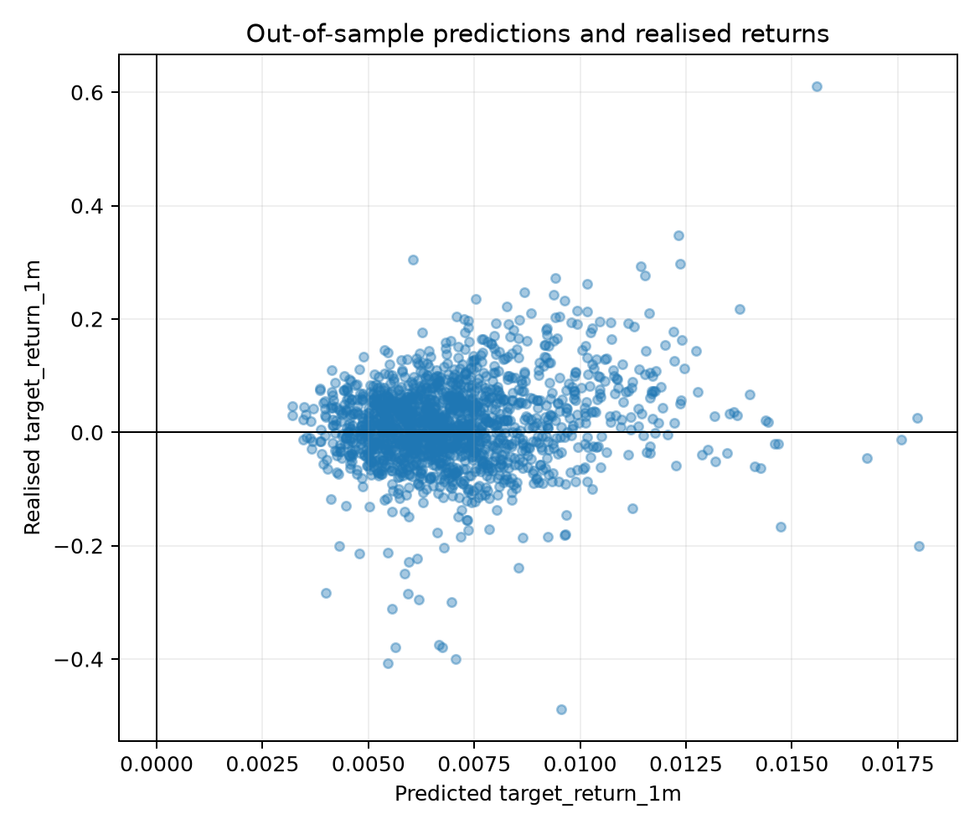
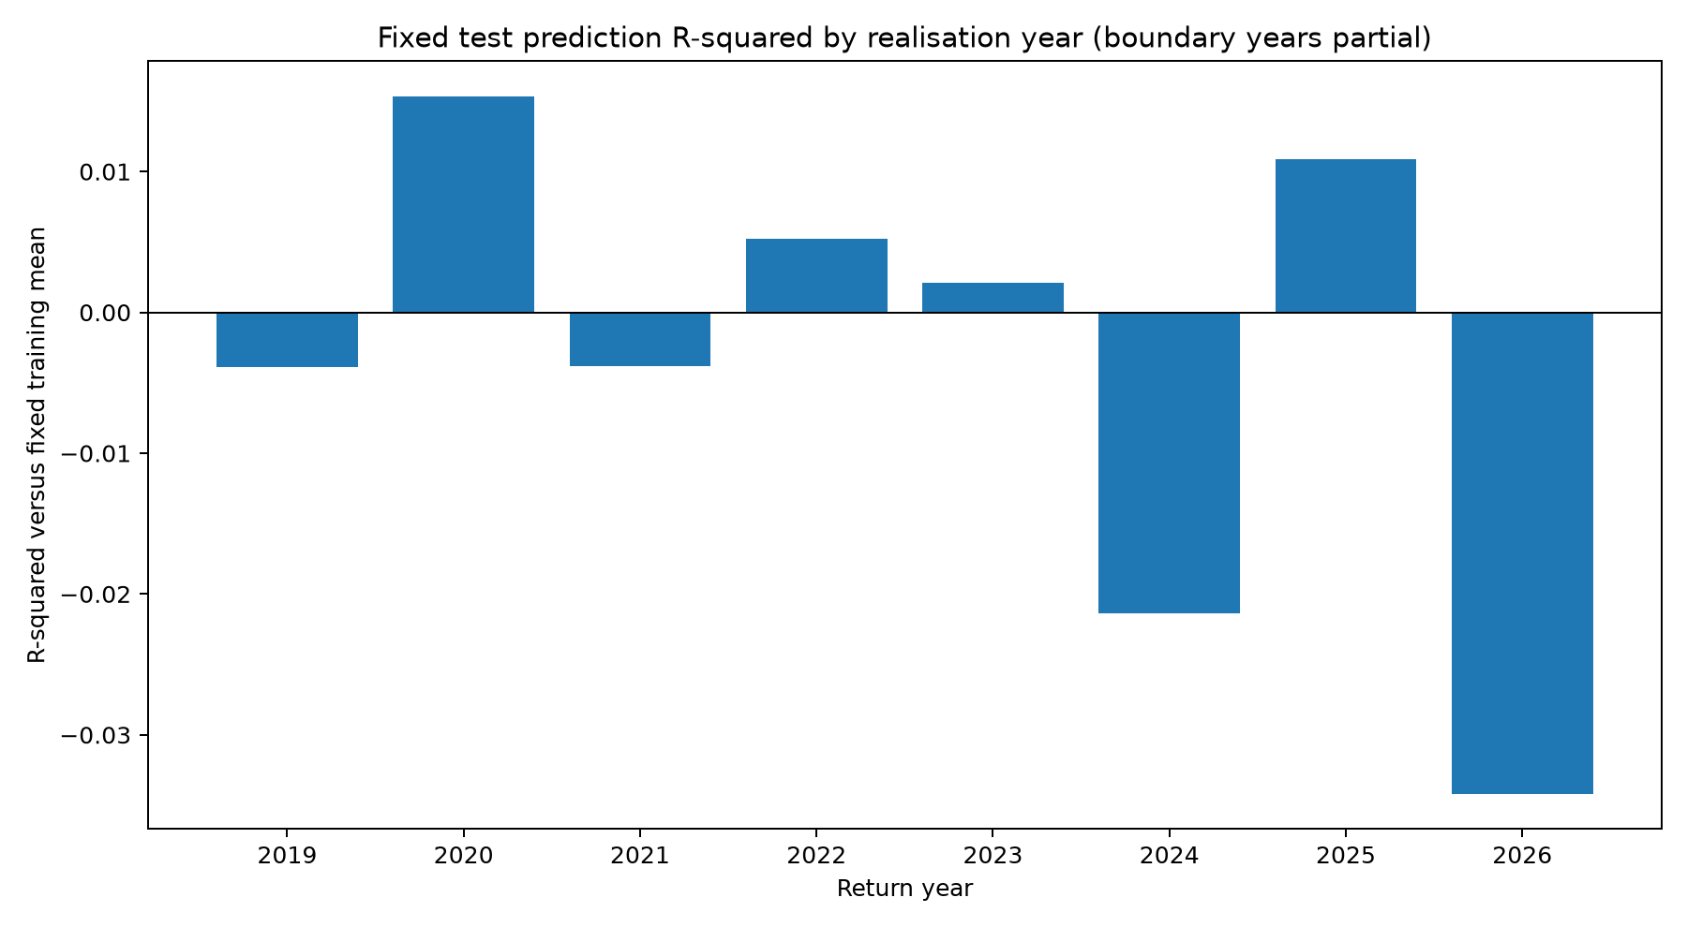
DSA5205 / GROUP 18
Forecast skill is small and unstable
Test R² +0.005713 | Monthly rank IC +0.019424 | 1,680 forecasts
R² compares squared error with a fixed historical training-mean forecast, not the test mean.
Source: frozen prediction_metrics.csv; annual_prediction_metrics.csv • Original saved PNGs, unchanged
07
Notes:
Member C: original figures embedded unmodified. For detailed labels, open frozen PNGs full size in VS Code. Narrow forecast range versus realised dispersion; annual R2 sign changes. 84 signal months, 20 ETFs. Validation IC negative, test weak positive. No significance claim. Member C: at 1920×1080 these embedded plots show the overall patterns, but small axis/legend text may be difficult to read. If any label is too small, open the unchanged full-size PNG test_prediction_scatter.png and test_prediction_r2.png from artifacts/20261024T155915Z_final_us_industry_project/figures/ in VS Code, hide sidebars and zoom as needed. Pre-open these tabs; do not recreate, crop, or resave the figures. Stay with figures/slides for performance interpretation; no routine CSV or code switching.

Slide 8
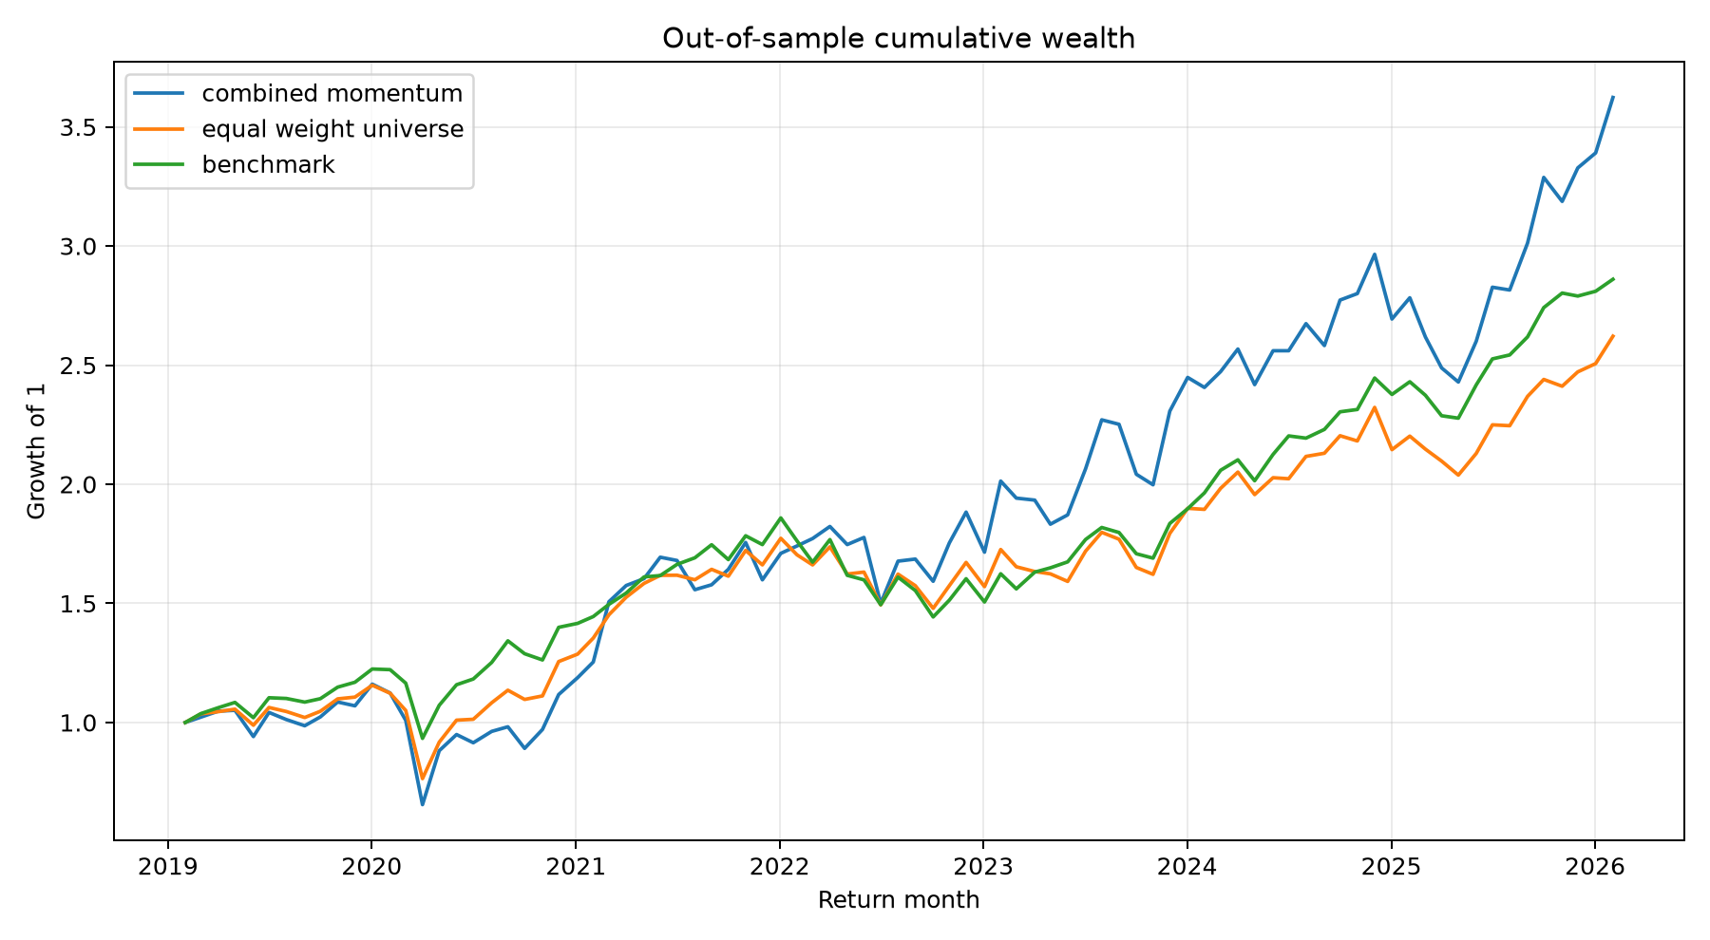
DSA5205 / GROUP 18
Higher growth, but lower Sharpe than SPY
Portfolio
CAGR
Volatility
Sharpe
Max drawdown
Strategy
20.19%
29.95%
0.771
−43.57%
Equal weight
14.76%
20.69%
0.775
−33.89%
SPY
16.20%
17.26%
0.962
−23.79%
3.6235 ×
Terminal wealth per initial unit
SPY: 2.8604 ×
Equal weight: 2.6214 ×
Holdings: Feb 2019–Feb 2026
Source: frozen metrics.csv and equity_curve.png • After costs • 84 signal months, Jan 2019–Dec 2025
08
Notes:
Member C: do not read every value. Compare growth, volatility and Sharpe. CAGR geometric with 12 periods/year; sample monthly std times sqrt12; Sharpe monthly mean/std times sqrt12, risk-free zero. Metric definitions are explained on the slide; no additional performance-code visit is needed. Actual holding horizon 2019-02-01 to 2026-02-02. Equal-weight 20.694995% rounds 20.69%. Member C: at 1920×1080 these embedded plots show the overall patterns, but small axis/legend text may be difficult to read. If any label is too small, open the unchanged full-size PNG equity_curve.png from artifacts/20261024T155915Z_final_us_industry_project/figures/ in VS Code, hide sidebars and zoom as needed. Pre-open these tabs; do not recreate, crop, or resave the figures. Stay with figures/slides for performance interpretation; no routine CSV or code switching.

Slide 9
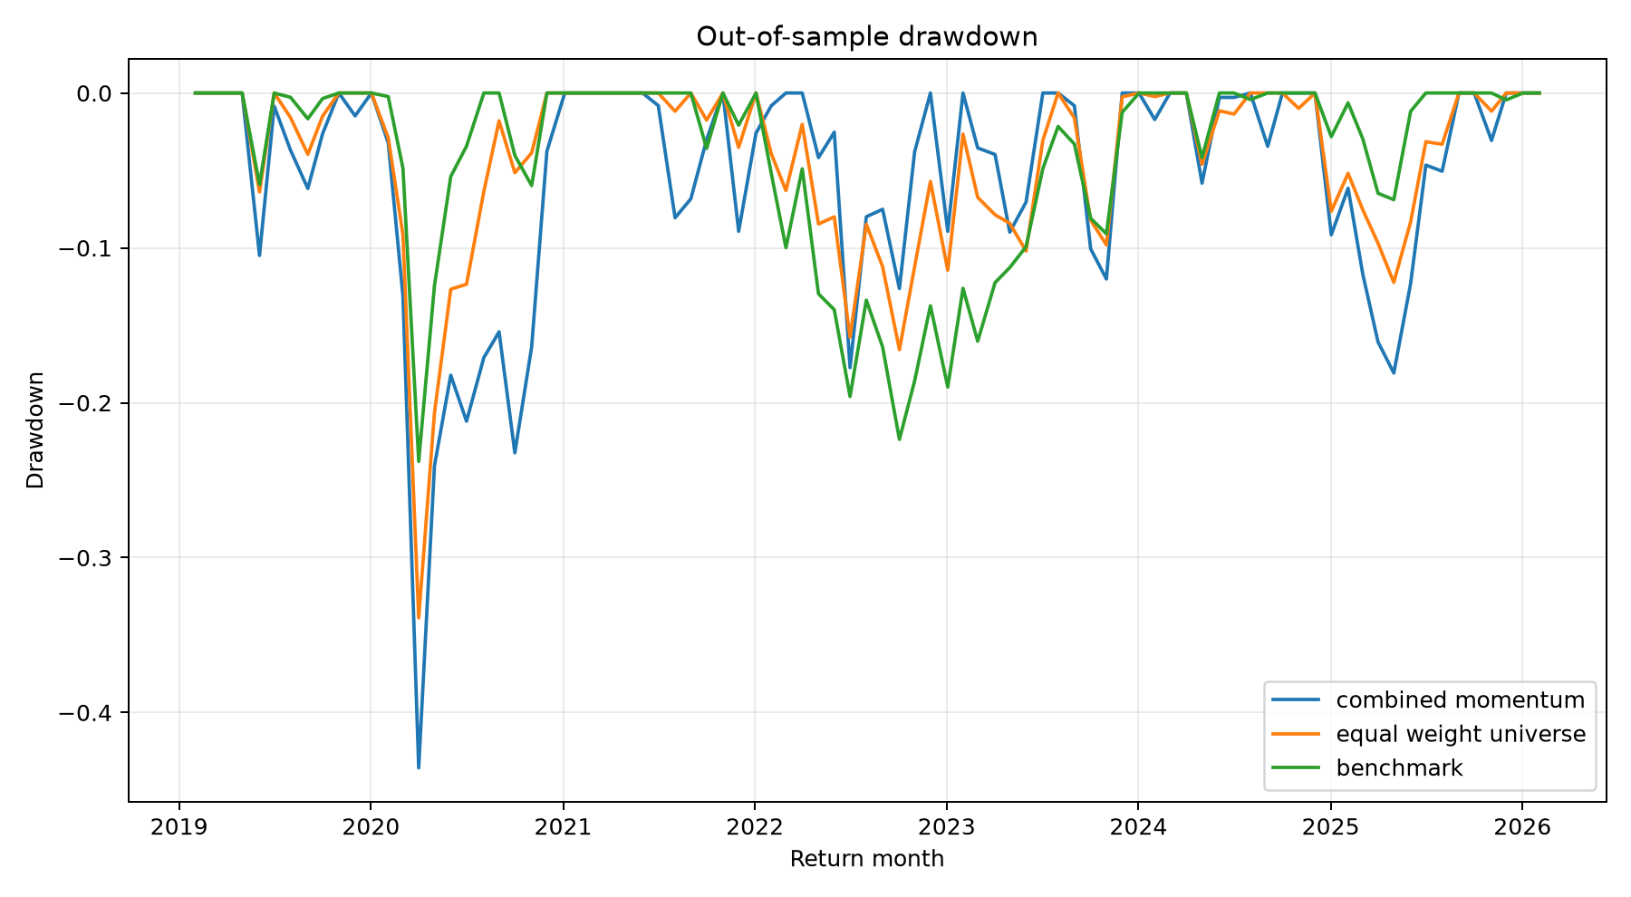
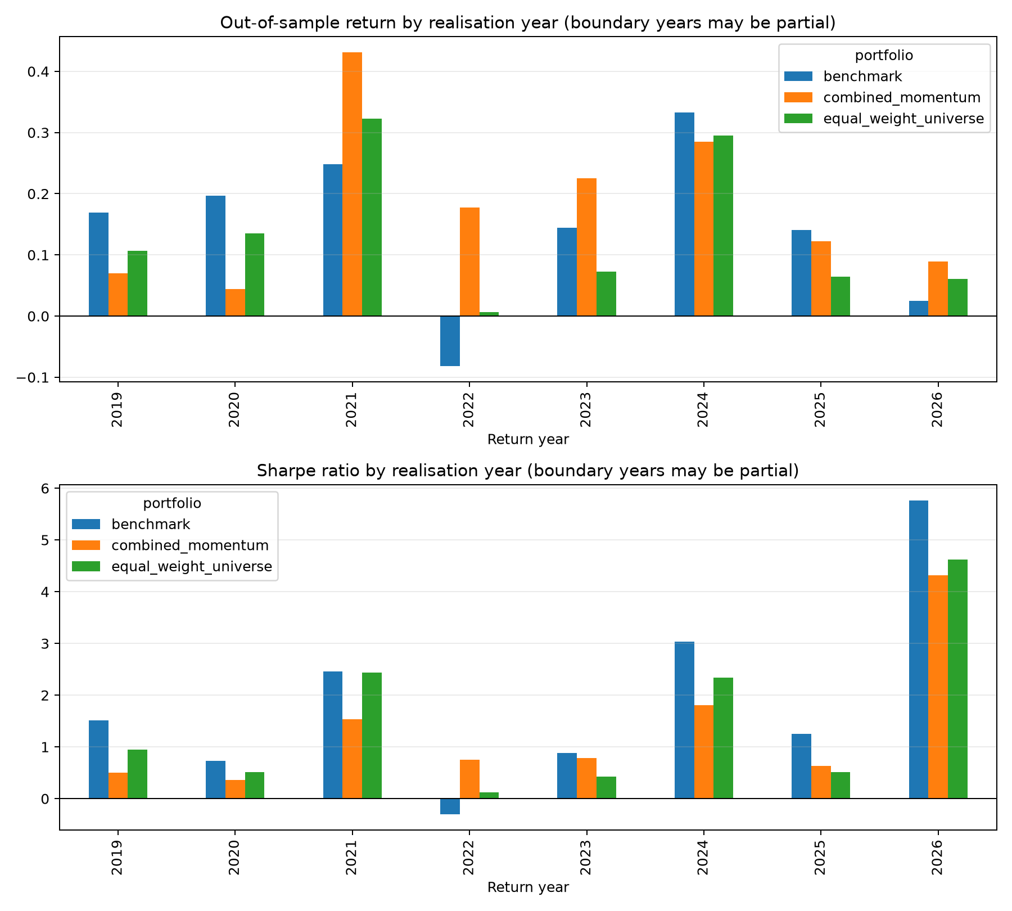
DSA5205 / GROUP 18
Drawdowns and period results expose the risk
−43.57% vs −23.79%
Strategy vs SPY sampled drawdown
Includes initial wealth; monthly endpoints.
Source: original drawdown.png and annual_performance.png • Annual groups use holding-period endpoint year
09
Notes:
Member C: annual PNG is tall; open the same existing PNG full size in VS Code while explaining its return and Sharpe panels. 2019 has 10 periods; 2026 has two, so Sharpe unstable. Groups are return_date.year, not conventional calendar-year investment returns. Strong relative strategy years 2022/2023, trails both in 2024. Drawdown observed monthly, not daily. Member C: at 1920×1080 these embedded plots show the overall patterns, but small axis/legend text may be difficult to read. If any label is too small, open the unchanged full-size PNG drawdown.png and annual_performance.png from artifacts/20261024T155915Z_final_us_industry_project/figures/ in VS Code, hide sidebars and zoom as needed. Pre-open these tabs; do not recreate, crop, or resave the figures. Stay with figures/slides for performance interpretation; no routine CSV or code switching.

Slide 10
DSA5205 / GROUP 18
A useful process; no established risk-adjusted alpha
01
02
03
Weak forecasts
Higher growth
More risk
Small test skill; negative validation IC.
Concentrated exposures and uneven periods.
Lower Sharpe and deeper losses than SPY.
Limits that matter
Retrospective universe + predecessor history • Vendor-adjusted prices
Idealised fills + constant fees • Fixed model + overlapping exposures
No factor attribution or proof of historical research independence
Source: MEMBER_C_HANDOFF.md; FINAL_US_INDUSTRY_UNIVERSE.md
10
Notes:
C concludes with higher compounded growth but weak forecasting and worse SPY risk-adjusted performance. No established risk-adjusted alpha; no statistically significant alpha claim. Explicitly hand over to D for actual end-to-end execution; A–C only explained source/saved outputs. D uses no slides.

