Slide 1
DSC 630 Term
Project Milestone 4
Zack DeNoto, Chris Goodwin, and Kenny Waite

Slide 2
Question/Hypothesis
“Can we predict the number of wins a college basketball team will have in a given year?”
Why?
How?

Slide 3
The Data
We will use Andrew Sundberg’s College Basketball Dataset found on Kaggle.
This dataset contains statistics about every NCAA Division I college basketball team from 2015 - 2020.

Slide 4
The Data
24 columns (Both numeric and categoricals)
Range from standard basketball statistics like turnover percentage and three point shooting percentage, to more complex analytic values like power rating and adjusted tempo

Slide 5
Exploratory Data Analysis
Initial analysis to identify relevant data points
Leverage relevant data points in an attempt to build an accurate prediction model for the number of wins
Our analysis will focus on years 2015-2019
Exclude 2020 from our model due to the COVID-19 pandemic

Slide 6
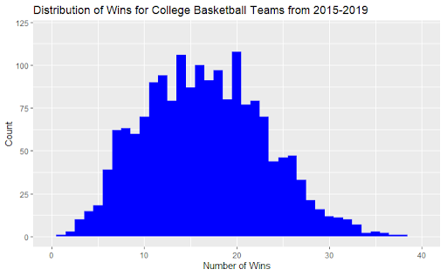
Exploratory Data Analysis - Target Variable
Target Variable - Wins
Symmetric with a slight positive skew
No data transformations needed

Slide 7
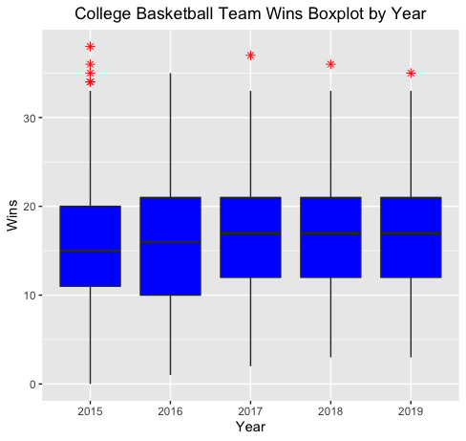
Exploratory Data Analysis - Number of Wins
Reviewed outliers and historical win data
Identified these totals as accurate and necessary for inclusion

Slide 8
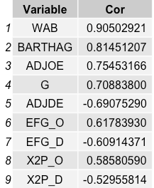
Exploratory Data Analysis - Feature Selection
Identified variables with a correlation greater than 0.50 or less than -0.50
These variables will be the focus of our modeling

Slide 9
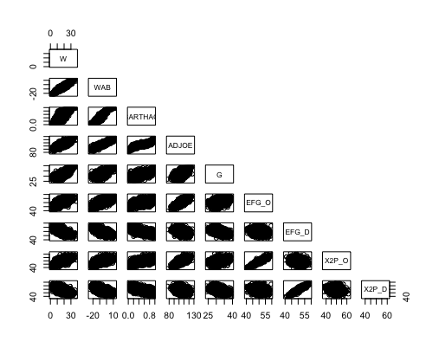
Exploratory Data Analysis - Feature Selection
Correlation matrix shows strength and direction of relationships

Slide 10
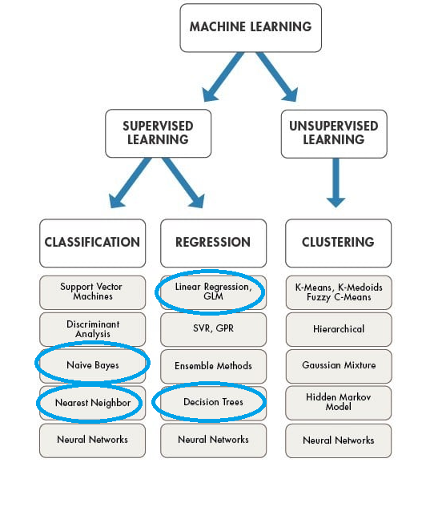
Modeling
K-Nearest Neighbor (KNN)
Naive Bayes
Random Forest
Ridge Regression

Slide 11
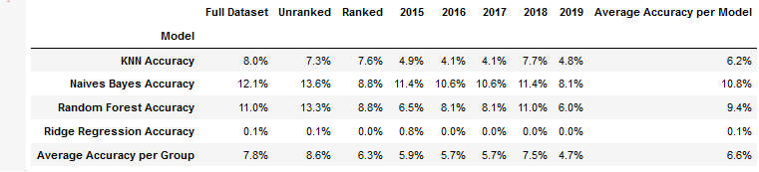
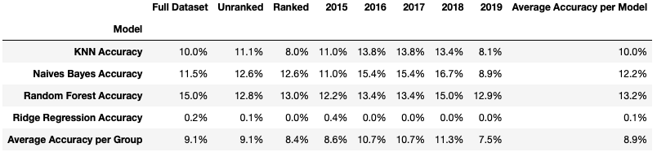
Preliminary Modeling Results

Slide 12
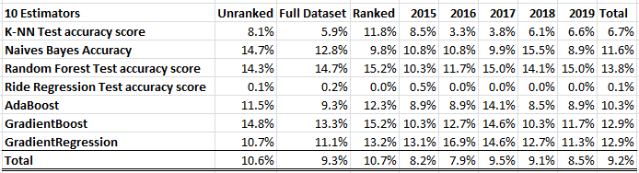
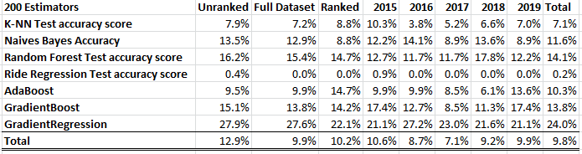
Adding Ensemble Techniques

Slide 13
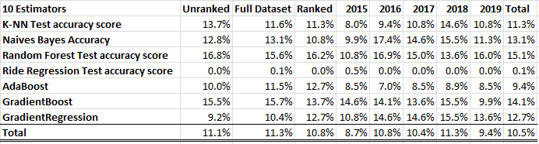
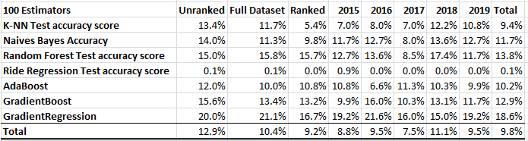
Adding Ensemble Techniques Continued

Slide 14
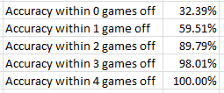
Results
Grouping Impact
Ensemble Impact
Best and worst accuracies

Slide 15
Conclusion and What’s Next
Exploratory data analysis broke down the data
Initial modeling accuracies improved when we only included the variables with high correlations
Boosting models improved overall accuracy substantially
Where do we go from here?

