Slide 1
DAMA: Data- and Model-aware Alignment of Multi-modal LLMs
Jinda Lu¹ Junkang Wu¹ Jinghan Li¹ Xiaojun Jia² Shuo Wang¹ Yifan Zhang³ Junfeng Fang⁴ Xiang Wang^{1*} Xiangnan He^{1*} ¹USTC ²NTU ³CAS ⁴NUS (ICML 2025)
Presented by Zezhao Guo

Slide 2
Introductions & Backgrounds
Trustworthiness Dimensions:
Groundedness: Response should be supported by input or external facts
Alignment: Response should be aligned with user’s safety policy
Consistency: Response should be consistent across different phrasing of prompts
Calibration: Response should be calibrated using uncertainty to reflect confidence
Interpretability: Response should be explainable to reveal model’s behavior
Fairness and unbiasedness: Response should treat all inputs fairly without bias
Groundedness is the most fundamental factor of trustworthiness. Without groundedness, even a consistent, fair, and well-aligned response might be completely untrue and filled with hallucinations.
Notes:
At first, I will introduce the six trustworthiness dimensions.
.....
Groundedness is the most fundamental factor of trustworthiness. Without groundedness, even a consistent, fair, and well-aligned response might be completely untrue and filled with hallucinations.
So hallucinations can be defined as generated content cannot be supported by input or external facts.

Slide 3

Connections with Persona Vector
Groundedness → “Hallucination” Persona
Alignment → “Evil” Persona
Consistency → “Sycophancy” Persona
Calibration → “Overconfidence/Overcautiousness” Persona
Interpretability → “Opacity” Persona
Fairness and biasedness → “Biasedness” Persona
What are the causes for these harmfulness personalities? --- Emergent Misalignment
How to avoid these harmfulness personalities? --- Representation Engineering

Slide 4
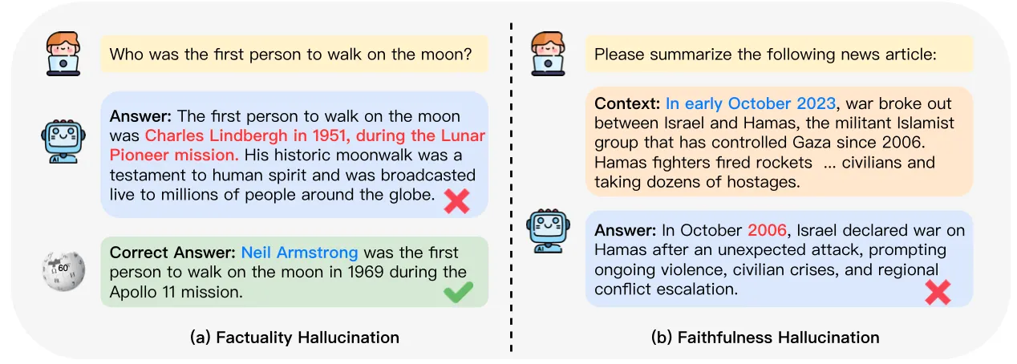
Hallucinations
Factuality hallucination (a.k.a. External hallucination): discrepancy (e.g. contradiction, fabrication) between generated content and verifiable real-world facts
Faithfulness hallucination (a.k.a. Intrinsic hallucination): self-inconsistency (e.g. context, logic) between generated content and user input evidence (e.g. instruction, context)
Notes:
After that, based on the definition of hallucinations, we can divide hallucinations into two categories
the first one is external hallucination ....
the second one is intrinsic hallucination ....
Below is an example of these two kinds of hallucination ...

Slide 5
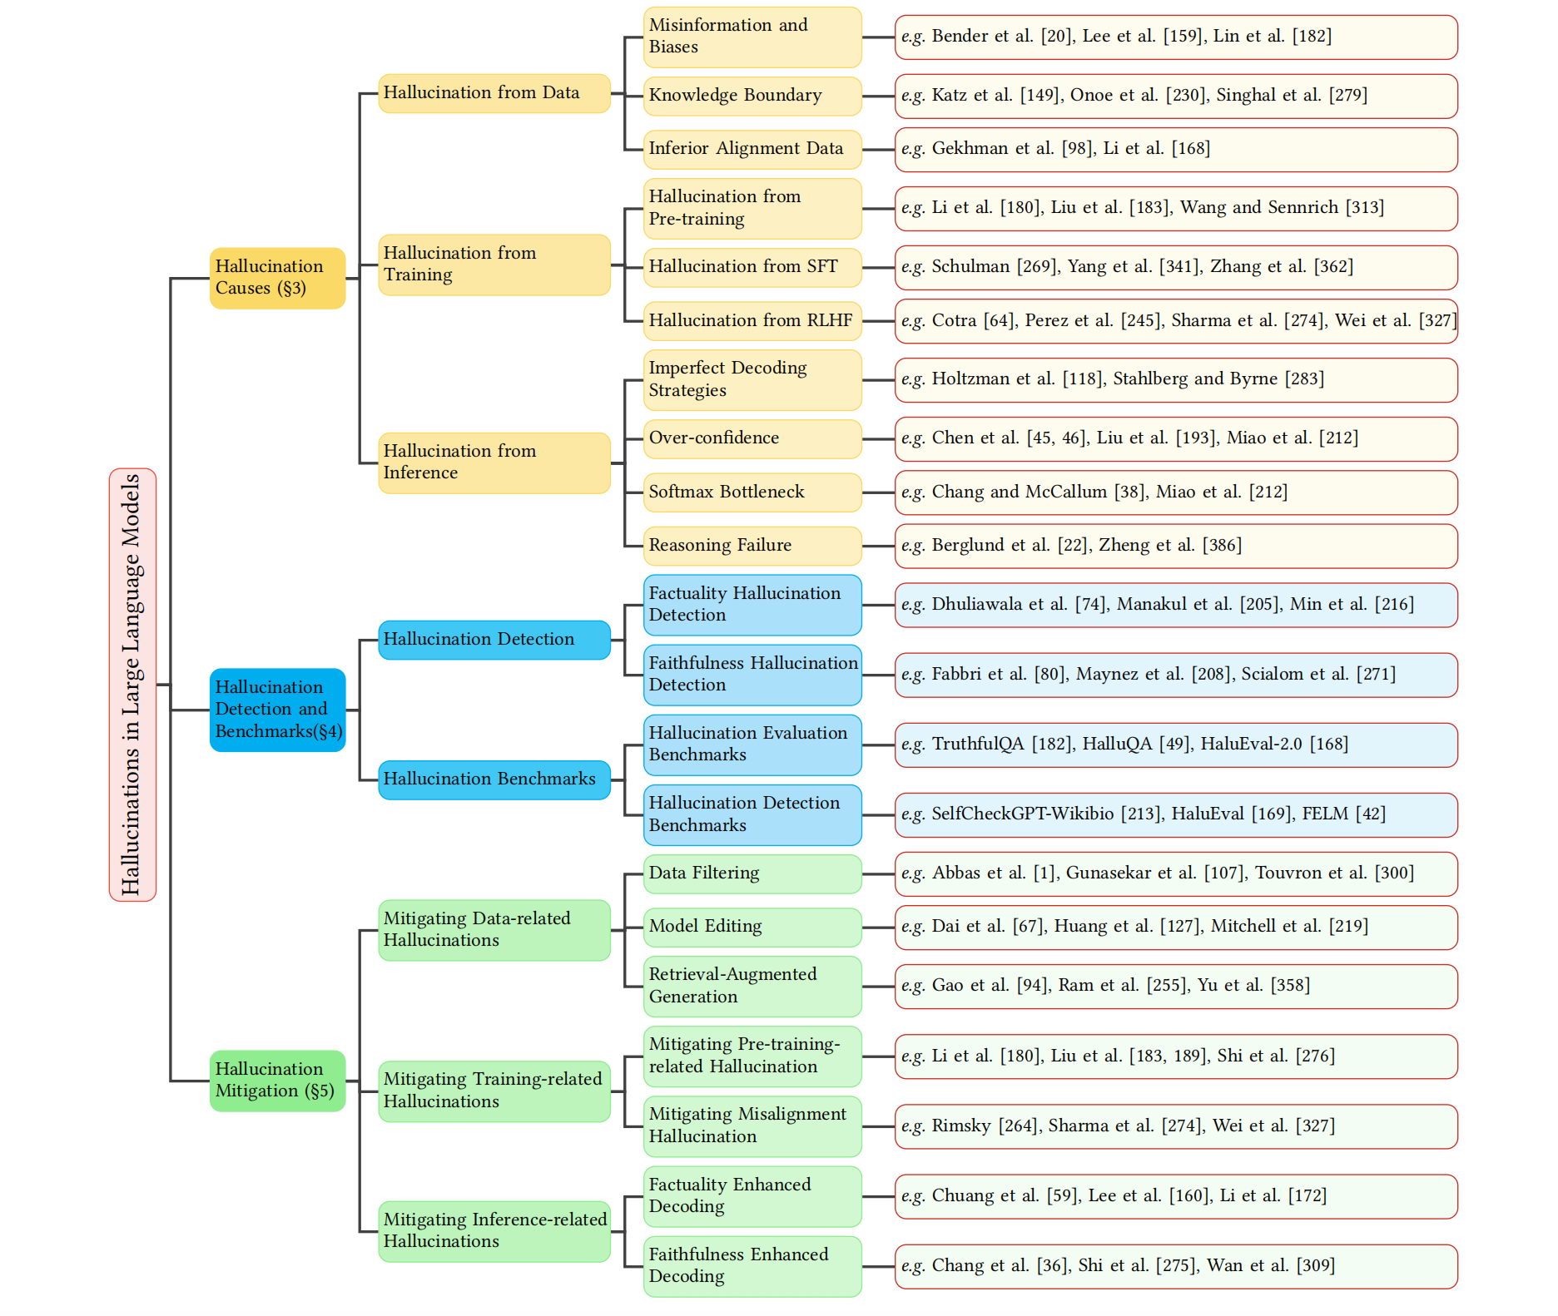
Hallucinations in LLM^{[1]}
[1] A Survey on Hallucination in Large Language Models
Notes:
So, to delve into the hallucination in LLM, we have to know the causes of hallucinations and how to detect, mitigate, and evaluate hallucinations.

Slide 6
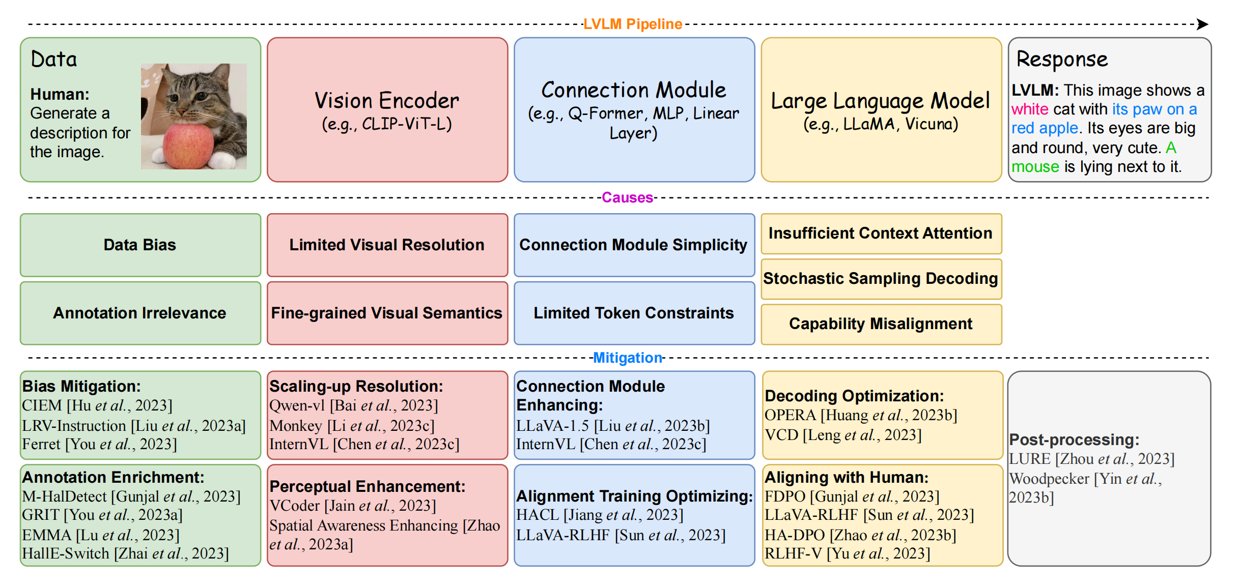
Hallucinations in LVLM^{[2]}
[2] A Survey on Hallucination in Large Vision-Language Models
Notes:
After understanding hallucinations in LLM, we can transition to hallucinations in LVLM.
This one is similar to hallucinations in LLM, but it invovles more additional modality-specific modules, introducing more complex causes of hallucinations and requiring more mitigation methods of hallucinations.

Slide 7
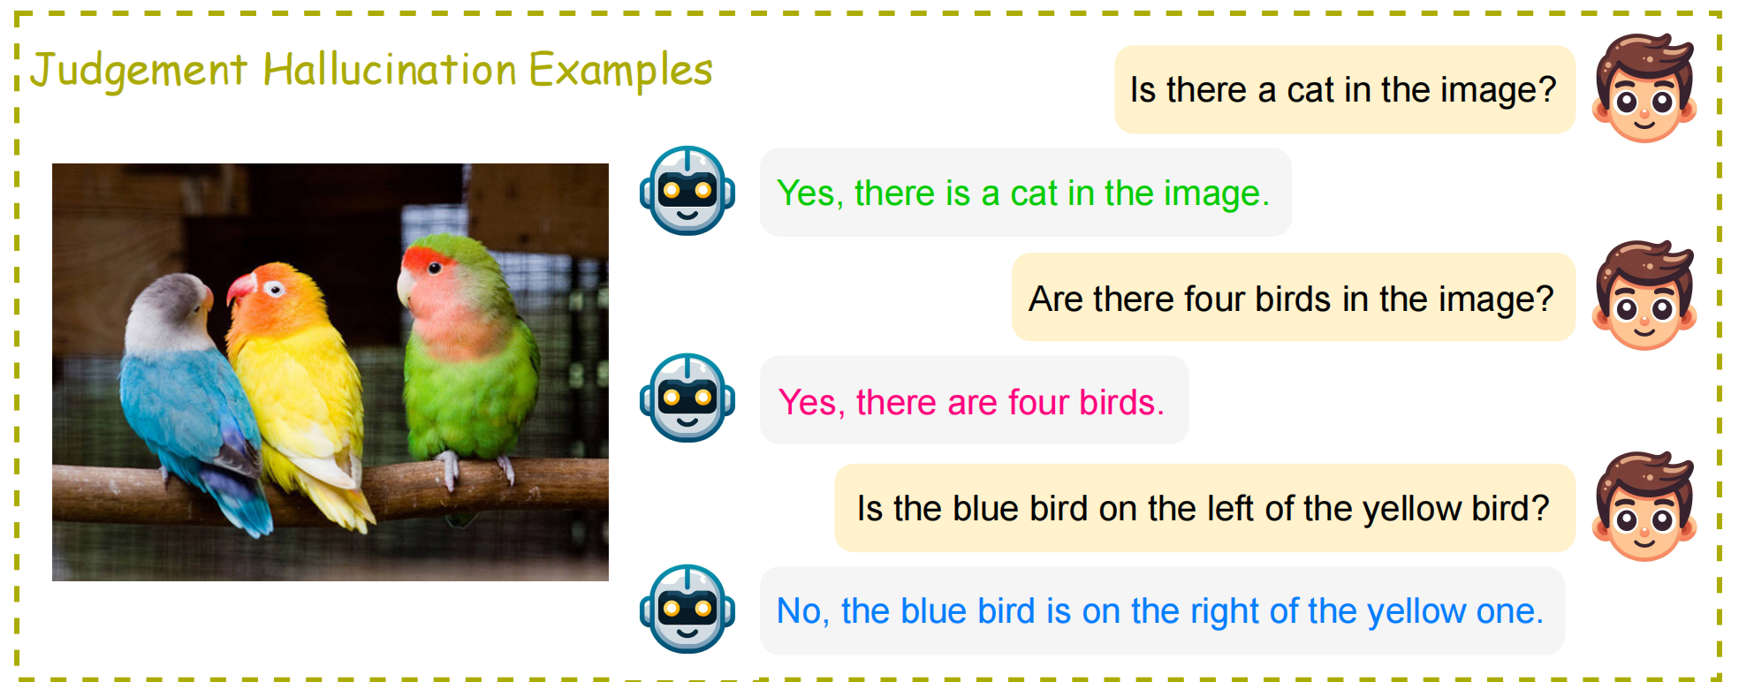
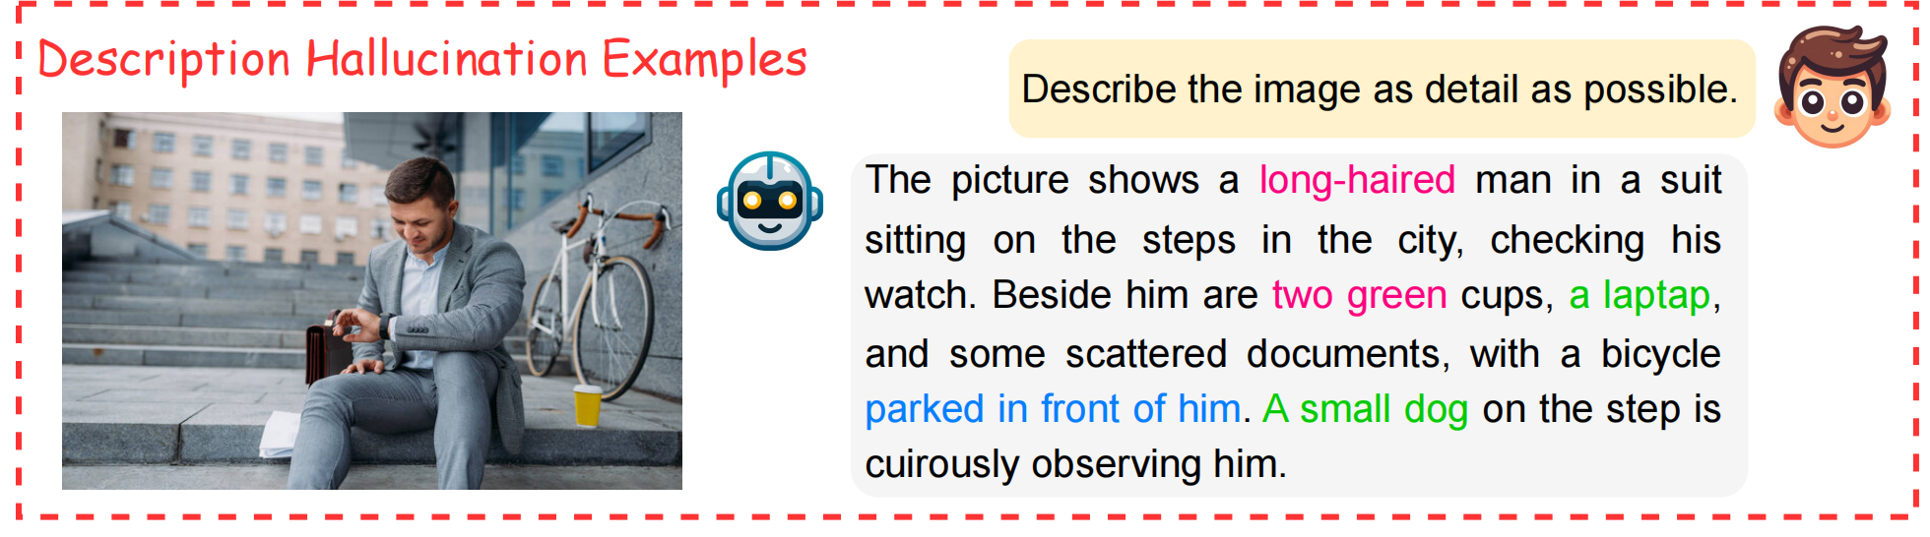
Faithfulness Hallucinations in LVLM^{[2]}
Judgement Hallucination: false judgements between generated textual content and factual content of the image, Easy to detect
Description Hallucination: inaccuracies in descriptions between generated textual content and factual content of the image, hard to detect
Image context
Image logic
Obejct-level Attribute-level
Relationship-level
[2] A Survey on Hallucination in Large Vision-Language Models
Notes:
Based on the type of instruction prompt, i.e., the type of dataset used for hallucination evaluation, we can divide faithfulness hallucinations in LVLM into two categories.
The first one is Judgement hallucination ...
The second one is Description hallucination ...
Below is an example of two kinds of hallucinations However, we can observe that these two kinds of hallucinations exist the imbalanced detection hardness. For example, judgement hallucination is usually easier to detect than description hallucination in this example

Slide 8
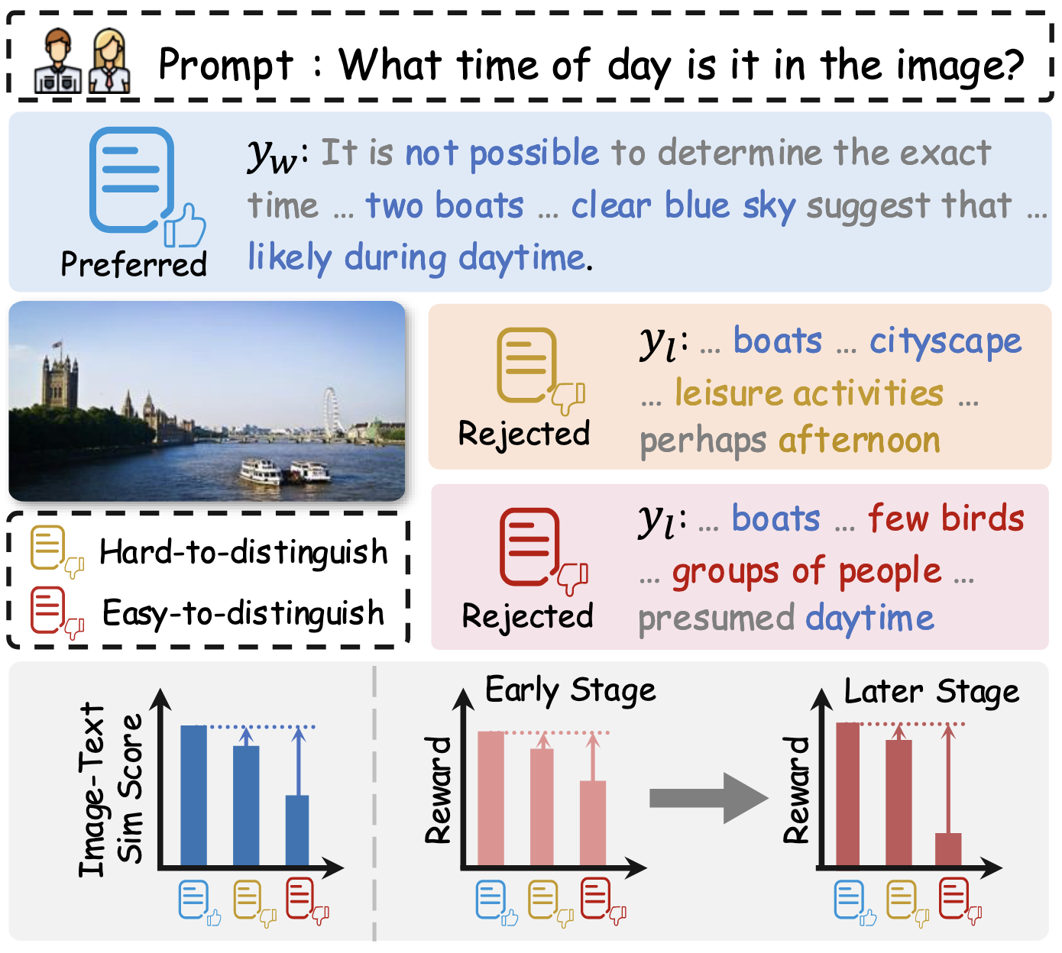
Motivations & Challenges
Imbalanced responsiveness in handling data with varying hardness during the optimization process
“Easy-to-distinguish” data:
Large Image-Text similarity score gap
Amplified reward gap→Stronger alignment
“Hard-to-distinguish” data:
Small Image-Text similarity score gap
Stagnated reward gap→Weaker alignment
“rich-get-richer” dynamic^{[3]}
[3]“rich-get-richer” dynamic (a.k.a Matthew Effect): strong responses get stronger and weak ones get weaker

Slide 9
Methods: Curriculum Learning
Formulation: Hardness Quantification
Data-aware Preference Optimization: CLIP-based Image-Text Score Gap
(1) Split into atom claims
(2) Calculate CLIP-score between the image and the atom claims
(3) Normalize the combined CLIP-score using the softmax function
(4) Caculate CLIP-score gap between preferred and rejected responses
Model-aware Preference Optimization: Implicit Reward Gap
(1) Calculate implicit reward gap bwteen the preferred and rejected responses
(2) Normalize the implicit reward gap using an estimated mean
(3) Filter out sensitive outliers of instances using a mask vector
Notes:
So, how to solve this imbalanced responsiveness caused by the large reward gaps from easy samples, which may lead the model to overfit to those easy cases, and the small reward gaps from hard samples, which may result in the model underfit to them?
The intuitive idea is to introduce the quantified instance-specific hardness into the model training process, i.e., curriculum learning allows the model to first learn from easy samples and then gradually incorporate harder ones.
In doing so, curriculum learning prevents a “rich-get-richer” dynamic—where strong responses get stronger and weak ones get weaker—and instead promotes a more balanced and stable learning process.

Slide 10
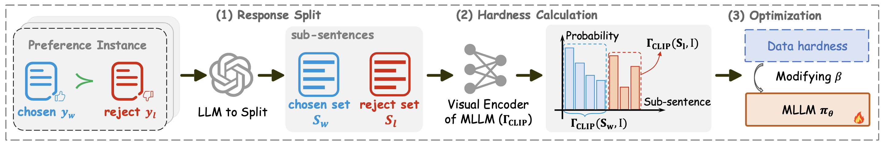

Data-aware Preference Optimization
(1) Split into atom claims
Given $\{(I,x,yw,yl)\}$~D, where $I, x, yw, yl$ denotes the image, question, preferred and rejected response, respectively.
To effective capture the similarity between the resposnes and the given image while alleviating the 77 token constraints in CLIP, we propose to prompt the LLaMA-3 to split $(yw,yl)$into atom claims$Sw=\{Sw,j|j=1,2,...p\}$and $Sl=\{Sl,k|k=1,2,...q\}$

Slide 11
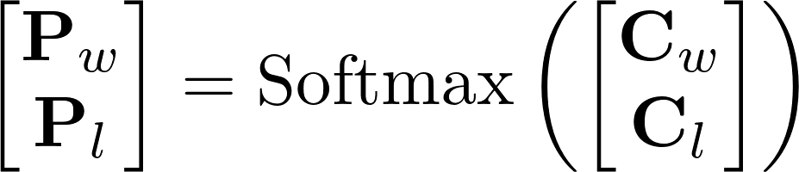
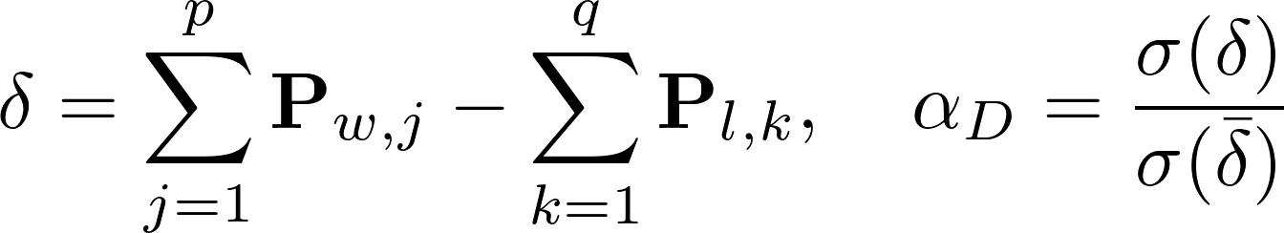
Data-aware Preference Optimization
(2) Calculate CLIP-score between the image and the atom claims
(3) Normalize the combined CLIP-score using the softmax function
(4) Caculate CLIP-score gap between preferred and rejected responses

Slide 12

Data-aware Preference Optimization
Incorporate the hardness into the optimization procedure
define the hardness based on the probability difference:
each reference instance corresponding to a specific β:
adapt β of DPO algorithm:

Slide 13
Methods: Curriculum Learning
Formulation: Hardness Quantification
Data-aware Preference Optimization: CLIP-based Image-Text Score Gap
(1) Split into atom claims
(2) Calculate CLIP-score between the image and the atom claims
(3) Normalize the combined CLIP-score using the softmax function
(4) Caculate CLIP-score gap between preferred and rejected responses
Model-aware Preference Optimization: Implicit Reward Gap
(1) Calculate implicit reward gap bwteen the preferred and rejected responses
(2) Normalize the implicit reward gap using an estimated mean
(3) Filter out sensitive outliers of instances using a mask vector

Slide 14
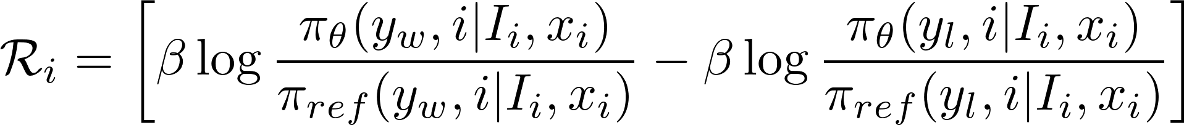
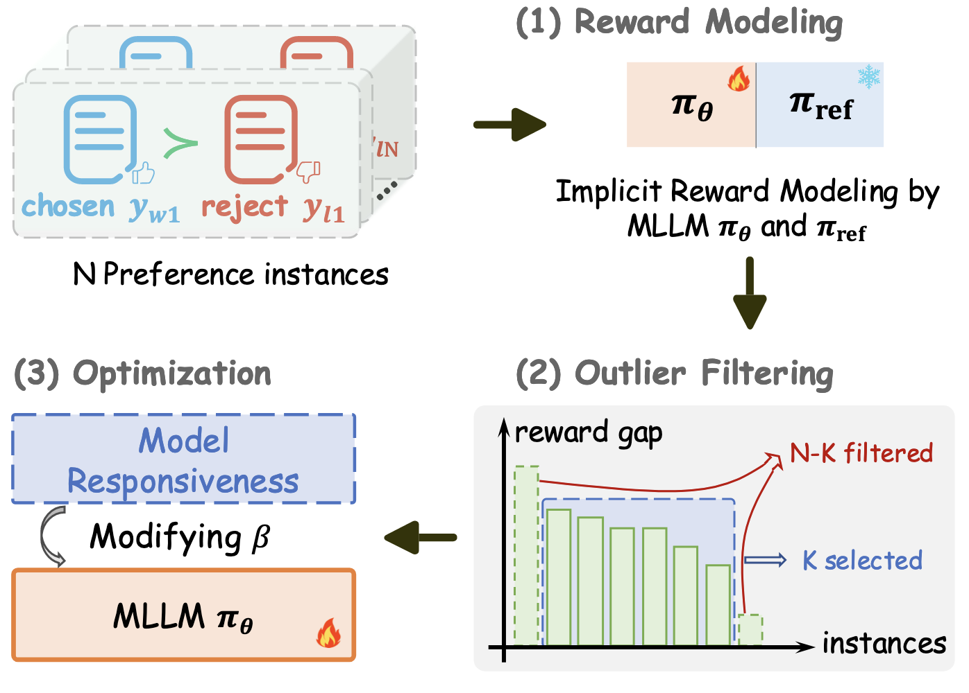

Model-aware Preference Optimization
A batch of preference instances from dataset
(1) Calculate implicit reward gap bwteen the preferred and rejected responses
Implicit reward gap R for the i-th instance in B:
(2) Normalize the implicit reward gap using an estimated mean

Slide 15
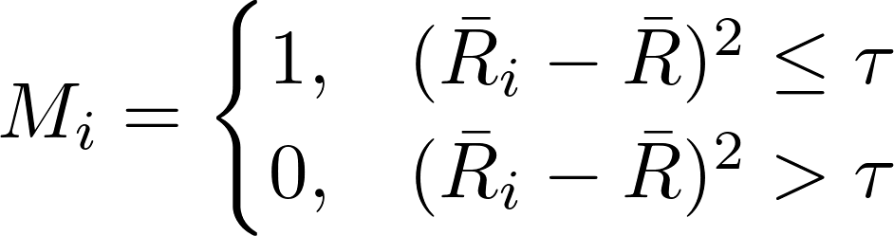
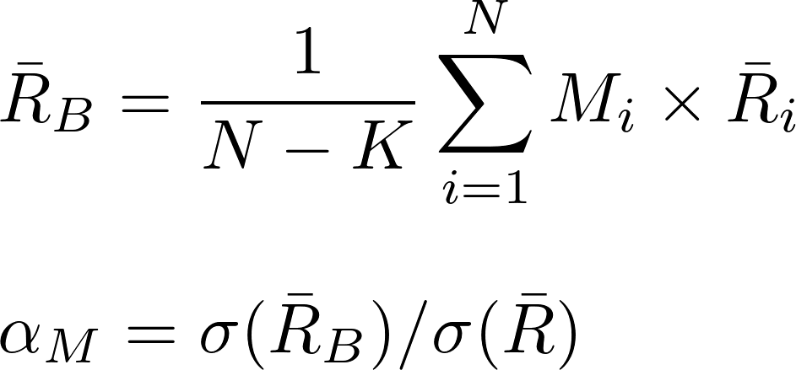

Model-aware Preference Optimization
(3) Filter out sensitive outliers of instances using a mask vector
filter out instances with exceptionally high or low gaps
current responsiveness of π_{θ}:
update the estimated mean using a moving average over batch

Slide 16

Model-aware Preference Optimization
Incorporate the hardness into the optimization procedure
define the hardness based on the implicit reward gap:
each reference instance corresponding to a specific β:
adapt β of DPO algorithm:

Slide 17


Element-wise Combination Strategy
To facilitate the optimization process to be both data- and model-aware, we combine α_{D} and α_{M} as:
Each reference instance corresponding to a specific β:
Adapt β of DPO algorithm:

Slide 18
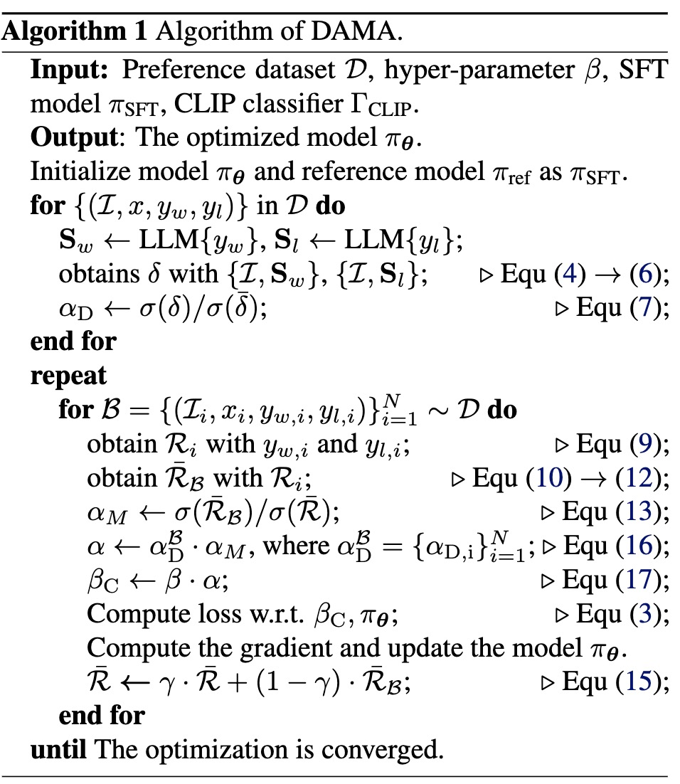
Data-aware
Recap of DAMA Algorithm
Model-aware
Element-wise combination

Slide 19
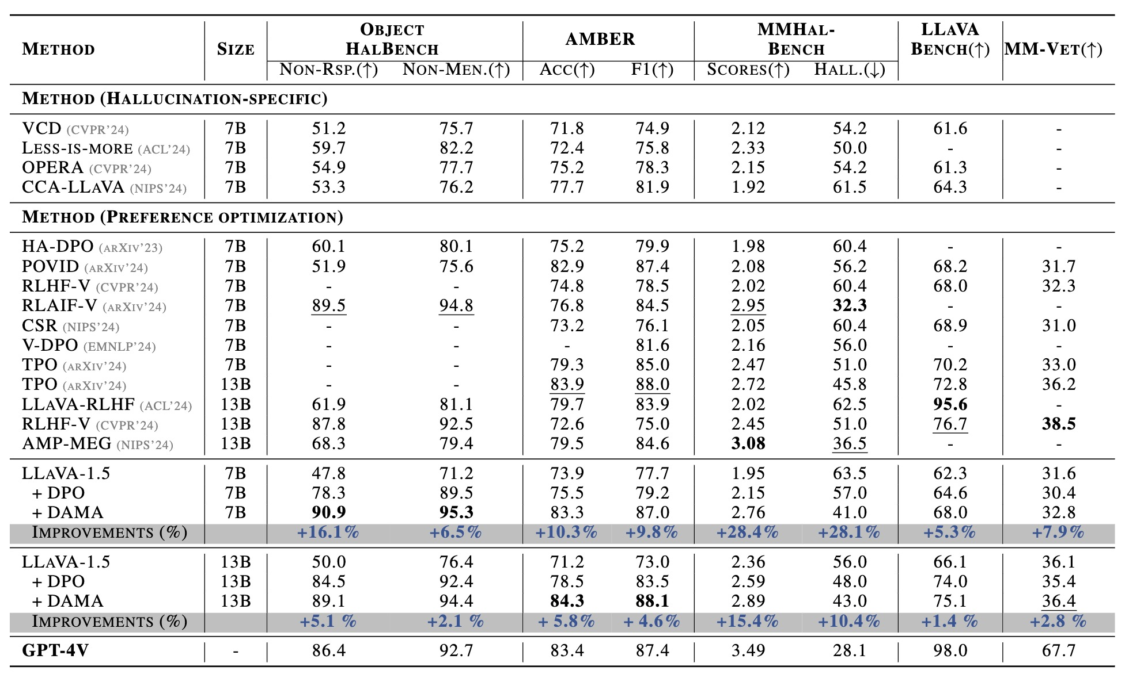
Experiments
Comparisons with state-of-the-art methods
Compared to DPO, DAMA achieves substantial performance improvements over all benchmarks

Slide 20
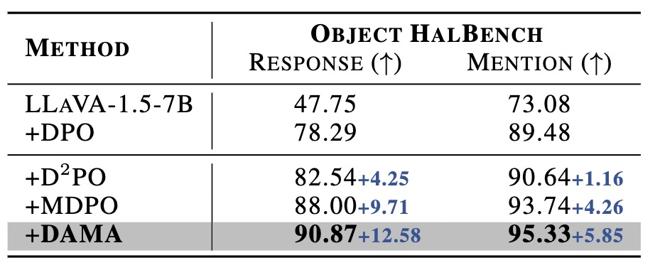
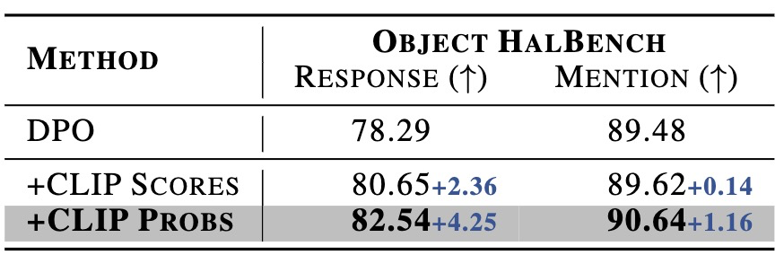
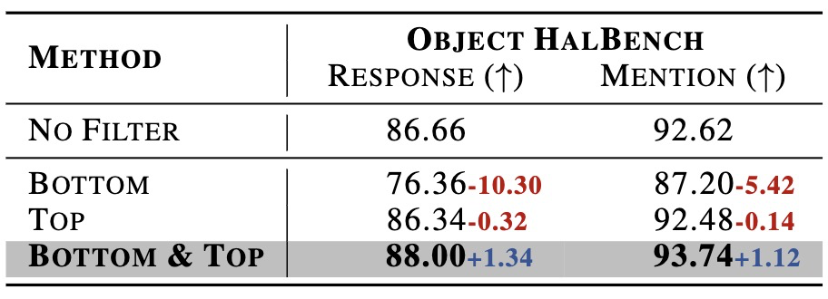
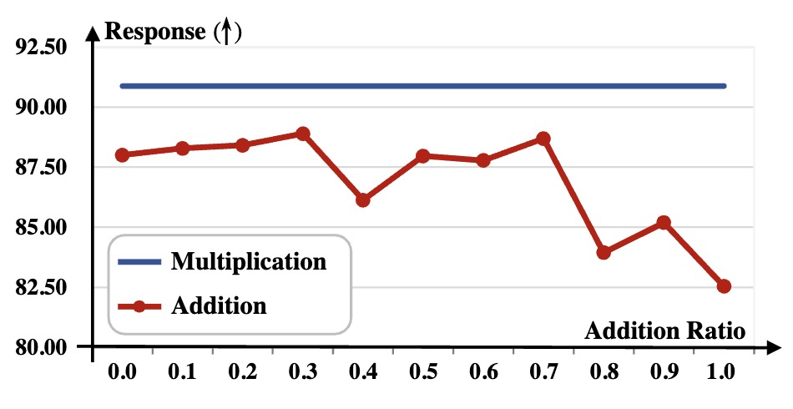
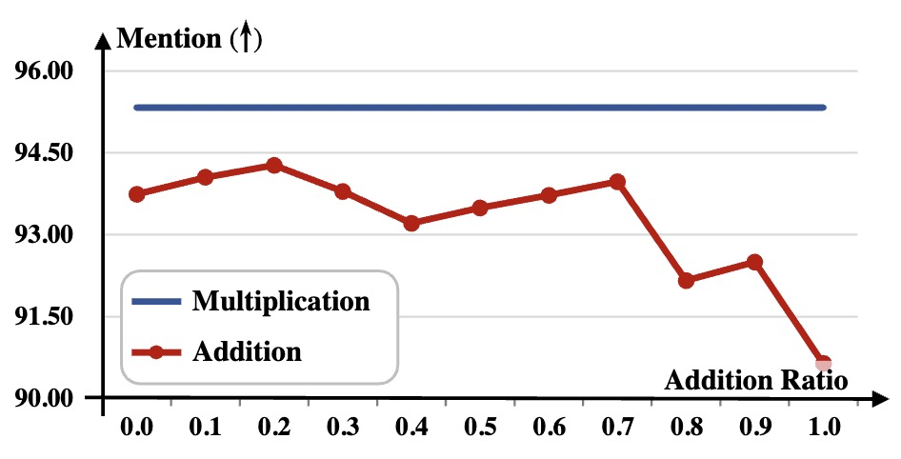
Experiments
Ablation Studies
results of different components of DAMA
results of different preference inconsistency construction strategies
results of different filtering strategies
results of the element-wise combination strategies

Slide 21
Conculusions
We propose Data- and Model-aware Direct Preference Optimization (DAMA) to adaptively adjust the model’s learning behavior from two aspects:
A data-aware strategy is proposed to dynamically adapt by incorporating the data hardness
A model-aware strategy is introduced to adaptively adjust by integrating the model's real-time responsiveness
Extensive experiments on five benchmarks from distinct aspects demonstrate the effectiveness of our method

