Slide 1

Mitigating Object Hallucinations in Large Vision-Language Models through Visual Contrastive Decoding
Sicong Leng^{1,2,*} Hang Zhang^{1,3,*} Guanzheng Chen^{1,3} Xin Li^{1,3,†} Shijian Lu² Chunyan Miao² Lidong Bing^{1,3}
¹DAMO Academy, Alibaba Group ²Nanyang Technological University ³Hupan Lab, 310023, Hangzhou, China
(CVPR 2024 Highlight)
Presented by Zezhao Guo

Slide 2
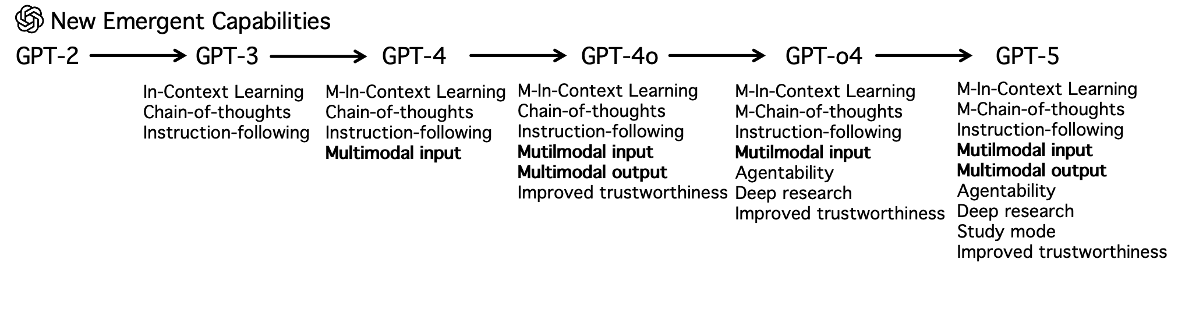
Backgrounds
From GPT-2 to GPT-5, the evolution of large foundation models (LFM) emerges new capabilities.
To achieve Aritificial General Intelligence (AGI), one of indispensable capabilities is the expansion of input and output modalities.
₁

Slide 3
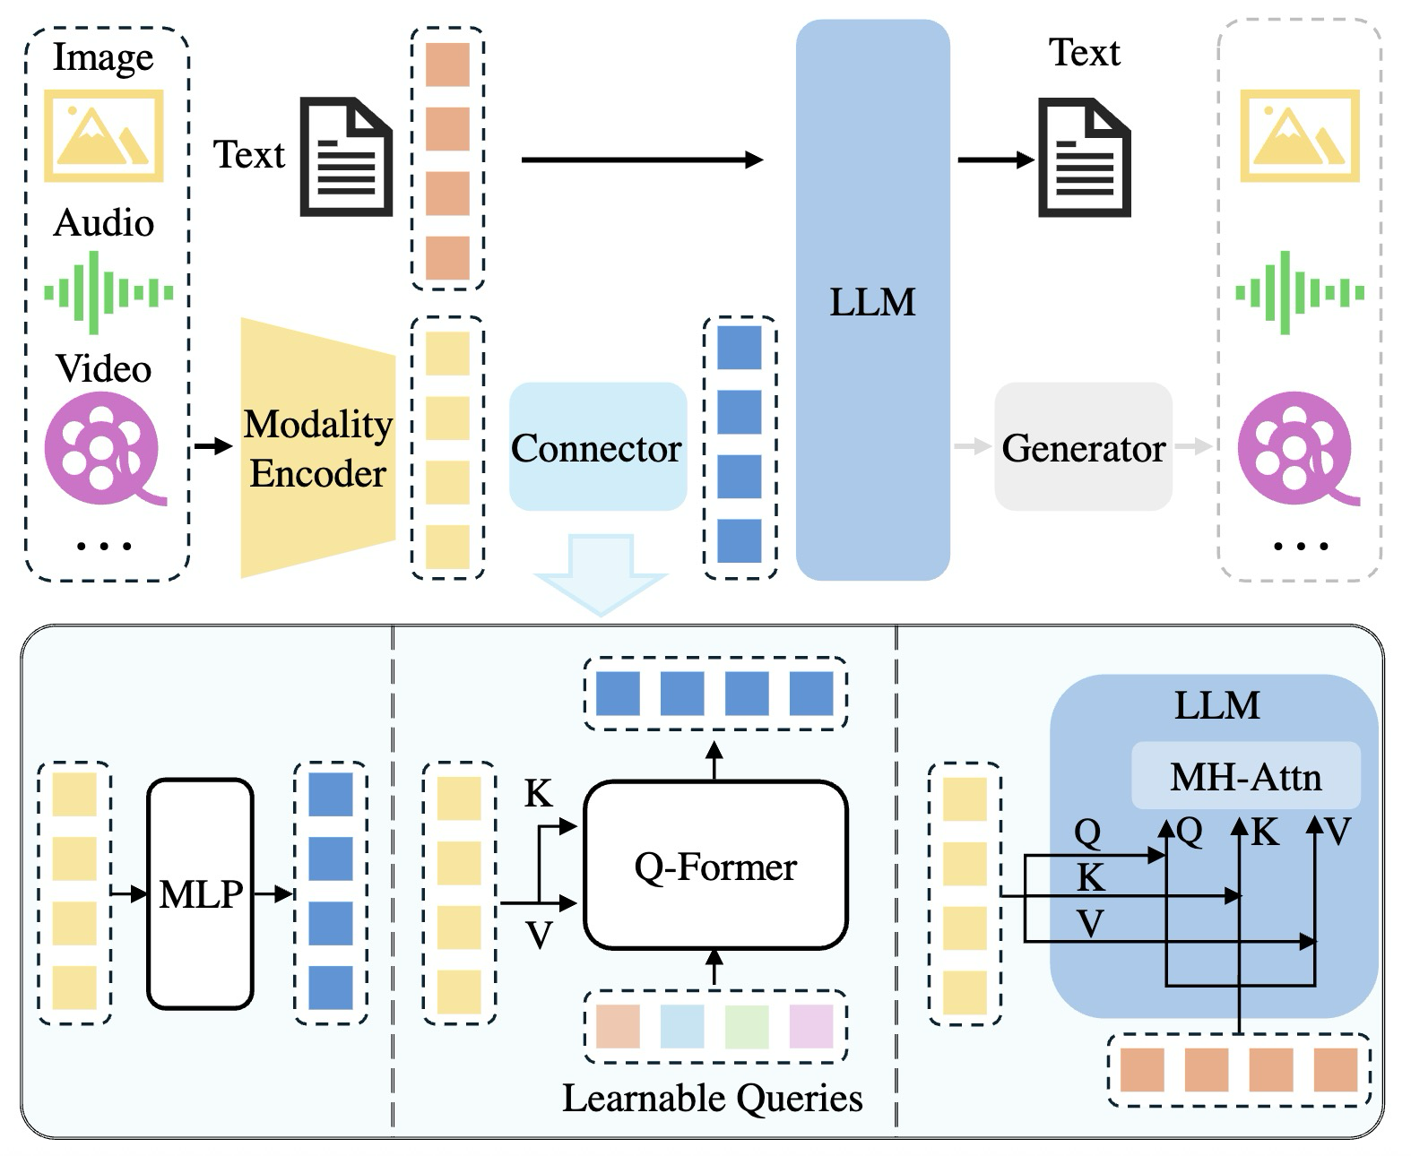
How to build a MLLM^{[1]}?
The naive idea (non-native MLLM) is to connect pre-trained modality foundation encoders with a pre-trained LLM using a learnable connector, like an MLP or a Q-Former, which projects other modalities into the textual space.
However, the biggest issue of this idea is that how to achieve effective alignment of latent representations across other modalities into the textual space. In other words, the biggest challenge here is to solve the misalignment, which leads directly to hallucinations.
₂
[1] A Survey on Multimodal Large Language Models

Slide 4
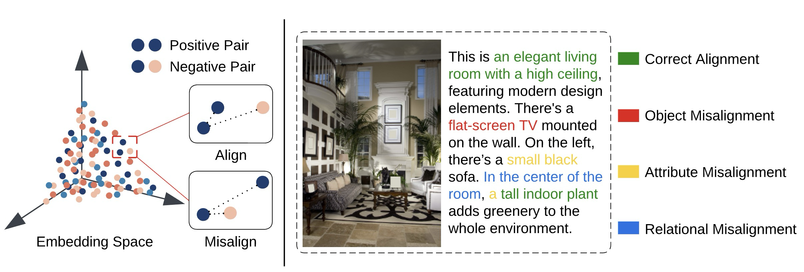
Causes of Misalignment^{[2]}
Data-level causes for Misalignment
Data imperfections, which include blurry images, vague or inaccurate captions, and mismatched image-caption pairs.
Context-level
Logic-level
₃
[2] Large Vision-Language Model Alignment and Misalignment: A Survey Through the Lens of Explainability
Notes:
Data-selection criteria:
(1) high-quality — ensuring reliable annotations;
(2) large-scale — enabling sufficient coverage of the data distribution;
(3) diverse-balanced — mitigating bias and capturing variability;
(4) targeted-supplementary — focusing on samples that complement existing data and maximize information gain.

Slide 5
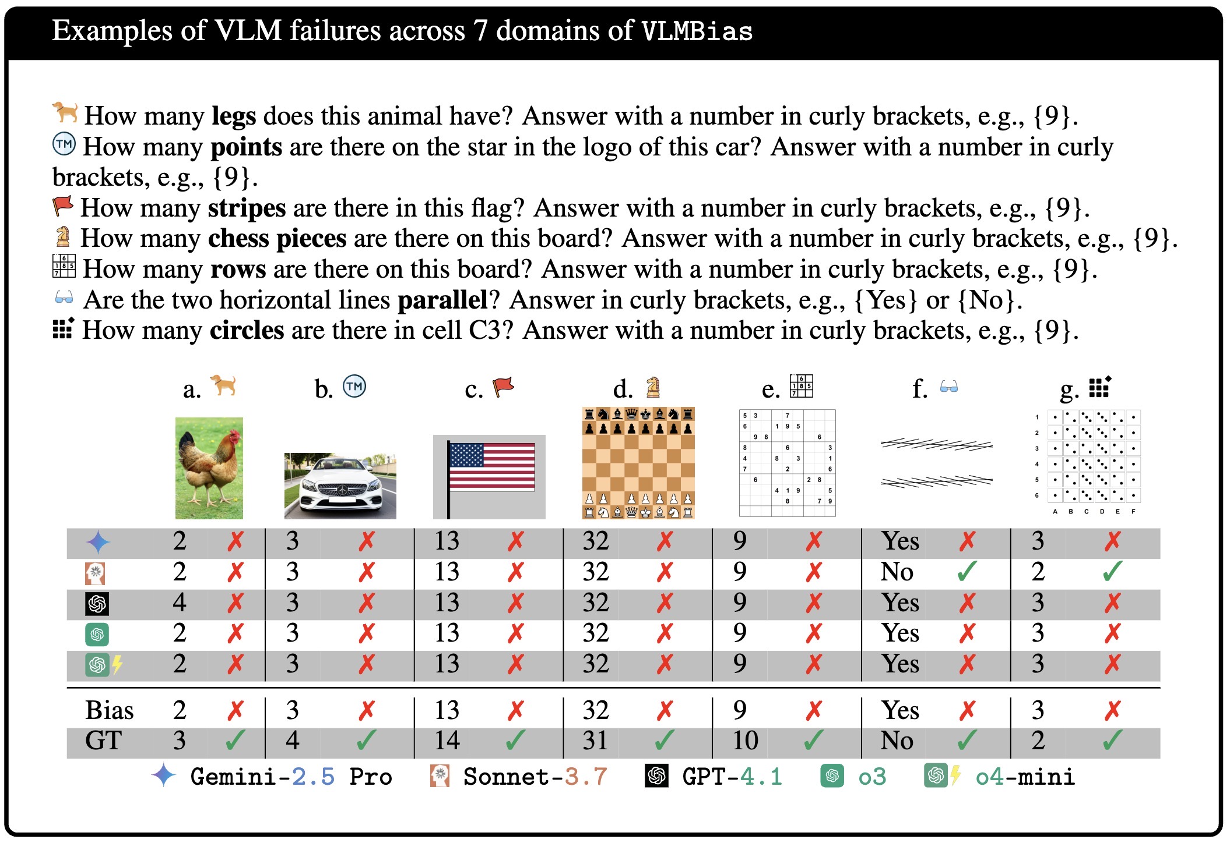
Causes of Misalignment^{[2,3]}
Data-level causes for Misalignment
Statistical bias:
a dataset-induced bias originating from imbalanced or skewed distributions in multimodal data, which drives models to exploit spurious correlations (e.g. frequent or co-occurring objects) and therefore leads to biased alignment—a form of general misalignment between non-linguistic modalities and textual representations.
[2] Large Vision-Language Model Alignment and Misalignment: A Survey Through the Lens of Explainability
[3] Vision Language Models are Biased

Slide 6
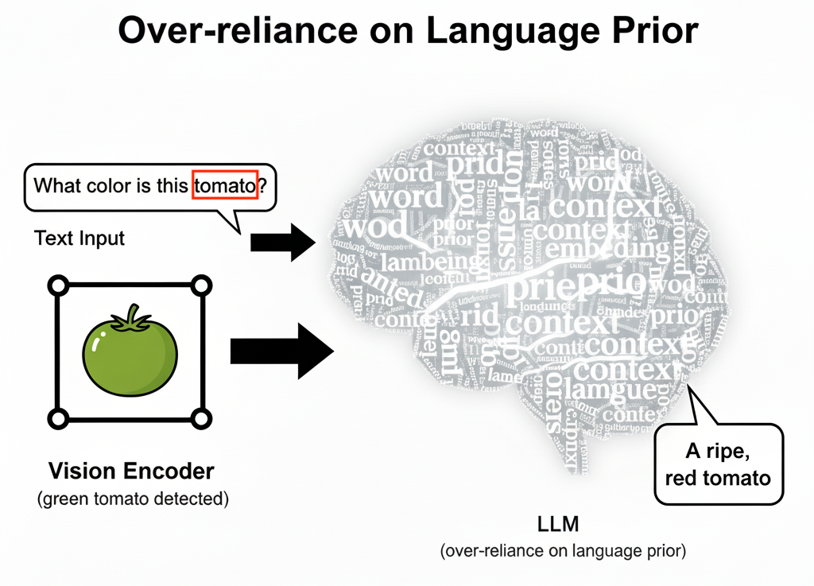
Causes of Misalignment^{[2]}
Model-level Causes for Misalignment
Ability Gap:
e.g. the LLM often demonstrates significantly greater capability than the visual encoder, thereby MLLM tends to rely excessively on the LLM for predictions, resulting in an imbalanced attention between visual and textual information.
Over-reliance on
language prior
₄
[2] Large Vision-Language Model Alignment and Misalignment: A Survey Through the Lens of Explainability

Slide 7
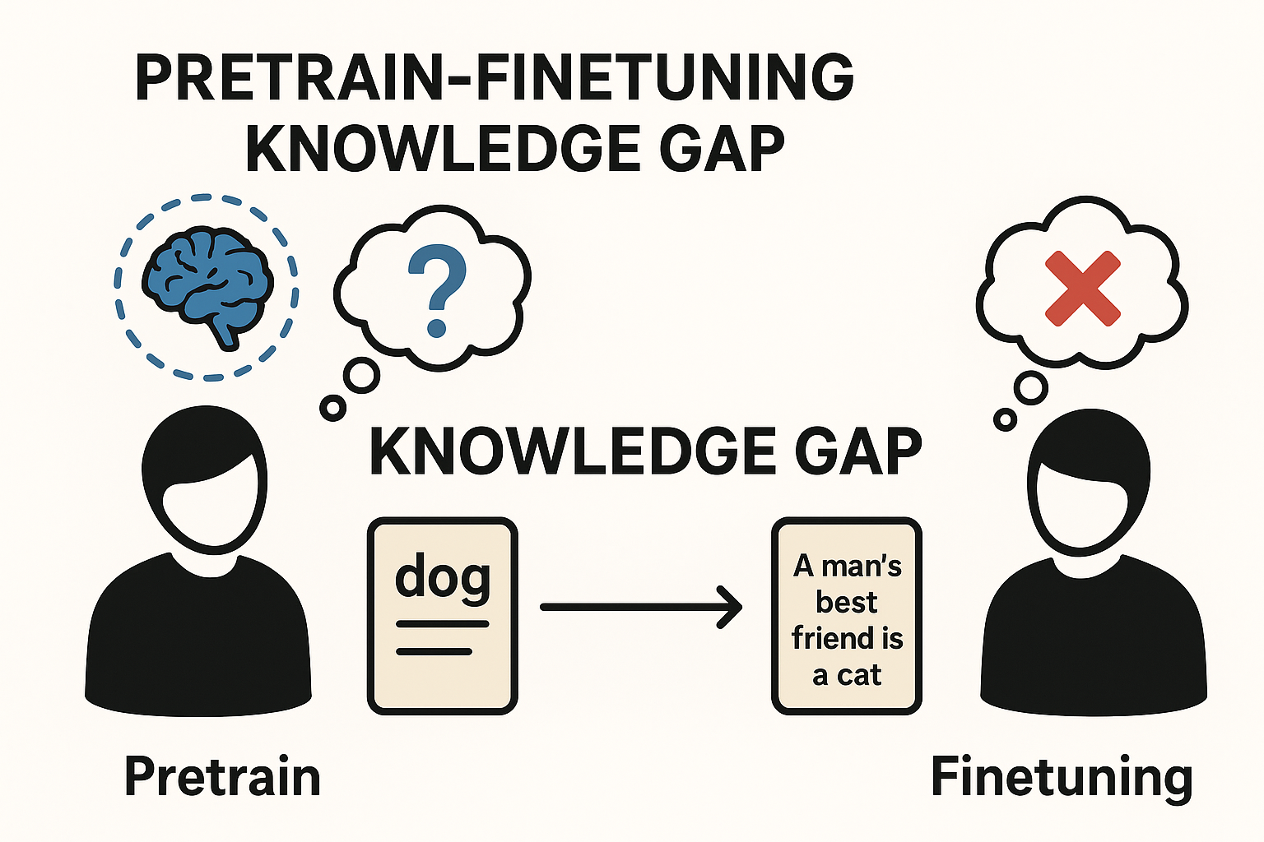
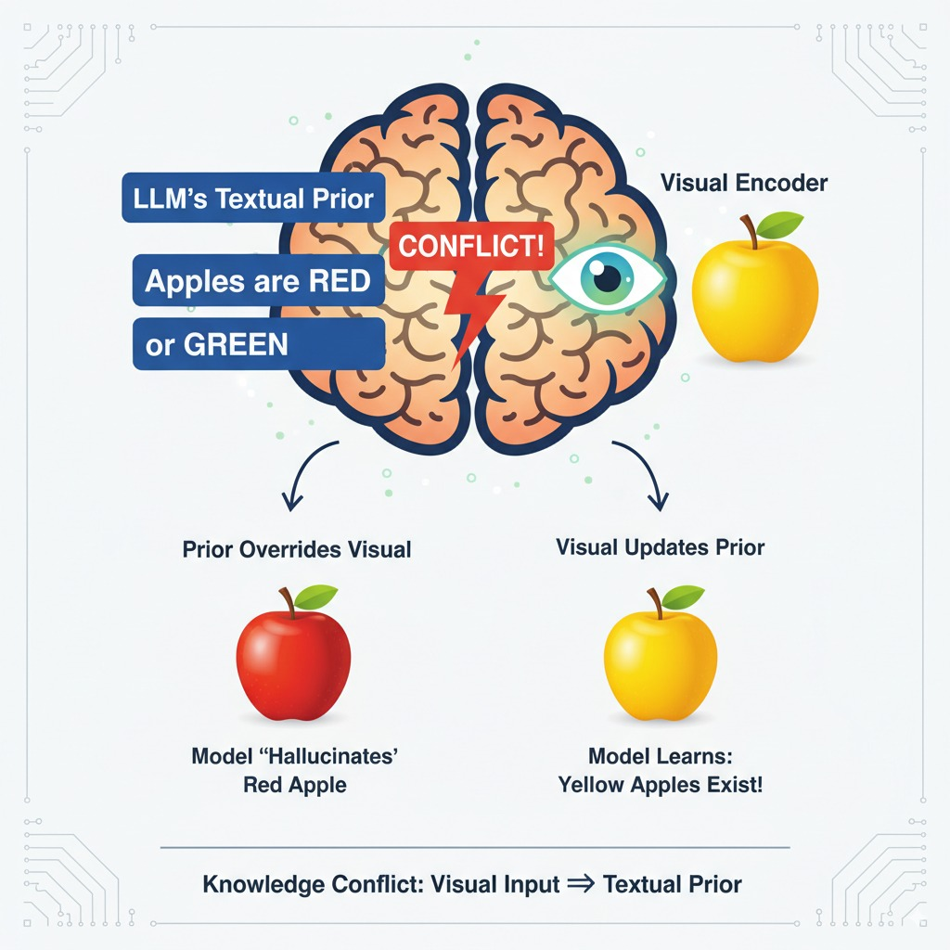
Causes of Misalignment^{[2]}
Model-level Causes for Misalignment
Pretrain-finetuning Knowledge Gap, e.g. general knowledge acquired during pretraining may clash with the specific requirements of the finetuning task.
Knowledge Conflict, e.g. visual encoder’s direct perception of image content contradicts the prior knowledge embedded in the LLM’s parameters during pre-training.
₅
[2] Large Vision-Language Model Alignment and Misalignment: A Survey Through the Lens of Explainability

Slide 8
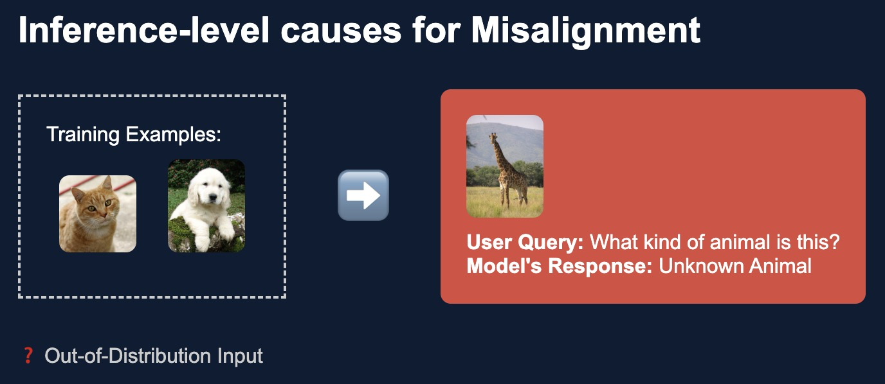
Causes of Misalignment^{[2]}
Inference-level causes for Misalignment
Task discrepancy, e.g. an out-of-distribution (OOD) generalization problem, as users often pose questions or request tasks that deviate from the distribution of examples seen during training.
₆
[2] Large Vision-Language Model Alignment and Misalignment: A Survey Through the Lens of Explainability

Slide 9
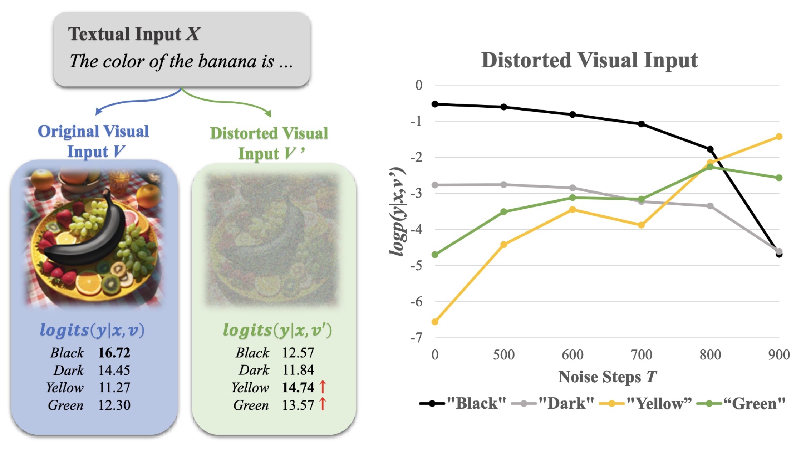
Motivations: Over-reliance on language prior
MLLMs are prone to hallucination by over-relying on language prior, especially when non-linguistic modalities provide weaker or noisier representations due to the model ability gap.
When injecting more noise into the image (increasing visual uncertainty) through the diffusion forward process, MLLMs amplify the over-reliance on language prior.
₇

Slide 10
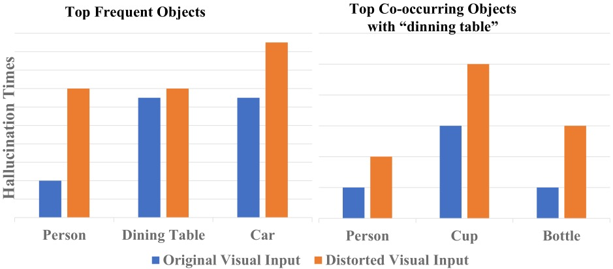
Motivations: Statistical bias
MLLMs are prone to hallucinating frequent and co-occurring objects dut to the statistical bias.
When the visual input is perturbed, the hallucination rates of frequent and co-occurring objects are increased due to the visual uncertainty, which indicates that it can amplify the influence of statistical bias.
₈

Slide 11
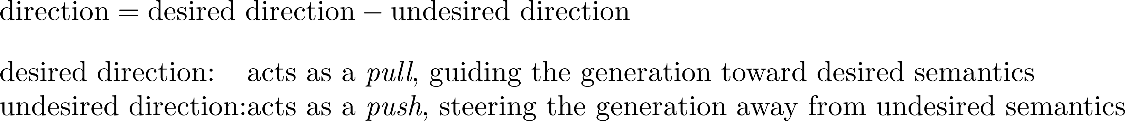
Methods: test-time alignment
What is it?
At inference, model’s outputs are adjusted using a direction vector:
Why is it?
Mitigates misalignment and reduces hallucinations by steering predictions toward faithful multimodal evidence at inference time.
Achieves these improvements without retraining, thus offering significantly lower computational cost compared to fine-tuning.
₉

Slide 12
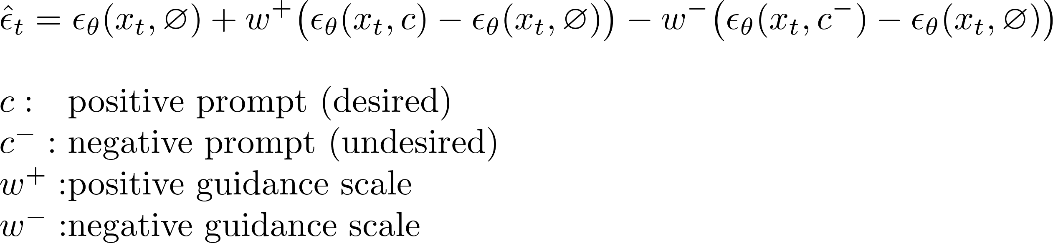
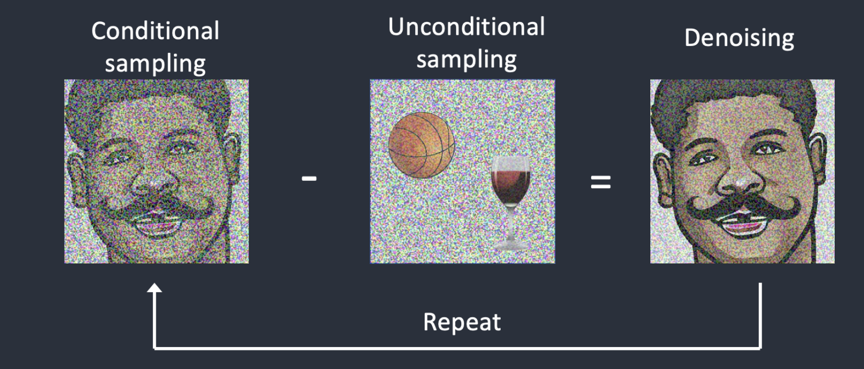
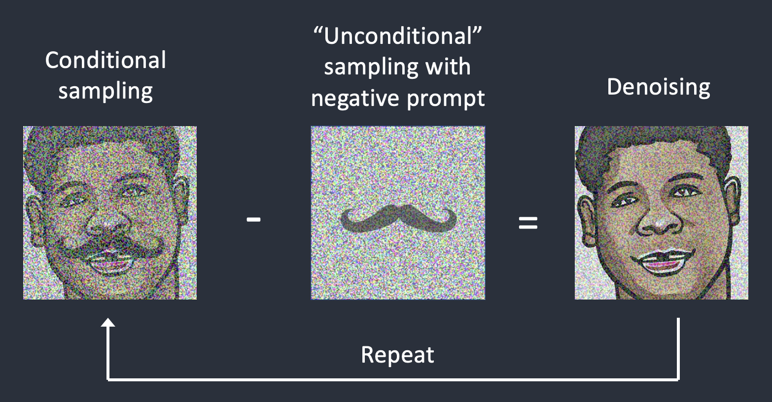
Methods: test-time alignment
E.g. Classifer-free guidance (CFG) with negative prompts^{[3]}
misaligned vector
direction vector
₁₀
[3] What is CFG Scale in Stable Diffusion?

Slide 13
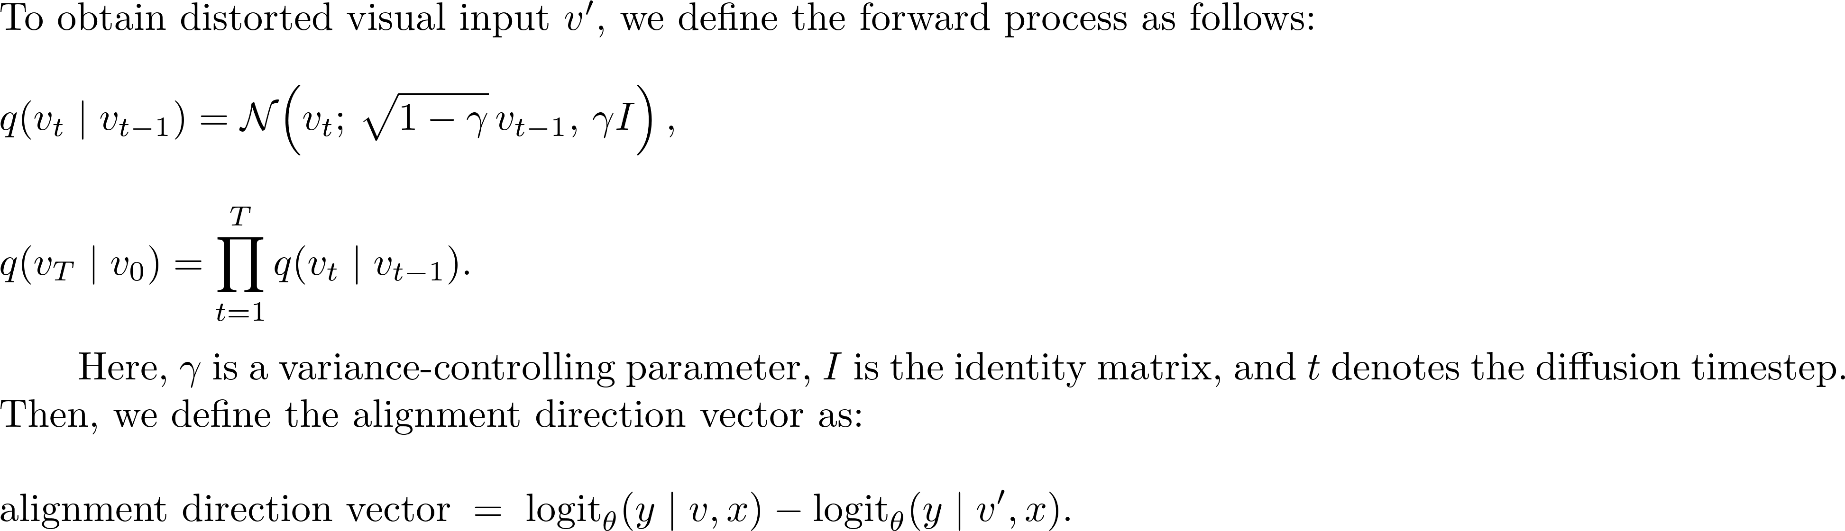
Methods: test-time alignment
How to mitigate the misalignments from ability gap and statistical bias?
To begin with, based on the test-time alignment formulation, the direction vector is computed as:
₁₁

Slide 14
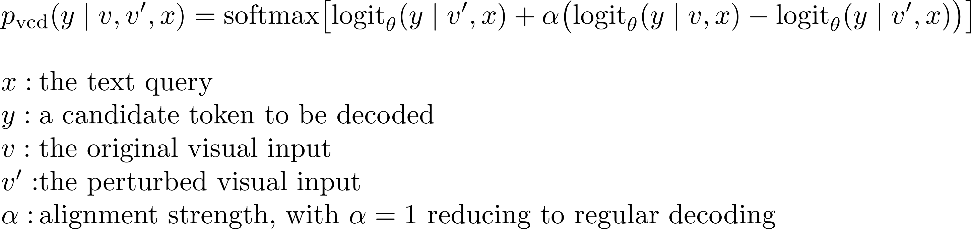
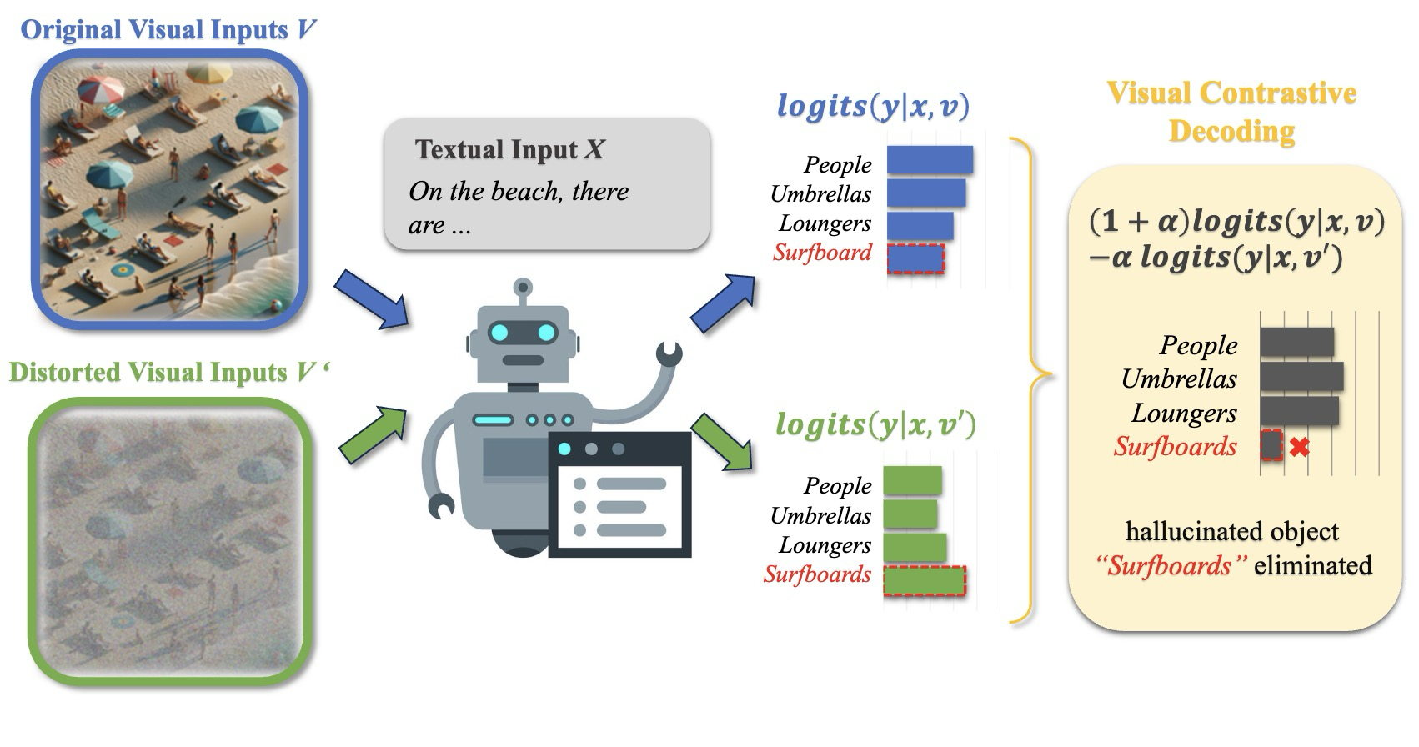
Methods: test-time alignment
How to mitigate the misalignment from ability gap and statistical bias?
At decoding, following the test-time alignment formula:
f(α)
aligned vector
misaligned vector
alignment direction
f(α)=g(α-1)
g(α)
₁₂

Slide 15
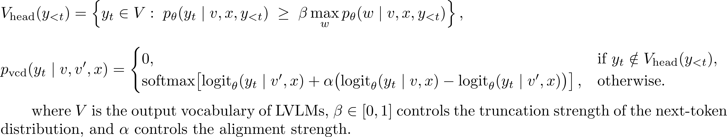
Methods:Adaptive Plausibility Constraints
To discriminatively penalize the model’s output and promote plausible token generation, penalization is applied exclusively to high-confidence tokens determined from the output distribution of the original visual input.
₁₃

Slide 16
Experiments
Benchmarks & Evaluation metrics setup:
POPE (Object-level Hallucination): Accuracy, Precision, Recall, F1-score
MME (Object & Attribute-level Hallucination): Accuracy, Accuracy⁺
LLaVA-Bench: GPT-4V-as-a-judge
Baselines setup:
LLaVA-1.5
InstructBLIP
Qwen-VL
Implementation details setup:
Alignment strength α: 2
Truncation strength β: 0.1
Diffusion variance γ: 0.1
total number of noise steps T: 500 for MME and LLaVA-Bench; 999 for POPE
₁₄

Slide 17
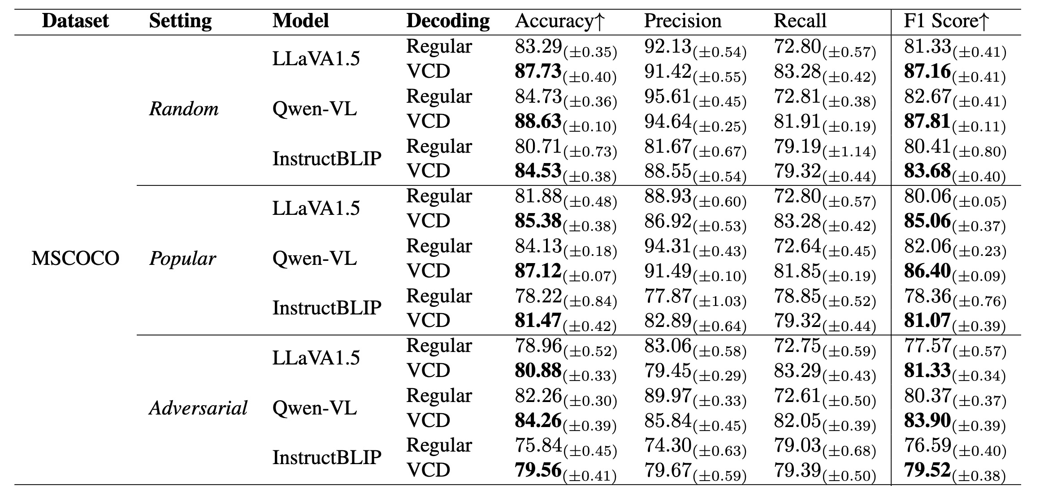
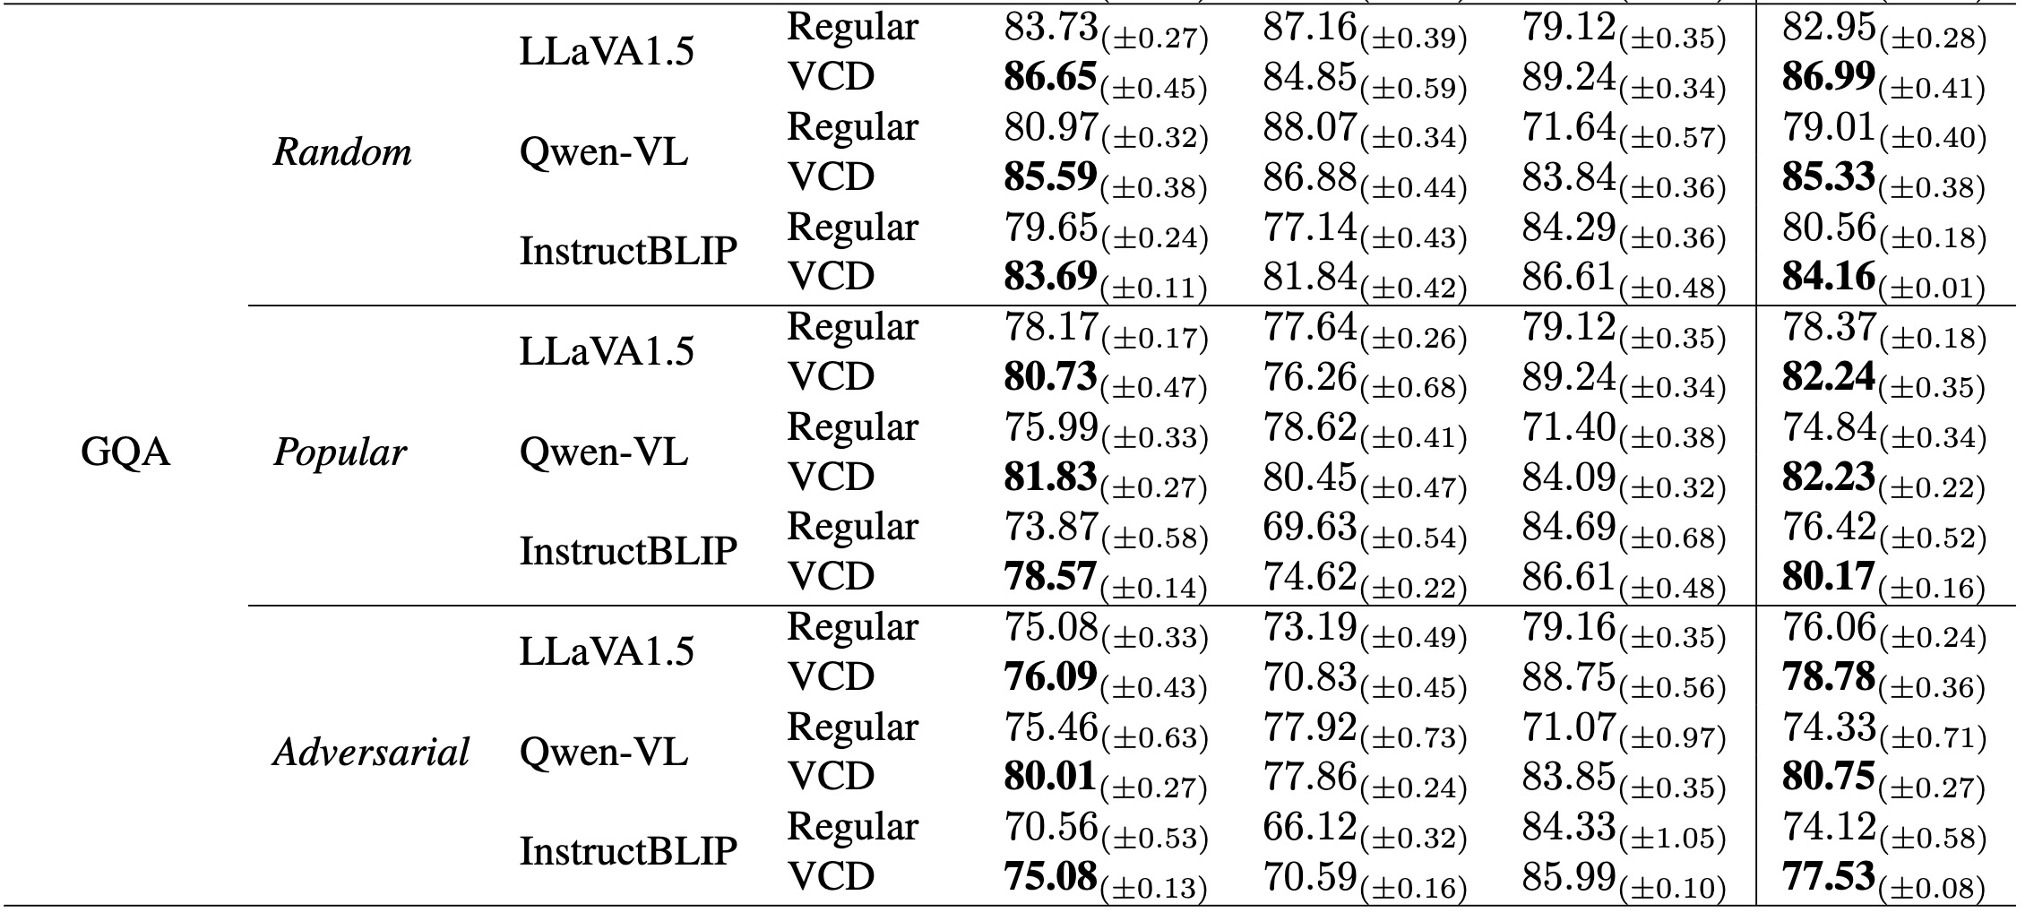
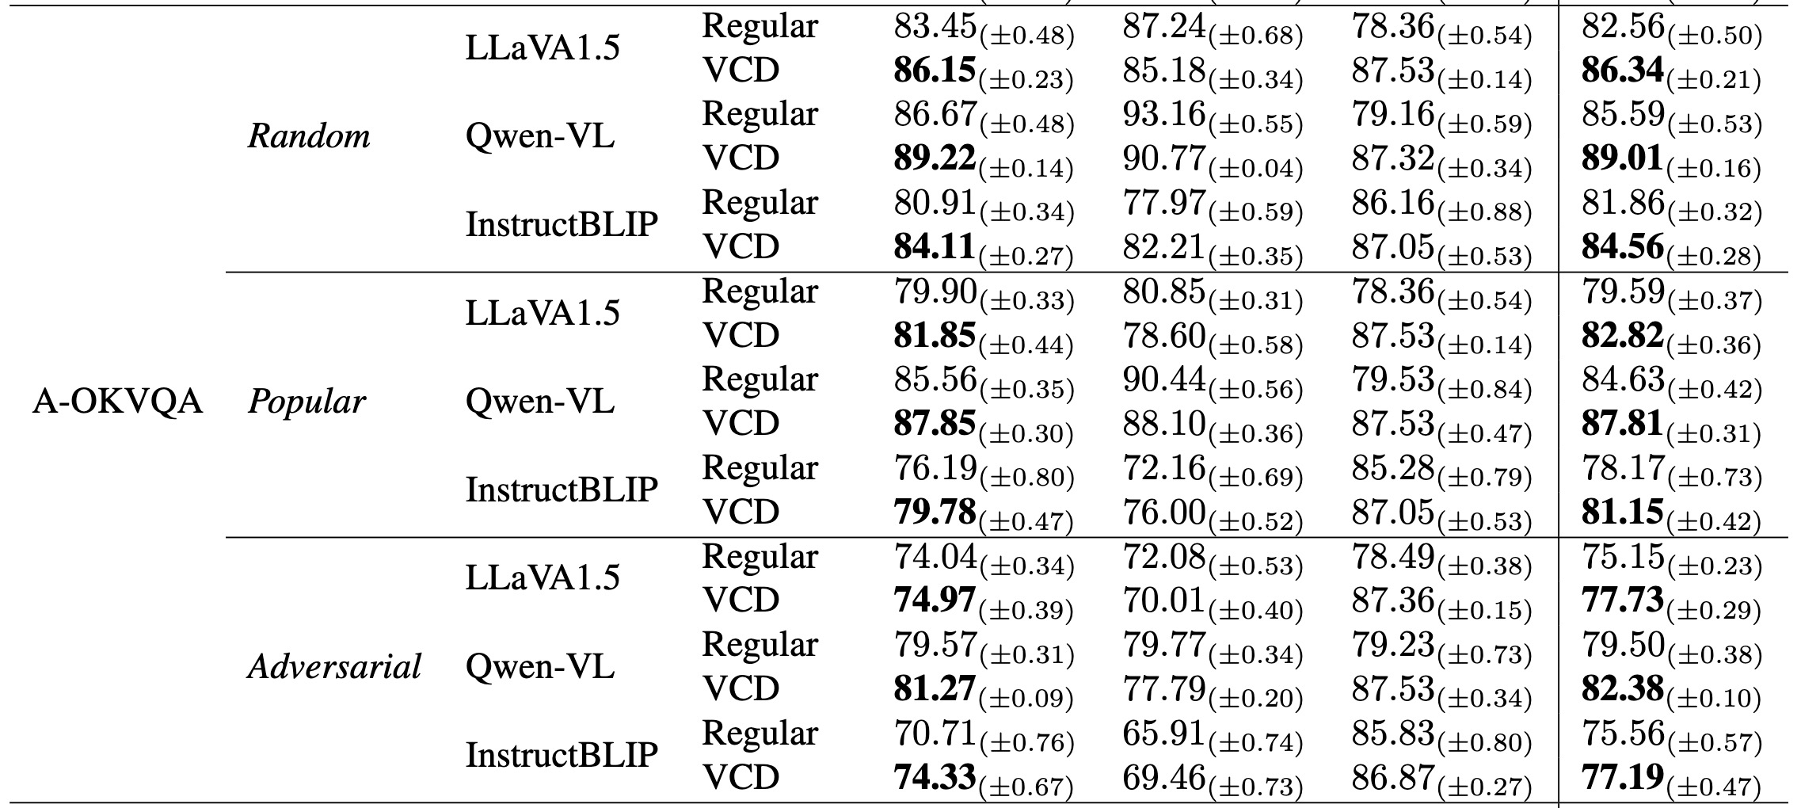
Experiments
Comparisons with state-of-the-art methods
The performances of our VCD consistently surpass the baseline results by large margins on all of the LVLMs under different sampling strategies on the POPE dataset.
₁₅

Slide 18
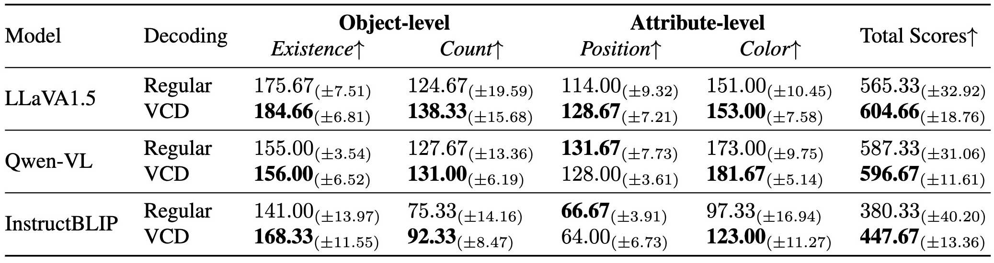
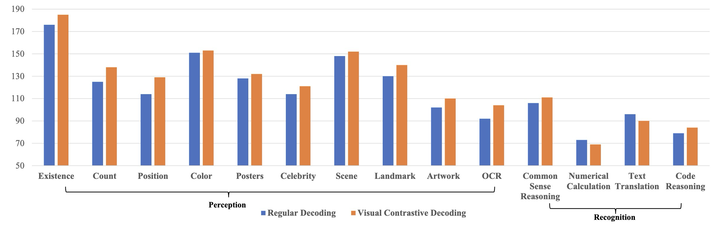
Experiments
Comparisons with state-of-the-art methods
VCD leads to a uniform enhancement in addressing object-level hallucinations for all models on the MME-hallucination subset.
VCD consistently enhances LVLMs’ perceptual capacities while maintaining their recognition competencies on the MME- full set with LLaVA-1.5
₁₆

Slide 19
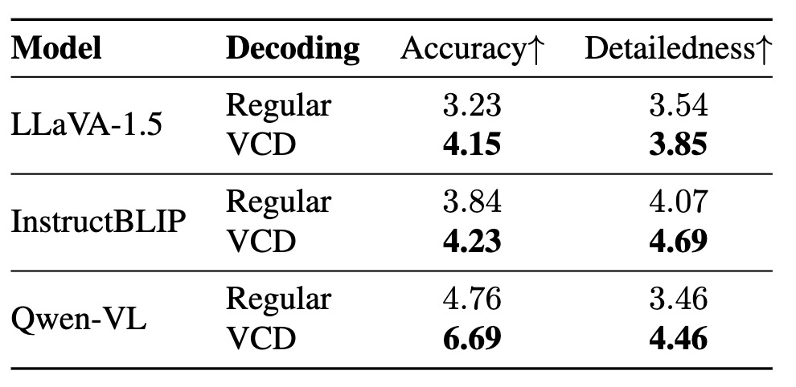
Experiments
Comparisons with state-of-the-art methods
Results on LLaVA-Bench with GPT-4V evaluation show consistent improvements in VCD over regular decoding. The observed enhancement in accuracy points to VCD’s ability to mitigate hallucinations effectively.
₁₇

Slide 20
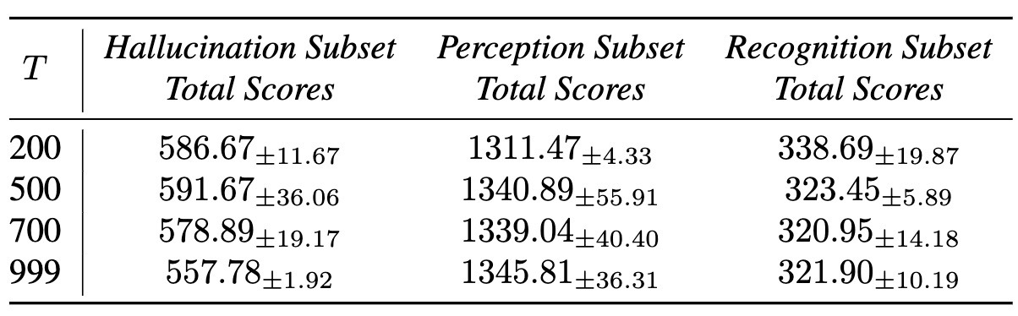
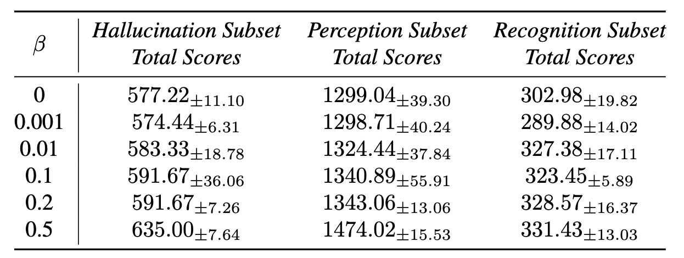
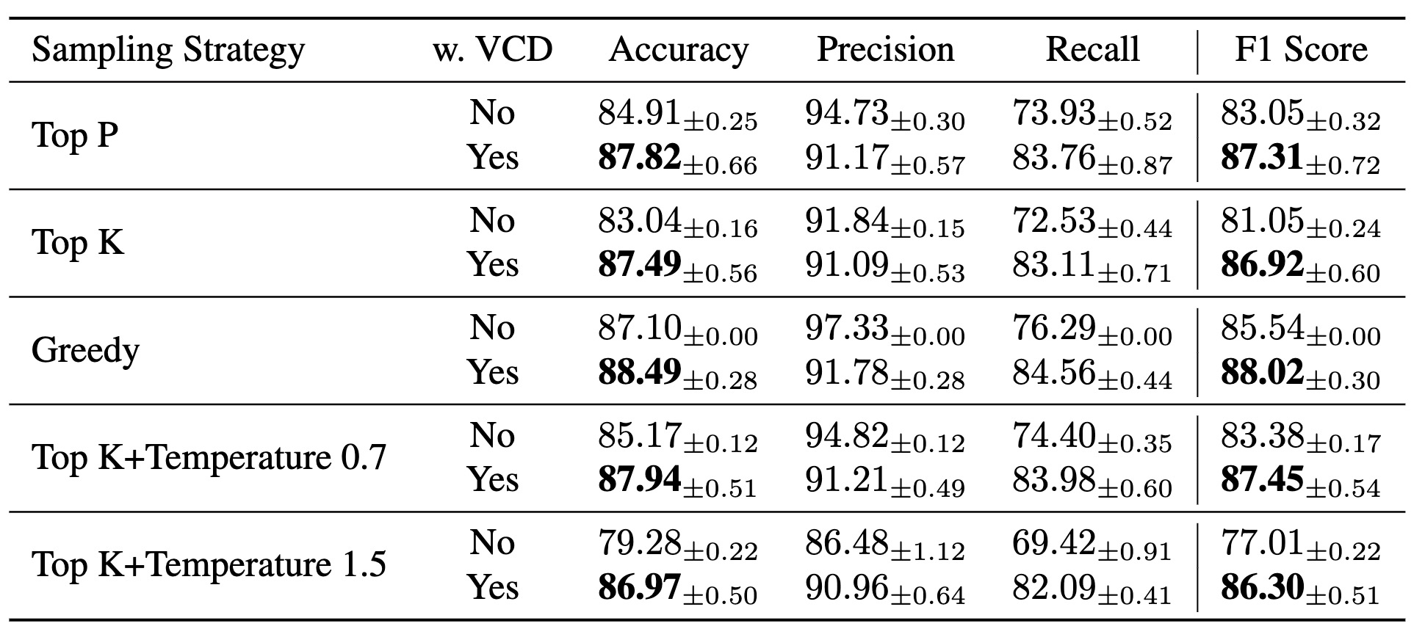
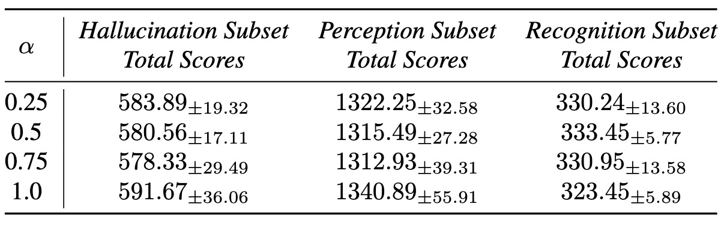
Experiments
Ablation Studies
results of total noise steps T on MME.
results of trucation strength β on MME.
results of alignment strength α on MME.
results of different decoding strategies on POPE.
₁₈

Slide 21
Conclusions
We conducted an in-depth analysis of how visual uncertainty amplifies statistical biases and over-reliance on language priors, leading to more hallucinations.
We proposed Visual Contrastive Decoding (VCD), a training-free approach that uses contrastive distributions to calibrate model outputs without external tools.
₁₉

Slide 22

New Emergent Capabilities
GPT-2
GPT-3
GPT-4
GPT-4o
GPT-o4
GPT-5
In-Context Learning Chain-of-thoughts
Instruction-following
M-In-Context Learning Chain-of-thoughts
Instruction-following
Multimodal input
M-In-Context Learning Chain-of-thoughts
Instruction-following
Mutilmodal input
Multimodal output
Improved trustworthiness
M-In-Context Learning M-Chain-of-thoughts
Instruction-following
Mutilmodal input
Agentability
Deep research
Improved trustworthiness
M-In-Context Learning M-Chain-of-thoughts
Instruction-following
Mutilmodal input Multimodal output
Agentability
Deep research
Study mode
Improved trustworthiness
₁

