Slide 1
Diversification Importance
Zach Lees

Slide 2
Objectives
We will be looking over a diversified portfolio made up of 10 stocks.
Look at one of the stocks in this portfolio, Apple Corp.
Look at a diversified portfolio made of VBTLX and VFAIX.
Compare the expected return and risk associated between them.
Detail the differences between investing in a diversified portfolio versus a single high achieving stock.

Slide 3
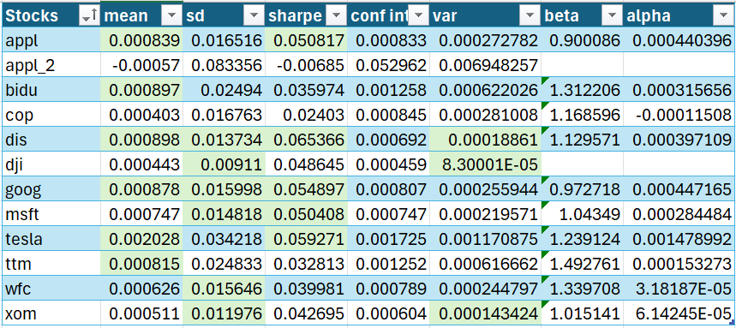
The 10 Stocks in the Portfolio
These are the 10 stocks that will be in the portfolio.
We can see that Apple has a mean greater than half of the portfolio as shown by it being highlighted green.
Apple also has a Sharpe ratio higher than half of the portfolio.

Slide 4
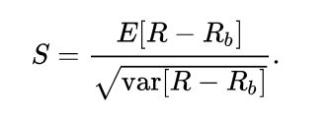

Sharpe Ratio
Sharpe ratio measure the excess return received for the extra volatility of a riskier asset.
Used to assess risk adjusted returns.
A higher Sharpe ratio (>1) is good.

Slide 5
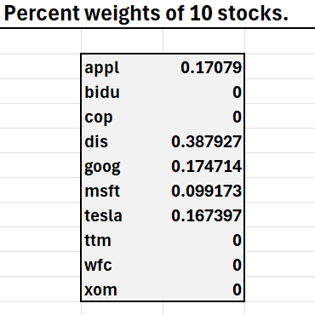
Portfolio of 10 stocks
This is a portfolio made up of 10 securities.
We use the optimal allocation of assets to determine the specific weights.
  That is to say, we determine which stocks we should invest in to maximize our return for a specific level of risk, by maximizing the Sharpe ratio.
  17.079% of our portfolio is Apple stock (appl), and 0% of the portfolio is Wells Fargo and Co stock (wfc).

Slide 6
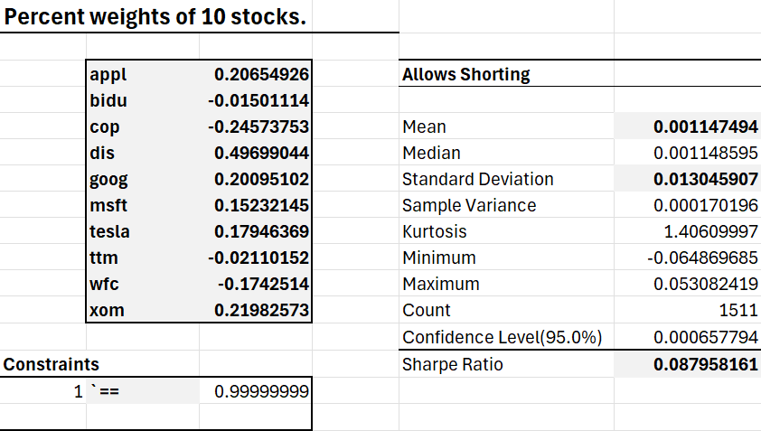
Portfolio Allowing Shorting
Shorting allows the return and Sharpe ratio to be higher compared to not allowing shorting
For this example, we will not be using shorting.

Slide 7
Mean and Standard deviation
Mean is the expected returns over time.
Standard deviation, is our variability around the mean.
If we have a mean of 1% and a standard deviation of 5% for monthly returns.
  Then we expect to see a 5% variability around the mean, 1%, in 68% of cases.
  We expect the monthly return to be between -4% and 6% in 68% of months.
  We expect the monthly return to be between -9% and 11% in 95% of months.
  We can see higher or lower returns per month, but it's unlikely (<5%).

Slide 8
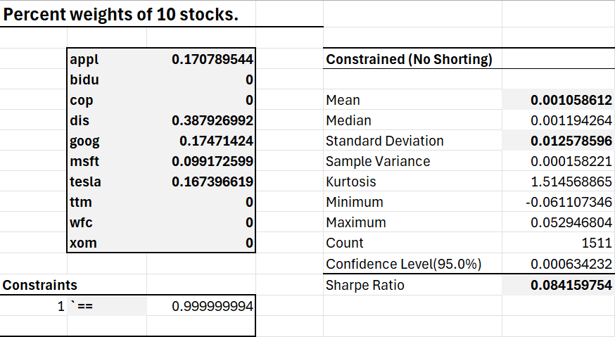
Portfolio Constrained (Not allowing shorting)
We can see a mean of 0.106%.
  This means that every month, we expect to see an average increase of 2.22%.
The standard deviation is 1.258%.
  This represents our daily variability.
  We expect to see a variation of +-5.76% per month.

Slide 9
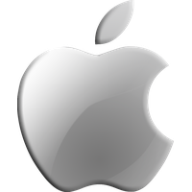
Single Stock, Apple
We are comparing a single stock, Apple (appl) to two portfolios of varying diversification.
Apple Inc is technology company.
ThePhoto by PhotoAuthor is licensed under CCYYSA.

Slide 10
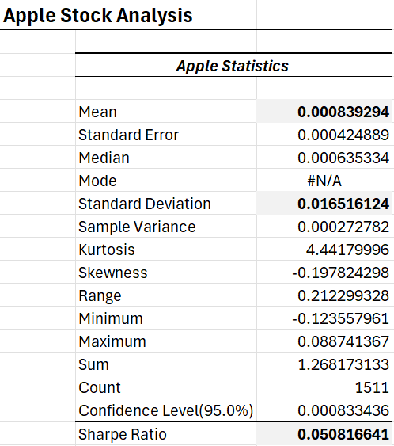
Apple Stock
We expect to see an average increase of 1.76% per month for the apple stock.
We expect to see a variation of +-7.57% per month.
  We expect to see +-7.57% variation in 68% of cases.
  We expect to see +-15.14% variation in 95% of months.

Slide 11
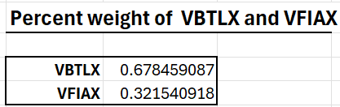
Portfolio of VBTLX and VFIAX
VBTLX is Vanguard's Total Bond Market Index Fund.
VFIAX is Vanguard's 500 Index Fund (equities).
  Tracks the S&P500.
This is a portfolio of these two funds to make the portfolio as optimal as possible, by maximizing the Sharpe ratio.
The allocation is 67.85% in VBTLX and 32.15% into VFIAX.
Due to bonds being inversely correlated with equities, it allows us to achieve a higher Sharpe ratio, and lower standard deviation (volatility).

Slide 12
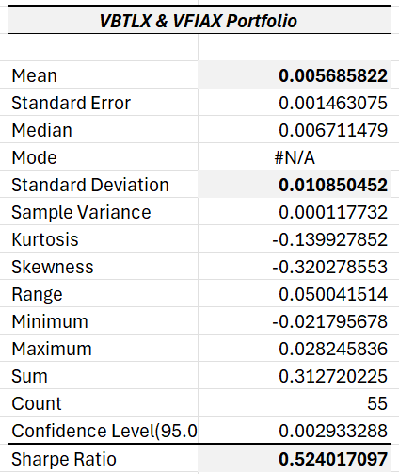
VBTLX and VFIAX Portfolio
A mean of 0.569% means we expect to see an average return of 0.569% every month.
We expect to see a variation of +-1.085% per month.

Slide 13
What do these Means and Standard Deviations actually tell us?
Since we know Apple is one of the higher achieving stocks, let's compare it to the portfolios as a whole.
Let's say we want to invest $100,000 into each.
  We invest $100,000 into Apple.
  We invest $100,000 into the 10 stock portfolio.
  We invest $100,000 into the VBTLX and VFIAX portfolio.

Slide 14
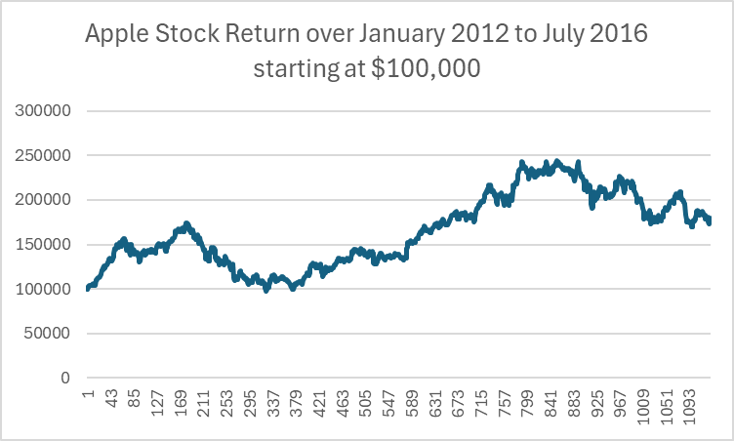
Investing $100,000 into Apple in January 2012
The final value of the position on June 30th 2016 is $179,508.
Even though Apple has a high mean, the high variation results in the earnings to stagnate and perform poorly during times of economic downturn.

Slide 15
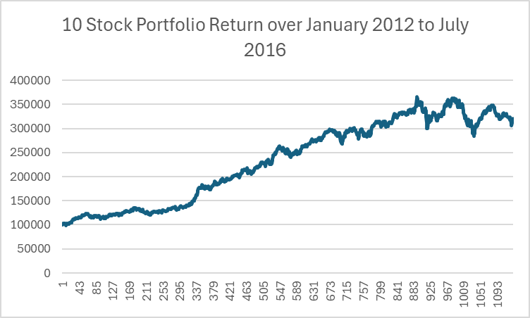
Investing $100,000 into the 10 Stock Portfolio in January 2012
The final value of the position on June 30th 2016 is $319,987.
Due to a lower standard deviation, we see steadier earnings and less variability.
But we do see some variability due to the increased risk.

Slide 16
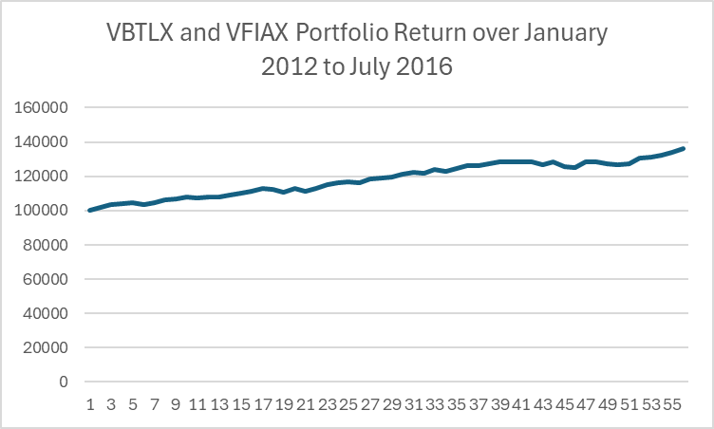
Investing $100,000 into the Diversified Portfolio in January 2012
The final value of the position on July 2016 is $136,163.
Due to a lower standard deviation, we see steadier earnings and less variability.
  This means that even during times of economic downturn we expect our portfolio to be less affected.

Slide 17
Comparing the 10 Stock Portfolio and Apple
The portfolio expected average is higher than Apple's expected average.
Apple has a higher standard deviation (risk) compared to the portfolio.
This is reflected in the Sharpe ratios for both the portfolio and Apple's.
  The 10 stock portfolio Sharpe ratio is 0.386
  Apple's Sharpe ratio is 0.233

Slide 18
Comparing VBTLX & VFIAX Portfolio to Apple and the 10 Stock Portfolio
The expected return of both the 10 stock portfolio and Apple are higher than the VBTLX & VFIAX portfolio (diversified).
The standard deviation of the diversified portfolio is much lower, only 1.09% monthly.
The Sharpe ratio of the diversified portfolio is higher at 0.524.

Slide 19
Diversification Impact on Returns
Even though we looked at Apple, a stock in the top half of performance (mean, Sharpe) compared to the other stocks in 10 stock portfolio, we found the portfolio outperformed.
In our example from before, investing $100,000 Apple returned $179,508. 10 Stock portfolio returned $319,987. And the diversified portfolio returned $136,163.
We saw significantly less variability in the portfolio graphs compared to Apple's graph that fell from nearly $250,000 to the ending return of $179,508.

Slide 20
Diversification Reduces Risk
A portfolio reduces unsystematic risk, allowing for more efficient geometric compounding over time.
Having a portfolio instead of a small amount of stocks that you are invested into decreases volatility.
  That is to say, when the stock market isn't doing well, you're portfolio likely won't decrease as much compared to if you were invested into a small handful of stocks.
  We see smoother earnings and less downside risk.

