Slide 1

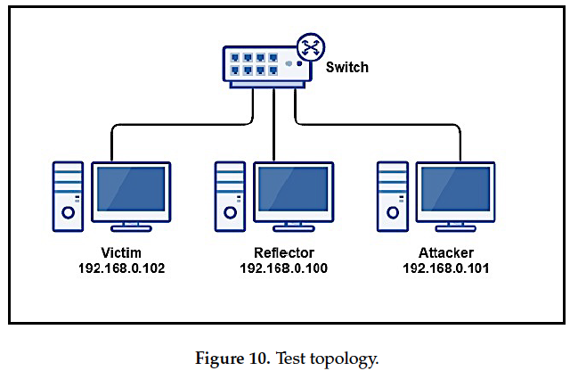
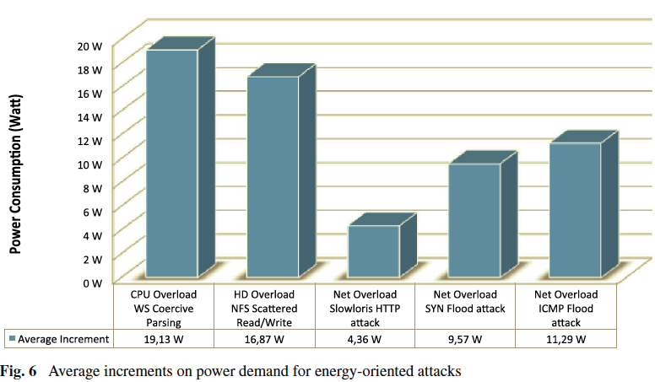
Distributed Denial of Service (DDoS) Attacks
By: Zachary Matthiesen for the Principia College Computer Science Department
Question
Vulnerability in the Internet of Things
Conclusion
Are DDoS attacks relevant in the modern technological landscape?
To test vulnerabilities on the IoT, Costa Gondim et. al. used the roles described in fig. 1 to produce a high traffic of packets (21). Wireshark was used to measure the volume of packets transmitted during an AR-DDoS attack (21).
DDoS attacks are relevant in the modern networking environment, as cloud computing and IoT are the future of network computing. As smart devices receive more features requiring network access, they will become susceptible to DDoS attacks, and require special mitigations to prevent coordinated attacks. The cloud is also vulnerable to DDoS attacks, especially considering the sensitivity of cloud computing users to loss of service.
Abstract
DDoS attacks are relevant if and only if modern networks are vulnerable to DDoS attacks. After conducting research, vulnerabilities within the Internet of things (IoT) and “cloud computing” networks arose as the greatest security threats to modern networks.
Figure 1. Testing diagram for IoT
Source: João Costa Gondim, et al. “A Methodological Approach for Assessing Amplified Reflection Distributed Denial of Service on the Internet of Things,” Sensors, vol. 16, no. 11, Nov. 2016, p. 1855. CrossRef, doi:10.3390/s16111855.
Power Consumption in Data Centers
Background
Palmieri et. al. found that power consumption increased significantly during DDoS attacks (1635). For the margins of power consumption over normal, see fig. 2 and note that conventional flooding attacks are not as effective as specially designed hardware stress DDoS attacks (1635).
Acknowledgements
“A distributed denial of service attack (DDoS) is a DoS attack where attack action is distributed among several entities which act in coordination against the target” (Costa Gondim et. al. 4).
Botnets are many computers, malware that allows the attacker to issue a flood of requests against a server, that overwhelm the server’s resources and cause a DoS event (Saravanan et. al. 511).
NICs are network interface cards, and they handle network traffic packet switching before the traffic finds its way to the server (Palmieri et. al. 1627). NICs are sensitive to spikes in network traffic, and this sensitivity can have a knock-on effect on CPU performance server side (Palmieri et. al. 1627 - 1628).
Costa Gondim, João, et al. “A Methodological Approach for Assessing Amplified Reflection Distributed Denial of Service on the Internet of Things.” Sensors, vol. 16, no. 11, Nov. 2016, p. 1855. CrossRef, doi:10.3390/s16111855.
Loukas, Georgios, and Gülay Öke. “Protection against Denial of Service Attacks: A Survey.” The Computer Journal, vol. 0, no. 0, May 2009, p. 19, doi:0.1093/comjnl/bxh000.
Palmieri, Francesco, et al. “Energy-Oriented Denial of Service Attacks: An Emerging Menace for Large Cloud Infrastructures.” The Journal of Supercomputing, vol. 71, no. 5, May 2015, pp. 1620–41. CrossRef, doi:10.1007/s11227-014-1242-6.
Patrikakis C, Masikos M, Zouraraki O. 2004. Distributed Denial of Service Attacks - The Internet Protocol Journal. The Internet Protocol Journal. 7:13–36.
Saravanan, Renukadevi, et al. “Behavior-Based Detection of Application Layer Distributed Denial of Service Attacks during Flash Events.” TURKISH JOURNAL OF ELECTRICAL ENGINEERING & COMPUTER SCIENCES, vol. 24, 2016, pp. 510–23. CrossRef, doi:10.3906/elk-1308-188.
Figure 2. Watts over standard power consumption for various DDoS attacks on a data center.
Source: Francesco Palmieri, et al. “Energy-Oriented Denial of Service Attacks: An Emerging Menace for Large Cloud Infrastructures,” The Journal of Supercomputing, vol. 71, no. 5, May 2015, pp. 1635, CrossRef, doi:10.1007/s11227-014-1242-6.
Methods
Discussion
Palmieri et. al. used the strategy of real world testing on a small rig to draw conclusions about the effects of energy focused DDoS attacks on large data centers’ power consumptions (1629). The testing for each energy-oriented attack consisted of a small, hyper-threaded, LAN (Local Area Network) connected, PC and laptops connected to it on a LAN to simulate attacks (Palmieri et. al. 1629).
Costa Gondim et. al. used DOTA (Decision Oriented Tool Agnostic) methods to preform an Active Vulnerability Assessment (AVA) on the IoT, including penetration testing and scientific rigor: repeatability, clarity and discourse (2).
Costa Gondim et. al. presented an abstracted attack on the IoT and demonstrated that a generalized approach to penetration testing was needed to uncover the DDoS vulnerabilities in the IoT (26). Also, coordinating attacks of a conventional DDoS style were challenging in the IoT because they required the attacker to have a depth of knowledge in the framework of a given network (26).
As for data centers and the cloud, Palmieri et. al. discovered that attacks targeting CPUs to boost their power consumption were effective enough to shred the profits of a carefully tuned data center (1636).
Further Reading
https://www.nist.gov/programs-projects/advanced-ddos-mitigation-techniques
The Open Web Application Security Project (OWASP)
A general overview of DDoS http://d-scholarship.pitt.edu/19225/1/FinalVersion.pdf

