Slide 1
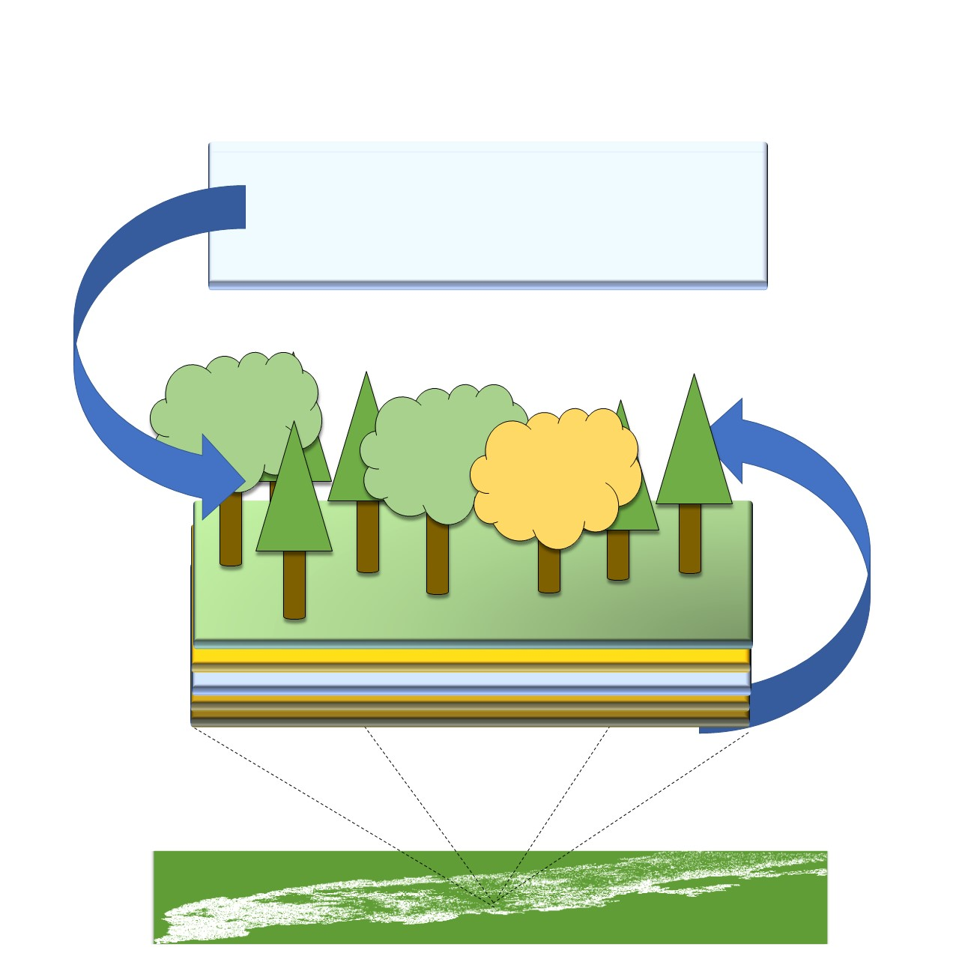
Modeling Landscape Dynamics in The Southern Appalachians
Zachary Robbins
Notes:
Hi my name is Zachary Robbins, and I'm am going to present on Landscape scale Modeling in the Southern Appalachians

Slide 2
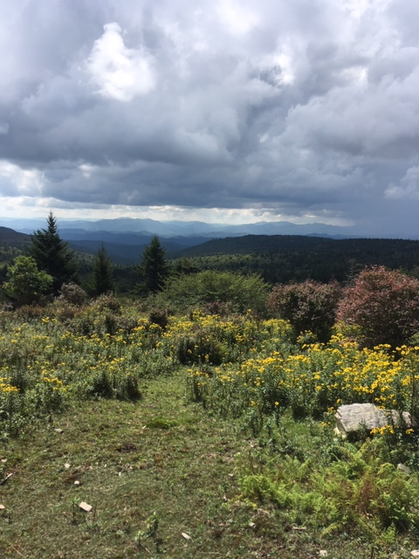
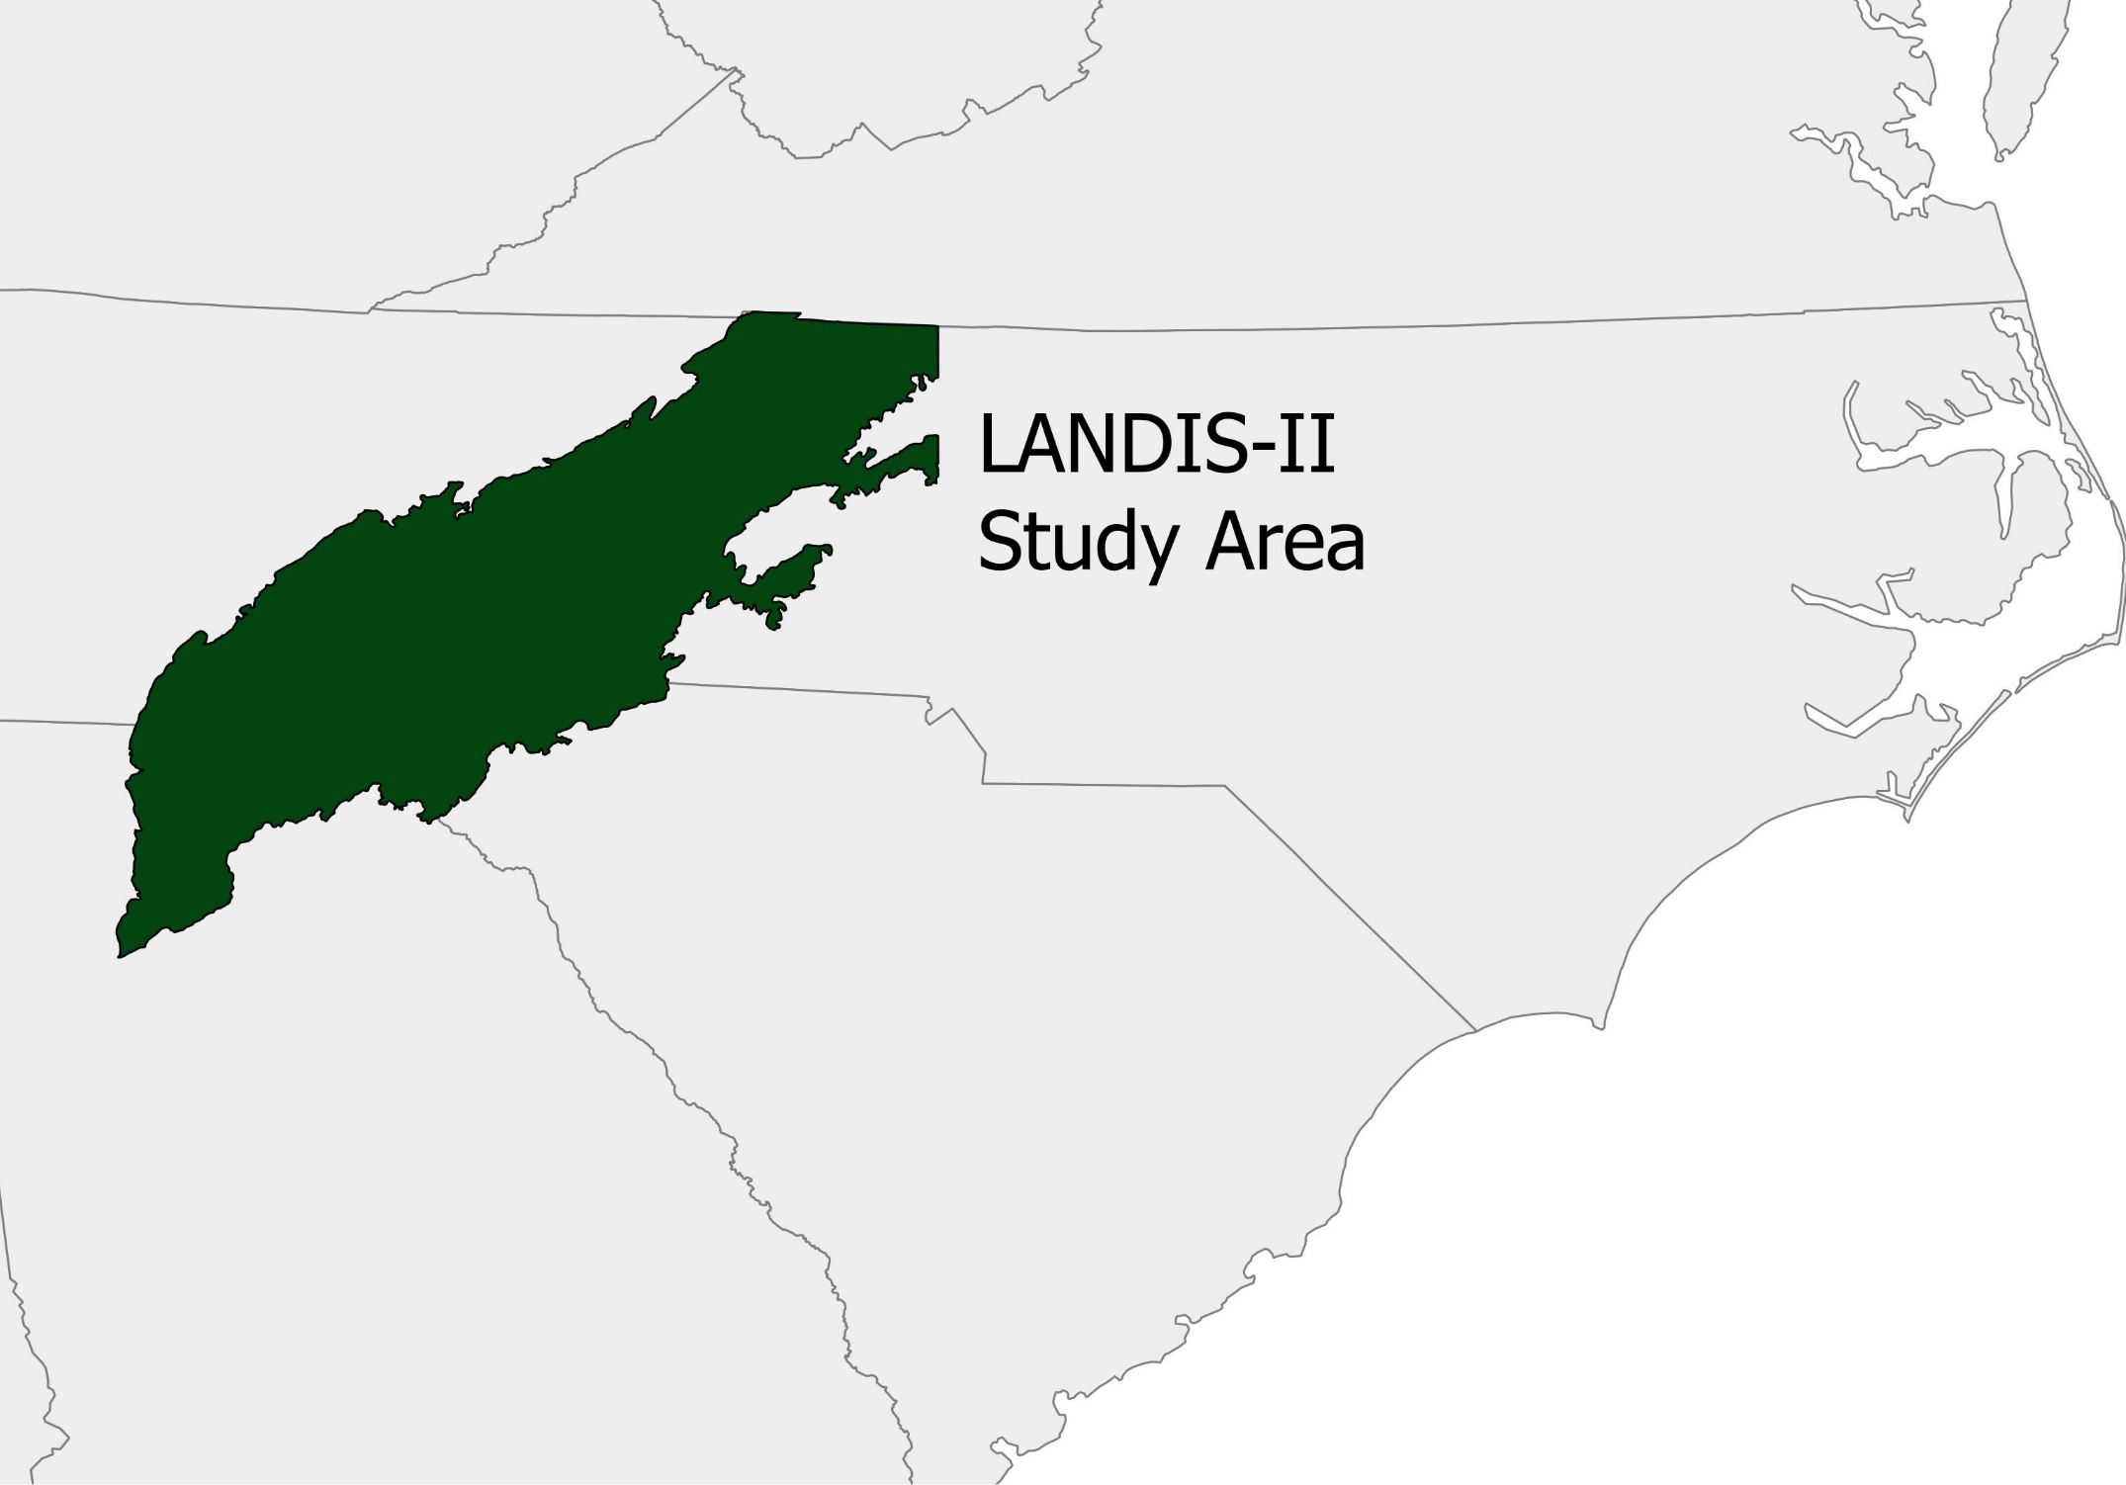
Southern Appalachians
Notes:
The Southern Appalachians is an ancient mountains range that stretches from the Virginias down through Georgia. It’s hotbed of biodiversity, arising from its diverse geomorphic structure, and lack of glacial coverage in the last ice-age. Many dynamics determine the composition of this landscape including thousands of years of human management.

Slide 3
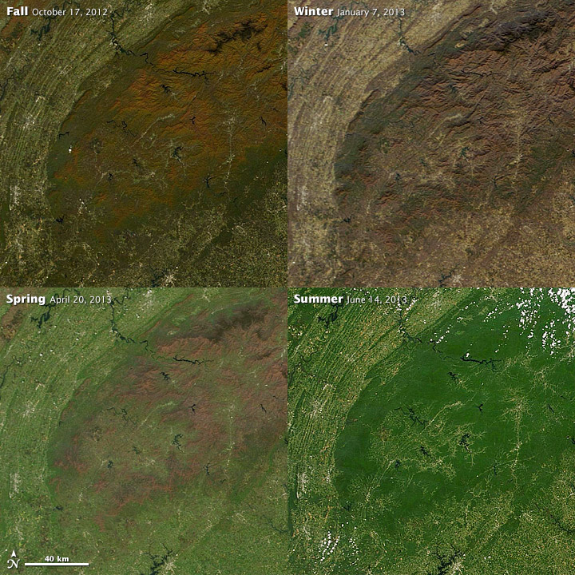
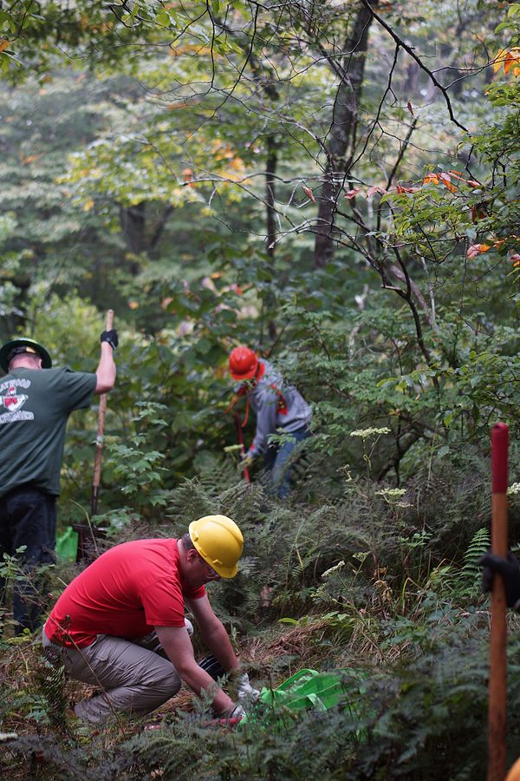
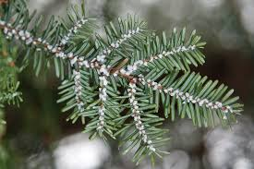
Concerns for the future
Notes:
From shelterwood cuts to the re-introduction of fire, current managers are working to maintain habit and preserve endemic species.
However many factors are currently in flux. Climate change will likely alter the range of species, as precipitation and temperature regimes change. The introduction of the invasive species Hemlock wooly adelgid is leading to landscape level Eastern Hemlock mortality . Under these conditions, researchers and managers need the ability to forecast and understand how our interactions with the landscape will alter future conditions

Slide 4
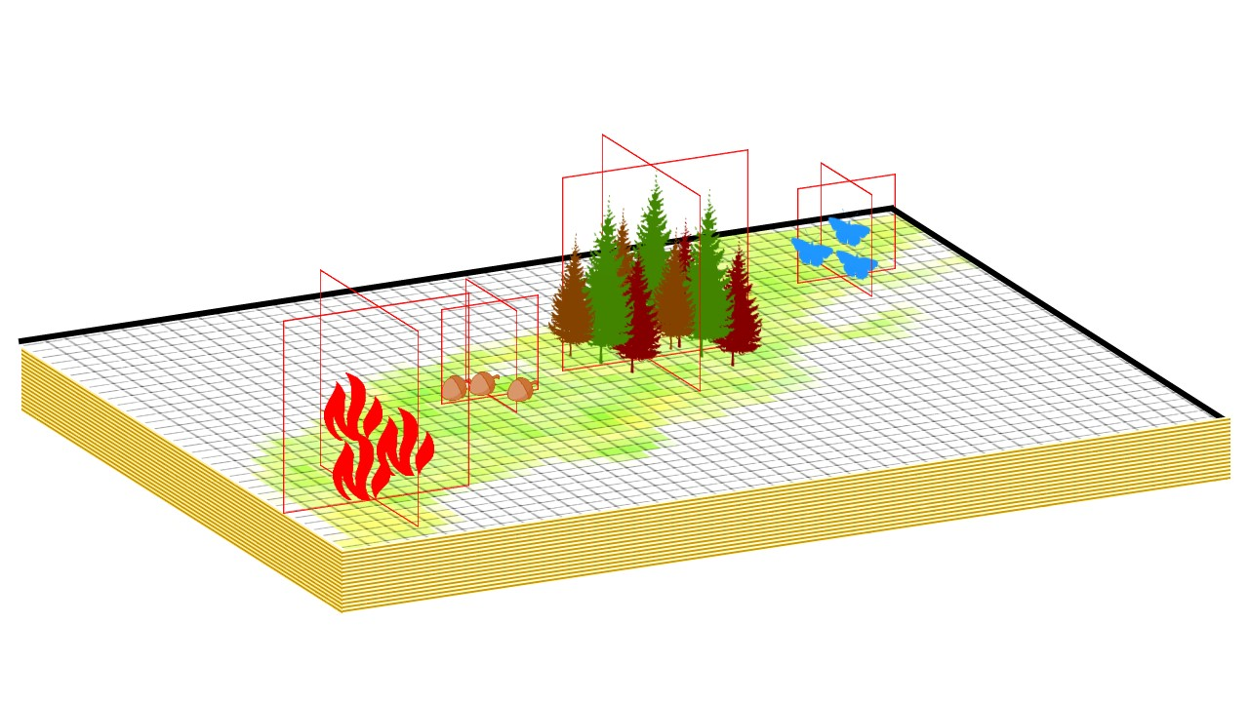
Landscape Processes Model
How do we represent processes that take place over 100’s of years and millions of acres?
Notes:
However the results of these processes span over million acres and make take 100’s years to fully take affect. How can we provide information to managers and researchers on what these conditions will look like? One way we can attempt to forecast these changes is using a Landscape processes model.

Slide 5
LANDIS-II
Notes:
Slide
The model we are using is LANDIS-II. In Landis-II. with each stand is made up of tree cohorts whose growth is determined by the amount of resources they receive from the soil, sun and atmosphereThese cells of the model then interact with one another, through spatial dispersal of propagules and the spread of disturbances. This requires that we have an understanding of all of these processes in order to get them to work in concert

Slide 6
Data Science and Modeling
Synthesizing data sets, primary literature, and domain knowledge of subject experts and managers.
Temporally and spatially diverse sets of data need to be integrated.
Domain Knowledge
Statistics / Mathematics
Data
Science
Programming
Notes:
I think of this process of landscape modeling as a process of Data Science. Building and testing statistical and mechanical models of domain knowledge through data sources. Creating New uses for data sets and geospatial tools using hacking or programming skills. And final validating our assumptions not just through numbers but through expert and manager input. I will give you some examples of how we have been doing this in the Southern Appalachians.

Slide 7
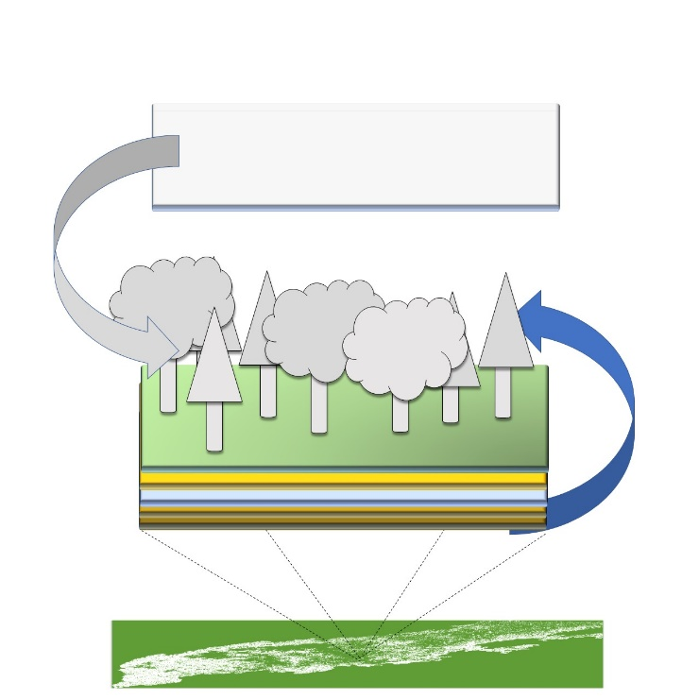
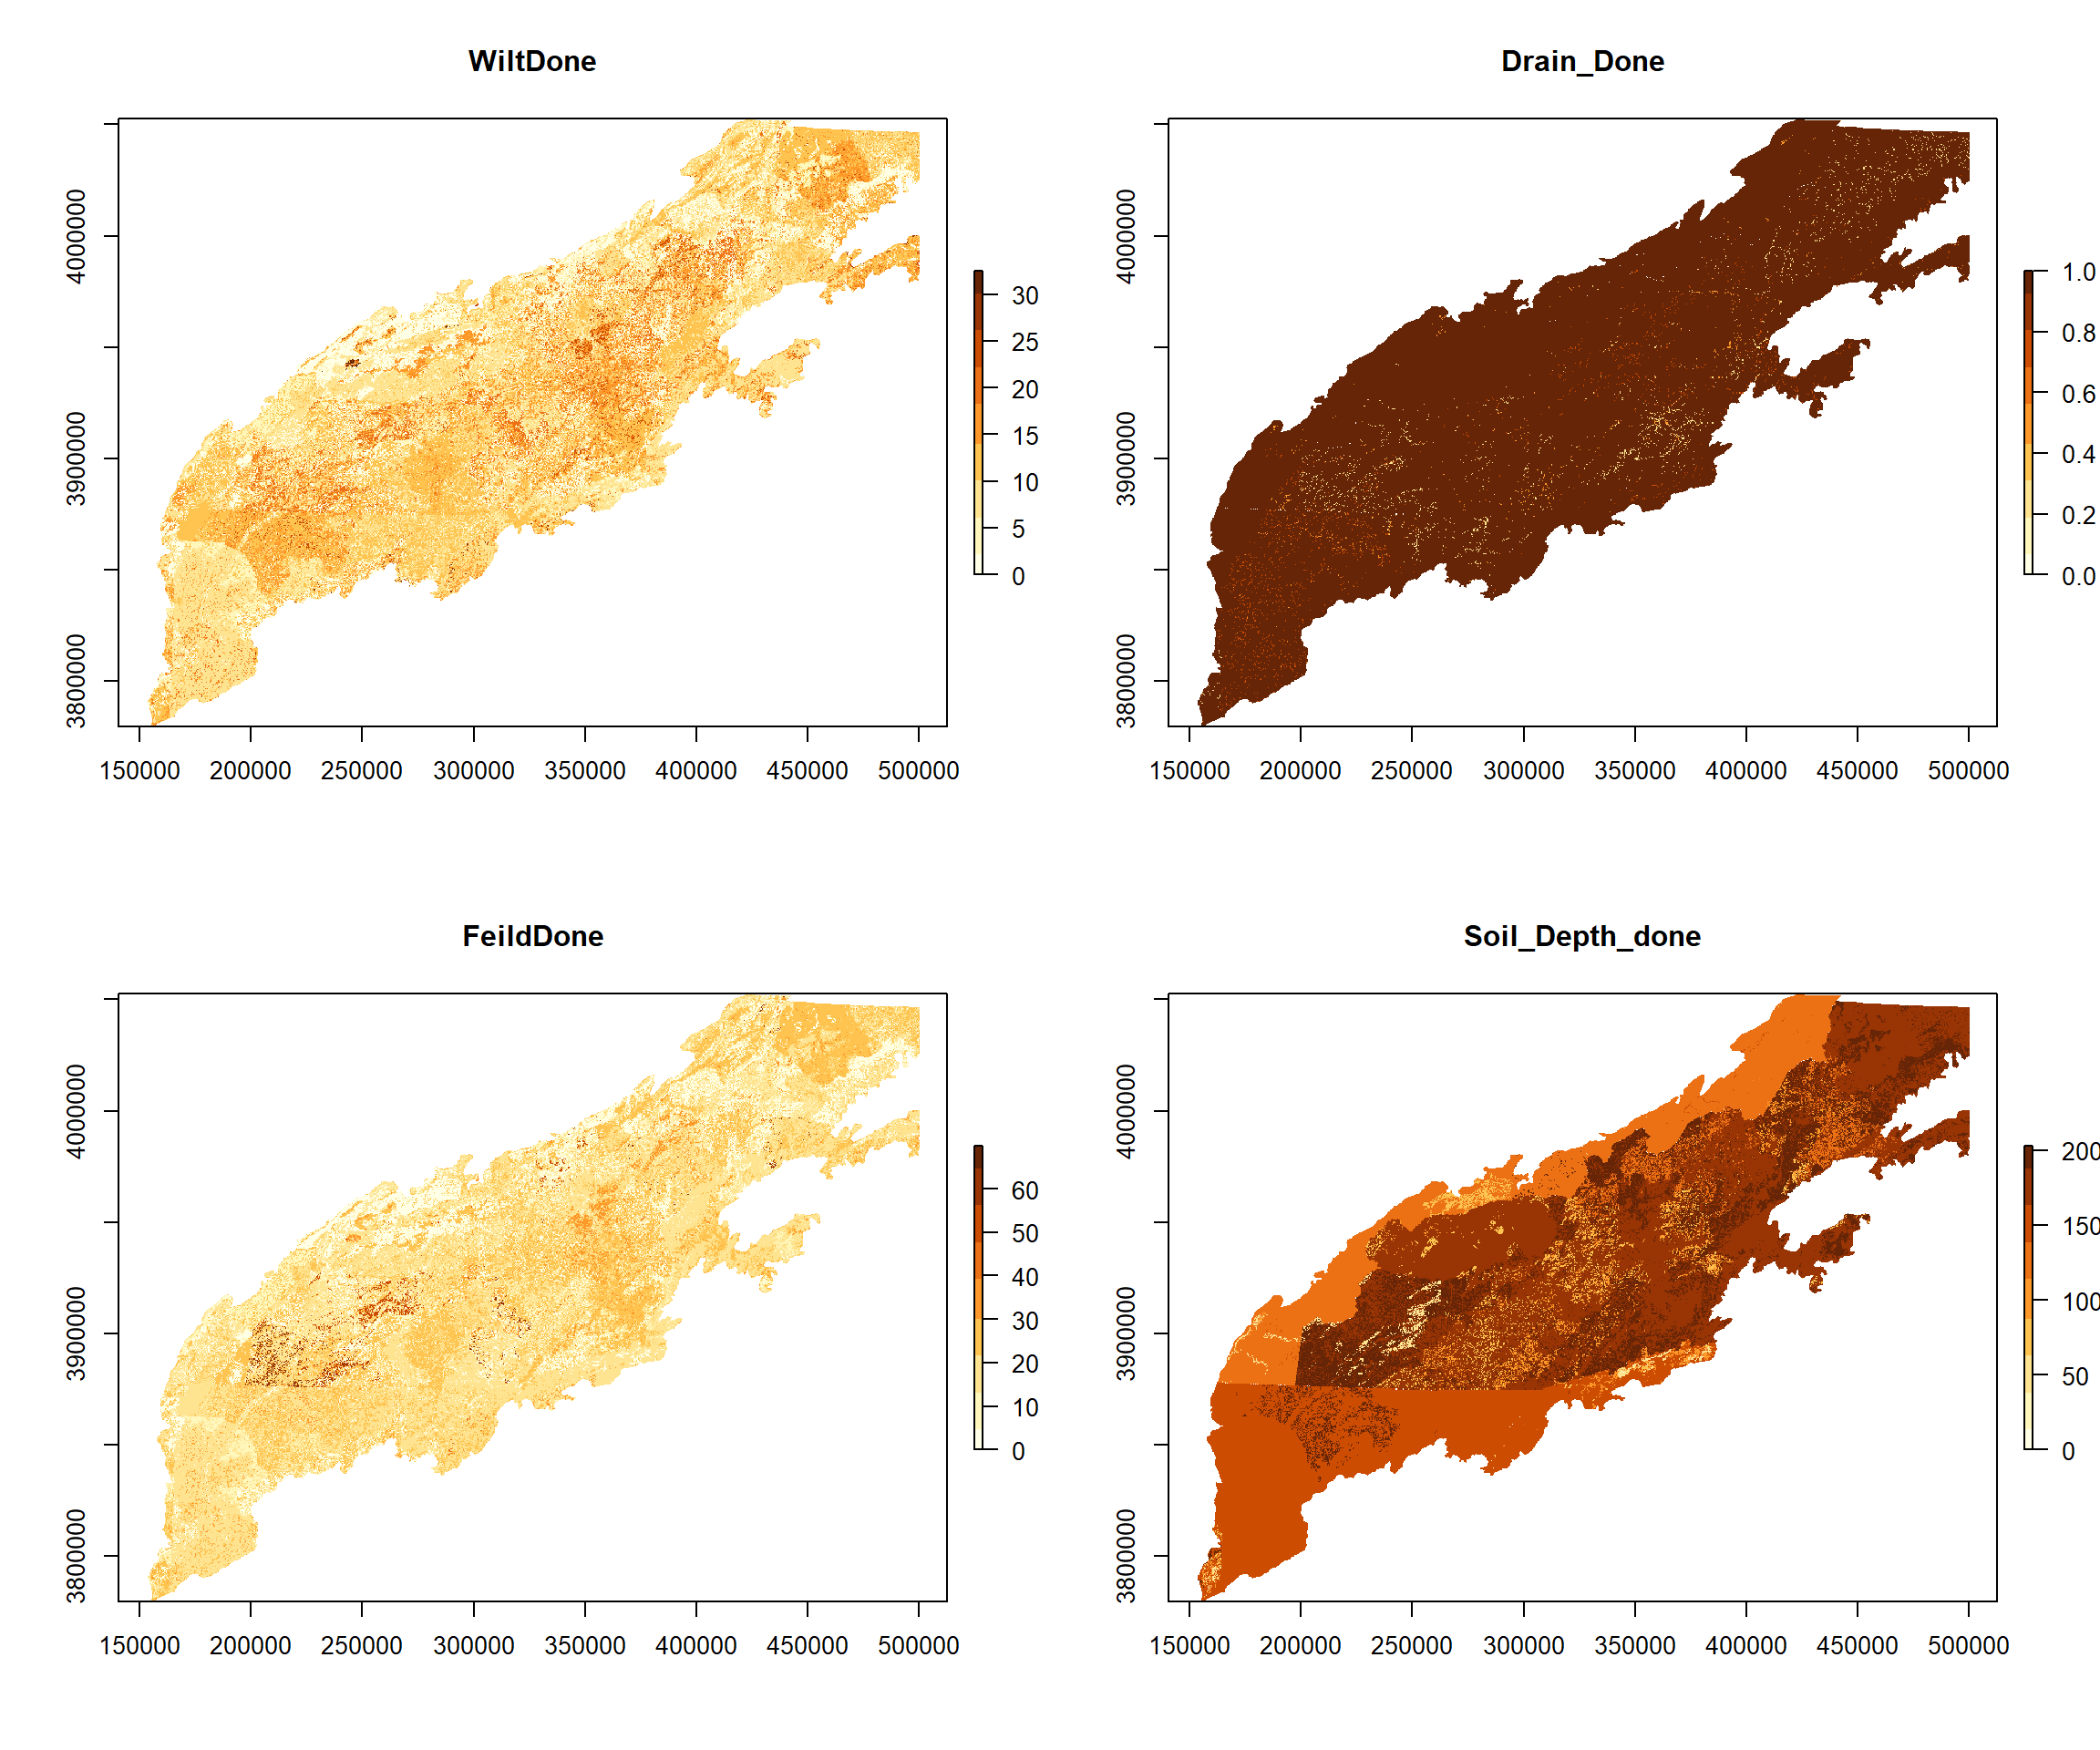
Soils
Using USGS SSURGO data gives us soil makeup, depth, and hydrology parameters.
Using carbon imputations as well as published C:N ratios gives us ecological important pools of carbon and nitrogen.
Notes:
For soils we are using National Surveys of soil conditions, we isolate ecological important metrics, and we combine these with spatial imputed soil carbon levels. Using published C:N ratios we create different ecological pools of carbon and nitrogen. These are then validated over 500 year runs, to understand nitrogen inputs, pool exchange, and outputs from the system.

Slide 8
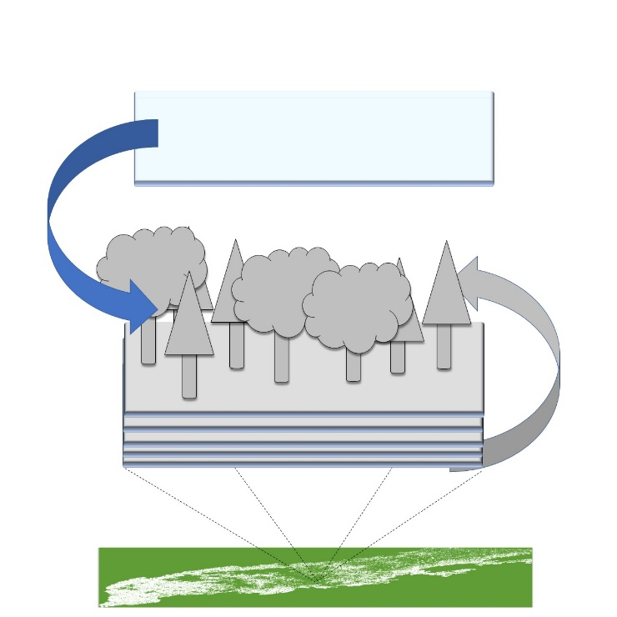
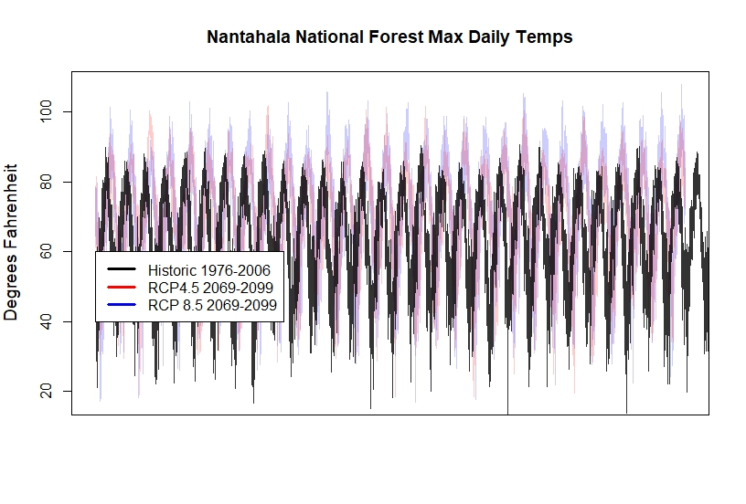
Climate
We isolate climate regions on the landscape.
Build an understanding of the differences in historic, low and high emissions scenarios.
Notes:
For Climate we isolate different climate regions within the study area using 40 years of historical daily data. Then Get the same climate regions as climate models under different concentration scenarios.

Slide 9
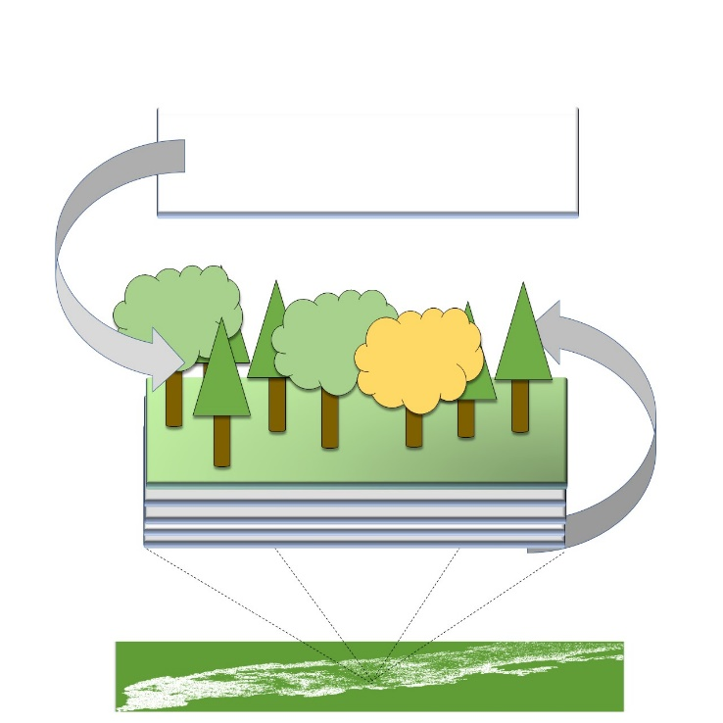
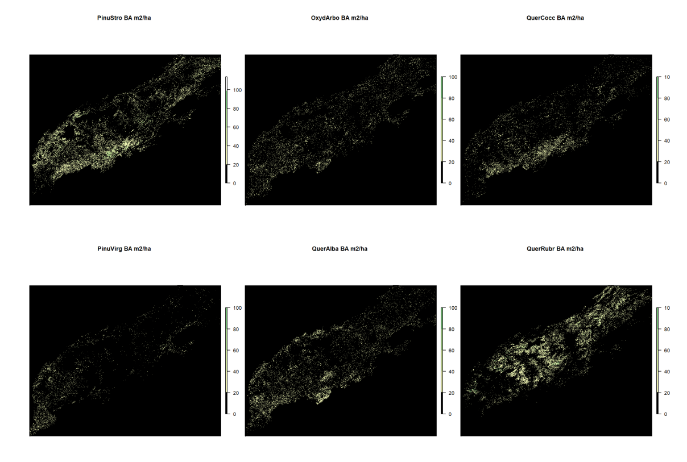
Forest Composition
Determine the distribution and density of species across the landscape.
Notes:
In order to determine forest composition we use forest service imputations made from spatially located FIA data, and environmental niche modeling

Slide 10
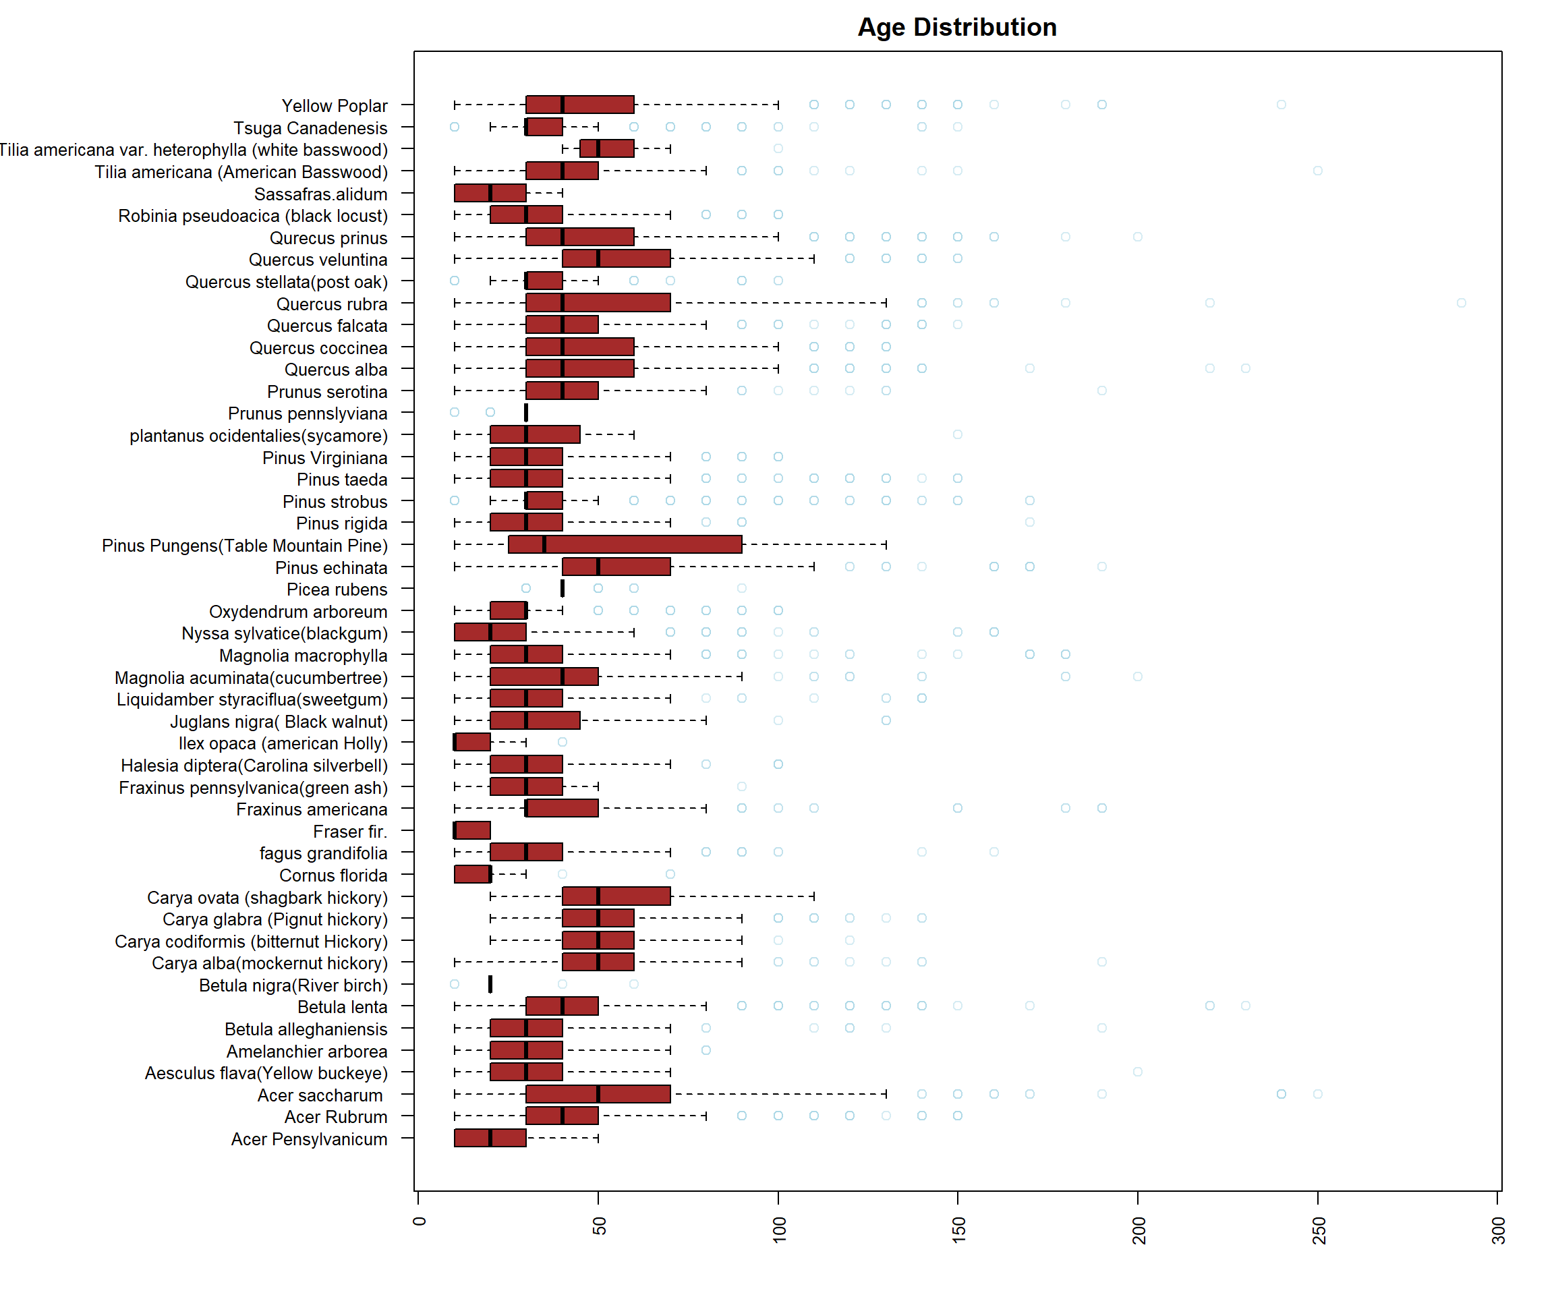
Forest Composition
Associate landscape scale imputations with detailed FIA data on stand-level conditions.
Notes:
we isolated cohorts measured in different FIA sites to obtain aboveground biomass age, and other stand level characteristics and associate them with landscape scale stands.

Slide 11

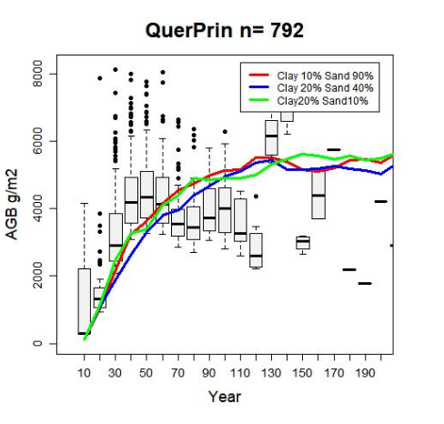
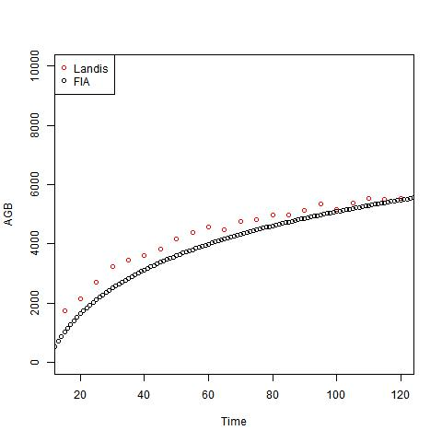
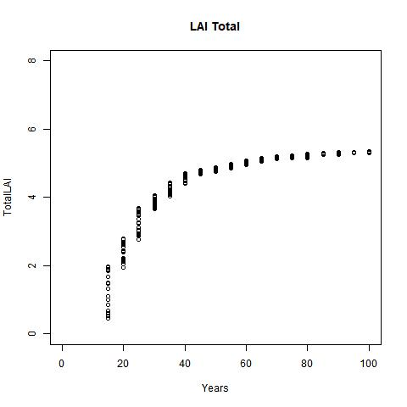
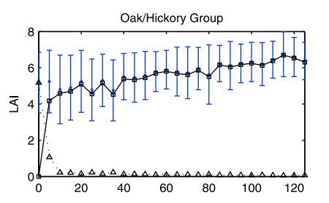
Species Dynamics
Characterize life history traits such as shade tolerance, fire resistance, and dispersal.
Test these against published data and data models.
He, L., Chen, J. M., Pan, Y., Birdsey, R., & Kattge, J. (2012). Relationships between net primary productivity and forest stand age in US forests. Global Biogeochemical Cycles, 26(3).
Notes:
We have to determine many characteristics of species in order to get an accurate model. Gathering published values for charaterics like shade tolerance, fire resistance, and growth rates. We begin to piece together what each species looks like with assistance from domain experts, this is than validated against FIA data models we build on growth, age. and accumulated biomass.

Slide 12
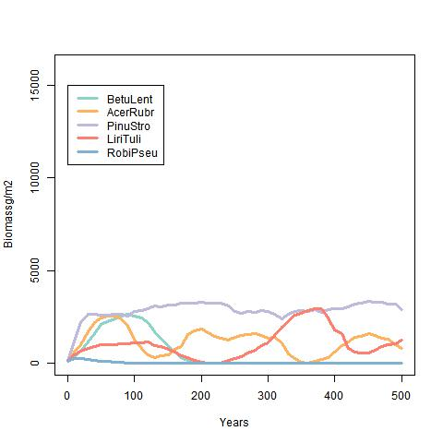
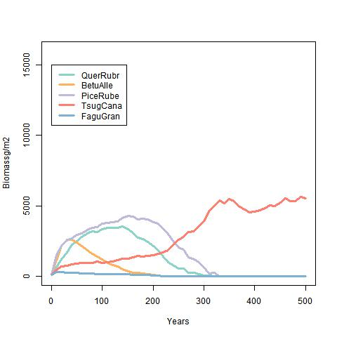
Forest Growth
Compare successional dynamics in different ecoregions.
Notes:
Then we test forest communities on different ecoregions to see if they match our prior ecological understanding of forest succession and growth strategies.

Slide 13
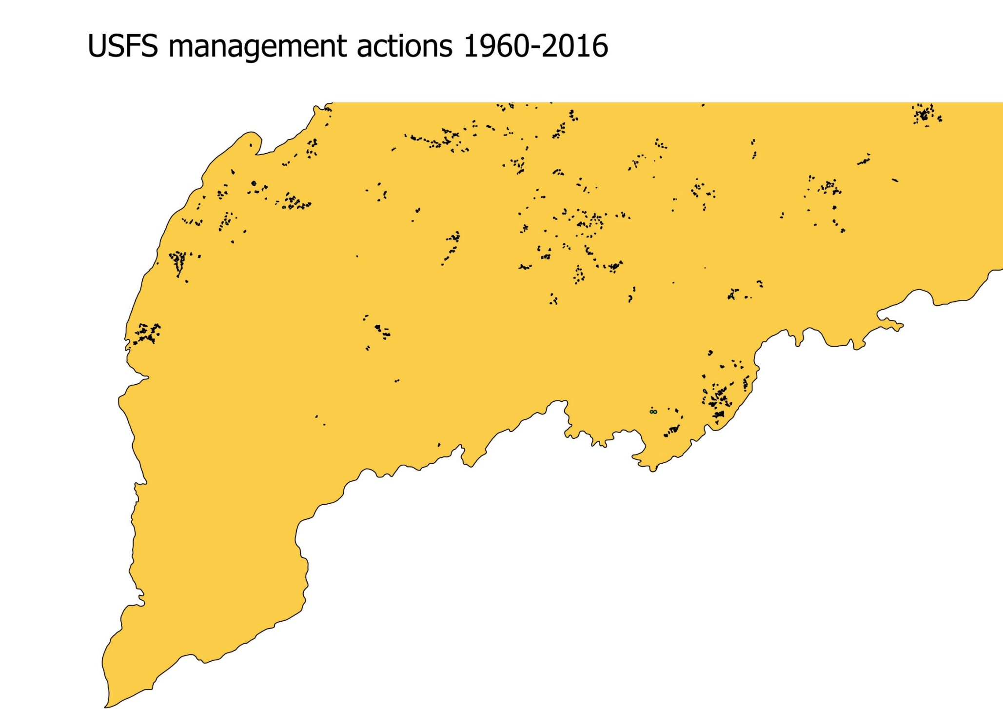
Future Work
Model management actions from the federal, state from records.
Model land-use change on private lands to approximate harvest.
Model prescribed and lightning lightning started fires.
Notes:
In the future we will be compiling geospatial data on land use change as well as state and federal management actions to estimate landscape scale harvest rates and prescription cuts. We will also be parameterizing a SCRAPPLE fire model to account for prescription and wildfires in the Southern Appalachians.

Slide 14
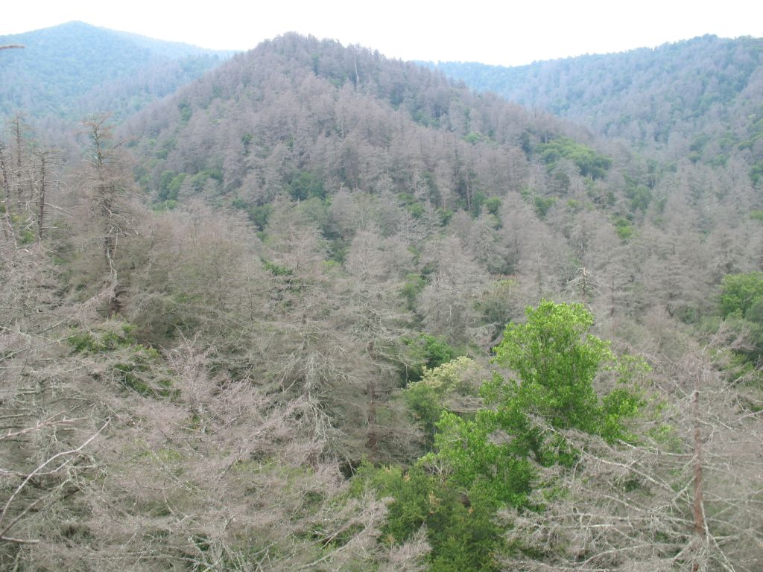
Questions We Hope To Answer.
How do different management scenarios preform under future climate.
How the history of chestnut blight may have lead to oak dominance on the landscape.
How will species composition will change given the loss of eastern hemlock.
Notes:
Some questions we hope to answer with this model are how management might affect change under future climate scenarios, how historical chestnut blight may have lead to oak dominance on the landscape, and how species composition will change given the loss of eastern hemlock.

Slide 15
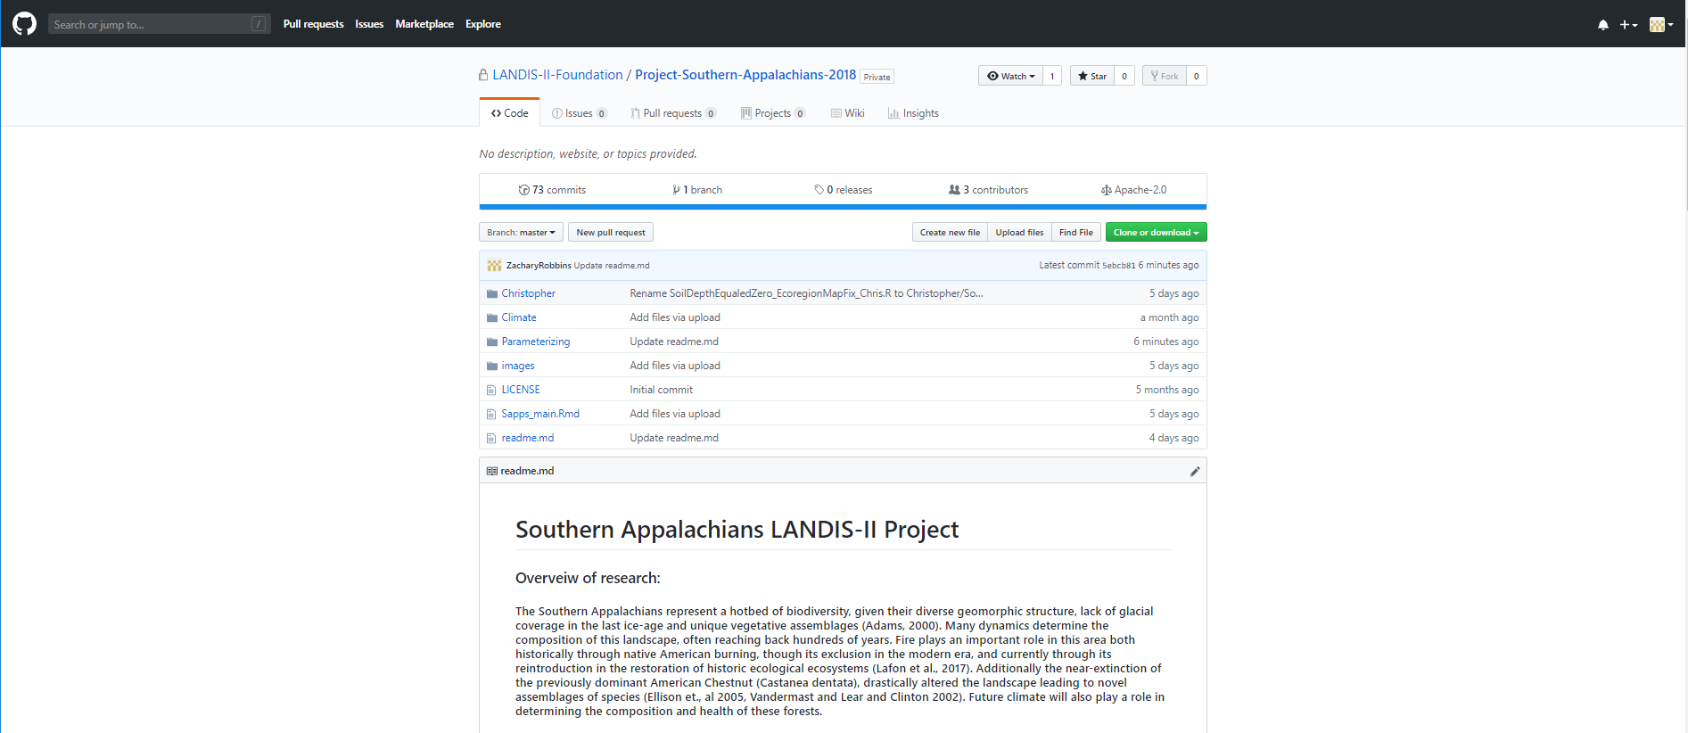
Open Data And Reproducibility
Notes:
All of these results, the code to produce them and data sources necessary to run these analyze will openly available on our github. Hopefully this will allow more transparency and reproducibility and aid future landscape modelers.

Slide 16

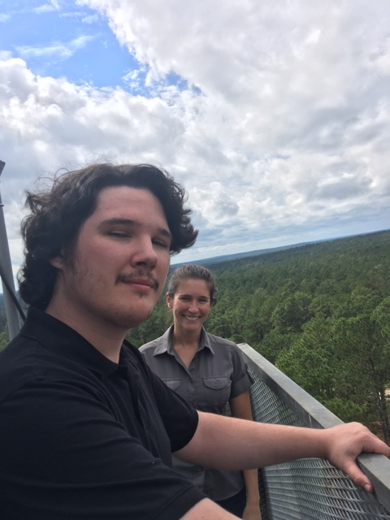


Thanks to my advisor, lab mates, collaborators, and funders
Photo Credits NPS Photo, Smokey Mountain Seasons: https://terra.nasa.gov/news/smoky-mountains-seasons, Newfound Gap. NPS Photo, Management: USFS, All others are the authors.
Notes:
I would like to thank my advisory rob schiller, my lab mates collaborators and funders.
Photo Credits NPS Photo, Smokey Mountain Seasons: https://terra.nasa.gov/news/smoky-mountains-seasons, Newfound Gap. NPS Photo, Management: USFS, All others are the authors.

