Slide 1
Silly reasons to not make a puzzle game
Cerise Talis
(she/they)

Slide 2
Goals
TK

Slide 3
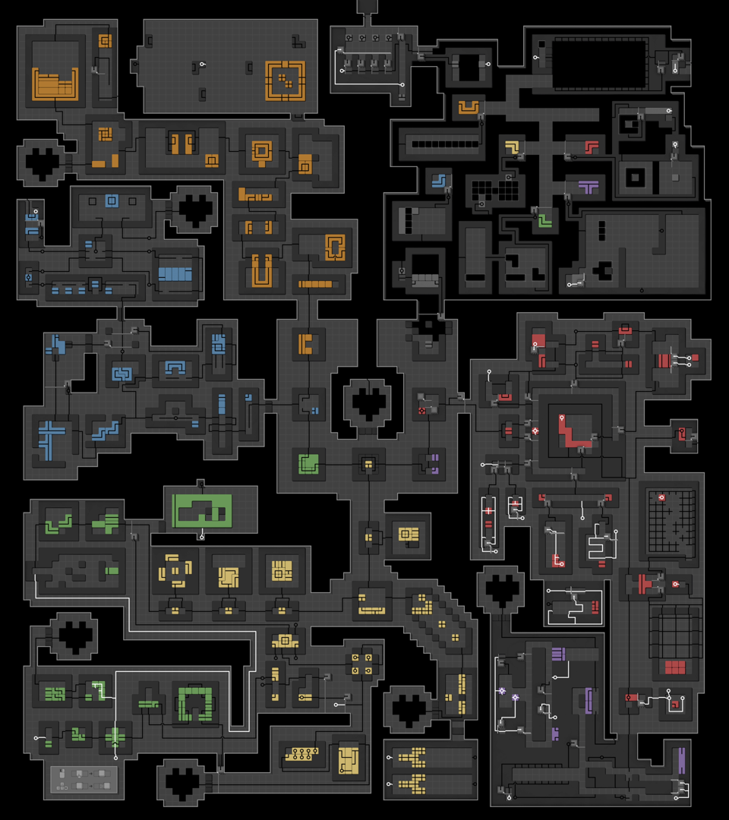
Background
0PLAYER
Pen-and-paper puzzles
Scuba Beavers
0PLAYER (2025)

Slide 4
“Solutions are non-unique”
TK

Slide 5
“Impossible to extract”
External apparatus
Impossible for computers, possible for players
Embrace post-modernity
Moment-to-moment goals

Slide 6
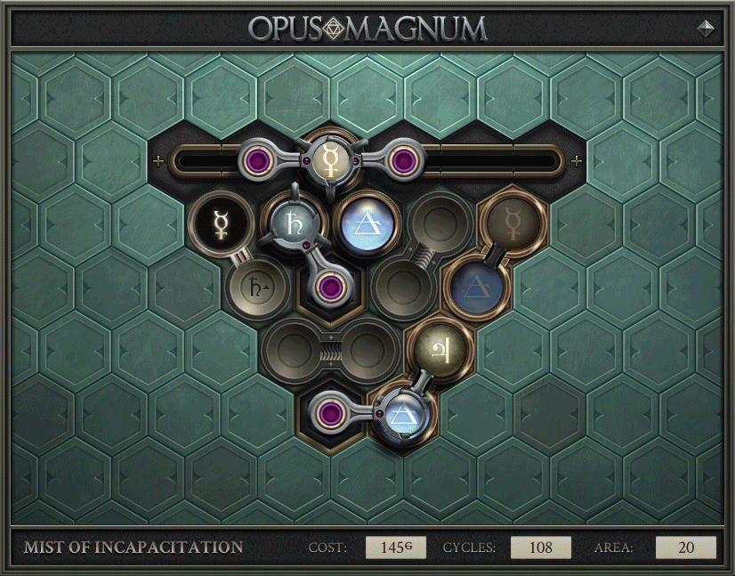
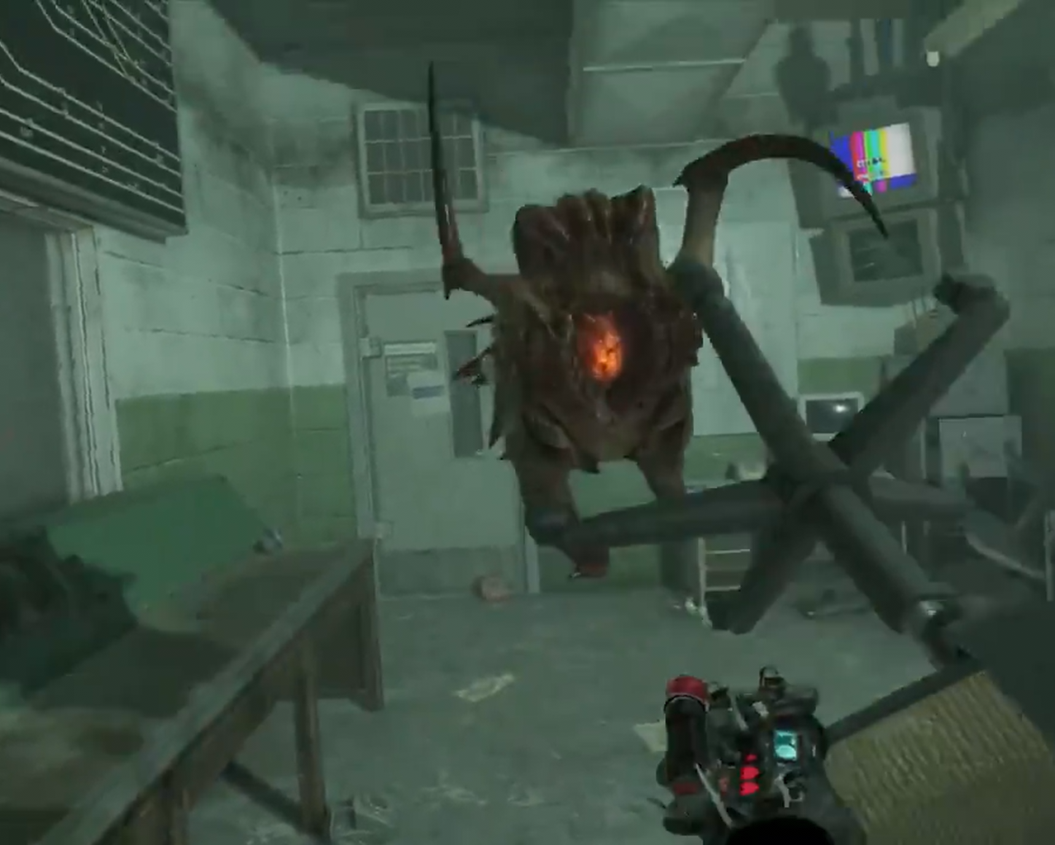
“Impossible to extract”
Opus Magnum (2017)
Half-Life: Alyx (2020)
Notes:
Opus Magnum: Those goals in the bottom-right were only suggestions, and I didn’t follow them. Instead, I was guided by my own sense of beauty.
HL Alyx: TK

Slide 7
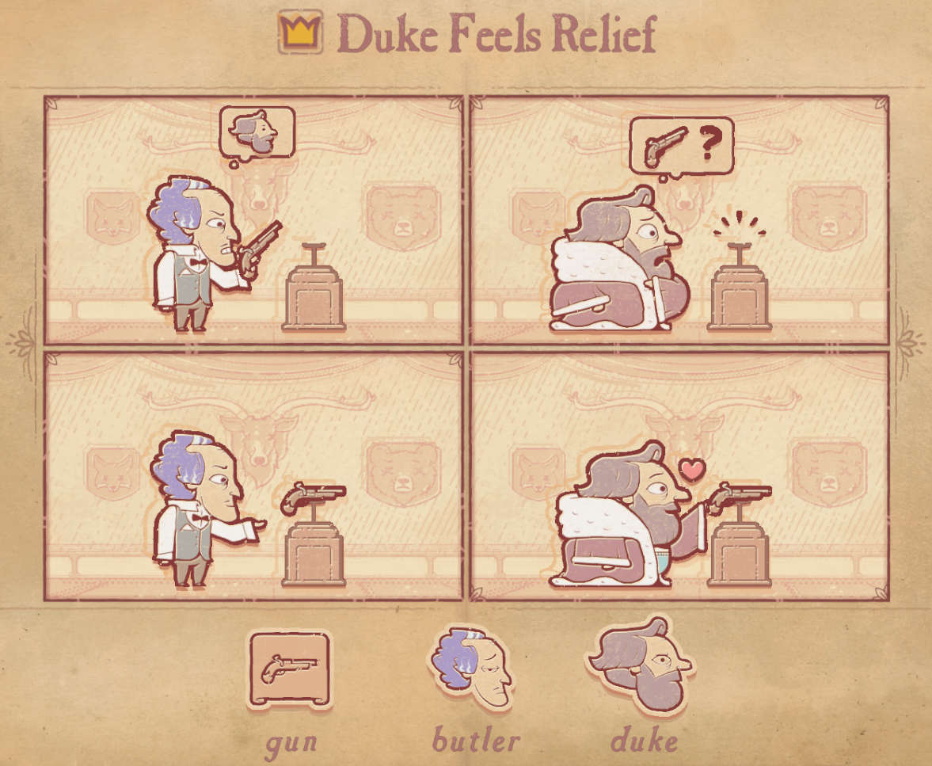
“Wouldn’t quiz the player enough”
Making puzzles easier is the bulk of the work
Some systems never get difficult
Storyteller (2023)

Slide 8
“Lacks a twist”
Quizzing the player
Don’t undermine your game’s confidence
You shouldn’t know how your game ends

Slide 9
“No musical bird”
TK

Slide 10
The difficulty of notating a vocal line that preserves the integrity of spoken words is not a small one, but neither is it insurmountable... and the compensations are large.
Few orthodox musicians would call such vocal lines "musical," and Combarieu declares that the songs of birds are not "musical" either, because they are "very difficult to take down in notation."
Will some divine power please create a "musical" bird to sing the Air for G String in exact Equal Temperament for M. Combarieu?
– Harry Partch, Genesis of a Music (2nd ed.), 45-46

Slide 11
What do our first prototypes look like?
Square grid
Player character
Solutions are sequences of directional inputs
Player pushes crates
Walls block player and crates
Multipush (or lack thereof)
Interactions take place in a world of physics
Linear, discrete time, with dead-end states
Undo stack management
Level ends immediately once solved

Slide 12
“Undo stack management too futzy”
“Designing to reveal the nature of the undo stack” – Katelyn Δ

Slide 13
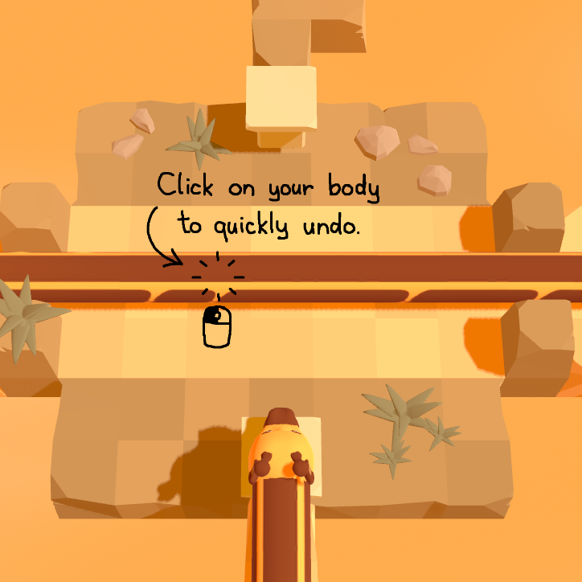
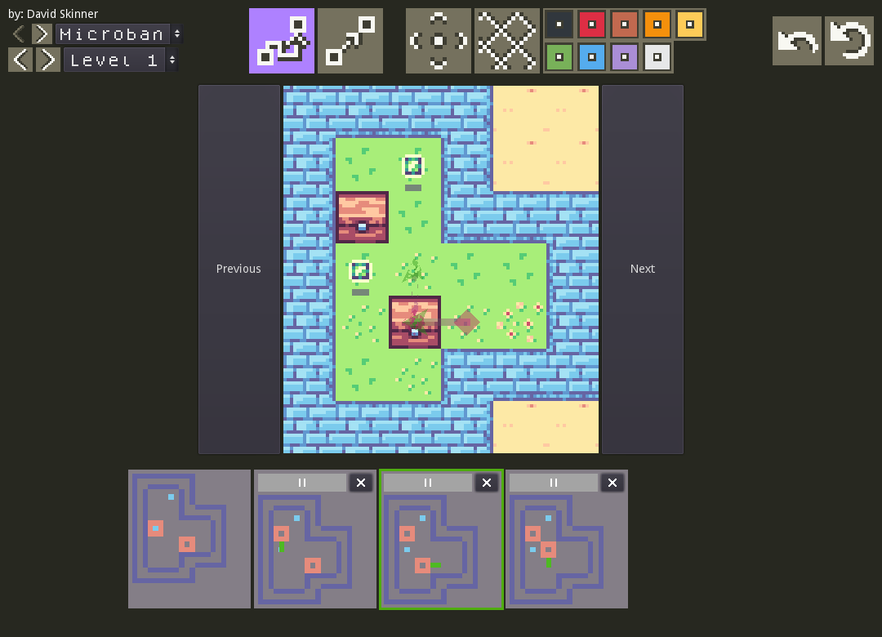
“Undo stack management too futzy”
Trifolium: The Adventures of Gary Pretzelneck (upcoming)
Jack’s Sokoban (2022)
Notes:
Trifolium: TK
Jack’s Sokoban: Maximalist approach. Implements a ruleset isomorphic to sokoban.

Slide 14
“Can’t be wordless”
Appearance of a puzzle game
Artists’ statements
No qualifiers →
Natural terms →
Hesitation minimized

Slide 15
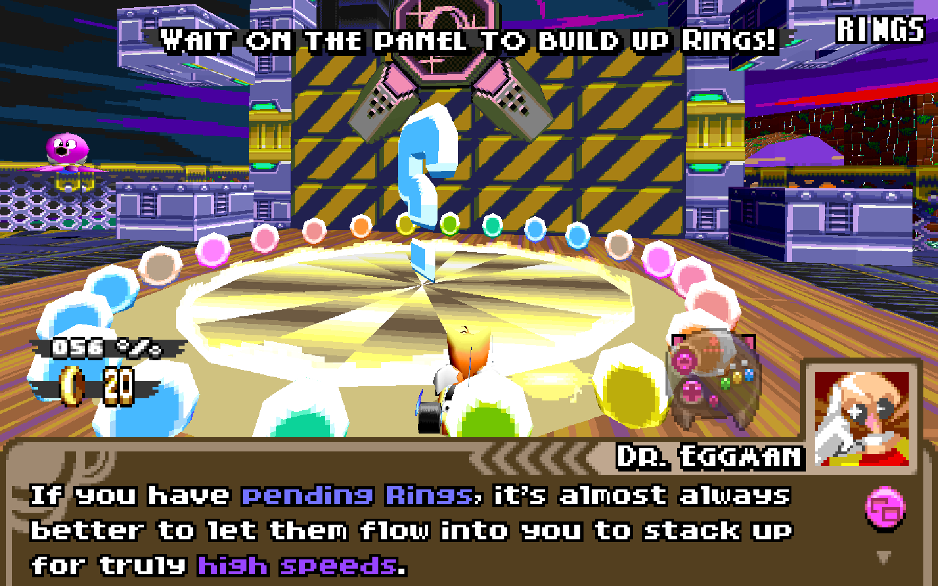
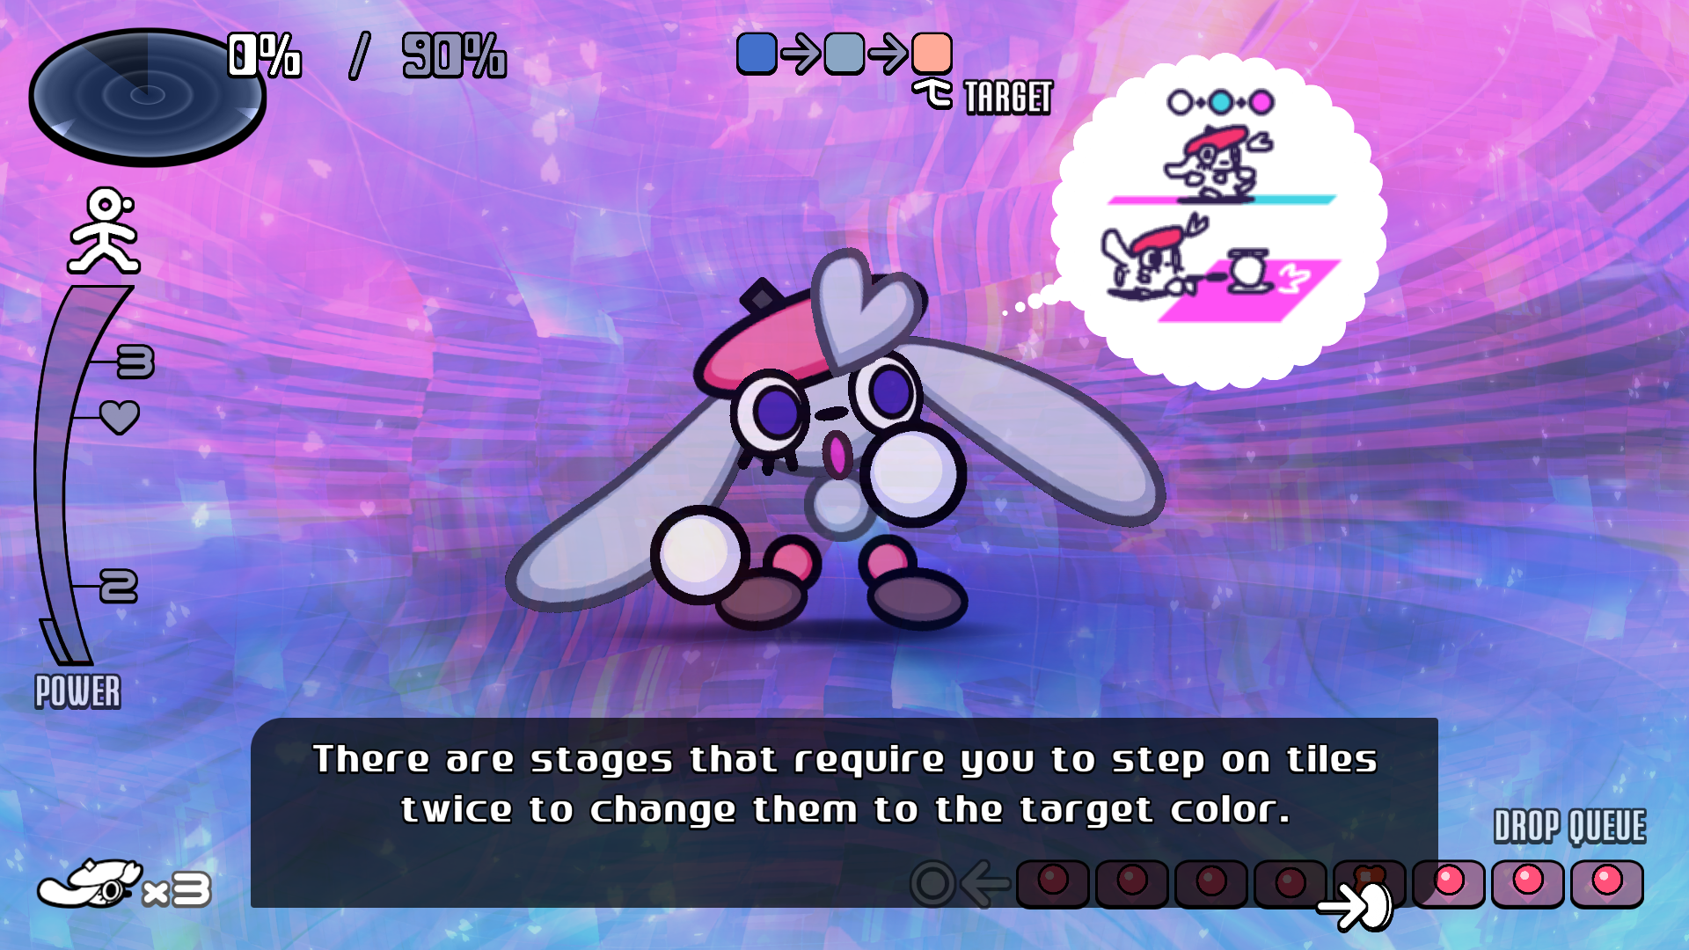
“Can’t be wordless”
Dr. Robotnik’s Ring Racers (2024)
Vividlope (2023)
Notes:
Opus Magnum: Those goals in the bottom-right were only suggestions, and I didn’t follow them. Instead, I was guided by my own sense of beauty.
HL Alyx: TK

Slide 16
“Doesn’t work without hints”
Your game is not pure maths
Subtle prerequisites

Slide 17
“Too many ideas at once”
TK

Slide 18
“Induces analysis paralysis”
Common in boardgame design
Overly concerned with player discomfort

Slide 19
“Motivated by spite”
I am surprised that among so many rare minds who would have done this much better than I, there was no one who had the patience to unravel these things and that they almost all imitated those travelers who leaving the main road to take a crossroad remain lost in the brambles and precipices.
– René Descartes, Meditations on First Philosophy,
as translated by John Cottingham

Slide 20
“Afraid of edge cases”
TK

Slide 21

“Afraid of edge cases”
The Sekimeiya: Spun Glass (2017)
Rivals of Aether (2017)
Notes:
Opus Magnum: Those goals in the bottom-right were only suggestions, and I didn’t follow them. Instead, I was guided by my own sense of beauty.
HL Alyx: TK

Slide 22
“Requires pre-existing trust”
TK

Slide 23
“TK”
TK

Slide 24
Solutions are non-unique
Impossible to extract
Wouldn’t quiz the player enough
Lacks a twist
No musical bird
Undo stack management too futzy
Can’t be wordless
Doesn’t work without hints
Too many ideas at once
Induces analysis paralysis
Motivated by spite
Afraid of edge cases
Requires pre-existing trust
Thanks to...
cerisetalis.com/email

