Slide 1
167025

Slide 2
Lecture 4 Project 1
CS 3339
Lecture 4 – Project 1
Greg LaKomski
Texas State University
Fall 2018

Slide 3
Announcements
Homework due NOW
Round Rock Hackathon
Competitive Coding Club
Register to Vote!

Slide 4
Today
First go over the project
Then go over debugger
Then we will start a python review until we run out of time. I have a LOT of slides!!! Will cherry pick and post them all
In real life you will have to learn lots of languages over your career – by yourself – on your own time – while standing on your head -

Slide 5
Who is Dana Ulery??

Slide 6
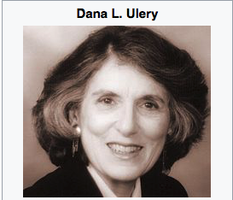
Who is Dana Ulery??

Slide 7
Who is Dana Ulery??
She was the first woman engineer to work at the Jet Propulsion Laboratory in 1961
She was a Computer Scientist
She was an algorithm developer who worked on deep space tracking.
A true CS pioneer!

Slide 8
Project Definition
Project 1is a dissasembler for ARM machine code
You will take a set of machine code and convert it to assembly language instructions matching the machine code
We will work with a subset of the (ARM) LEGv8 instructions which is a subset of ARMv8
You will work in teams of two for this project

Slide 9
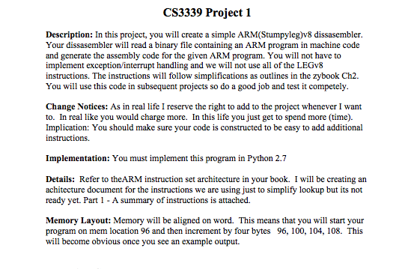
Instructions

Slide 10
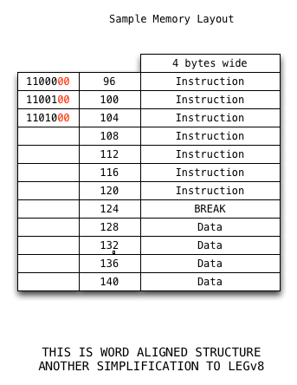
Memory Map – Simplified to Word Align

Slide 11
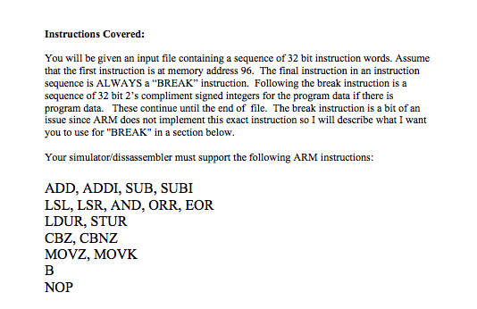
Instructions

Slide 12
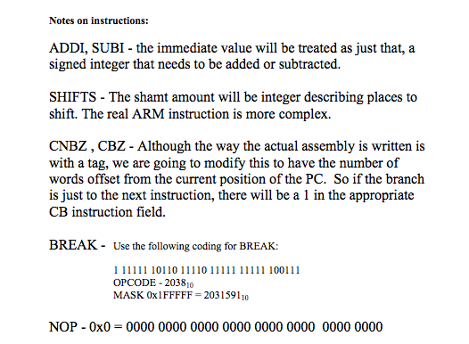
Instructions

Slide 13
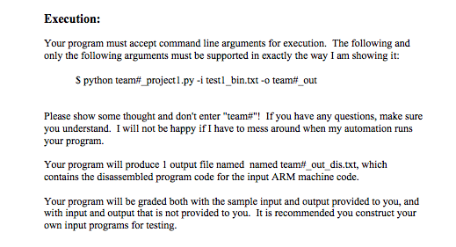
Instructions
My output file is named:
team0_out_dis.txt

Slide 14
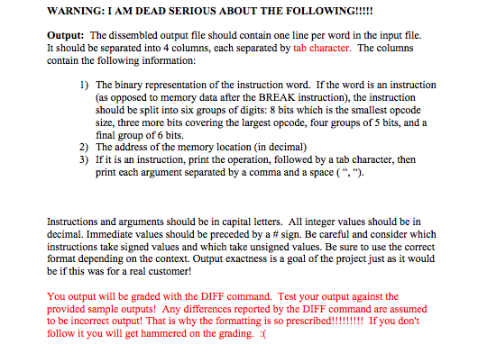
Instructions

Slide 15
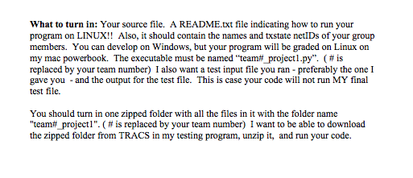
Instructions

Slide 16
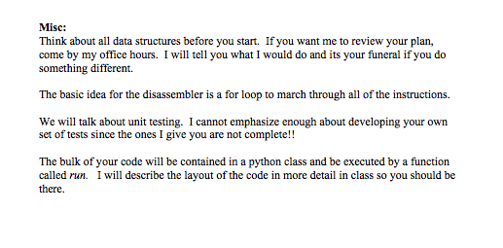
Instructions

Slide 17
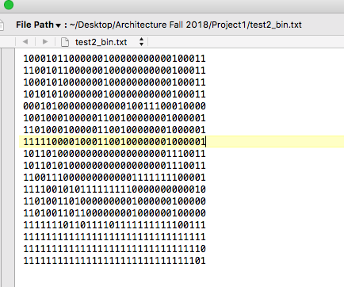
Sample Input

Slide 18
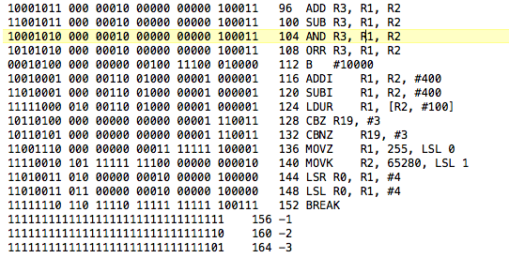
Sample Output

Slide 19
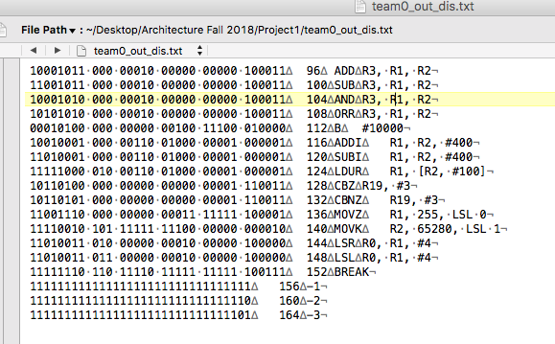
Output with Invisibles

Slide 20
First Part of my code
import sys import os opcodeStr = [] # <type 'list'>: ['Invalid Instruction', 'ADDI', 'SW', 'Invalid Instruction', 'LW', 'BLTZ', 'SLL',...] validStr= [] #<type 'list'>: ['N', 'Y', 'Y', 'N', 'Y', 'Y', 'Y', 'Y', 'Y', 'Y', 'Y', 'Y', 'Y', 'Y', 'Y',...] instrSpaced = [] # <type 'list'>: ['0 01000 00000 00001 00000 00000 001010', '1 01000 00000 00001 00000 00000 001010',...] arg1 = [] # <type 'list'>: [0, 0, 0, 0, 0, 1, 1, 10, 10, 0, 3, 4, 152, 4, 10, 1, 0, 112, 0] arg2 = [] # <type 'list'>: [0, 1, 1, 0, 1, 0, 10, 3, 4, 5, 0, 5, 0, 5, 6, 1, 1, 0, 0] arg3 = [] # <type 'list'>: [0, 10, 264, 0, 264, 48, 2, 172, 216, 260, 8, 6, 0, 6, 172, -1, 264, 0, 0] arg1Str = [] # <type 'list'>: ['', '\tR1', '\tR1', '', '\tR1', '\tR1', '\tR10', '\tR3', '\tR4', .....] arg2Str = [] # <type 'list'>: ['', ', R0', ', 264', '', ', 264', ', #48', ', R1', ', 172', ', 216', ...]' arg3Str = [] # <type 'list'>: ['', ', #10', '(R0)', '', '(R0)', '', ', #2', '(R10)', '(R10)', '(R0)',...] mem = [] # <type 'list'>: [-1, -2, -3, 1, 2, 3, 0, 0, 5, -5, 6, 0, 0, 0, 0, 0, 0, 0, 0, 0, 0, 0, 1, 0] binMem = [] # <type 'list'>: ['11111111111111111111111111111111', '11111111111111111111111111111110', ...] valid = [] opcode = []

Slide 21
Start of Class
class TestMe: #def __init__(self): def run(self): global opcodeStr global validStr global arg1 global arg2 global arg3 global arg1Str global arg2Str global arg3Str global mem global binMem global valid global opcode

Slide 22
Command Line Decode
This gets part of the file names off the command line. You need to build the output file name into final form. See instructions
for i in range(len(sys.argv)): if (sys.argv[i] == '-i' and i < (len(sys.argv) - 1)): inputFileName = sys.argv[i + 1] print inputFileName elif (sys.argv[i] == '-o' and i < (len(sys.argv) - 1)): outputFileName = sys.argv[i + 1]

Slide 23
Running
If my class is named Dissemble:
typically at end of code so will run from command line input:
dissme = Dissemble()
dissme.run()
ALSO GOOGLE THIS
if __name__ == "__main__": # execute only if run as a script main()
this way you can run both as a script or use pycharm with command script entries to test.

Slide 24
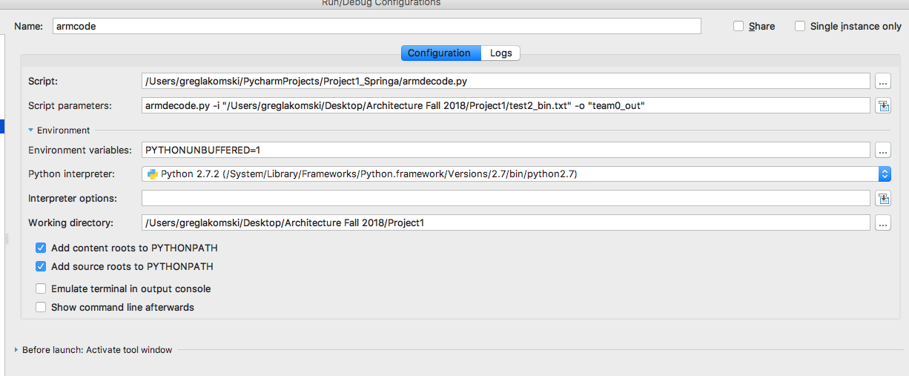
pycharm
Screen shot of a pycharm run configuration screen showing how to enter the command line script parameters.

Slide 25
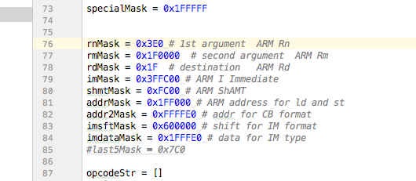
Parsing a machine code string
I use masks and shift . Real Engineers know how to do this. You can also use string methods.

Slide 26
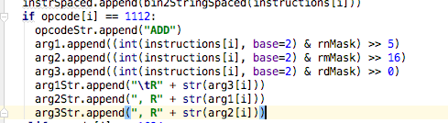
How I attacked decoding
The basic idea is to loop through the instructions until you see break, processing the instructions as – well – instructions. Then after break switch to processing as data.
After some deeeep thinking, lots of naps and because I’m making coding great again (for us coding elites, not you) , I used if – elif structure.

Slide 27
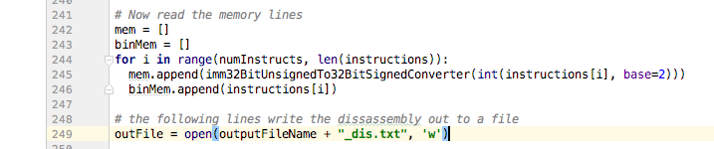
Read the data after the break

