Slide 1



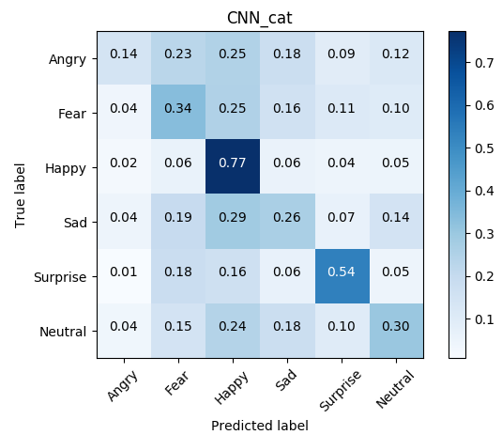
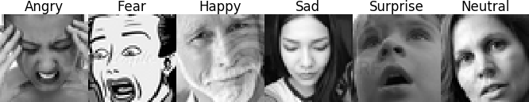
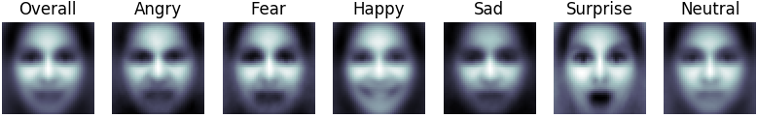

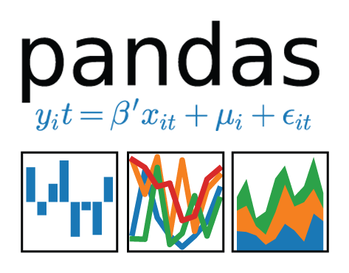




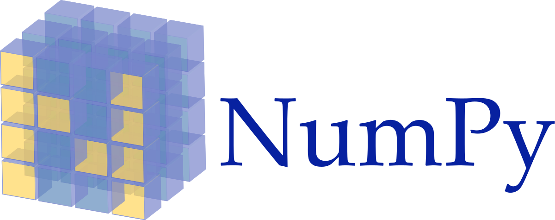


Emotional Face Classifier
Danny Lumian, PhD
/github.com/dlumian
in
/in/lumian
dlumian@gmail.com
Background
Models
Results
Test Case: Movies
Faces are rich sources of emotional information
Emotions can be organized categorically (e.g., happy, sad)
Many people are quite good at rapidly and dynamically monitoring such information
However, sometimes additional means of quantifying emotional expressions may be helpful
Multinomial Naive Bayes (MNB), Random Forest (RF), Convolutional Neural Network (CNN)
Trained on balanced and unbalanced datasets
Model | Balanced | Train Log Loss | Test Log Loss | Train Accuracy | Test Accuracy
MNB | No | 25.549 | 25.661 | 25.4 | 25.2
MNB | Yes | 25.684 | 25.730 | 24.9 | 25.0
RF | No | 0.331 | 4.733 | 99.1 | 37.4
RF | Yes | 0.337 | 5.225 | 99.1 | 32.7
CNN | No | 13.109 | 19.494 | 60.4 | 42.3
CNN | Yes | 14.909 | 20.532 | 55.5 | 39.5
Data
CNN
Conclusion
Data obtained from Kaggle FER2013 dataset (www.kaggle.com / c /challenges-in-representation-learning-facial-expression-recognition-challenge/data)
Expressions: Angry, Fear, Happy, Sad, Surprise, Neutral and Disgust
Disgust was dropped due to a low number of images (XXX)
Images were 48x48, gray scale
Example Images
Averaged Images
(
(
Label | Train # | Balanced Train # | Validation # | Test #
Angry | 3995 | 3171 | 528 | 491
Fear | 4097 | 3171 | 879 | 528
Happy | 7215 | 3171 | 895 | 879
Sad | 4830 | 3171 | 653 | 594
Surprise | 3171 | 3171 | 415 | 416
Neutral | 4965 | 3171 | 607 | 626
TOTAL | 28273 | 19026 | 3977 | 3534
Tech Stack
Future Directions
Notes:
<number>

