Slide 1



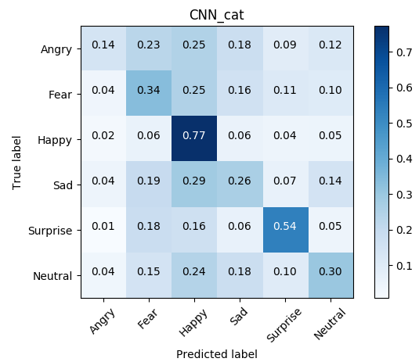
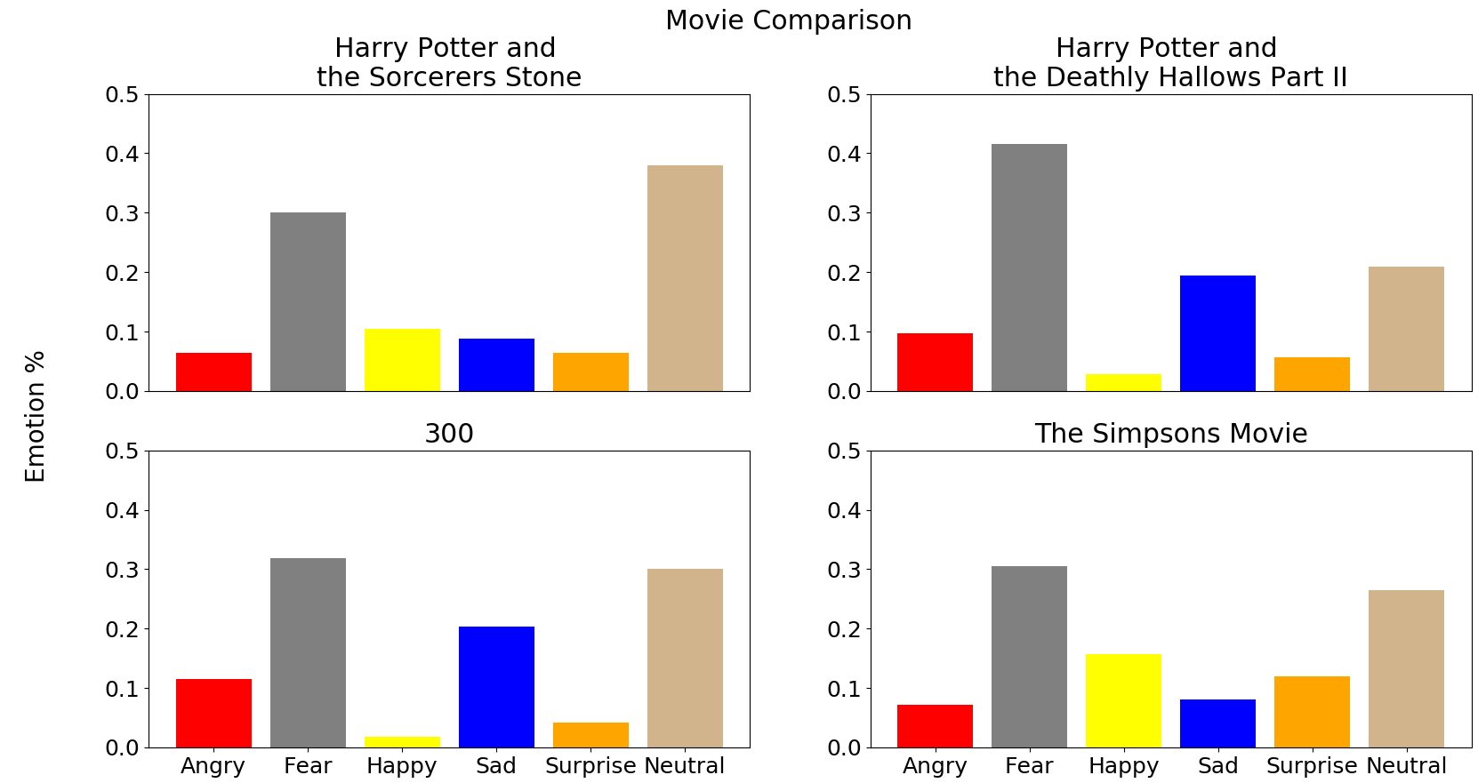
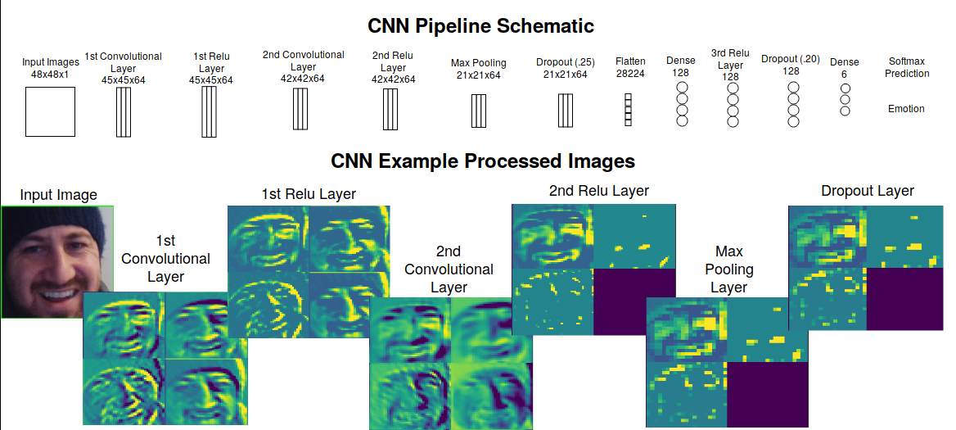
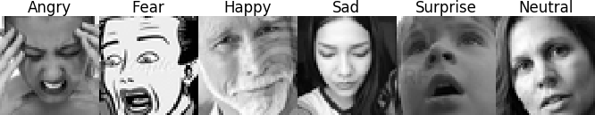
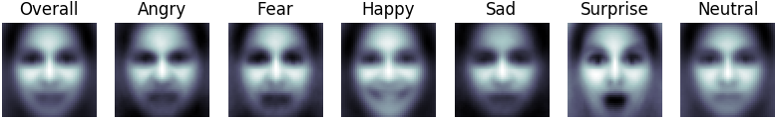

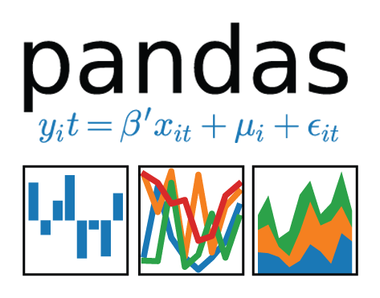




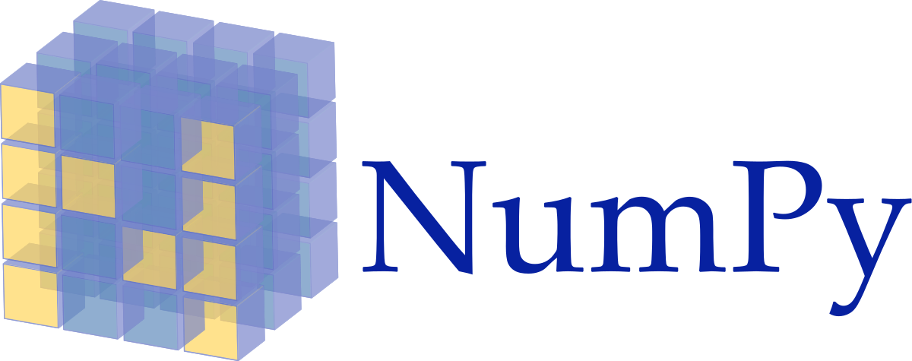


Emotional Face Classifier
Danny Lumian, PhD
/github.com/dlumian
in
/in/lumian
dlumian@gmail.com
Background
Models
Results
Test Case: Movies
Faces are rich sources of emotional information
Emotions can be organized categorically (e.g., happy, sad)
Many people are quite good at rapidly and dynamically monitoring such information
However, sometimes additional means of quantifying emotional expressions may be helpful
Multinomial Naive Bayes (MNB), Random Forest (RF), Convolutional Neural Network (CNN)
Trained on balanced and unbalanced datasets
Classified all facial expressions in 4 movies
Model | Balanced | Train Log Loss | Test Log Loss | Train Accuracy | Test Accuracy
MNB | No | 25.549 | 25.661 | 25.4 | 25.2
MNB | Yes | 25.684 | 25.730 | 24.9 | 25.0
RF | No | 0.331 | 4.733 | 99.1 | 37.4
RF | Yes | 0.337 | 5.225 | 99.1 | 32.7
CNN | No | 13.109 | 19.494 | 60.4 | 42.3
CNN | Yes | 14.909 | 20.532 | 55.5 | 39.5
Data
Convolutional Neural Network
Conclusions
Data obtained from Kaggle FER2013 dataset (www.kaggle.com / c /challenges-in-representation-learning-facial-expression-recognition-challenge/data)
Expressions: Angry, Fear, Happy, Sad, Surprise, Neutral and Disgust
Disgust was dropped due to a low number of images (547)
Images were 48x48, gray scale
Several machine learning models were able to classify emotion better than chance (i.e., 17% with 6 classes)
The CNN model outperformed both Multinomial Naive Bayes and Random Forest models
The CNN model trained on the full dataset performed best with an accuracy of over 40%
Some emotions (e.g., happy and fear) appear easier to classify than others
The model was successfully applied to static images, recorded video (motion pictures) and live stream video capture (webcam)
Example Images
Averaged Images
Convolutional Layers: 2
Activation Layers: 4
Max Pooling Layers: 1
Filters: 64
Pool Size: (2, 2)
Kernel Size: (4, 4)
Batch Size: 256
Epochs: 100
Total Classes: 6
Label | Train # | Balanced Train # | Validation # | Test #
Angry | 3995 | 3171 | 528 | 491
Fear | 4097 | 3171 | 879 | 528
Happy | 7215 | 3171 | 895 | 879
Sad | 4830 | 3171 | 653 | 594
Surprise | 3171 | 3171 | 415 | 416
Neutral | 4965 | 3171 | 607 | 626
TOTAL | 28273 | 19026 | 3977 | 3534
Tech Stack
Future Directions
Utilize model with real-time feedback to facilitate social interactions for individuals with emotion processing impairments
Develop an app with user input and feedback to expand training dataset

