Slide 1
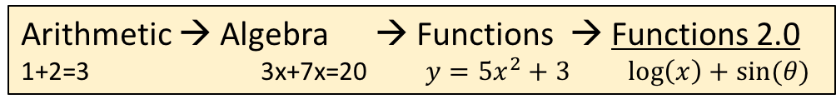

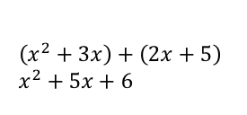

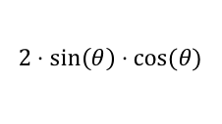

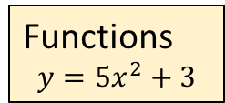
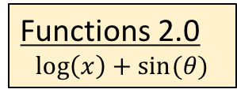
Arithmetic → Algebra → Functions → Functions 2.0
1+2=3 3x+7x=20 $y=5x^{2}+3$ $\log\left(x\right)+\sin{(θ)}$
“Most people overestimate what they can do in 1 week and underestimate what they can achieve in 1-year” (Bill Gates)
Arithmetic
1+2=3
Real Numbers
Algebra
Review from Algebra-I
Algebra
3x+7x=20
Equations
Relations, Functions, Graphs
Domain, Range, 1-1 function, lines
$$y=mx+b$$
Functions
$$y=5x^{2}+3$$
Tools
System of equations
Graphs of two lines
$\left(x^{2}+3x\right)+\left(2x+5\right)$
$x^{2}+5x+6$
Polynomials
Factoring
Powers, Roots, Complex Numbers
Quadratic equations
Solving: Factoring, complete square, formula
Quadratic graphs: Parabola
Functions transformations
Rational expressions
Division
$$\frac{x^{3}+3x^{2}+4}{x+5}$$
Polynomial functions
Graphs, behavior, roots
Functions 2.0
$$\log\left(x\right)+\sin{(θ)}$$
Exponents, Logarithms
New functions: Graphs, manipulations
$$e^{x}+2\log\left(x^{2}+5\right)$$
Sequences and Series
Arithmetic, Geometric
Trigonometric functions
Geometry meets algebra (again!)
$$2⋅sin\left(θ\right)⋅cos⁡(θ)$$

Slide 2
Arithmetic → Algebra → Functions → Functions 2.0
1+2=3 3x+7x=20 $y=5x^{2}+3$ $\log\left(x\right)+\sin{(θ)}$
“Most people overestimate what they can do in 1 week and underestimate what they can achieve in 1-year” (Bill Gates)
Arithmetic
1+2=3
Real Numbers
Algebra
Review from Algebra-I
Algebra
3x+7x=20
Equations
Relations, Functions, Graphs
Domain, Range, 1-1 function, lines
$$y=mx+b$$
Functions
$$y=5x^{2}+3$$
Tools
System of equations
Graphs of two lines
$\left(x^{2}+3x\right)+\left(2x+5\right)$
$x^{2}+5x+6$
Polynomials
Factoring
Powers, Roots, Complex Numbers
Quadratic equations
Solving: Factoring, complete square, formula
Quadratic graphs: Parabola
Functions transformations
Rational expressions
Division
$$\frac{x^{3}+3x^{2}+4}{x+5}$$
Polynomial functions
Graphs, behavior, roots
Functions 2.0
$$\log\left(x\right)+\sin{(θ)}$$
Exponents, Logarithms
New functions: Graphs, manipulations
$$e^{x}+2\log\left(x^{2}+5\right)$$
Sequences and Series
Arithmetic, Geometric
Trigonometric functions
Geometry meets algebra (again!)
$$2⋅sin\left(θ\right)⋅cos⁡(θ)$$

