Slide 1
Best deal?!?

Slide 2
Avalon Yoga pricing model
One-Year Unlimited Memberships — $1450
Monthly w/Autopay — No Contract! $145/Mo
Monthly memberships without auto-pay — $190.
Packages:
1 class - $22
5 classes - $95
10 classes - $165
20 classes - $308
40 classes - $528
http://avalonyoga.com/pricing-packages/

Slide 3
Avalon Yoga pricing model
One-Year Unlimited Memberships — $1450
Monthly w/Autopay — No Contract! $145/Mo
Monthly memberships without auto-pay — $190/Mo
Packages:
1 class - $22 ==> $22 per class
5 classes - $95 ==> $19 per class
10 classes - $165 ==> $16.5 per class
20 classes - $308 ==> $15.4 per class
40 classes - $528 ==> $13.20 per class
http://avalonyoga.com/pricing-packages/

Slide 4
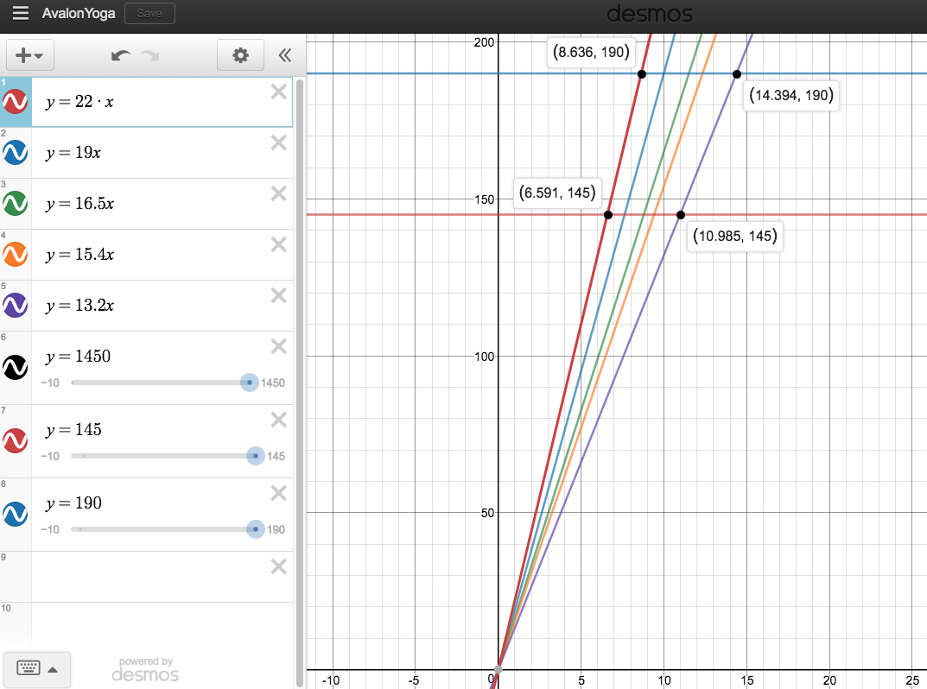
https://www.desmos.com/calculator/ecsss58bsq

Slide 5
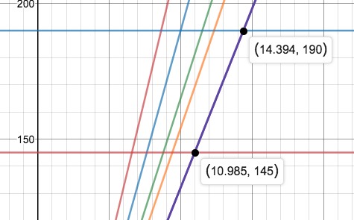
From the graph
40-classes deal:
If I take 11 classes or more a month: Better use $145.
15 classes or more per month: Even the $190 deal is worth it.

Slide 6
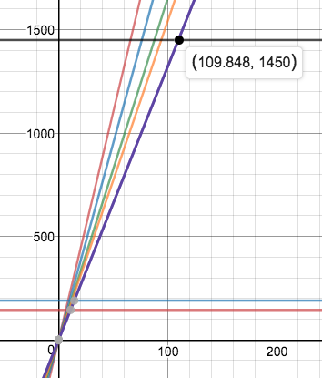
From the graph
If I take more than 109 classes a month, the 1450 deal is best!

Slide 7
Can you calculate some of these break-even points using algebra?
You can show on desmos, but also calculate.

Slide 8
Other ideas
Leasing a car
Renting
Mortgages
Great America (or other) season tickets
Theater/Synphony/Movies deals

Slide 9
The End

