Slide 1
What is the current state of COVID-19?
By Zach Mistelske

Slide 2
What is COVID-19?
Coronavirus known as SARS-CoV-2
Causes severe symptoms to older ages.
Has many different symptoms.
Virus is highly spreadable and attacks the lungs and Immune system.

Slide 3
How much damage has been caused?
Data pulled from https://github.com/owid/covid-19-data/tree/master/public/data Our world in data website.
Nearly 10,000,000,000 total cases in the world, reaching a peak of 9,041,649,020 in May 2022.
Death toll reached a peak of 90,456,230 in May 2022.
Max of 88,655,44 people in hospitals and 383,213 people in ICU as of in 2021.

Slide 4
Is it getting worse?
Vaccinations reaching a peak 218,360,913,167 with 16,579,479,685 boosters and 53,785,994,142 people fully vaccinated in May 2022.
Many people are getting tested and vaccinated, tests reaching an all time high of 98,825,571,335 in April 2022.

Slide 5
Geographical
https://public.tableau.com/app/profile/zach.j.mistelske/viz/CovidAnalysis1_2/Sheet1?publish=yes
https://public.tableau.com/app/profile/zach.j.mistelske/viz/CovidAnalysis2_1/Sheet1?publish=yes
Interactive Geographical models displaying statistics by country.

Slide 6
Statistical
https://public.tableau.com/app/profile/zach.j.mistelske/viz/CovidAnalysis1_16647618211660/TotalCasesTestsDeathsIcuandHospitalizedpatients?publish=yes
https://public.tableau.com/app/profile/zach.j.mistelske/viz/Covidanalysis2_16645138256080/Sheet1?publish=yes
Statistical models displaying line graphs for deaths, vaccinations, cases etc… and three year forecast.

Slide 7
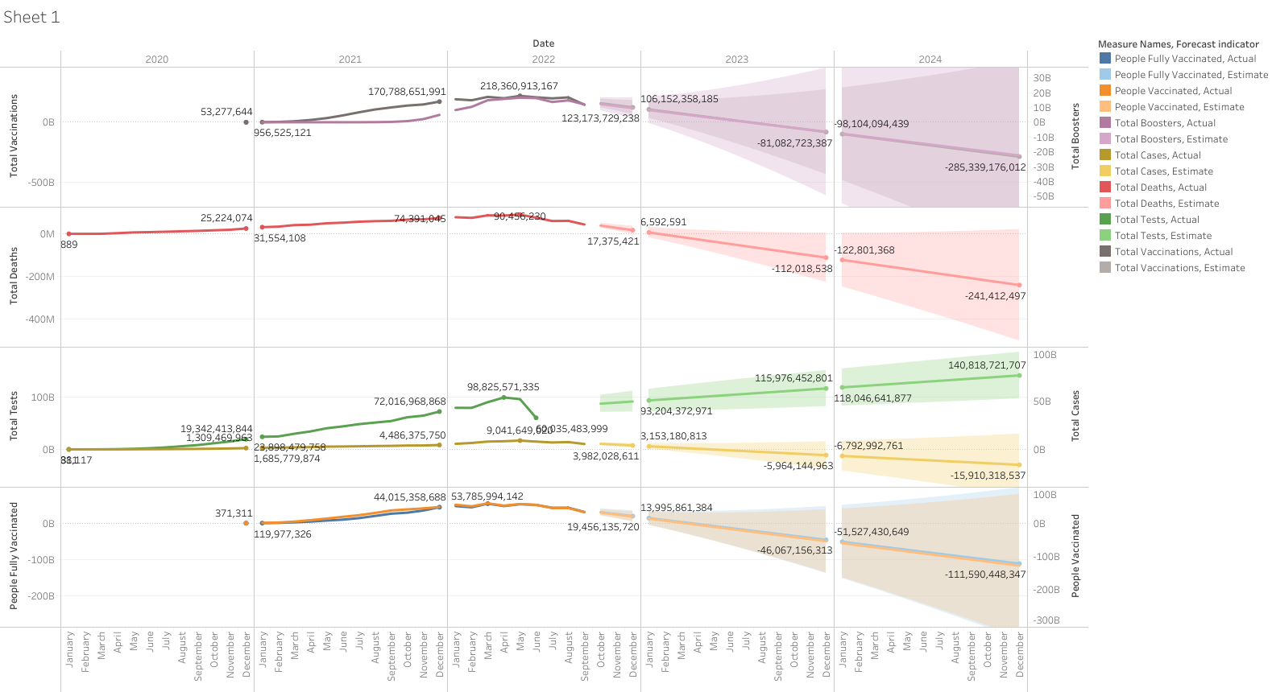
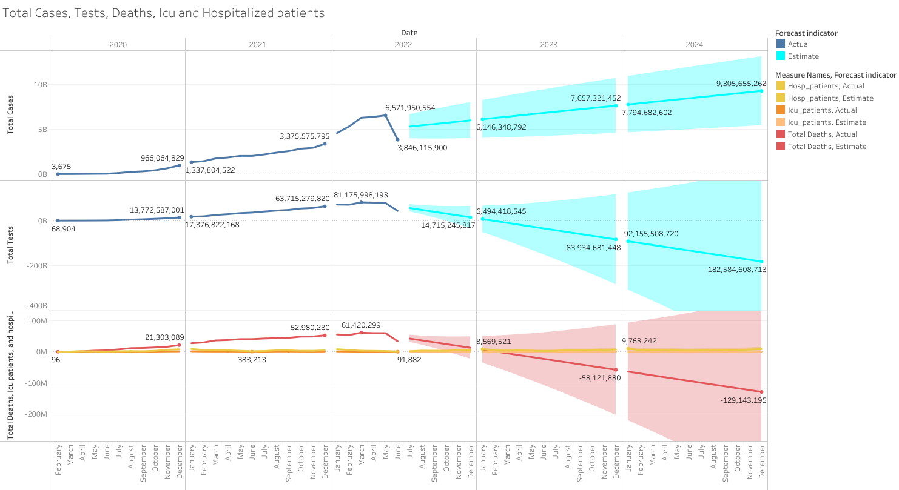
Dashboard
Line charts with forecasting deaths, cases, tests, vaccinations, etc…

Slide 8
How does the next three years look?
According to the data and forecast, deaths, people in ICU and hospitals, cases, vaccinations will cease in 2023.
Tests will continue to increase to keep covid in check.

Slide 9
In conclusion
Covid-19 will cease to persist in our lives in 2023.
Tests and vaccinations must continue to increase to get rid of cases and deaths.
Keep regular hygiene practices going.

Slide 10
Thank you

