Slide 1
FINAL YEAR PROJECT
Optimized Energy Management system for PV-grid system
Group - 18
Abhijit Goswami - 230610003004
Bijuban Deka - 230610003024
Arihant Malu - 230610003014
Joysheel Borah - 230610003046
Mentor: Mrs. Priyakshi Shyam, Assistant Professor (EE)

Slide 2
PV-BATTERY GRID-CONNECTED SYSTEM
The system consists of a solar photovoltaic (PV) generation unit integrated with a battery energy storage system (BESS) and connected to the utility grid.
The PV system supplies the local load, while excess generation is stored in the battery. When PV generation and available battery energy are insufficient, power is imported from the grid.
PHASE 3
Add the cost of battery wear to the plan, so we save money without overworking the battery.
PHASE 4
Compare all methods on cost and battery life, on sunny and cloudy days and with different tariffs.

Slide 3
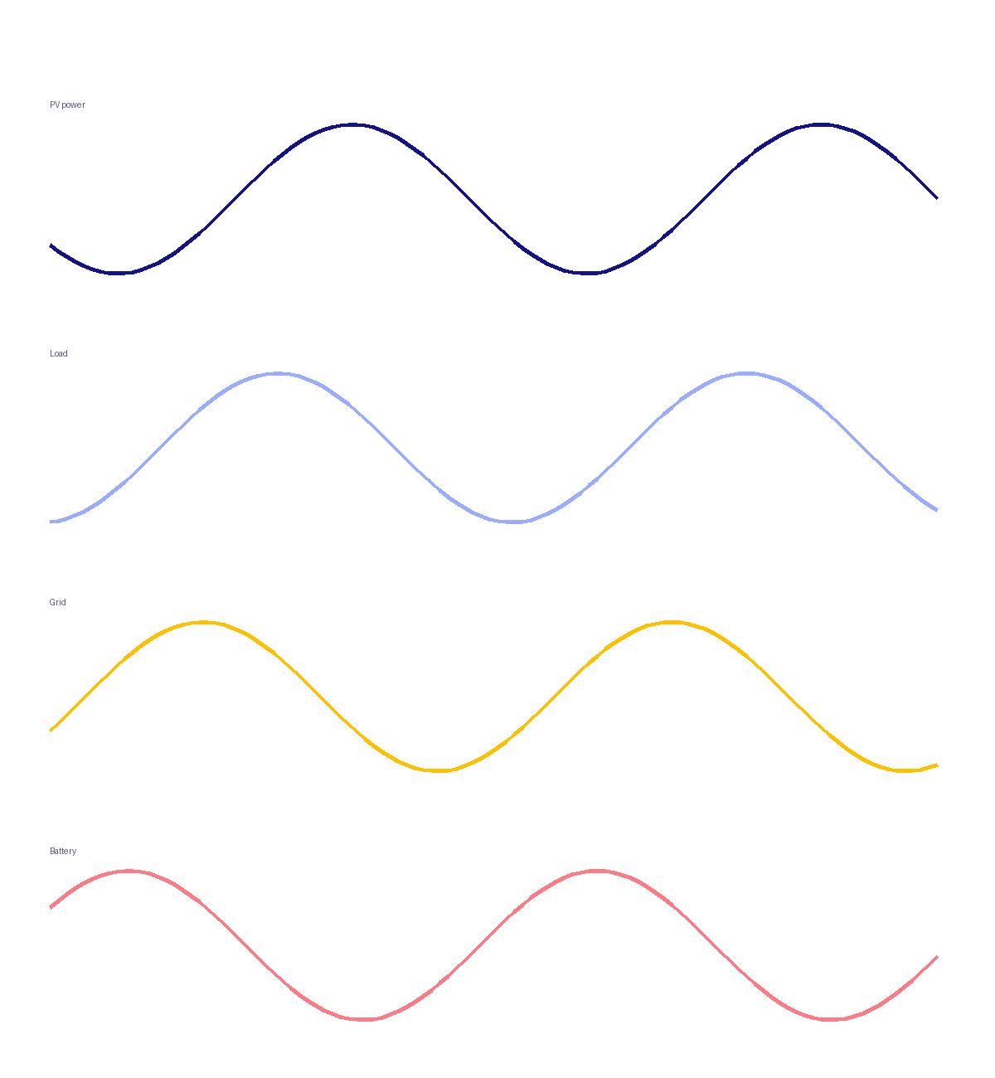
Daily Dispatch - Sunny Day
WHAT THE PLOTS SHOW
Baseline: No battery. The midday PV surplus is exported at the low solar-slot rate.
Heuristic: Charges from ~9 h to ~13 h, exports once full, then discharges 15 h to 20 h.
LP: Charges in short midday pulses, then discharges from ~17 h into the night.
Sunny day, 24-hour dispatch.

Slide 4
Savings Comparison
Rs 12.89
Baseline
Rs 7.20
Heuristic EMS
Rs 5.85
LP EMS
WHAT THE PLOTS SHOW
Sunny: LP saves Rs 7.04/day over baseline — about Rs 211 per month.
Cloudy: The advantage narrows to Rs 10.87/day, about Rs 326 per month.

Slide 5
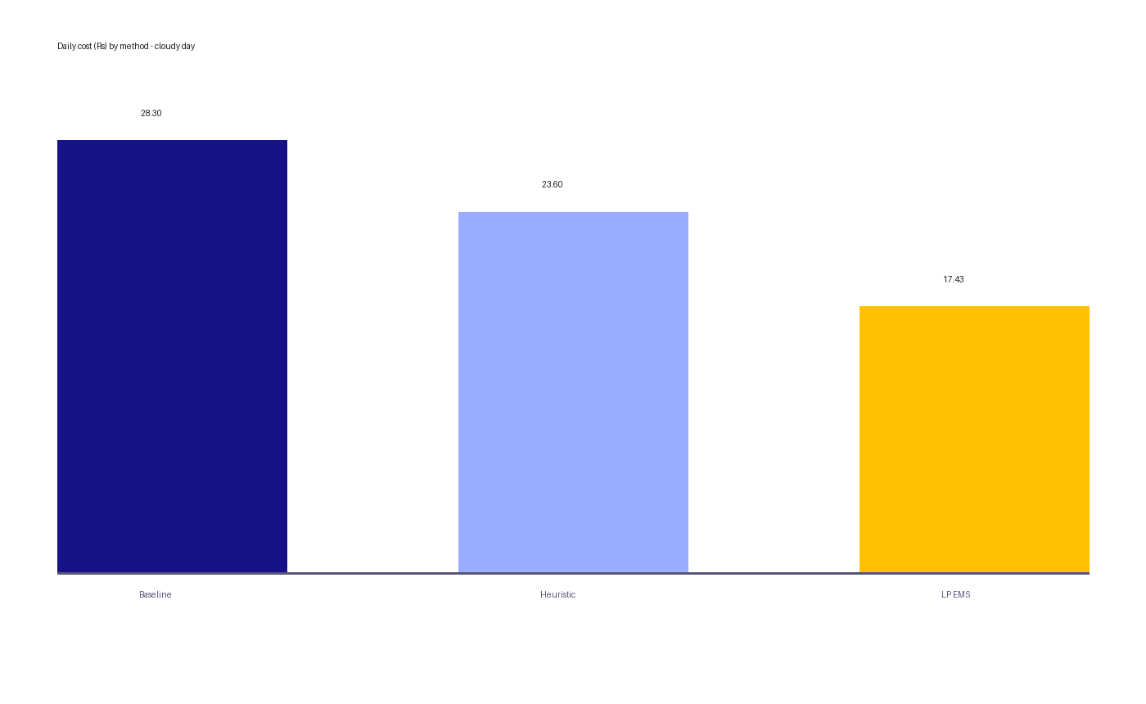
Cost: Sunny vs Cloudy
LP vs baseline
55%
38%
sunny
cloudy
LP vs heuristic
19%
26%
sunny
cloudy
Heuristic vs baseline
44%
17%
sunny
cloudy
Monthly household bill by method, sunny day.

Slide 6
FUTURE SCOPE
PHASE 3
Battery-friendly EMS
Add the cost of battery wear to the plan, so we save money without overworking the battery.
PHASE 4
Compare everything
Compare all methods on cost and battery life, on sunny and cloudy days and with different tariffs.
PHASE 5
Real-time control
Re-plan every 15 minutes using real campus meter data and solar forecasts.
PHASE 6
Live dashboard
Build an app with sliders and live graphs to show the system working in the final demo.
Goal: lower electricity bills while keeping the battery healthy for longer.

Slide 7
Savings Comparison
Scenario | Method | Daily cost (Rs) | Saving vs baseline (Rs/day) | Saving (%) | Monthly saving (Rs)
Sunny | Baseline (no battery) | 12.89 | - | - | -
 | Heuristic EMS | 7.20 | 5.69 | 44% | 171
 | LP EMS | 5.85 | 7.04 | 55% | 211
Cloudy | Baseline (no battery) | 28.30 | - | - | -
 | Heuristic EMS | 23.60 | 4.70 | 17% | 141
 | LP EMS | 17.43 | 10.87 | 38% | 326
LP saves 55% on sunny and 38% on cloudy days.

Slide 8
THANK YOU

