Slide 1
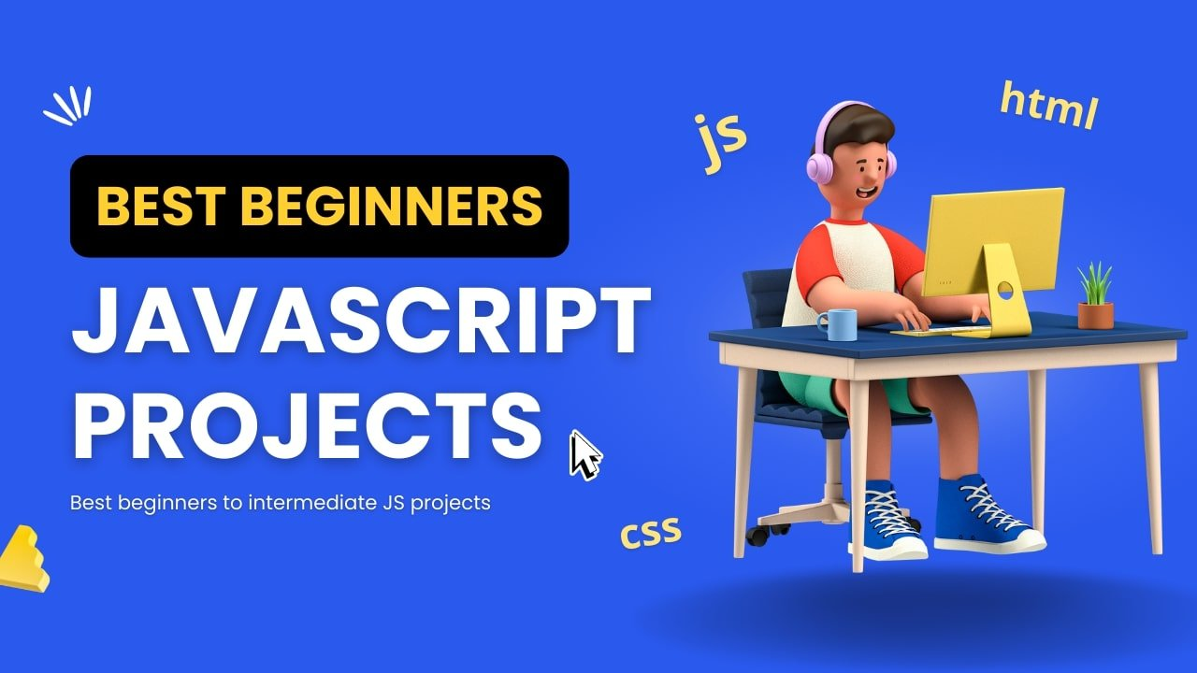

Slide 2
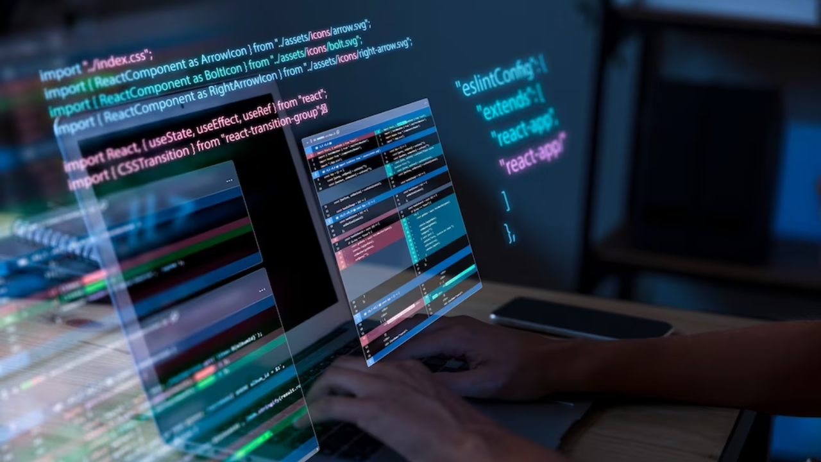
NextGen Developers

Slide 3
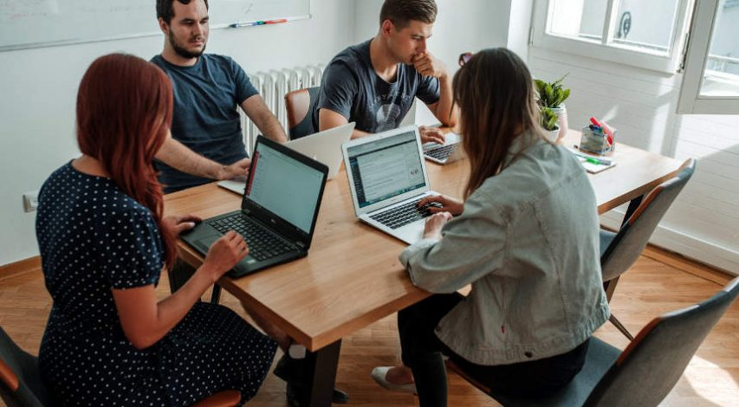
Rulles
Day 1
Every group work with 3 computers
Every group divide 3 teams
Team 1 Work html
Team 2 work css
Team 3 work Javascript
And finnaly together files in 1 folder
Day 2
Display Groups project to the lecture
Every group project represent 1 person

Slide 4
Project 1 To-Do List.
This basic project includes adding tasks to the list and removing tasks from the list.
Project Structure
We'll have the following files:
index.html
styles.css
script.js

Slide 5
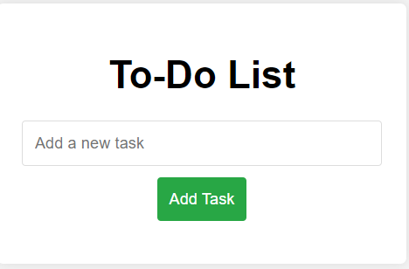

Slide 6
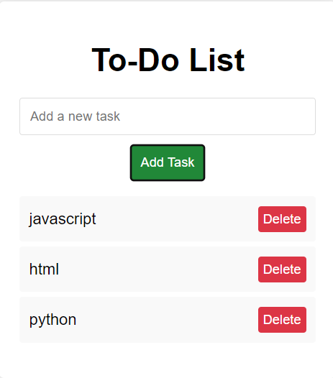

Slide 7
Project 2 Simple Weather App
This project includes a basic input field to enter a city name and a button to fetch the weather data for that city.
Project Structure
We'll have the following files:
index.html
styles.css
script.js

Slide 8
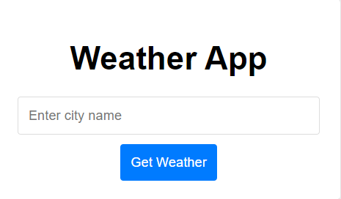

Slide 9
Project 3 Simple Calculator
This calculator will support basic arithmetic operations like addition, subtraction, multiplication, and division.
Project Structure
We'll have the following files:
index.html
styles.css
script.js

Slide 10
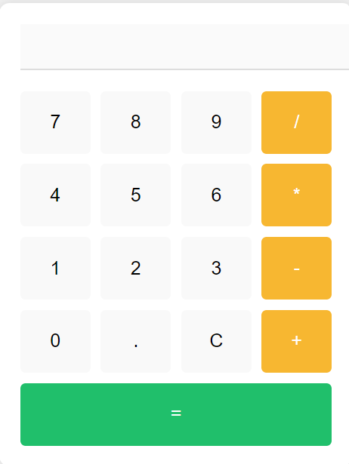

Slide 11
Project 4 Quiz App
This app will present a set of questions with multiple-choice answers, keep track of the score, and display the final result.
Project Structure
We'll have the following files:
index.html
styles.css
script.js

Slide 12
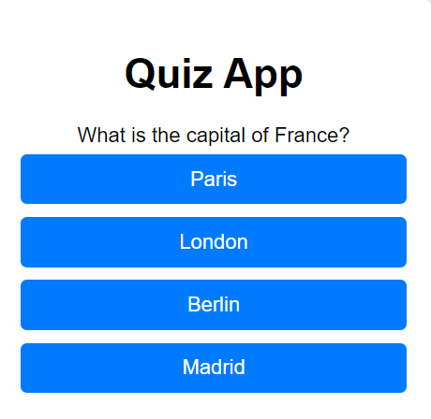
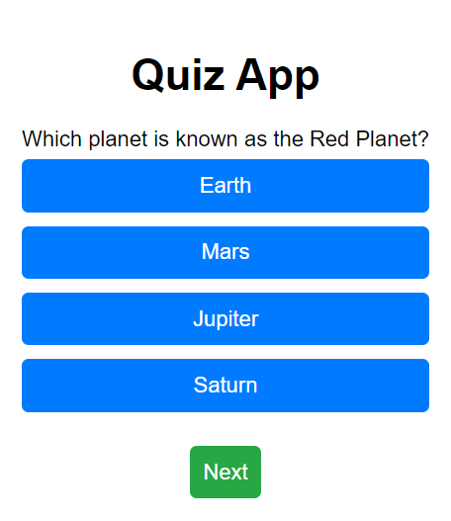
Interface
Next Button

Slide 13
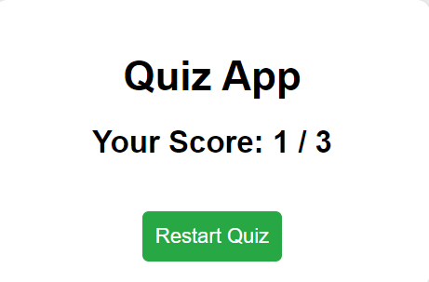
Result

Slide 14
Project 5 Recipe App
This app will allow users to browse and search for recipes.
Project Structure
We'll have the following files:
index.html
styles.css
script.js

Slide 15
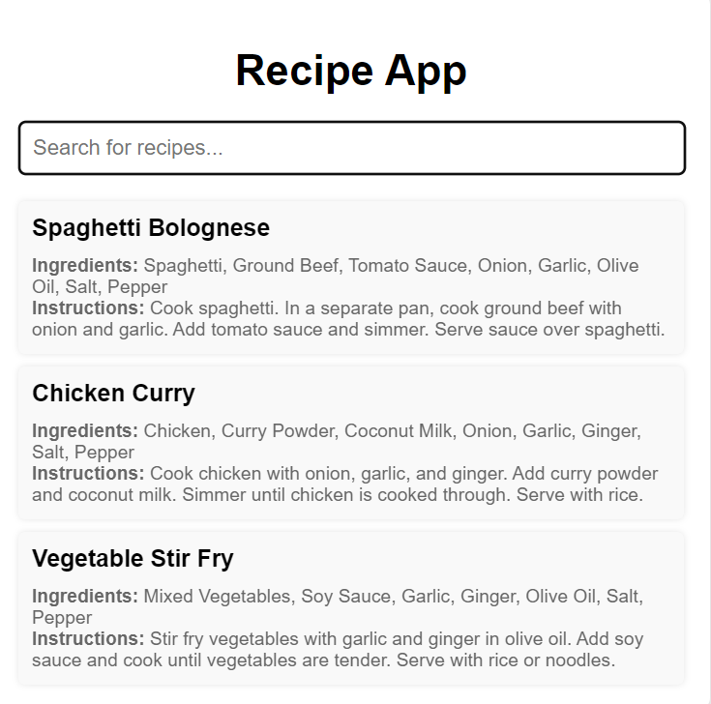
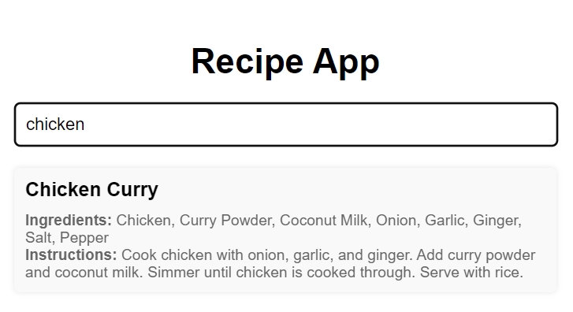
Interface
Result

Slide 16
Project 6 Personal Budget Tracker
This app will allow users to input their income and expenses, categorize them, and track their overall budget.
Project Structure
We'll have the following files:
index.html
styles.css
script.js

Slide 17
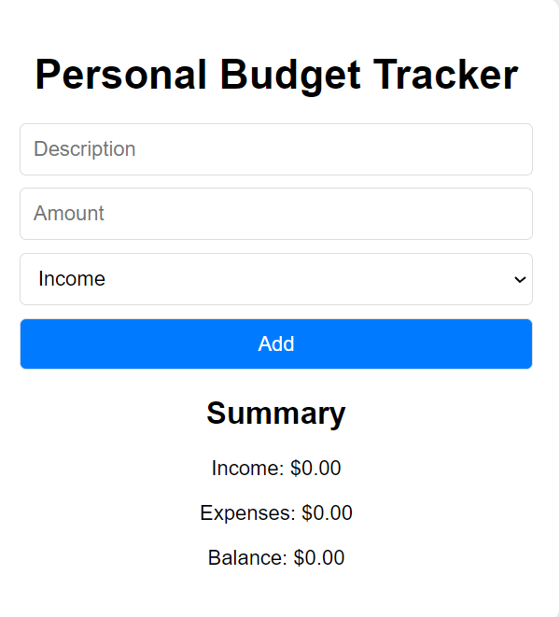
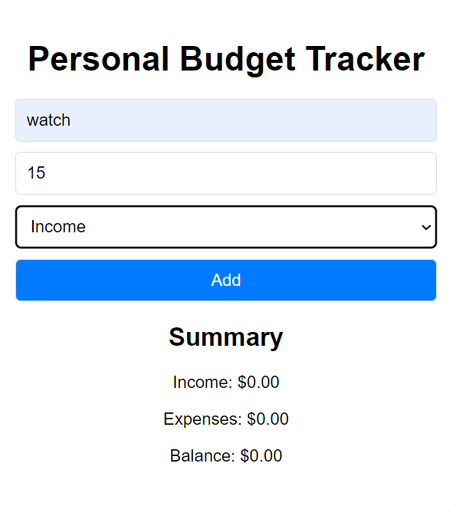
Interface 1
Enter Data

Slide 18
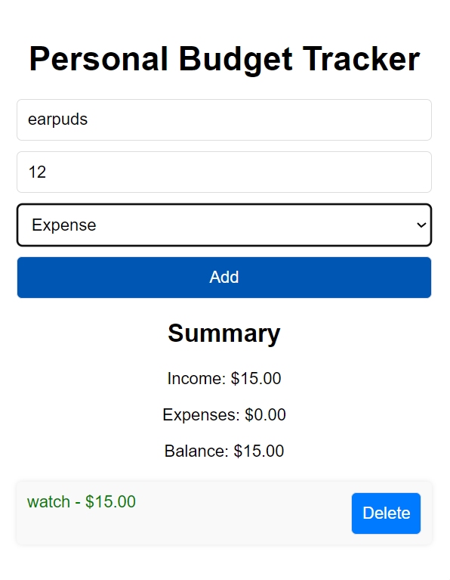
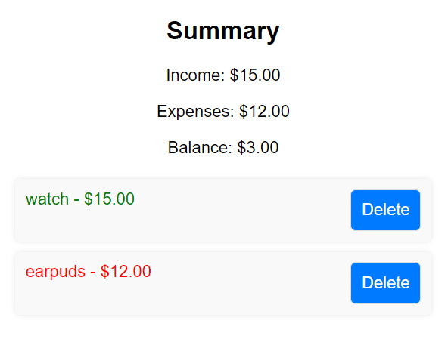
Enter Data
Result

Slide 19
Project 7 Book Library App
This app will allow users to add books to their personal library, mark them as read or unread, and delete them from the library.
Project Structure
We'll have the following files:
index.html
styles.css
script.js

Slide 20
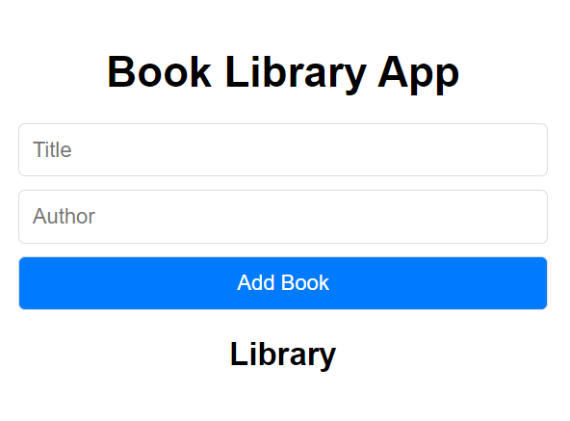

Slide 21
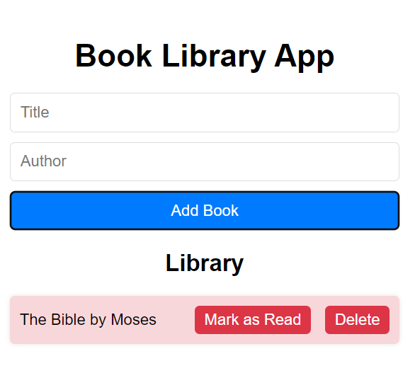
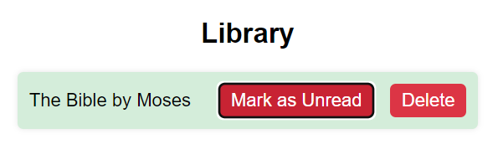
Entery data
Display data

Slide 22
Project 8 Task Manager Web Application
This app will allow users to add, update, delete, and mark tasks as completed.
Project Structure
We'll have the following files:
index.html
styles.css
script.js

Slide 23
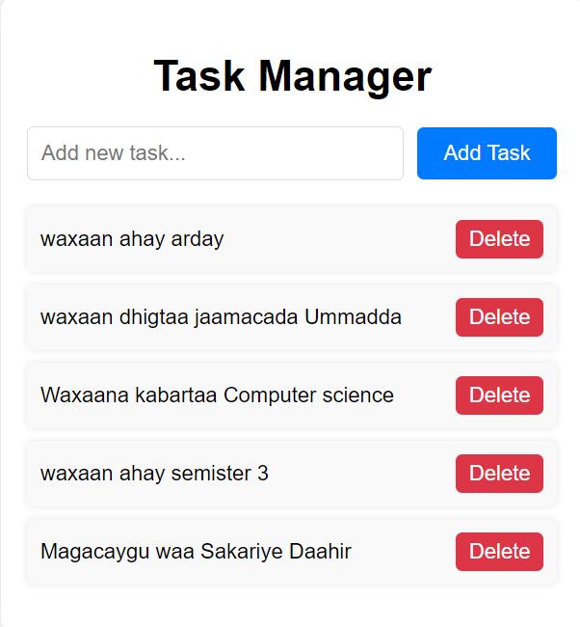
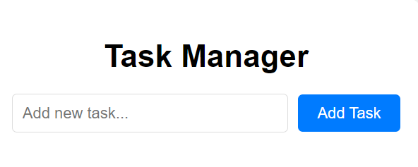
Interface
Display

Slide 24
Project 9 Student Tracker Web Application
This is a basic implementation of a Student Tracker Web Application. Users can add student information, which will be displayed as a list below the form.
Project Structure
We'll have the following files:
index.html
styles.css
script.js

Slide 25
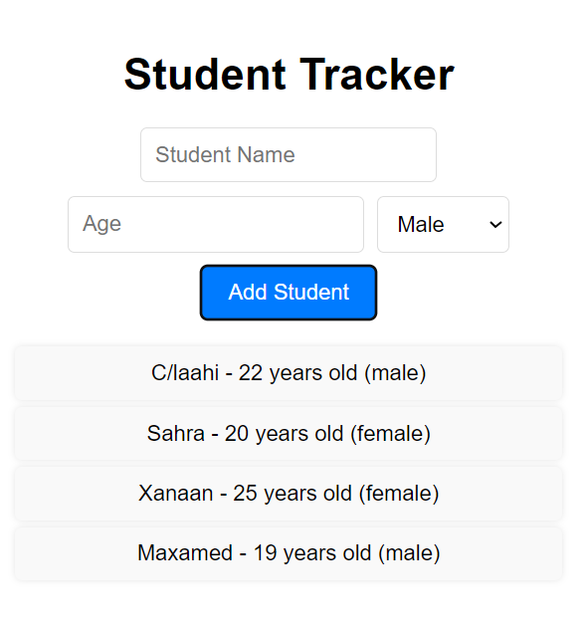
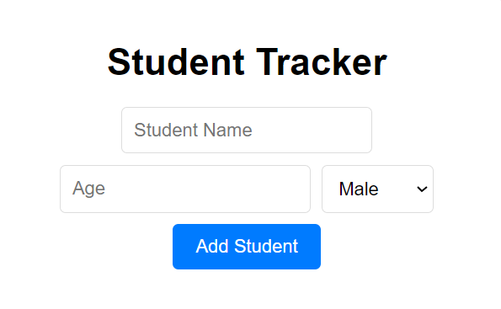
Interface
Entery data

Slide 26
Project 10 Attendance Management System
This system will allow users to mark attendance for different events or classes.
Project Structure
We'll have the following files:
index.html
styles.css
script.js

Slide 27
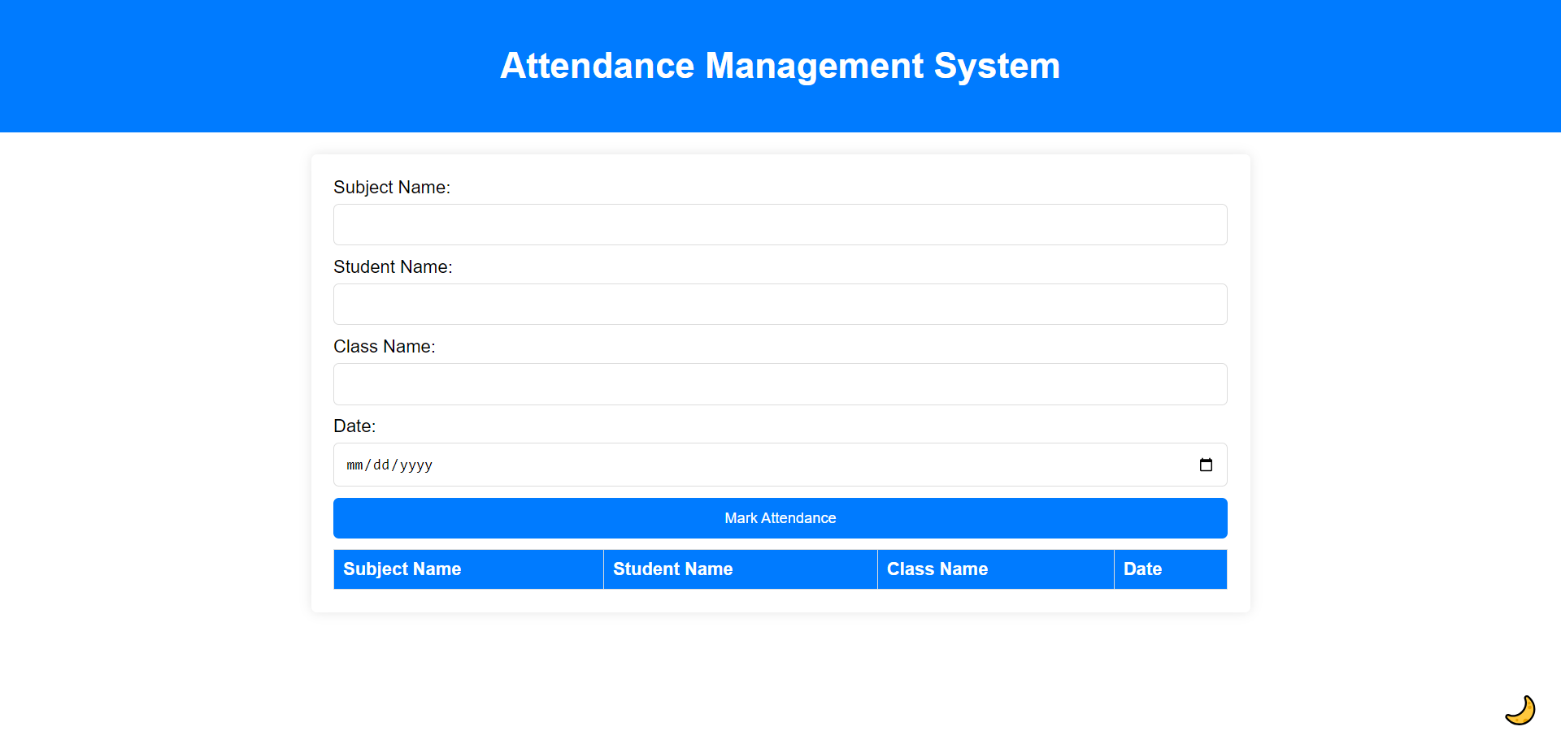
Interface

Slide 28
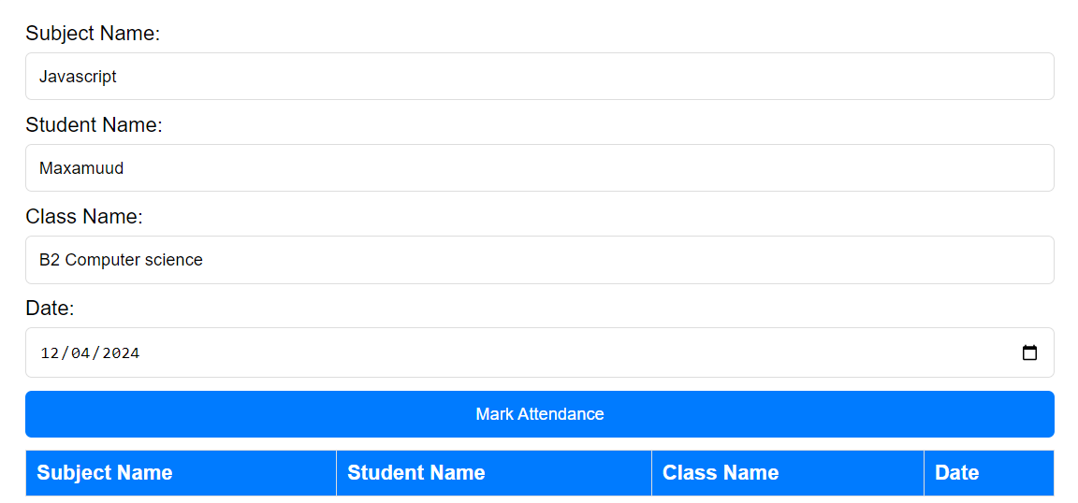
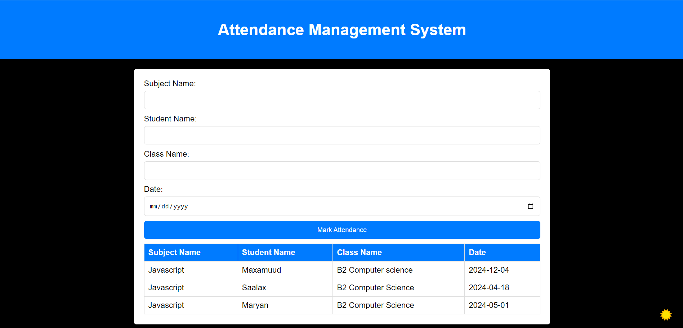
Entery data
Display data

Slide 29

Software development manager
Zack Daahir
Is the owner of the idea,
and mentor for this project
Special thanks lecture C/laahi shariif
More information:
https://www.linkedin.com/in/zack-daahir

Slide 30


