Slide 1

Ramrao Adik Institute of Technology
Department of Computer Engineering
TE MINI Project - Presentation
On
“ Tropical Cyclone Intensity Prediction”
By
Roll No. Name of Students
20CE1197 Umit Shah
20CE1104 Sahil Gujral
20CE1209 Sarthak Salunke
20CE1171 Rishabh Shah
Guided by
Mrs. Tabassum Maktum

Slide 2
Outline
Introduction
Literature Survey of the existing systems
Limitations of the existing systems
Problem statement
Proposed methodology
System Design
Details of Hardware and Software
Results and Analysis
Conclusions and Future work
References

Slide 3
Introduction
Tropical cyclones, also known as typhoons or hurricanes, are among the most destructive weather phenomena.
Every year, 1000s of families and their homes are washed away because of the inaccurate forecasting of intensity of the cyclones.
To reduce Tropical Cyclone (TC) related human loss and harm, it is essential to predict and identify TC intensity.
The proposed cyclone intensity estimation mechanism will be developed using the CNN architecture, for latent feature abstraction, memory retention, and categorization skills.

Slide 4
Motivation
Scientific interest: Building a model that can predict their intensity can contribute to the scientific community's understanding of these events.
Disaster management: Predicting their intensity can help emergency responders and the general public prepare for and respond to these events more effectively.
Societal impact: By developing a model that can predict cyclone intensity, you can potentially provide useful information to help people prepare for the impacts of a cyclone and potentially save lives.

Slide 5
Objective
Developing accurate prediction models: The primary objective of a cyclone intensity prediction project is to develop accurate models that can forecast the intensity of cyclones with a high degree of precision.
Improving emergency response: By accurately predicting the intensity and trajectory of a storm, emergency responders can take proactive measures to evacuate affected areas, distribute necessary supplies, and provide aid to those in need.
Mitigating the impact of cyclones: A cyclone intensity prediction project can also aim to reduce the impact of these storms by identifying areas that are particularly vulnerable to damage and taking steps to strengthen infrastructure and housing in those areas.

Slide 6
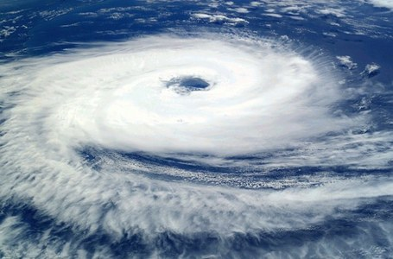
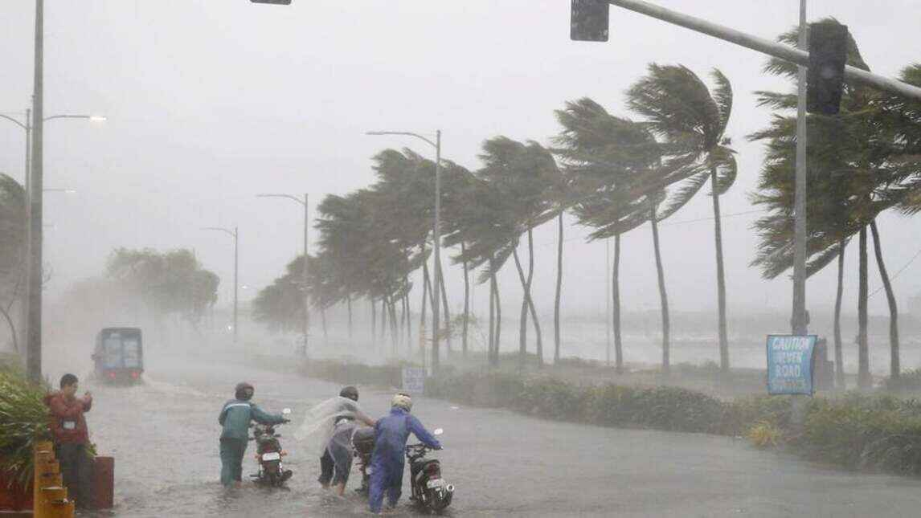
Objective
Enhancing scientific understanding: A cyclone intensity prediction project can contribute to our scientific understanding of these powerful natural phenomena.
Overall, the objectives of a cyclone intensity prediction project are to save lives, protect property, and reduce the economic and social impact of these devastating storms.

Slide 7
Literature Survey of the existing systems
Sr No | NAME | TECHNIQUES USED
1 | The ocean’s impact on hurricane intensity. | CNN Model by using satellite imagery and other remote sensing data
2 | Tropical Cyclone Intensity Estimation Using a Deep Convolutional Neural Network | The intensity of tropical cyclones using a deep convolutional neural network consisting of 5 convolutional layers and 3 fully connected layers
3 | Tropical Cyclone Intensity Estimation Using Multi-Dimensional Convolutional Neural Networks from Geostationary Satellite Data | It uses convolutional neural networks (CNNs) to estimate the intensity of tropical cyclones from multi-sensor based satellite images

Slide 8
Literature Survey of the existing systems
Sr No | NAME | TECHNIQUES USED
4 | Predicting Tropical Cyclone Intensity from Geosynchronous Satellite Images Using Deep Neural Networks | The model proposed five convolutional neural network models independently trained on data from each of the five channels of luminescence data
5 | Tropical cyclone intensity detection by geometric features of cyclone images and multilayer perceptron | The Model proposed an image processing based method to estimate the tropical cyclone intensity from satellite images collected from Institute of Meteorological Satellite Studies and IMD.
6 | An effective tropical cyclone intensity estimation model using Convolutional Neural Networks | It uses convolutional neural networks to suggest a model for calculating the strength of tropical cyclones

Slide 9
Limitations of existing systems
Limited coverage: Existing methods for cyclone intensity estimation may be limited in their ability to provide accurate estimates for storms that occur in remote or poorly monitored regions.
Uncertainty and variability: Like prediction models, existing methods for cyclone intensity estimation can be subject to uncertainty and variability. This can result in a range of potential intensity estimates, which may not always be accurate or reliable.
Limited ability to account for local factors: Existing methods for cyclone intensity estimation may not always be able to account for local factors such as topography, which can influence the intensity of a storm in specific regions. This can result in inaccurate or incomplete intensity estimates for storms that affect these areas.

Slide 10
Problem statement
Despite significant advances in cyclone intensity estimation methods, accurately predicting the intensity of these storms remains a significant challenge. The problem, therefore, is to develop a cyclone intensity estimation model that can provide accurate and reliable estimates of cyclone intensity, with a focus on addressing the limitations of existing methods.
By developing an accurate and reliable cyclone intensity estimation model, we can improve our ability to prepare for and respond to these devastating natural disasters, ultimately saving lives and reducing the economic and social impact of cyclones.

Slide 11
Proposed methodology /Techniques
Convolutional neural network (CNN) architecture is used in order to train and evaluate the model.
Convolutional Neural Networks is well- suited for image classification and recognition tasks.
CNNs typically consist of multiple layers, including pooling layers, convolutional layers, and fully connected layers.
The model is assembled with a loss function, optimizer, and metric for assessment after creating the CNN architecture.
The training data, which comprises of already-processed photos, is then used to train the model.

Slide 12
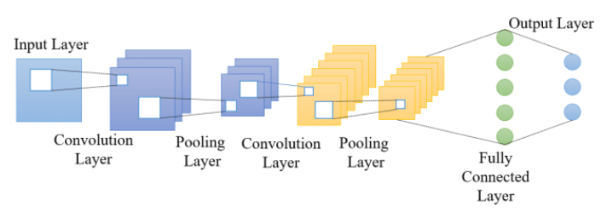
Proposed methodology /Techniques
To get the best results, you can change the batch size and number of epochs.
The term ”batch size” refers to the amount of samples processed in a single iteration, while the term ”epoch” refers to one cycle of training on the complete dataset.
The model is assessed on the test data after training to determine its
accuracy and loss.
Architecture of CNN Model

Slide 13
System Design
Data Collection: The data used in this project is the Tropical Cyclone Intensity Records (TCIR) dataset, which includes information about the location, intensity, and various other features of tropical cyclones.
Data Processing and Feature Extraction : The data is processed using and converted to an HDF5 file format. The features extracted include Infrared and Passive Microwave Imagery (IRPMW), which are used as input to the model for training.
Model Training : The dataset is trained using the CNN model in which the dataset is trained and tested in the ratio of 80:20.
Model Evaluation : It is evaluated using the test data set. The evaluation metrics used include Root Mean Squared Error (RMSE) and Mean Absolute Error (MAE).
Model Deployment: The model can be used to predict cyclone intensity based on new data collected from various sources.

Slide 14
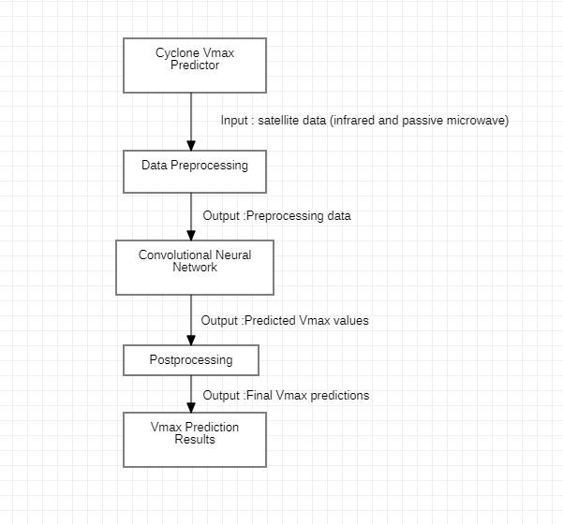
System Design
System Flowchart

Slide 15
Details of Hardware and Software
Recommended System Requirements
Processors: Intel Core i5 processor 4300M at 2.60 GHz or 2.59 GHz, 32 GB of RAM
Disk space: 2 to 3 GB
Operating systems: Windows 10, Windows 11, macOS, and Linux
Minimum System Requirements
Processors: Intel Atom processor or Intel Core i3 processor
Disk space: 1 GB
Operating systems: Windows 7 or later, macOS, and Linux
Python versions: 2.7.X, 3.6.X

Slide 16
Result and Analysis
They are highly helpful in comprehending the instantaneous structural changes that occur throughout the evolution.
Accurate center determination is necessary for traditional techniques of intensity estimation.
When a cyclone is just forming and pinpointing its exact center is difficult, developing a CNN-based model for estimating intensity would be extremely beneficial.
The evaluation metric taken into consideration is the Root Mean Squared Error (RMSE) and Mean Absolute Error (MAE)
The mean squared error or mean squared deviation of an estimator measures the average of the squares of the errors–that is, the average squared difference between the estimated values and the actual value

Slide 17
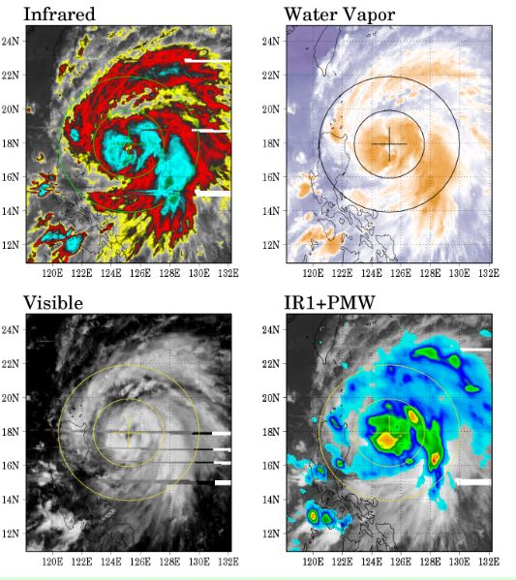
Result and Analysis
The dataset we used is Tropical Cyclone data from TCIR.
These dataset contains satellite images including 4 channels.
The 4 channels available are:1)Infrared
2) Water Vapour
3) visible
4)passive microwave

Slide 18
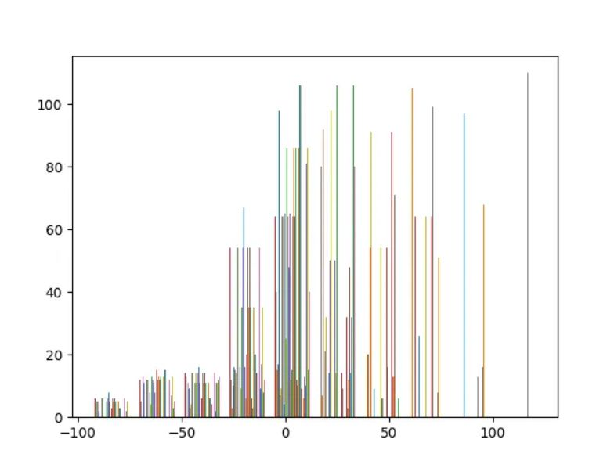
Result and Analysis
The histogram shows the distribution of the errors between the actual Vmax values and the predicted Vmax values.
The horizontal axis represents the error values (the difference between the actual and predicted values), and the vertical axis represents the frequency of occurrence.
Histogram

Slide 19
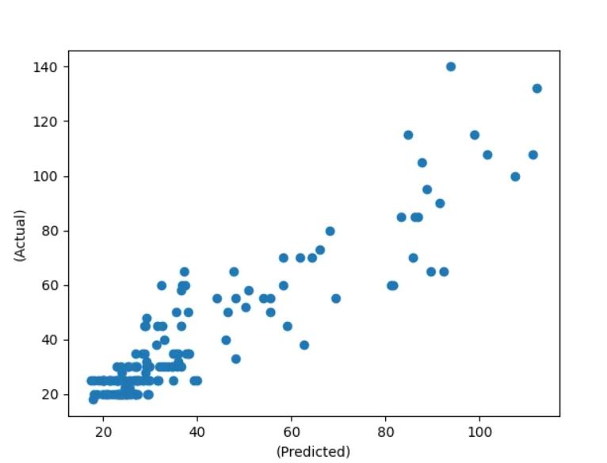
Result and Analysis
The scatter plot is a graphical representation of the relationship between the actual Vmax values and the predicted Vmax values.
The horizontal axis represents the actual Vmax values, and the vertical axis represents the predicted Vmax values.

Slide 20
Conclusion and Future work
Convolutional Neural Networks (CNNs) have the potential to improve the accuracy and efficiency of forecasting models by extracting features from large and complex datasets.
Integration of diverse data sources, including satellite, radar, and ground-based observations, is necessary for the development of CNN-based models for tropical cyclone prediction.
The pre-processed data is then input into the CNN, which employs convolutional layers to extract pertinent features before moving on to fully connected and pooled layers for classification and regression tasks.
Decision-makers and emergency responders may better plan for and react to severe storms with the aid of tropical cyclone prediction, which has the potential to greatly enhance the accuracy and timeliness of forecasting models.
Future work in the field of tropical cyclone prediction using CNNs should focus on the integration of additional data sources, model optimization, model interpretability, real-time forecasting, and integration with decision support systems

Slide 21
References
[1] Shay, L. K., & Brewster, J. K. (2010). The ocean's impact on hurricane intensity. Nature, 468(7322), 493-499.
[2] Tropical Cyclone Intensity Estimation Using a Deep Convolutional Neural Network,Ritesh Pradhan, Daniel October 2017.
[3] Tropical Cyclone Intensity Estimation Using Multi-Dimensional Convolutional Neural Networks from Geostationary Satellite Data By Juhyun Lee and Jungho,December 2019
[4] Predicting Tropical Cyclone Intensity from Geosynchronous Satellite Images Using Deep Neural Networks, Udumulla, Niranga Mahesh, December 2020
[5] Kar, C., Kumar, A., & Banerjee, S. (2019). Tropical cyclone intensity detection by geometric features of cyclone images and multilayer perceptron. SN Applied Sciences, 1, 1-7.
[6] Swarna, M., Sudhakar, N., & Vadaparthi, N. (2021). An effective tropical cyclone intensity estimation model using Convolutional Neural Networks. MAUSAM, 72(2), 281-290.

Slide 22
Thank You

