Slide 1
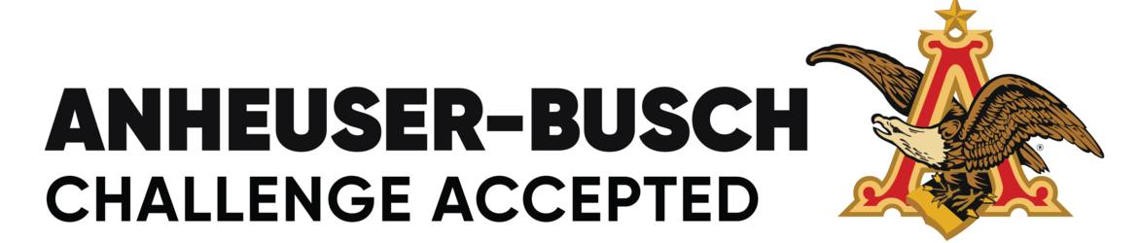


Let’s Make The Right Decisions
John Girard
Edwin Karabidian
Zack Bunn
Notes:
Bunn

Slide 2
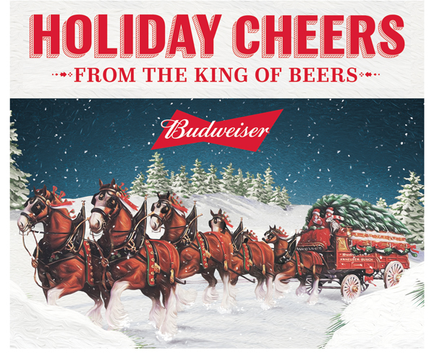
Background
Our firm was brought on to determine market research points by the Anheuser-Busch company to help grow the “King of Beers” brand
We were given a large source of data that showed us a range of characteristics
Sources of Truth
Basis of Ethics
Notes:
2,3- Girard

Slide 3
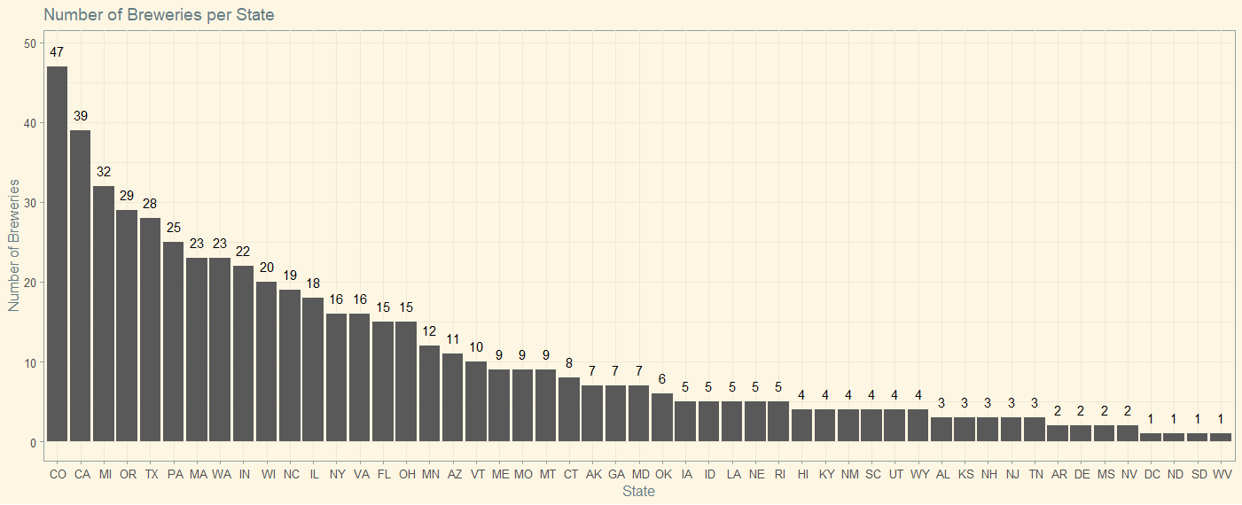
Breweries in Each State
The number of breweries in each state are shown in the graph.
Colorado with 47 breweries, has the highest number of breweries in the country.
Washington DC, North Dakota, South Dakota, and West Virginia each with 1 brewery have the least number of breweries in the country.
Notes:
1- Edwin

Slide 4
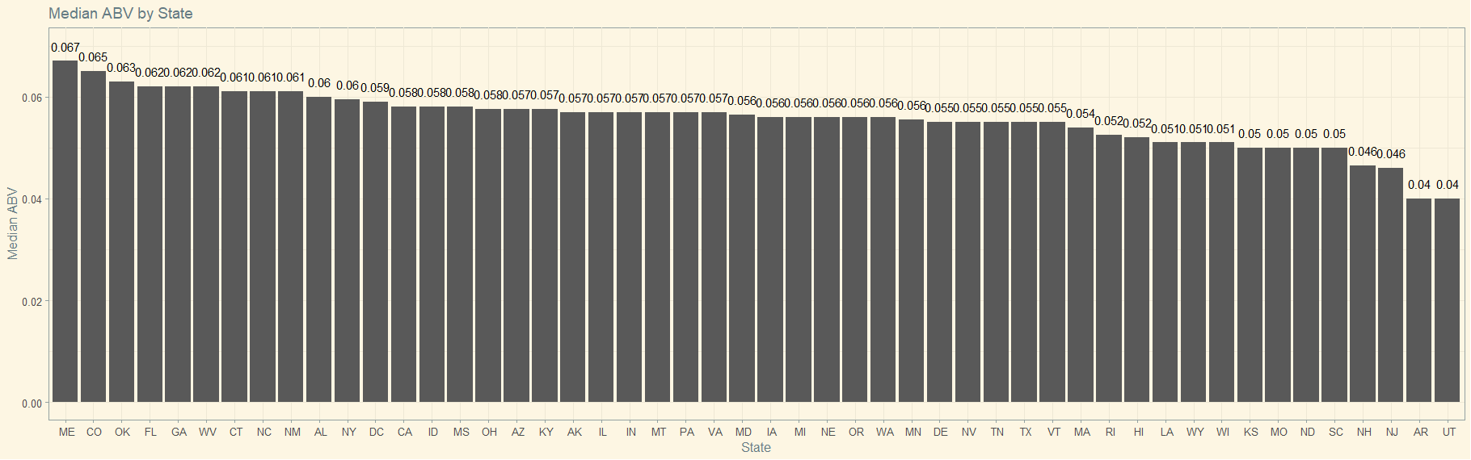
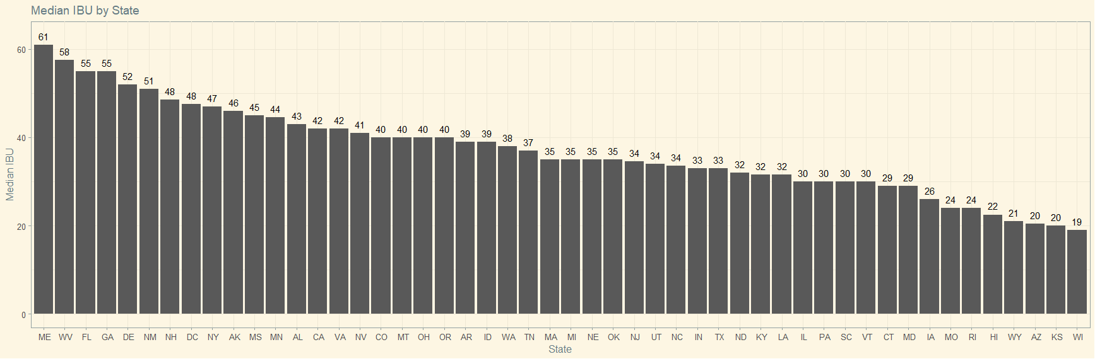
Median ABVs and IBUs
These 2 plots show the medians for the ABV and the IBU for each state.
The state of Maine with a median of 6.7% has the highest ABV median , for a state, in the country.
The states of Arizona and Utah with a median of 4%, have the lowest ABV median , for a state, in the country.
The state of Maine with a median of 61, has the highest IBU median , for a state, in the country.
The state of Wyoming with a median of 19 has the lowest IBU median , for a state, in the country.
Notes:
4- Edwin

Slide 5
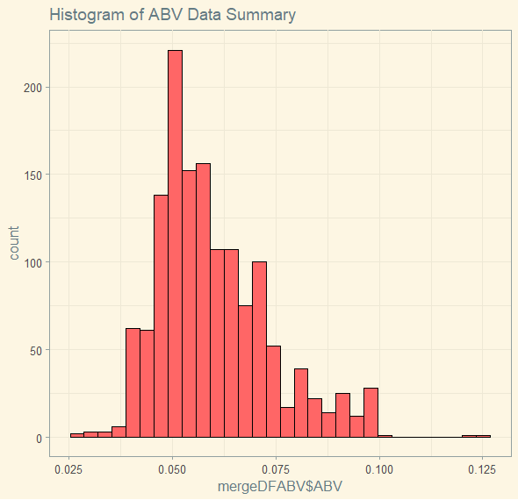
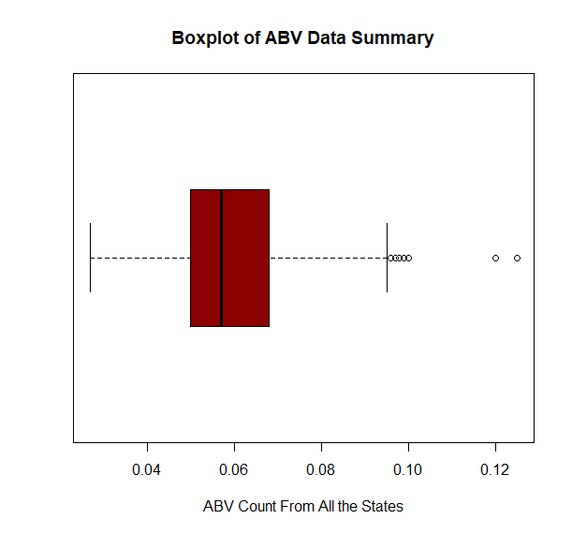
ABV Data Summary
Min | 0.027
1st Quartile | 0.05
Median | 0.057
Mean | 0.05991
3rd Quartile | 0.068
Max | 0.125
Notes:
6-ZB

Slide 6
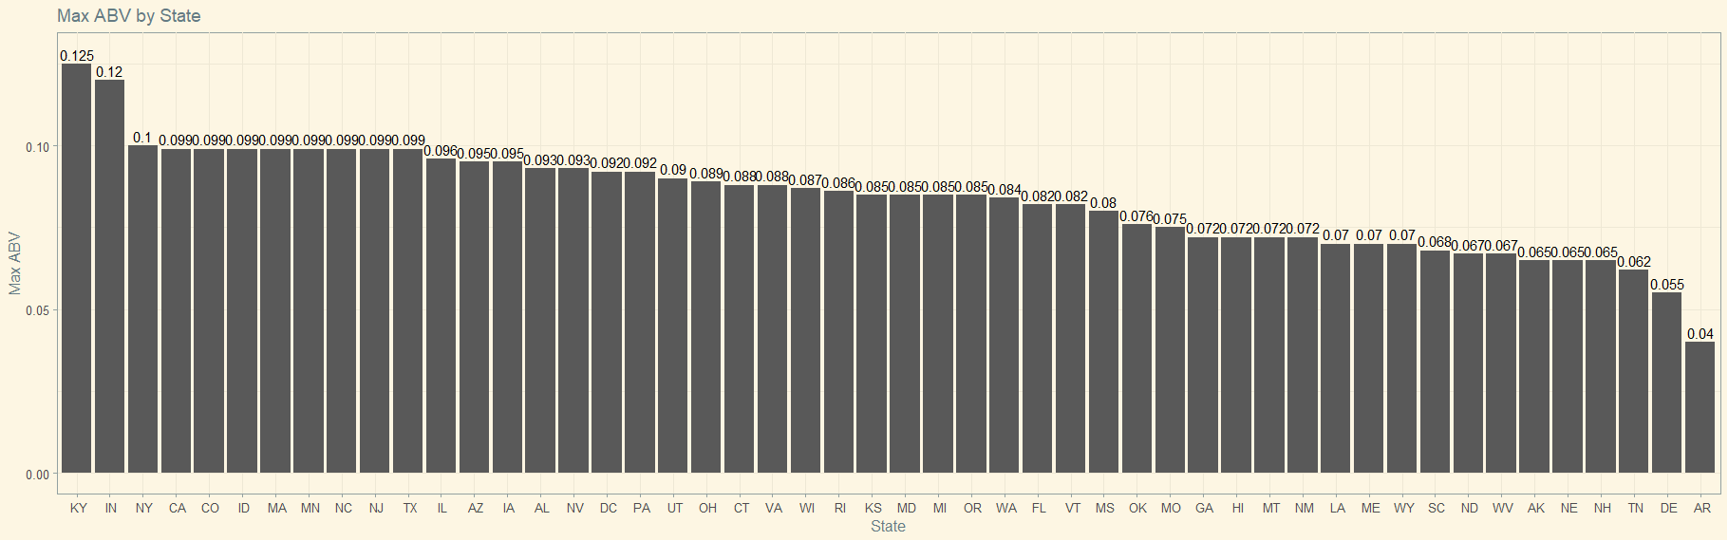
Maximum ABV
This plot shows the maximums for the ABV and the IBU for each state.
The state of Kentucky has the highest maximum ABV of 12.5% in the country.​
The state of Arizona with a maximum of 4%, has the lowest in the country.
Notes:
5-ZB

Slide 7
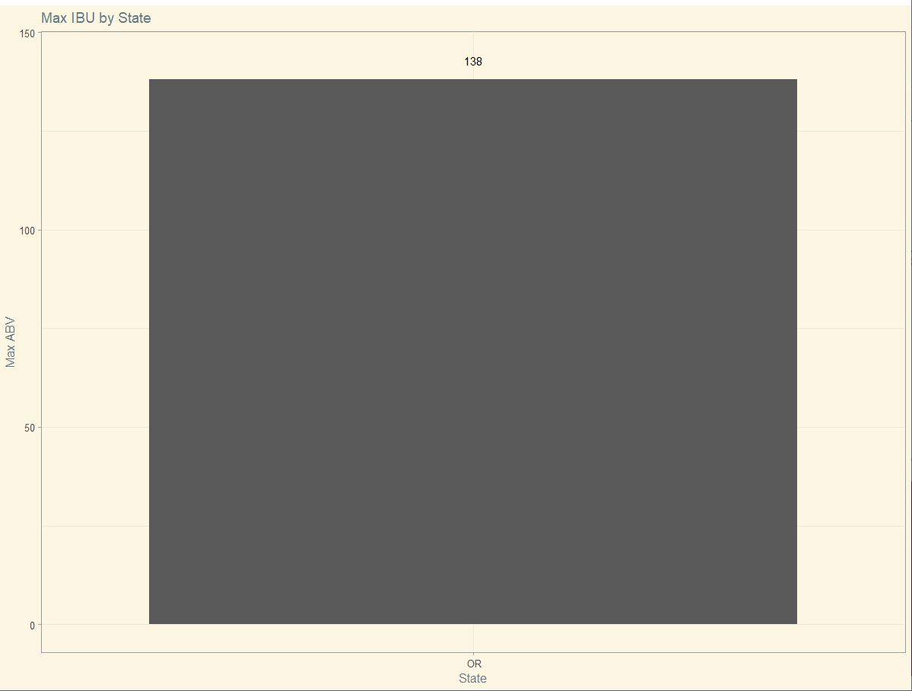
Bitter Beers
Astoria Brewing Company, Oregon
“Bitter B**** Imperial IPA”
Notes:
5-ZB

Slide 8
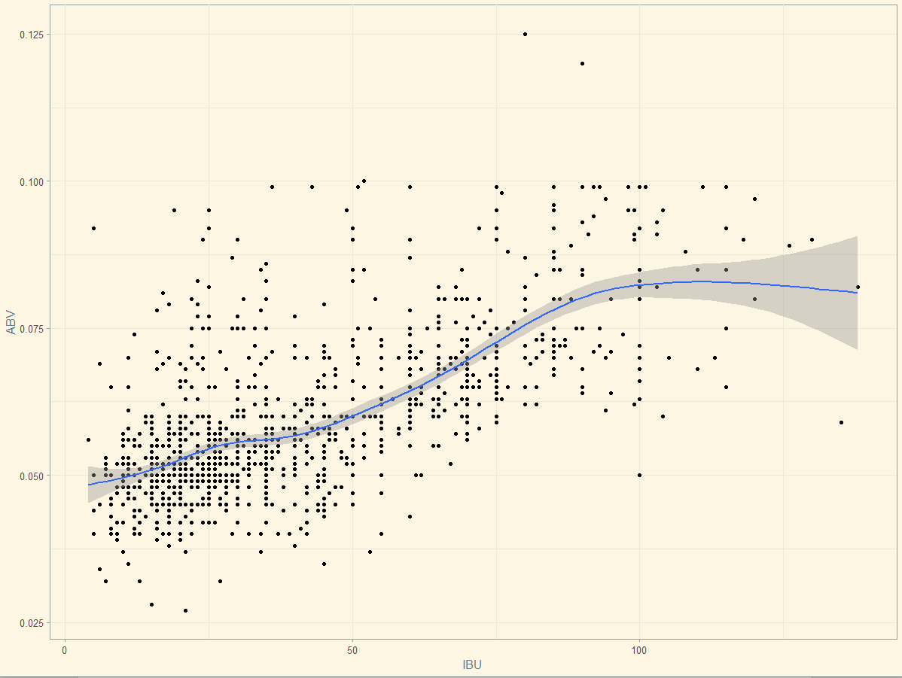
ABV and IBU Relationships
According to our findings there was a slight positive curve in correlation between ABV and IBU.
Notes:
7- Girard

Slide 9


Closing Thoughts
Notes:
Girard

