Slide 1


Empowering our workforce, The Frito Lay Way!
DDSAnalytics
Zack Bunn
Notes:
Bunn

Slide 2
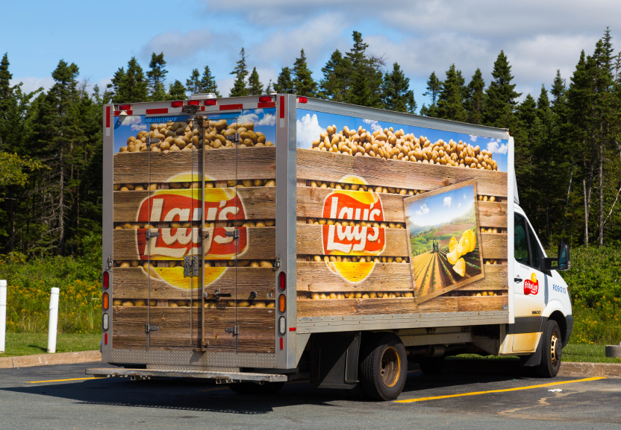
Purpose
DDS was brought on to determine to analyze attrition within Frito Lay and metrics that influence it.
Our goal is to find quantified metrics behind attrition and create a method for a better workplace.
Notes:
2,3- Girard

Slide 3

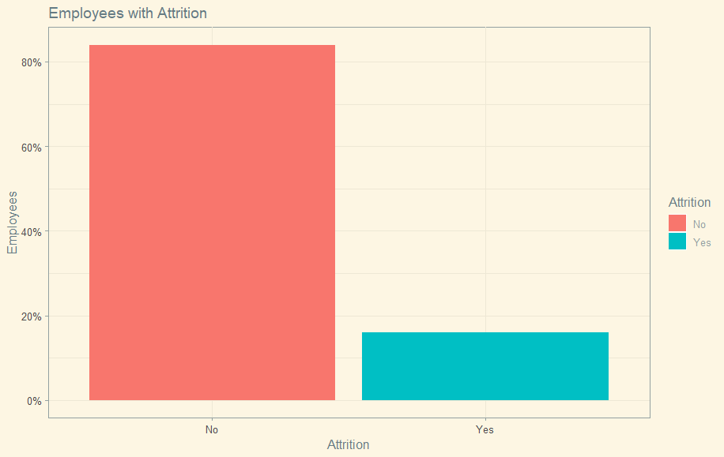

Attrition by the numbers
84% of Employees don’t have attrition
16% of Employees do
Notes:
1- Edwin

Slide 4
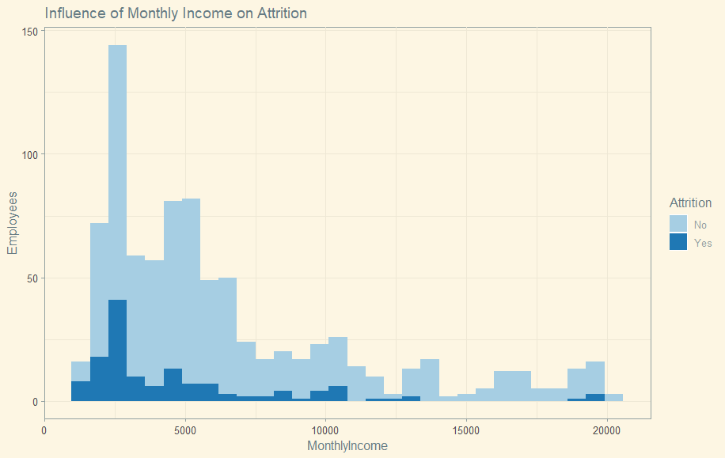
Monthly Income
Most employees affected by attrition are around $2500 in monthly income.
Notes:
4- Edwin

Slide 5

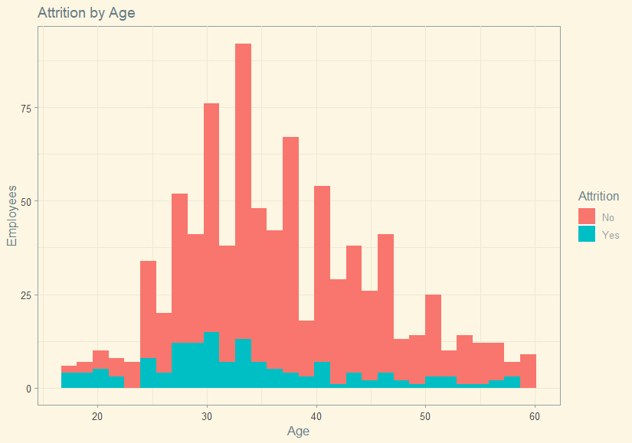
Attrition based on Age
Employees approaching 30 through 35 years of age are the largest population with attrition.
Notes:
6-ZB

Slide 6
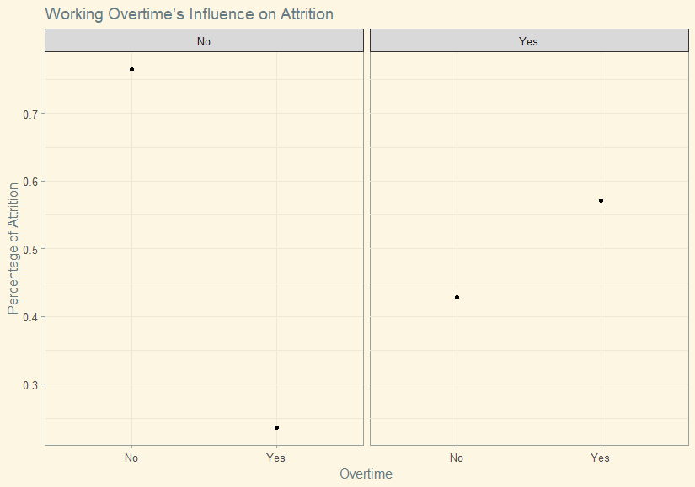
Over time Employees
Employees in the Yes box are those with attrition. There tends to be many more with it where their role has overtime.
Notes:
5-ZB

Slide 7
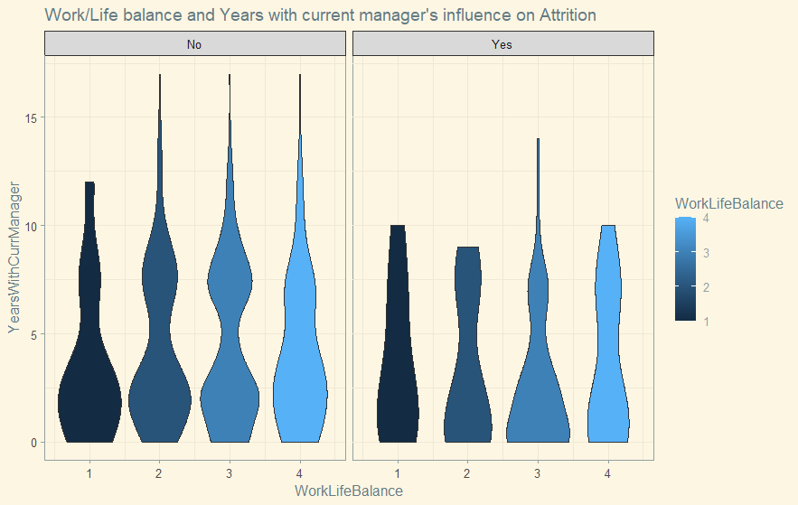
Work Life balance and Years with manager
Most employees with attrition aren’t with the same manager for more than 10 years.
This also indicates that the longer employees are with the same manger the worse their work/life balance is.
Notes:
5-ZB

Slide 8
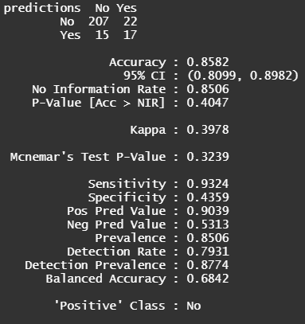
Testing and Modeling
Testing method results:
85.82% Accuracy
93.24% Sensitivity
43.59% Specificity
Linear model results:
RMSE: $1392.77
Notes:
7- Girard

Slide 9

Closing Thoughts
Notes:
Girard

