Slide 1
Predicting Item Sales in Walmart During Extreme Weather Days
Zexi Yu, zexi.yu@usask.ca

Slide 2
Overview
Objective:
What is the goal
Who cares
A General Summarize
Dataset:
How the data is collected, cleaned and wrangled
Exploratory data analysis (EDA):
Which features may be useful for the prediction
Learning Model:
General structures
Algorithm used
Result and Recommendation

Slide 3
Objective: What is the Goal
This project comes from a kaggle competition.
Walmart wants a model that can "accurately predict the sales of 111 potentially weather-sensitive products (like umbrellas, bread, and milk) around the time of major weather events at 45 of their retail locations"

Slide 4
Objective: Our Goal
A model that will predict product sales in major weather events
Evaluate how the weather condition and other factors affect the sales

Slide 5
Objective: Who cares?
Client: Walmart
Reason:
It will help Walmart better manage its inventory, and keep its customers out of rain.
It will help Walmart better evaluate the eectiveness of its current management against weather event

Slide 6
Objective: A Simplified Workflow
Data Summary
Data Merge
Data Wrangling
Data Cleaning
Data Interpolation
Add New Features
Train-Test Split
Learning Model
Learning Model Selection
Result

Slide 7
Dataset: Where does the data come from
Kaggle competition homepage:
https://www.kaggle.com/c/walmart-recruiting-sales-in-stormy-weather
Include four files:
Train.csv: units, store_nbr, item_nbr
Test.csv
Weather.csv: station_nbr, preciptotal
Key.csv: station_nbr, store_nbr

Slide 8
Dataset: Data Summry
Important Columns:
date
units
item_nbr
store_nbr
station_nbr
codesum
preciptotal

Slide 9
Dataset: Data Wrangling
Data Merge: train.csv/test.csv, key.csv, weather.csv using pandas.merge
Data Cleaning:
Replace “T” with 0 in preciptotal feature
New columns from codesum: RN, SN
Data Interpolation:
sort on store, item, date (in this order)
pandas.interpolate()

Slide 10
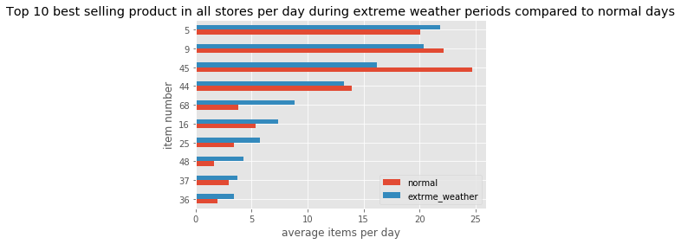
EDA: Which items sell best?

Slide 11
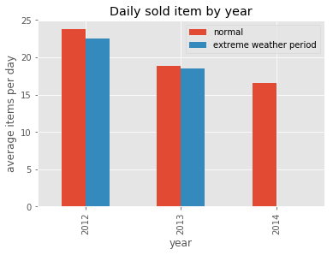
EDA: Which features influence these important items?
Year

Slide 12
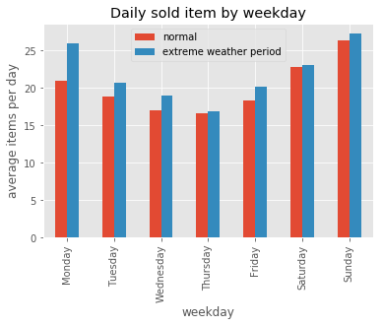
EDA: Which features influence these important items?
Weekdays

Slide 13
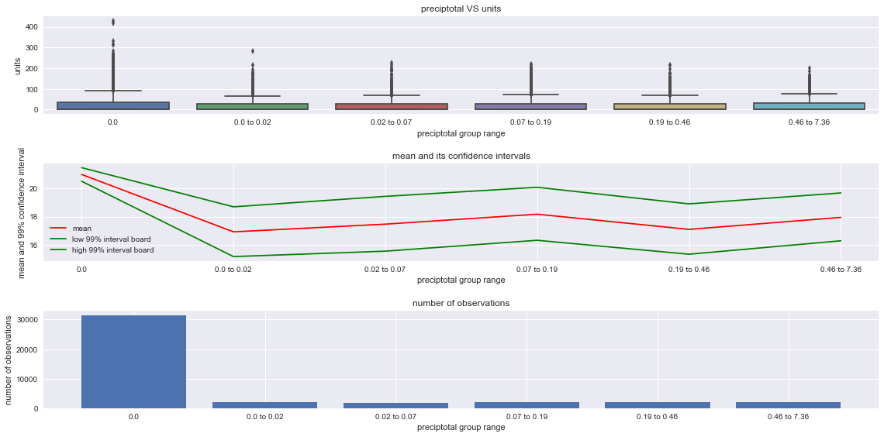
EDA: Which features influence these important items?
Rainfall:

Slide 14
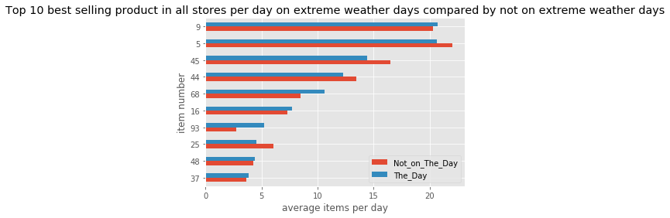
EDA: Which features influence these important items?
The day vs not on the day:

Slide 15
EDA: New features
Date related:
Year
Month
weekday
Sales related:
Previous week sale
Next week sale
Weather related:
Condition

Slide 16
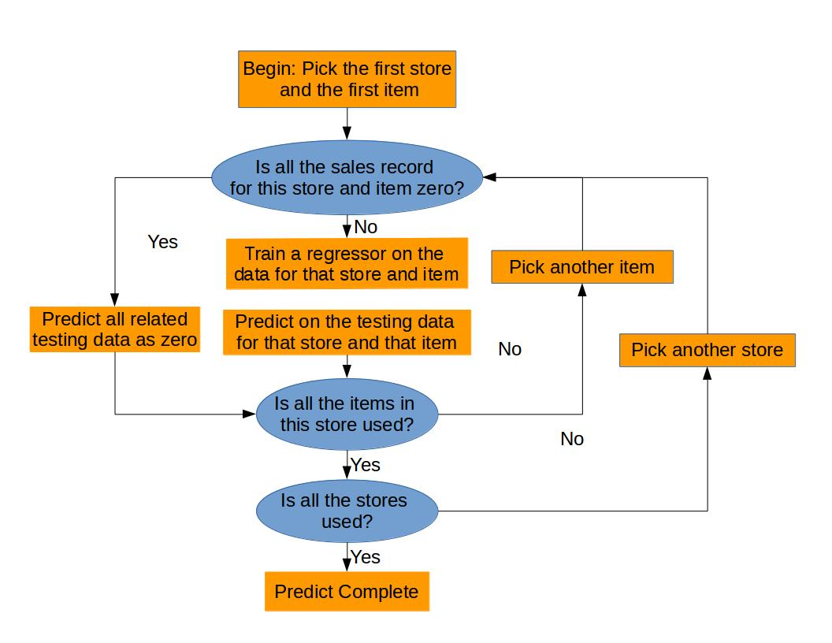
Learning Model: General Structure

Slide 17
Learning Model: Algorithms and Why
SVM
Fast speed
Easy explanation
Decision Tree & Random Forest
Dummy features
Neural Network
Non-linear relation

Slide 18
Results: In error score
RMSLE: Root Mean Square Logarithmic Error
Algorithm Name | RMSLE score | Training Note
Base Submission | 0.11701 | interpolation
SVM version 1 | 0.12024 | trained with numeric weather features
SVM version 2 | 0.10286 | trained without numeric weather features
SVM version 3 | 0.10841 | trained with linear kernel
Decision Tree | 0.11461
Random Forest | 0.13851
Deep Neural Network | 0.14245

Slide 19
Results: For explaining
Averaging over all the items:
Feature Name | Coefficient Value | Note
Before_Sales | 0.556280 | Average sales of previous week
After_Sales | 0.526110 | Average sales of next week
weekday_6 | 0.111950 | Sunday
weekday_3 | -0.071970 | Thursday
weekday_5 | 0.067471 | Saturday
Condition | 0.066983 | The weather event day
weekday_2 | -0.063852 | Wednesday
weekday_1 | -0.039919 | Tuesday
year_2014 | -0.038446 | 2014
SN | 0.032191 | snow day

Slide 20
Results: Different case for different item
For item 51:
Feature Name | Coefficient Value | Note
After_Sales | 1.773143 | Average sales of next week
month_12 | 1.227078 | December
Before_Sales | 1.046728 | Average sales of previous week
SN | 0.533850 | Snow day
month_1 | 0.227107 | January

Slide 21
Results: Recommendation
In general, sales record for past week and the weekday are the most dominant features for predicting one item sales in a given day.
It is wise to manage item storage independently. For items related to seasons, month and snowing might be a better indicator than weekday.

Slide 22
Results: Future work
Refine the model: Parameter Tuning

