Slide 1
Tumor recognition using CNN
Zexi Yu, zexi.yu@usask.ca

Slide 2
Overview
General Summary:
        Objective
        Audience and benefit
        General Structure
Data Wrangling
Learning Model:
        CNN introduction
        Structure used in this project
Result and Future works

Slide 3
General Summary
Objective:
  Build a model that will detect whether a lung cancer occurred.
Audience and benefit:
  Audience: hospitals/governmental health/cancer departments
  Benefit:
    reduce the false positive rate that plagues the current detection technology
    get patients earlier access to life-saving interventions
    give radiologists more time to spend with their patients.

Slide 4
General Summary
General Structure:
  Data Wranglings
    HU transformation
    Morphology operations
  Down-sampling
  CNN

Slide 5
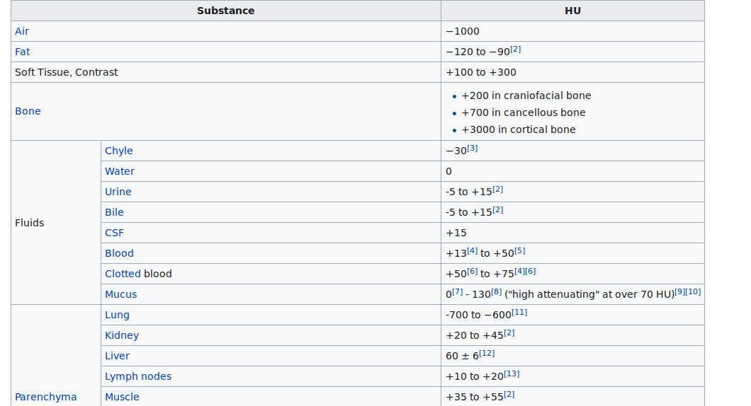
DW: DICOM Reading& HU transform
Hounsfield Unit / CT numbers:
  Image from wiki

Slide 6
DW: DICOM Reading& HU transform
DICOM Reading:
  Dicom.read_file
HU transform:
  Dicom.RescaleIntercept
  Dicom.RescaleSlope

Slide 7
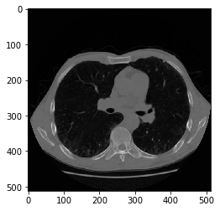
DW: Morphology Operations
Goal: Segmentation of nodes in lung
Six Steps
Original Image

Slide 8
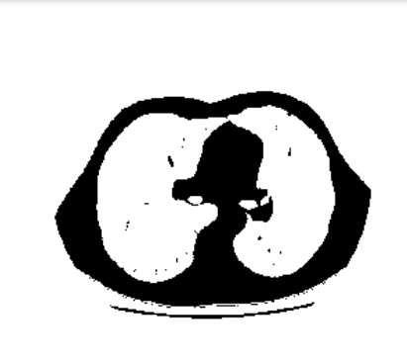
DW: Morphology Operations
Step 1: Convert the image into a binary one

Slide 9
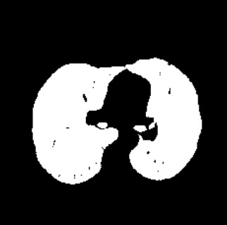
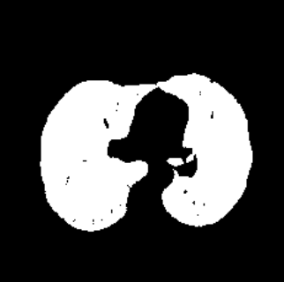
DW: Morphology Operations
Step 2: Remove the blobs connected to the border of the image
Step 3: Label the image and keep 2 largest areas

Slide 10
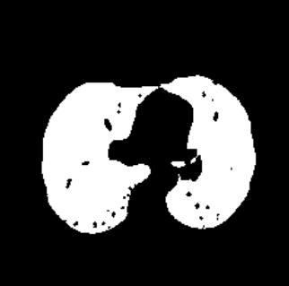

DW: Morphology Operations
Step 4: Erosion operation with a disk of radius 2 – separate the lung nodules
Step 5: Closure operation with a disk of radius 12 – keep nodules attached to lung wall

Slide 11

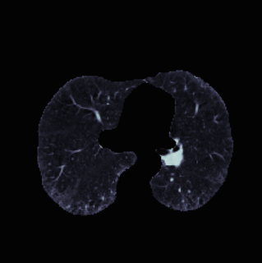
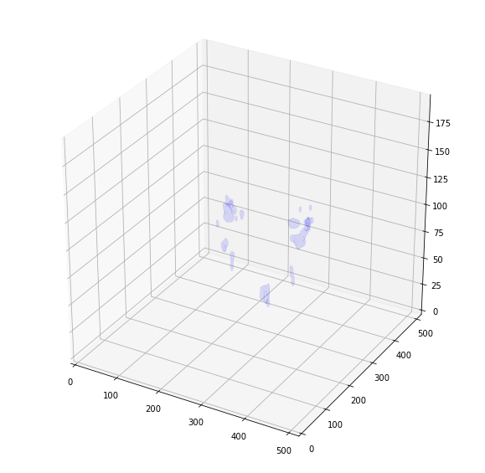
DW: Morphology Operations
Step 6: Fill in the holes
Superimpose

Slide 12
DW: Down-sampling
Sacrifices due to time and computation limit:
  No further node segment
  Only 1/5 of training set is used
  Down-sampling

Slide 13
Learning Method: CNN Intro
CNN - Convolutional Neural Networks
  Suitable for recognition task in Image processing
  Use convolutional layer to identify image characteristics
  Fully connected layer for classification
  Maxpool layer and dropout layer to prevent overfitting

Slide 14
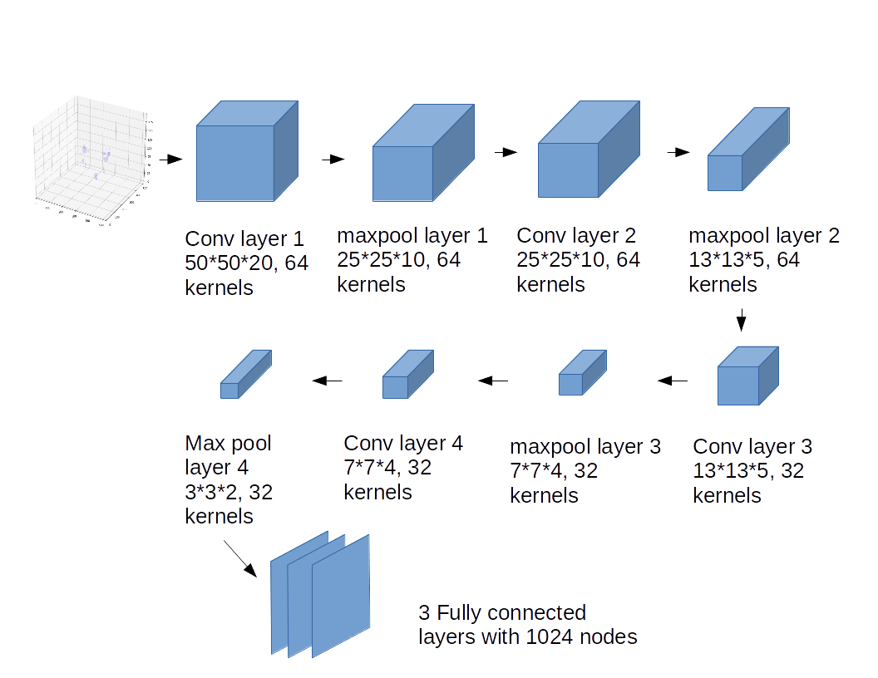
Learning Method: CNN structure
General Structure:

Slide 15
Result
Kaggle score is log loss function. Small score is better
Kaggle score 0.63856, beat the benchmark 0.69314
Tend to predict the non-cancer, may have high false negative rate

Slide 16
Future Work
Train the CNN using all the training set instead of 1/5 of them and see if the performance improves.
Manually label the nodes in the training set, perform node segmentation and train and change CNN structure according to the single node images.

