Slide 1


Tools Used For Development
Short Definitions
Slides by: Zack Enixey

Slide 2
We are:
Transpiling via Babel,
Bundling via webpack,
Linting via ESLint,
Testing via mocha,
Serving the app via Express and,
tying all this goodness together via npm scripts.

Slide 3

BABEL
Babel is a JavaScript compiler

Slide 4

Babel is a toolchain that is mainly used to convert ECMAScript 2015+ code into a backwards compatible version of JavaScript in current and older browsers or environments. *
Babel allows software developers to write source code in a preferred programming language or markup language and have it translated by Babel into JavaScript. **
With Babel we convert (transpile) the version we write in into the version that can run on any browsers.
* https://babeljs.io/docs/en/
** https://en.wikipedia.org/wiki/Babel_(compiler)

Slide 5
Webpack
Wrapping JavaScript code in a BUNDLE

Slide 6

webpack is a static module bundler for modern JavaScript applications. When webpack processes your application, it internally builds a dependency graph which maps every module your project needs and generates one or more bundles. *
Bundle – en. Package; Bundler – en. someone who package things
We use WEBPACK to extract JavaScript into a single minified file that works in the browser.
Webpack has a rich plugin interface. Most of the fatures are internal plugins using this interface. This makes webpack very flexible
Performance: webpack uses async I/O and has many multiple catching levels, this makes webpack fast.
* https://webpack.js.org/concepts/

Slide 7
Mocha
Most Popular JS Testing Framework

Slide 8

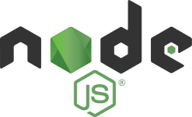
Mocha is a feature-rich JavaScript test framework running on Node.js and in the browser, making asynchronous testing simple and fun. Mocha tests run serially, allowing for flexible and accurate reporting, while mapping uncaught exceptions to the correct test cases. *
Mocha allows asynchronous testing and it has wide browser support.
Node.js® is a JavaScript runtime built on Chrome's V8 JavaScript engine. In Node.js we write whole WebApp in JavaScript so all app is written in one language. **
* www.mochajs.org/
** https://en.wikipedia.org/wiki/Node.js

Slide 9
Middleware
Everything between our app and Linux kernel

Slide 10
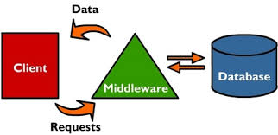
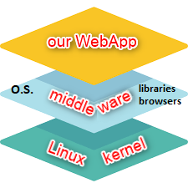
Middleware
Software that acts as a bridge between an operating system and applications, especially on a network.
It is a general term for software that serves to "glue together" separate, often complex and already existing programs.
Everything between our application and Linux Kernel is ‘middleware’. If we are using Android operating system, all that
middleware libraries are compiled to machine language

Slide 11
ESLint
ESLint will tell us for errors and omissions

Slide 12
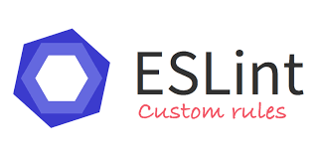
Code linting is a type of static analysis that is frequently used to find problematic patterns or code that doesn’t adhere to certain style guidelines.
With ESLint we find ‘problematic parts of code’.
Linting tools like ESLint allow developers to discover problems with their JavaScript code without executing it.
A Lint or a Linter is a program that supports linting (verifying code quality).
With ESLint we verify credibility of our written code.
It’s a pluggable linter that’s going to tell you if you’ve imported something and not used it, if your function could be short-handed.

Slide 13
EasdfasasdfasdfSLint
ESLint will tell asdfasdfasdfasdfus for errors and omissions

Slide 15
EasdfasdfSLint
ESLint will telsdfasdfasdfasdfasdfl us for errors and omissions

Slide 17

a
Brendan Eich is an American technologist and creator of the JavaScript programming language.
a
Brendan Eich

