Slide 1

Steps Taken
Zachary Farr

Slide 2
Question: Am I meeting the recommended daily average for steps?
What potential factors can affect my daily steps?

Slide 3
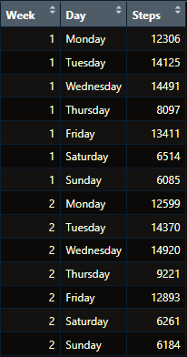

Data
14 days of collected data
Steps taken daily

Slide 4
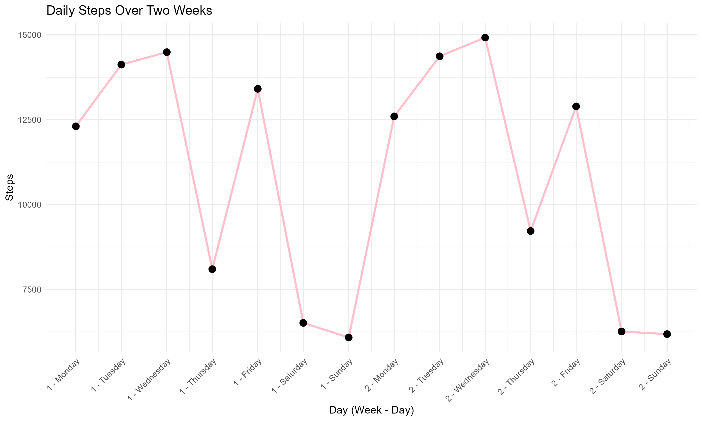
Visualizing My Data

Slide 5

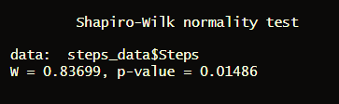
Is my data normally distributed?
Used Shapiro-Wilk Test in Rmarkdown
Commonly used for small samples sizes
N < 50
Null Hypothesis: The data is normally distributed
P-value < 0.05
Data is not normally distributed

Slide 6
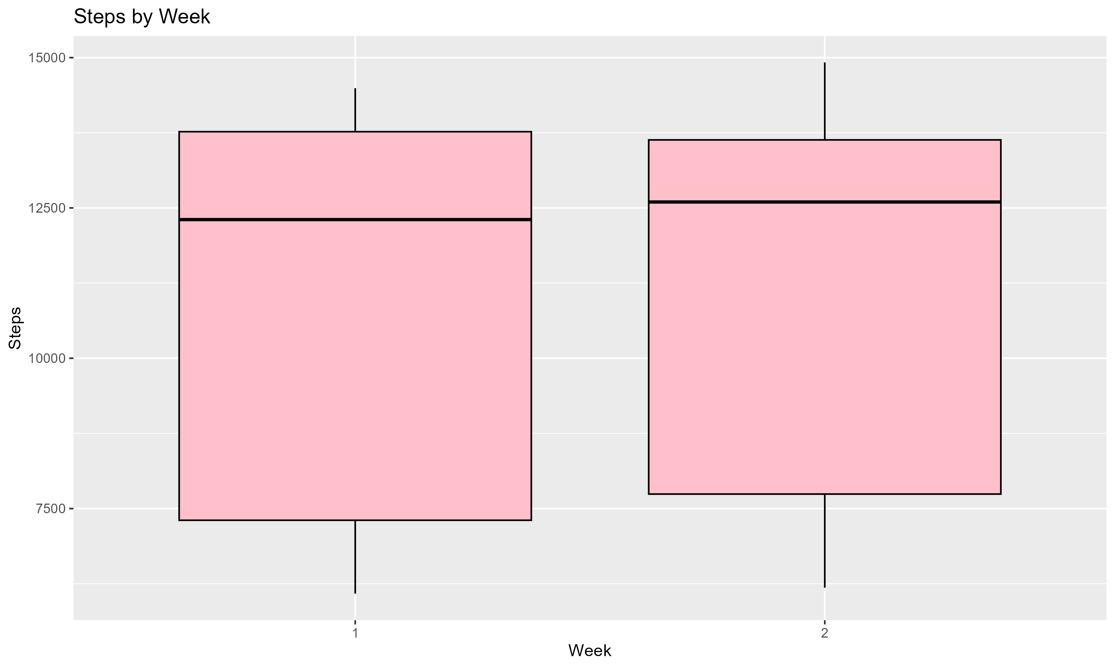
Potential Outliers?

Slide 7
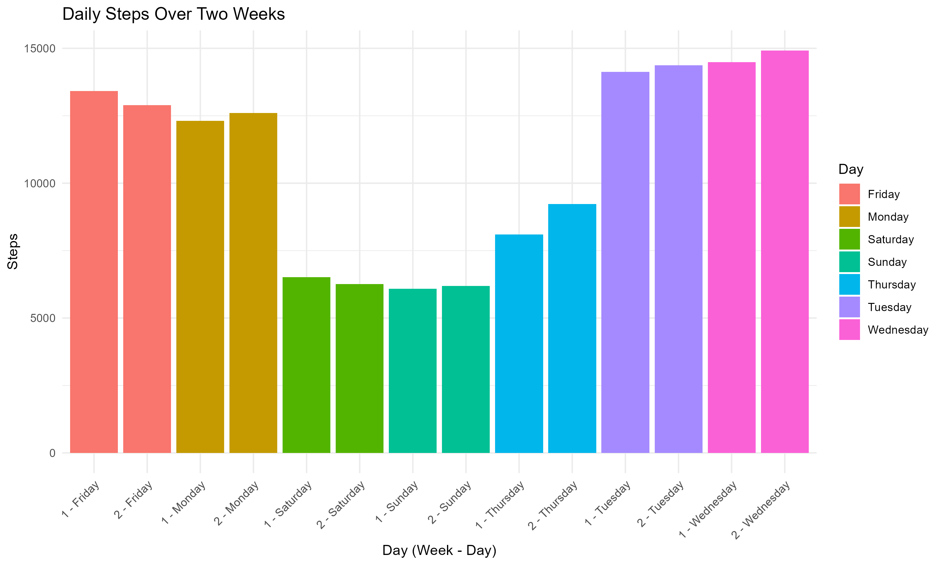
Understanding the Causes of Low Points in the Step Data
Classes
Gym
Studying

Slide 8

Hypothesis Testing
CDC recommends 10,000 steps (Medical News Today, 2024)
Claim: I consistently take more than 10,000 steps per day.
Medical News Today. (2024). How many steps should you take a day? Retrieved from https://www.medicalnewstoday.com/articles/how-many-steps-should-you-take-a-day#for-general-health

Slide 9
Hypothesis Testing
Step 1
Null Hypothesis
H₀: The average number of steps I take per day is equal to the recommended 10,000 steps
H0 :μ = 10,000
Step 2
Conducting a one-sample t-test
Alternative Hypothesis
The average number of steps I take per day is greater than 10,000 steps
H1 :μ>10,000

Slide 10
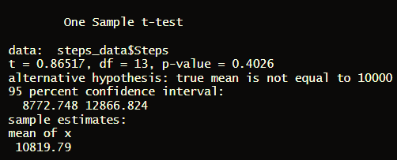
Hypothesis testing
Step 3
Test statistic = 0.86517
P-value = 0.4026
Step 4
Using a significance level 0.05
Fail to reject the null hypothesis

Slide 11

Conclusion
Since the p-value is 0.4026, we fail to reject the null hypothesis. There is not enough evidence to support the claim that I get more than the recommended average for daily steps.

