Slide 1
Context aware modelling of prosody (CAMP)
A two-stage approach to modelling prosody in context
Zack Hodari
Internship presentation
January – July 2020

Slide 2
Overview
– Relationship between context and prosody
– Proposed models
Duration modelling
Prosody representation learning
Prosody prediction using context
– Evaluation

Slide 3
Speech synthesis
– In TTS we typically split the problem into three parts
Text processing → Acoustic modelling → Waveform prediction
– We propose a two-stage acoustic model to directly model prosody
stage-1: goal – Naturalness (acoustic quality)
stage-2: goal – Appropriateness (prosody quality)

Slide 4
Prosody is a weak signal
– Prosody is a channel of communication
i.e. It can provide information not already expressed in words
– It is realised through suprasegmental effects such as:
timing (rhythm), intonation (F0), and loudness
– problem-1: Prosody is a weak signal

Slide 5
Context determines prosody
– Prosody is determined by the context a speaker sees as relevant
Syntax, semantics, affect, pragmatics, setting
– In TTS our context typically includes only,
lexical information (phonemes), and
some syntax information (in HUS linguistic features)
– problem-2: We need more context!

Slide 6
CAMP – Context aware model of prosody
– To address these two problems we proposed a two-stage paradigm
stage-1: Prosody representation learning
stage-2: Prosody prediction using context
– Similar to
VQ-VAE’s learnt prior – focusses on phonetic discovery
TP-GST – focusses on sentence-level style w/o additional context
Linguistic linker – focusses on on F0 w/o additional context

Slide 7
Methods
1. Tacotron-2
2. Duration modelling
3. CAMP

Slide 8

S2S – Tacotron-2
– Tacotron-2 like model
– Sequence-to-sequence with attention

Slide 9

DurIAN+ S2S w/joint duration model
– Tacotron-2 like model
– Attention replaced with jointly-trained duration model

Slide 10
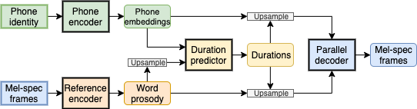
ORA – Oracle prosody
– Autoencoder model for representation learning
– Sequence-to-sequence with jointly-trained duration model
– Word-level reference encoder

Slide 11
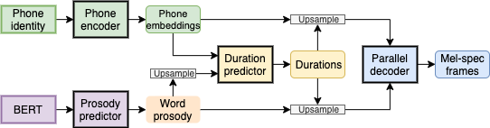
CAMP – Predicted prosody
– Proposed two-stage approach
– Sequence-to-sequence with jointly-trained duration model
– Context-based prediction of word-level prosody embeddings

Slide 12
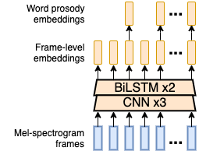
Reference encoder (for oracle prosody)
– Makes model an autoencoder
– Embeds mel-spectrogram frames
– Keep last frame’s embedding for each word (downsampling)

Slide 13
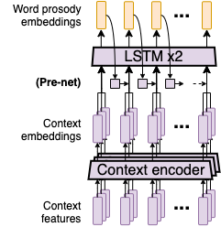
Prosody predictor
– Predicts word-prosody representations
– Replaces reference encoder which relied on the spectrogram
– Uses one or more context encoders
i.e. Information used in prosody planning

Slide 14
Context features
– Syntax features
Part-of-speech (POS) – syntactic role of a word
Word-class – open/closed class (content/function)
Compound noun structure – boolean flag
Punctuation structure – boolean flag
– Semantic context encoder
Fine-tuned BERT_{BASE}

Slide 15
Evaluation
1. Context features
2. Duration modelling
3. CAMP

Slide 16
Data
– 40 hours of long-form reading content
– 80-band mel-spectrograms with a 12.5ms frame-shift
– Durations extracted using forced alignment with Kaldi

Slide 17


Context feature ablation
– Compare CAMP with different context encoders
CAMP_{syntax} – Context encoder for each syntax features
(POS, word-class, compound noun, punctuation)
CAMP_{BERT} – BERT context encoders
CAMP_{BERT+syntax} – All syntax context encoders and BERT
$$<$$
$$=$$

Slide 18
Duration benchmark
– Determine the contribution of joint duration modelling

Slide 19



CAMP
– MUSHRA evaluation of our proposed model – CAMP
DurIAN+ | Lower-bound | Duration-based Tacotron-2
CAMP | Proposed | Predicted prosody specification
ORA | Top-line | Oracle prosody specification
Nat | Upper-bound | Natrual speech (no vocoding)
25.8%
68.8%
37.5%
$$<$$
$$<$$
$$<$$

Slide 20
Conclusion
– Closed the gap between strong duration baseline and natural speech
25.8%
– Future work
68.8% – Improve representation learning
37.5% – Improve context modelling

Slide 21
Thanks!

Slide 22
Paragraph level TTS
– Experimented with improving the prosody prediction
Provide wider context by training on paragraphs
– Informally we found that
Sentence transitions were improved
Only short sentences had noticeable prosody improvements
– We need to improve the architecture to fully utilize this context

Slide 23
Speaking rate behaviour
– As we added more information the speaking rate improved
However, the L1 loss got worse
This is likely due to the non-Gaussian distribution of durations

Slide 24
Prosody embedding space structure
– In earlier models we saw three clusters
One cluster clearly represented silences
Two clusters represented words
– However, we did not determine the meaning of the two word clusters
e.g. average pitch, emphasis, proximity to silences

