Slide 1
VIBE
A look at how the elements of popular music change over time

Slide 2
The
Data
Database contains two tables:
A table of every album to make the Billboard top 200 albums list for every week from 1963-2019.
A table containing the tracks from about 72% of those albums, along with spotify data points describing each one.

Slide 3
The Process
Step 1
Step 2
Step 3
Acquire/Clean Data
Queries
Missing Values
Fill in missing data for Kenny G’s Silhouette
Explore/Understand Data
Spotify EchoNest data available for about 72% of the albums.
Datapoints like:
Danceability
Energy
Speechiness
etc.
Analysis
Compile popularity of each element for each week from 1963-2019 to see how the musical landscape changes over time.

Slide 4
Example

Slide 5
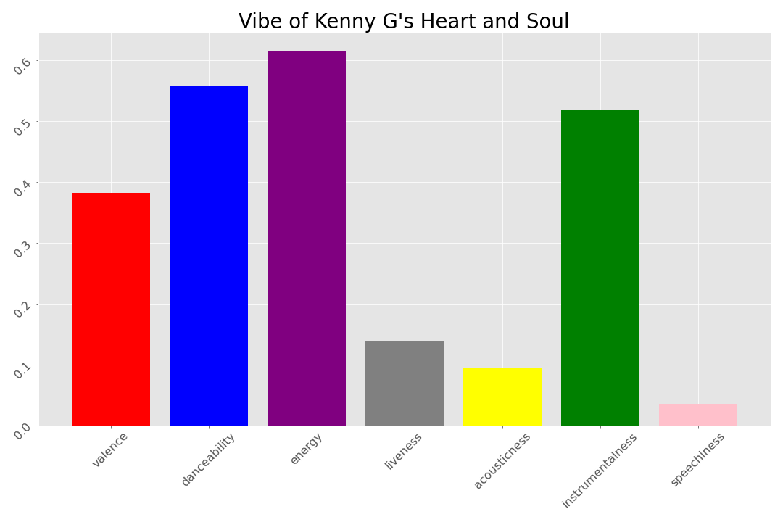
Vibe of Kenny G’s Heart and Soul

Slide 6
Figures

Slide 7
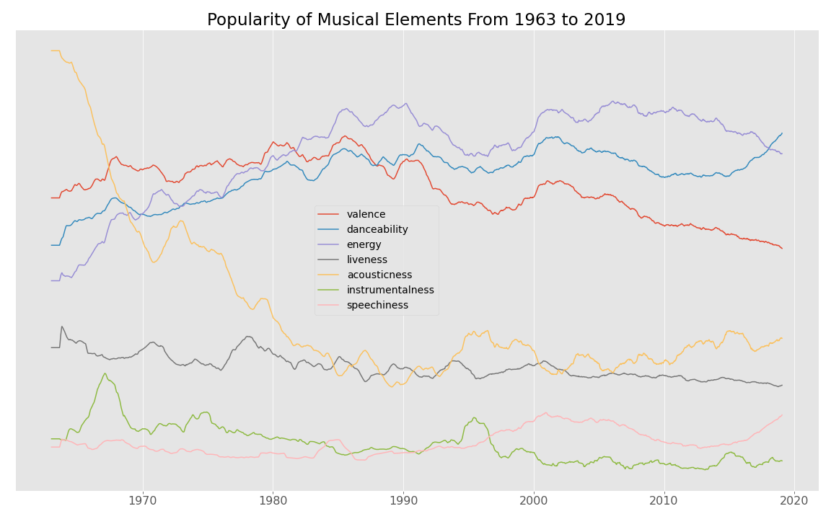

Slide 8
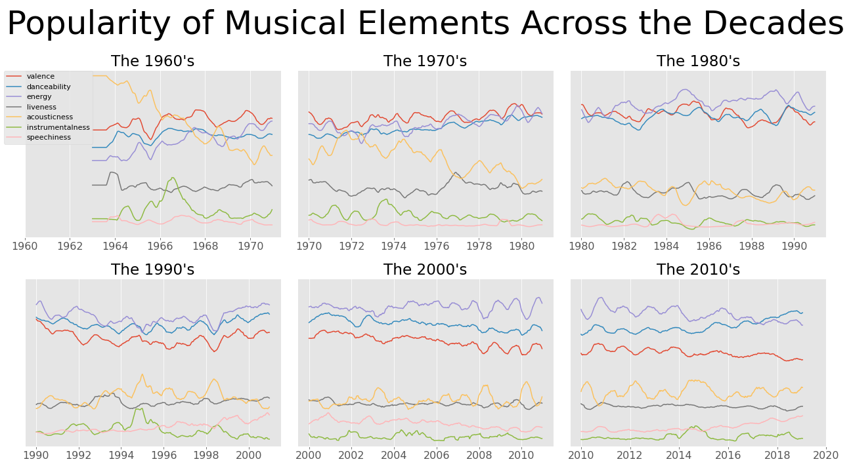

Slide 9
Hypotheses

Slide 10
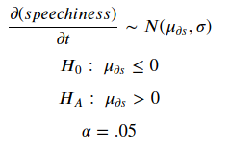
Hypothesis:
The average “speechiness” of music trends upward after 1985, as rap music is invented and popularized
Results
Successfully rejected null hypothesis
p = 0.008

Slide 11
Hypothesis:
Correct!
From the year 1985 onward, there is a statistically significant upward trend in the popularity of “speechy” music.
The average “speechiness” of music trends upward after 1985, as rap music is invented and popularized

Slide 12
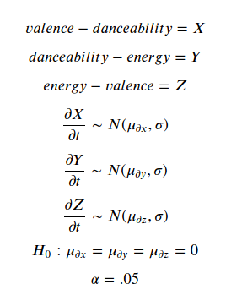
Hypothesis:
Results
Successfully rejected null hypothesis on
[valence vs danceability] : p = 5.75e-14
Failed to reject null hypothesis on
[danceability vs energy] : p = 0.87
Successfully rejected null hypothesis on
[energy vs valence] : p = 2.09e-08
The relationship between danceability and energy is consistent over time, but “valence” (measure of joy/positivity) has been drifting away from them over time.

Slide 13
Hypothesis:
Correct!
The danceability and energy of popular music seem to remain linked, while “valence” has a significant drift away from both of them.
The relationship between danceability and energy is consistent over time, but “valence” (measure of joy/positivity) has been drifting away from them over time.

Slide 14
Links
Project Repo:
github.com/zackmagnotti/tin-pan-data
Data Source:
components.one/datasets/billboard-200
List of Albums by Kenny G:
wikipedia.org/wiki/Kenny_G_discography

