Slide 1
Android Development
Android Themes and Styles
Lesson 13

Slide 2
Style Resources
A style is a collection of properties that specify the look and format for a View or window
Styles give your app a consistent appearance
A style can specify View properties such as height, padding, font color, font size, background color, and more

Slide 3
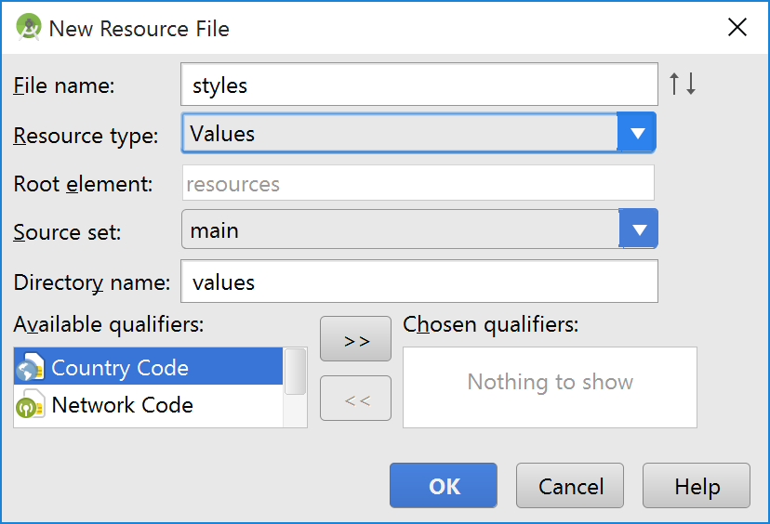
Where to Store a Style
If the res\values\styles.xml file doesn’t exist, you can create it
Under Res, right-click, then click New and choose Resource File to get the screen on the right

Slide 4
Styles and Themes
The styles.xml file will generally contain the application theme you selected when you created the app. Here is a sample from one of mine:
<resources> <!-- Base application theme. --> <style name="AppTheme" parent="Theme.AppCompat.Light.DarkActionBar"> <!-- Customize your theme here. --> <item name="colorPrimary">@color/colorPrimary</item> <item name="colorPrimaryDark">@color/colorPrimaryDark</item> <item name="colorAccent">@color/colorAccent</item> </style> </resources>

Slide 5
Adding Styles
You can add more styles under the <resources> tag by simply defining new <style> tags:
<style name="CodeFont" parent="@android:style/TextAppearance.Medium"> <item name="android:layout_width">fill_parent</item> <item name="android:layout_height">wrap_content</item> <item name="android:textColor">#00FF00</item> <item name="android:typeface">monospace</item> </style>

Slide 6
Inheritance
The parent attribute in the <style> element is optional and specifies the resource ID of another style from which this style should inherit properties
You can then override the inherited style properties
The previous style inherits from an Android-provided style

Slide 7
Inheritance
If you want to inherit from styles that you've defined yourself, you do not have to use the parent attribute.
Prefix the name of the style you want to inherit to the name of your new style, separated by a period.
For example, to create a new style that inherits the CodeFont style defined above, but makes the color red, you can author the new style like this:
<style name="CodeFont.Red">
<item name="android:textColor">#FF0000</item>
</style>

Slide 8
Style Properties
Style properties are defined by the <item> element
You can define any attributes that are allowed for the kind of thing to which the style applies
For example, an EditText View style can have any or all of the attributes listed here:
http://developer.android.com/reference/android/widget/TextView.html#lattrs

Slide 9
Applying Styles and Themes to the UI
Apply to an individual View by adding the style attribute to a View element in the XML for your layout.
Apply to an entire Activity or application by adding the android:theme attribute to the <activity> or <application> element in the Android manifest.

Slide 10
Apply a Style to a View
<TextView style="@style/CodeFont" android:text="@string/hello" />

Slide 11
Apply a Theme to an Activity or Application
<application android:theme="@style/CustomTheme">
If you want a theme applied to just one Activity in your application, then add the android:theme attribute to the <activity> tag instead.
<activity android:theme="@android:style/Theme.Translucent">

Slide 12
Using Platform Styles and Themes
The Android platform provides a large collection of styles and themes
You can find a reference of all available styles in the R.style class
Look at the actual source code for the styles because this class is not well documented.

Slide 13
Material Design
Your theme should extend one of the AppCompat themes that is closest to what you want
Theme.AppCompat.Light.NoActionBar is a good starting point
In naming styles, use the “function” of the style rather than its appearance: “Header” rather than “Text30PointRed.”

