Slide 1
Sound and Media
Android Development

Slide 2
Assets
Assets are files that are bound to your program
They are always accessible
You should use these for “fixed” data, like the music in the app we’re about to use
Or, in the “pong” game, you can have various sounds for the ball hitting the paddle, for losing, etc.
Do not use these for files you’ll read and write

Slide 3
Assets
To create the Assets folder:
Right click on the app to get a menu
Click on New
Click on “Folder” in the list on the bottom of the menu
Choose “Assets Folder”
Copy files you want to be your assets into the folder
For example, I have various military bugle calls

Slide 4
Assets
Getting the Asset Manager:
This should probably be an instance variable declared this:
private AssetManager mAssets;
In your onCreate method:
mAssets = this.getApplicationContext().getAssets();

Slide 5
Assets
Listing assets
private static final String SOUNDS = “sampleSounds”;
String[] sounds = mAssets.list(SOUNDS);
At this point the sounds[] array has the names of all of the assets from the “sampleSounds” directory under assets

Slide 6
Assets
If you want to create a ListView of the songs, you can create an ArrayAdapter of all of the names, then attach that to the ListView
Create an ItemClickListener and attach it so you can get your selections

Slide 7
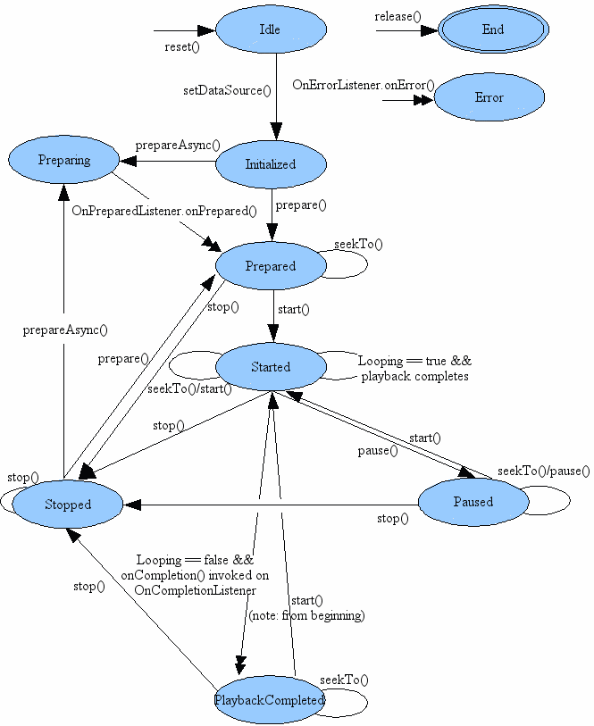
The Media Player

Slide 8
The MediaPlayer
The MediaPlayer class plays various kinds of media. We’ll be using it only for sound
In your instance variables, declare:
MediaPlayer mPlayer;
In the method where you’re going to play sounds, create a new instance of the player:
mPlayer = new MediaPlayer();

Slide 9
The Media Player
Get a file descriptor for one of your assets:
AssetFileDescriptor afd = mAssets.open(SOUNDS + “/reveille.mp3”);
Set the Media Player to play the asset:
mPlayer.setDataSource(afd.getFileDescriptor(), afd.getStartOffset(),
afd.getLength());
mPlayer.prepare();

Slide 10
The Media Player
Set a listener so we know when the selection has finished:
mPlayer.setOnCompletionListener(this);
Note that if you use the activity for the completion listener, you must implement the MediaPlayer.OnCompletionListener interface
This interface has the function onCompletion(MediaPlayer mp)
Thus the media file is played on its own thread and signals when it is done.

Slide 11
The Media Player
A sample implementation of the onCompletion function. It enables the button that started the play, and it releases the player.
public void onCompletion(MediaPlayer mp)
{
btnPlay.setEnabled(true);
mp.release();
}

Slide 12
Other MediaPlayer Functions
The isPlaying() function tells you that the media player is busy
You can stop the current playback by calling the stop() function
Pause playback with the plausibly named pause() function

Slide 13
Other MediaPlayer Functions
The getDuration() function returns the duration of playback in milliseconds
If the duration is not available, it returns -1
You could use this along with a timer to show progress of playing the current selection

Slide 14
Other MediaPlayer Functions
The seekTo(int msec) function lets you go to a particular place in the currently-playing file
The file must actually be playing (the isPlaying() function returns true) for this to work.

Slide 15
Text to Speech
The TextToSpeech class synthesizes speech from text for immediate playback or to create a sound file
A TextToSpeech instance can only be used to synthesize text once it has completed its initialization
Implement the TextToSpeech.OnInitListener to be notified of the completion of the initialization
When you are done using the TextToSpeech instance, call the shutdown() method to release the native resources used by the TextToSpeech engine

Slide 16
Set up the Listener
private EditText write;
ttsobj=new TextToSpeech(getApplicationContext(), new TextToSpeech.OnInitListener() {
@Override
public void onInit(int status) {
}
});

