Slide 1
User Interface Design
John Cole
Senior Lecturer
University of Texas at Dallas
Department of Computer Science
Notes:
Give a little of my background here.

Slide 2
Every Program Has One
With very few exceptions, such as device drivers, every program interacts with a user.
Most of us who write programs don’t use the kinds of programs we write.
The more work you put into the program, the less work your users will have to do to use it.
“The only intuitive user interface is the nipple.” A friend who has an infant assures me even this is not true.
Thus what we think of as intuitive interfaces are only familiar. Everything must be learned.

Slide 3
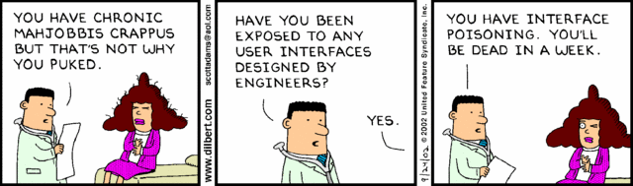
The Dilbert Take

Slide 4
Aspects of User Interfaces
Design of UI artifacts themselves. I. e. scrolling controls, lists, etc.
Design of programs that use existing UI artifacts. That’s what this talk is about.
Arrangement of artifacts
Use of color and sound
System navigation

Slide 5
Sovereign Applications
A “sovereign application,” that is the main thing on your user’s screen and he/she is interacting only with it
You should adjust the size of the program’s window to take as much of the screen top to bottom as possible, and center it
Adjust the sizes of screen objects if necessary

Slide 6
Which Interface?
There are a number of environments: Windows, Java, Mac, and browser-based, and various flavors for Unix/Linux, and of course mobile
Within Windows, there are at least WinForms and Windows Presentation Foundation. Each has unique capabilities, so the choice of UI is not part of this discussion.

Slide 7
It’s a Communication Problem
We know we’re better than our users. We’re college-educated, understand computers, and can write programs.
They know we’re idiots who couldn’t do their job if our lives depended upon it and we either talk down to them or talk over their heads.
Users would rather be successful than knowledgeable.
You have to understand how they work.

Slide 8
The User’s Goals
Feeling smart and in control
Getting a reasonable amount of work done
Not making serious mistakes or being able to fix mistakes easily
Having fun, or at least not being too bored
(Notice that the user doesn’t care about business goals, like balancing the account or entering insurance claims.)

Slide 9
The Programmer’s Goals
Write the minimum amount of code necessary unless you’re paid by the line or hour (we work under a deadline)
Have the programs mirror the data model (we spent a lot of time learning their business and creating the domain model)
Not having to do too much maintenance (unless we’re paid really well to do it)

Slide 10
Guiding Principle
The Principle of Least Astonishment: Your program should not do things that take the user by surprise.

Slide 11
Data Entry Applications
Much data is still entered by hand, using applications people like us write
Usually, there is a system of programs, sometimes a few, sometimes dozens, used to maintain various database tables and enter data

Slide 12
Data Entry Applications
For many reasons, expecting your users to enter data through SQL Server Management Studio or similar applications is simply unacceptable
Therefore, we write specialized programs to do this

Slide 13
Data Entry Applications
The people who use these programs are really good at it. They’re fast, and don’t want anything to slow them down.
They don’t want to take their hands off the keyboard.
They don’t want to click buttons.
They don’t want to answer questions.
Notes:
Examples: Entering rebate info; entering checks; Entering voter registration info.

Slide 14
The Intuitive Interface
This is a myth. Humans are really good at figuring things out but have almost no hardwiring.
What seems intuitive is only so because it is familiar
We know how to use such programs because we have seen similar things before

Slide 15
Consistency
Since there are no intuitive user interfaces, go for consistent ones:
If the Save (or Submit) button is on the bottom of one screen in a system of programs, it should be in roughly the same position on all of them.
If the Save button is the default (meaning that when you hit Enter, it’s equivalent to pressing that button) on one screen, it should be the default on all of them.
If your program has a menu, File (if this makes sense as a menu item) should be the leftmost item and Help the rightmost.

Slide 16
Consistency (continued)
The F1 key is common for help
The Tab key always moves from control to control. It should do so in some rational order
The Enter key can move between fields too, depending upon state

Slide 17
Guiding Principle
Simple things should be easy to do. Complex things should be possible.
For example, in an accounting program, entering checks should be easy. Deleting a check, which is dangerous, should be possible. Maintaining configuration information should be possible.
Audit trail

Slide 18
Features
Not all features of a program should be available to all users
For example, the person who enters checks cannot reconcile accounts

Slide 19
Program Navigation
Many programs have menus for navigation. This is good as far as it goes.
The next program offers a way to navigate to another screen so you don’t have to exit to a main menu, enter new data, then return to it.
Also note the amount of on-screen text.

Slide 20
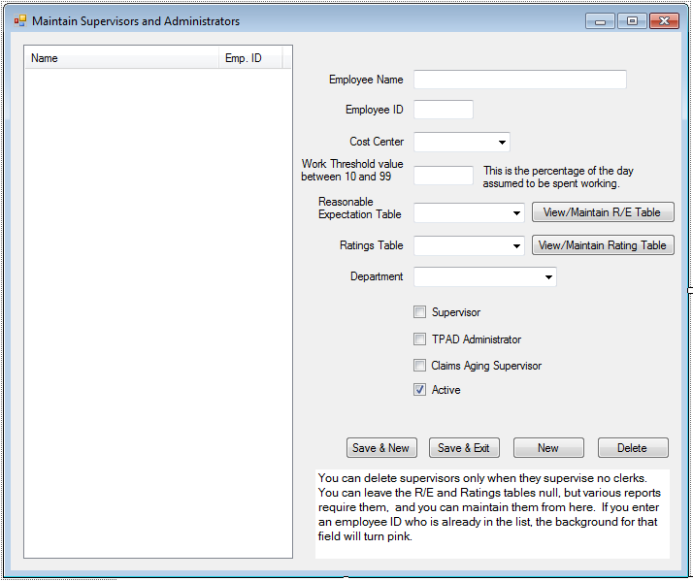

Slide 21
On-Screen Instructions
Some programs are not used very often. Give the user help with them
For example: Tooltips on controls that explain the kind of data expected.
A label control (or equivalent) that contains a paragraph of explanatory text.
“Expert Mode.”

Slide 22
Intelligent Defaults
In the screen shown, the default button, the one that Enter presses, is Save & New
The “Active” checkbox defaults to “checked” state for new supervisors
In the previous screen the Department defaults to the department of the person entering the data.

Slide 23
Entry Fields
In the sample, the lengths of the textboxes are roughly equivalent to how many characters may be entered
Never make all of the textboxes the same size “for consistency;” the user needs the visual cue as to how much data can be entered
For text data, limit the number of characters that can be entered to the size of the database field

Slide 24
Entry Fields
For text data, limit the number of characters that can be entered to the size of the database field
It at all possible, do not have text fields that scroll; the width should accommodate the longest string that can be entered

Slide 25
Screen Navigation
The tab key must move from one field to the next
Do not automatically move from one field to the next unless it makes sense. For example, choosing something from a list should not necessarily move to the next control.
Upon completion of an entry, the list of items entered should be updated, the entry fields are cleared, and focus should be on the first control, which is the employee name in the screen shown above.
Notes:
Entering parts of an SSN or product key

Slide 26
Down or Across?
In the screen shown, flow is down the page. Most languages, other than Semitic languages such as Hebrew and Arabic, read left to right, top to bottom
Your layout should make it easy for your user’s normal mode of reading

Slide 27
Down or Across?
Another layout could have multiple fields per line. However, beware making the entry area too wide for the eye to track easily. This is why newspapers have columns.

Slide 28
Position of Labels
Labels go to the left for a “mostly down” layout, above (usually) for a “mostly across” layout.
If you put the label in the field itself, that works for initial entry but not so well for editing existing data, but it can be useful when screen space is limited

Slide 29
The Need for Speed
Drop-down lists (combo boxes) are great if you don’t know what you want. If you do, they slow you down.
Ideally, you should be able to key into the edit part, but (usually) only things that are in the list.
Radio buttons and checkboxes usually slow the user down

Slide 30
Other Considerations
If they’re keying from a printed form, screen fields should correspond to the reading order of form fields.
Indicate optional fields somehow. Color can be a good way to do this.
The form shown is good when there are more data fields than will easily fit in a listview or datagrid.

Slide 31
Other Considerations (continued)
The Save & New button is active only when the fields contain valid data. Another way of doing this is to have it active and pop a message box when the user clicks it and tries to save. This is considered poor practice.
Delete is active only when deleting the supervisor would not violate referential integrity.
Notes:
Discourage the use of pop-ups

Slide 32
What Am I Doing?
A later version of this program had a status strip along the bottom
If you were modifying an entry, it showed “modifying Z231,” for example
If you were adding a new entry, it showed, “Adding new supervisor”
It also showed how many supervisors were in the list

Slide 33
Programs Should Be Forgiving
Accept multiple forms of some data, such as dates and phone numbers
Don’t restrict the delimiters for a phone number
Notes:
SQL Server and dates

Slide 34
Programs Should Be Forgiving
For dollar amounts, you can have an implicit decimal point; this saves one keystroke per entry but requires entry of trailing zeros
Allow commas in large dollar amounts
An accountant thinks $252,451.76 is a valid number; so should your program

Slide 35
Lists
If your program has a list, at the very least have sort headers on significant columns.
It can be a good idea to allow the user to reorder the columns
If the list has, of necessity, a large number of items (all possible parts in an auto-parts store) provide several ways to search

Slide 36
Lists
Often it is useful to use drop-down lists to qualify what shows in a big list
E. g. All parts, then all HP parts, then all HP printer parts, etc.
Virtual lists

Slide 37
Use of Color
A light pink background can be used to signal invalid input.
Green can be used to indicate things in balance, for example, and red, out of balance.
Yellow can indicate optional fields.
Colored backgrounds can be distracting or pleasing
Use color with caution. Some people have red-green colorblindness.

Slide 38
Visual Metaphors
Visual metaphors are on-screen artifacts that most people will recognize. For example:
An arrow pointing down invites the user to click it to make something drop down.
Red means warning (usually)

Slide 39
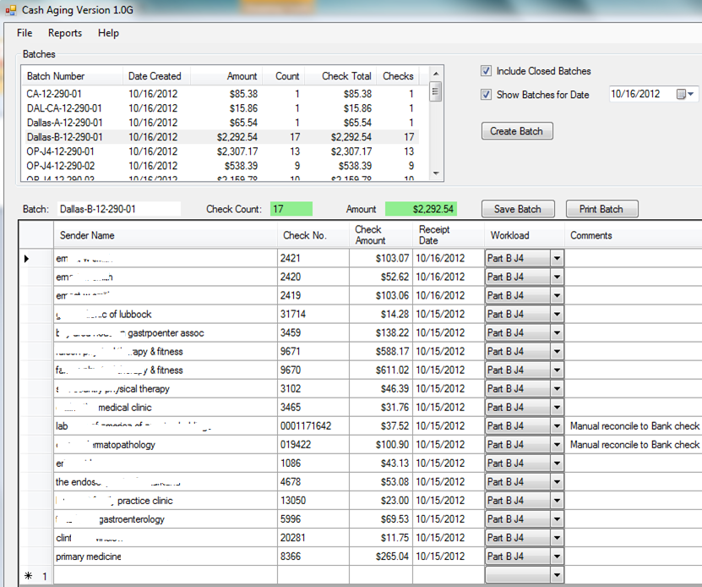
Even Faster Entry

Slide 40
Notes on the Preceding Screen
This is used for entry of checks. Users know, from the batch, the number of checks and the dollar amount
Each check goes on a separate line.
Function key F5 duplicates the previous amount and check type.
F5 increments the previous check number.
The program makes a sound when the correct number of checks has been entered and the dollar amount is correct. Note the use of color.

Slide 41
More Notes
This lends itself best to records that do not have a natural primary key.
Control-s saves at any time. (It won’t save a partially-entered line.)
It has a familiar look: Excel
Notes:
A later version of this program did an auto-save after each line was entered.

Slide 42
Use of Sound
Many programs make a sound to signal success or error
Quicken’s “cash register” sound when you enter a check
Sounds associated with message boxes
Reading text to the user
Sound can become annoying

Slide 43
When to Use Message Boxes
If they’re not for keying mistakes, then when?
System errors, such as database unavailability, attempts at unauthorized access, etc.
Messages must be explanatory. Not “The Checks database is offline” but “You do not appear to be connected to the server. Please call tech support at 5555.”
Not “Record not found” but “You do not appear to be an authorized user of this system. Please contact your supervisor.”
Notes:
Your user does not know and should not need to know the technical details of your program, such as where the database is located, or even that there is one.

Slide 44
Configurability
It’s easy to hard-code things
It is also usually a very bad idea
Allow your users (or a supervisor) to set various defaults

Slide 45
Configurability (continued)
For example, one of the programs I wrote lets the user load data from a spreadsheet. The default location of these spreadsheets is configurable.
Colors can be configurable.

Slide 46
Configurability (continued)
Information that appears in report headers, such as the company name.
Fiscal year end.
Time zone offset.
Internationalization.
Notes on writing the configuration screen.

Slide 47
Conclusions
Programs can be made, if not user-friendly, at least not user-hostile.
Programs can be written that provide visual cues for data entry without slowing down the user.
Programs can be written that are operated almost entirely from the keyboard.

Slide 48
References
Cooper, Alan, About Face
Cooper, Alan, The Inmates Are Running the Asylum
Petzold, Charles, Programming Windows

