Slide 1
User Interface Design
Lesson 8
Material Design

Slide 2
Acknowledgements
This material is mostly from https://material.google.com/
Also from: https://material.io/
Prototyping tools from: http://relativewave.com/form/
Additional information from other sources and your instructor’s experiments
Material design icons: https://material.io/icons/

Slide 3
Material Design
Material Design is a visual language for our users that synthesizes the classic principles of good design with the innovation and possibility of technology and science
Material Design is a unified system that combines theory, resources, and tools for crafting digital experiences
Develop a single underlying system that allows for a unified experience across platforms and device sizes
Mobile precepts are fundamental, but touch, voice, mouse, and keyboard are all ﬁrst-class input methods

Slide 4
Principles
Material is the metaphor
Think in terms of paper and ink
Everything drawn is ink on material surfaces
Bold, graphic, intentional
Motion provides meaning

Slide 5
Environment
Material design is a three-dimensional environment containing light, material, and cast shadows
All material objects have x, y, and z dimensions
All material objects have a single z-axis position
Key lights create directional shadows, and ambient light creates soft shadows

Slide 6
Environment – 3D World
The material environment is a 3D space, which means all objects have x, y, and z dimensions
The z-axis is perpendicularly aligned to the plane of the display, with the positive z-axis extending towards the viewer
Every sheet of material occupies a single position along the z-axis and has a standard 1dp thickness
On the Web the z-axis is used for layering and not perspective

Slide 7
Environment – Light and Shadow
Within the material environment, virtual lights illuminate the scene.
Key lights create directional shadows, while ambient light creates soft shadows from all angles.
In Android development, shadows occur when light sources are blocked by sheets of material at various positions along the z-axis
On the web, shadows are depicted by manipulating the y-axis only.

Slide 8



Environment – Light and Shadow
Shadow cast by Key Light Shadow cast by Ambient Light Combined shadows from Key and Ambient Light

Slide 9
Material Properties
Solid
Occupies unique points in space
Impenetrable
Mutable shape
Changes in size only along its plane
Unbendable
Can join to other material
Can separate, split, and heal
Can be created or destroyed
Moves along any axis

Slide 10
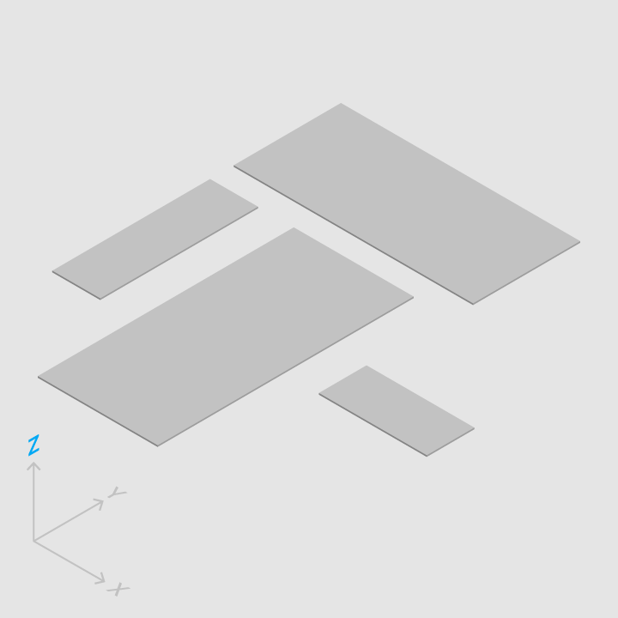
Physical Properties
Material has varying x & y dimensions (measured in dp) and a uniform thickness (1dp).

Slide 11
Physical Properties
Material casts shadows.
Shadows result naturally from the relative elevation (z-position) between material elements.
https://material.io/guidelines/material-design/material-properties.html#material-properties-physical-properties

Slide 12
Physical Properties
Content is displayed on material, in any shape and color.
Content does not add thickness to material
Content can behave independently of the material, but is limited within the bounds of the material.

Slide 13
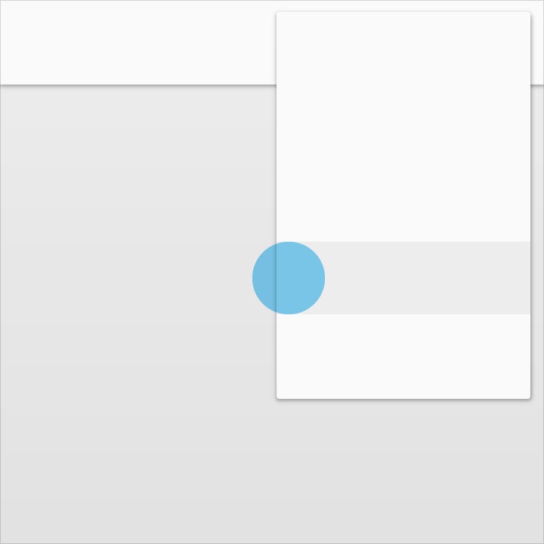
Physical Properties
Material is solid.
Input events cannot pass through material.

Slide 14

Physical Properties
Multiple material elements cannot occupy the same point in space simultaneously
Using elevation to separate material elements is one method of preventing multiple material elements from occupying the same point in space simultaneously.

Slide 15
Physical Properties
Material cannot pass through other material
For example, one sheet of material cannot pass through another sheet of material when changing elevation
You can shrink one sheet, or move it around the other, but not through

Slide 16
Transforming Material
Material can change shape
Material grows and shrinks only along its plane
Material never bends or folds
Sheets of material can join together to become a single sheet of material
When split, material can heal. For example, if you remove a portion of material from a sheet of material, the sheet of material will become a whole sheet again.

Slide 17
Movement of Material
Material can be spontaneously generated or destroyed anywhere in the environment
Material can move along any axis
Z-axis motion is typically a result of user interaction with material

Slide 18
Elevation and Shadows
Objects in material design possess similar qualities to objects in the physical world
In the physical world, objects can be stacked or affixed to one another, but cannot pass through each other
Objects also cast shadows and reflect light
Material design reflects these qualities to form a spatial model that is familiar to users and can be applied consistently across apps

Slide 19
Elevation
Measured from the front of one surface to the front of another, an element’s elevation indicates the distance between surfaces and the depth of its shadow
All material elements have resting elevations. While components have consistent resting elevations across apps, they may have different resting elevations across platforms and devices.
Dynamic elevation offsets are the goal elevation that a component moves towards, relative to its resting state

Slide 20
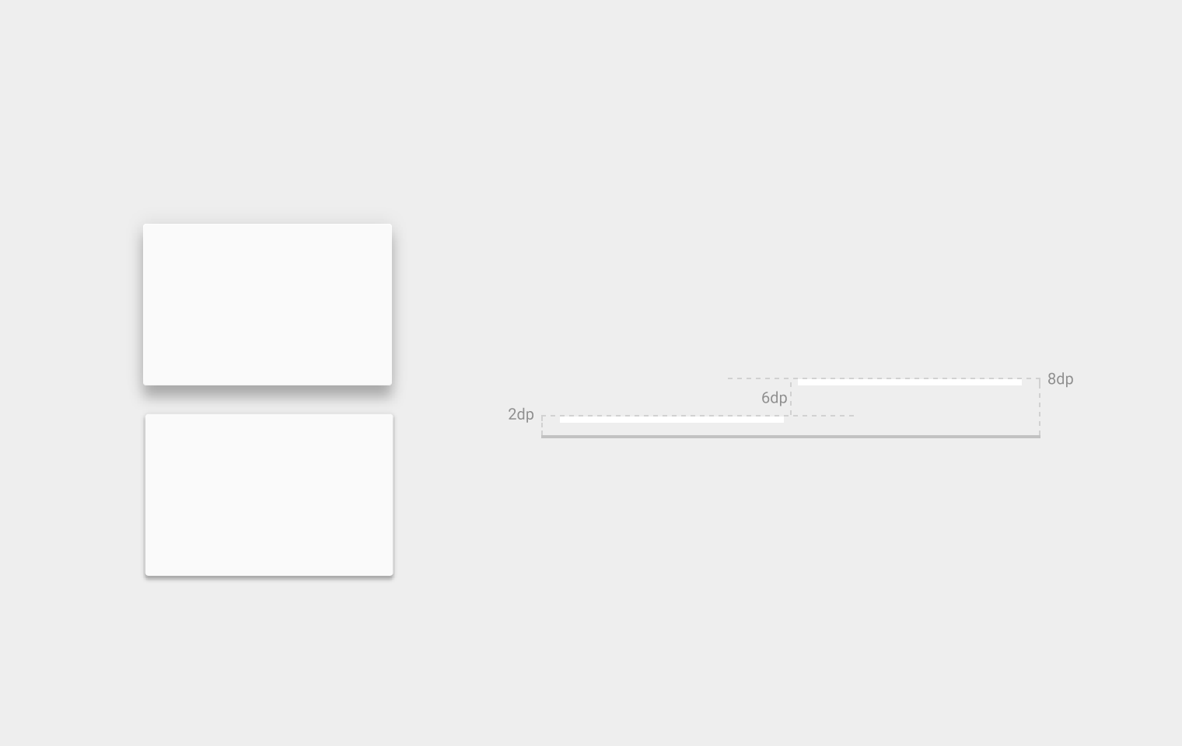
Elevation

Slide 21
Resting Elevation
All material objects, regardless of size, have a resting elevation, or default elevation that does not change.
If an object changes elevation, it should return to its resting elevation as soon as possible.
Desktop resting elevation is 2dp below the listed values to accommodate mouse and non-touch environments.

Slide 22
Component Elevation
Components maintain consistent resting elevations across apps. For example, the floating action button’s elevation does not vary from one app to another.
Components may have different resting elevations across platforms and devices, depending on the depth of the environment. For instance, TV has a greater depth than desktop as it has a larger screen and is viewed from further away.
Similarly, both TV and desktop have a greater depth than mobile

Slide 23
Shadows
Shadows provide important visual cues about objects’ depth and directional movement.
They are the only visual cue indicating the amount of separation between surfaces.
An object’s elevation determines the appearance of its shadow.

Slide 24
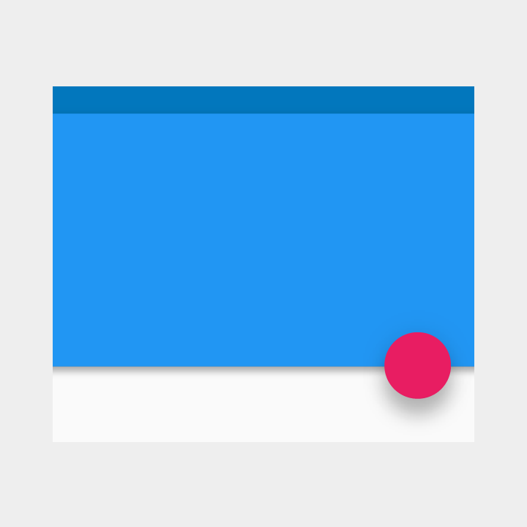
Shadows
Softer, larger shadows indicate the floating action button is at a higher elevation than the blue sheet, which has a crisper shadow.
In motion, shadows provide useful cues about an object’s direction of movement and whether the distance between surfaces is increasing or decreasing.

Slide 25

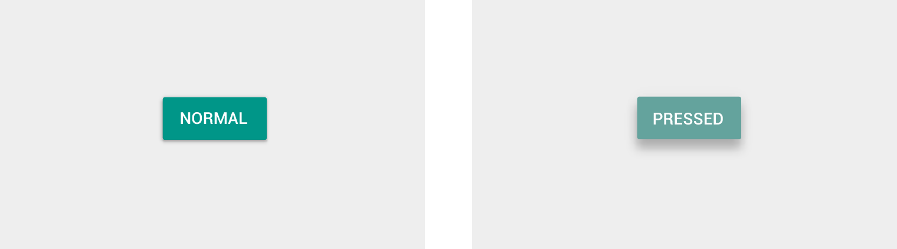
Component Reference Shadows
The following component shadows should be used as canonical references. If there are any differences between the following reference shadows and component shadows found elsewhere within this spec, defer to these reference shadows.

Slide 26
Object Relationships
Object Hierarchy
Exceptions
Interaction
Elevation

Slide 27
Object Hierarchy
How you organize objects in an app determines how they move in relation to one another. Objects can move independently of each other or be constrained by objects higher in the hierarchy.
All objects are part of a hierarchy described in terms of a parent-child relationships
Parent-child specifics:
Each object has one parent.
Each object may have any number of children.
Children inherit transformative properties from their parent, such as position, rotation, scale, and elevation.
Siblings are objects at the same level of hierarchy.

Slide 28
Exceptions
Items parented to the root, such as primary UI elements, move independently of other objects. For example, the floating action button does not scroll with content.
Other elements include:
An app’s side nav drawer
The action bar
Dialogs

Slide 29
Interaction
How objects interact with one another is determined by their place in the parent-child hierarchy.
For example:
Children have minimal z-axis separation from their parent; other objects do not get inserted between parents and children.
In a scrolling card collection, the cards are siblings of each other, so they all move together in tandem. They are children of the card collection object that controls their movement.

Slide 30
Elevation
How you determine the elevation of objects – their position in z-space – depends on the content hierarchy you want to express and whether an object needs to move independently of other objects

Slide 31
Motion
Many interactive programs show motion, from maps to games to settings
https://material.io/guidelines/motion/material-motion.html

Slide 32
Motion
Motion provides:
Guided focus between views
Hints at what will happen if a user completes a gesture
Hierarchical and spatial relationships between elements
Distraction from what’s happening behind the scenes (like fetching content or loading the next view)
Character, polish, and delight

Slide 33
How Does Material Move?
The material environment draws inspiration from real-world forces, such as gravity and friction
These forces are reflected in the way user input affects elements on screen and how elements react to each other

Slide 34
Motion is Responsive
Material is full of energy
It quickly responds to user input precisely where the user triggers it
In the pong game, the paddle must follow your finger without lag, not snap to a position when you lift it

Slide 35
Motion is Natural
Material depicts natural movement inspired by forces in the real world
An object's ability to speed up or slow down quickly is affected by weight and surface friction
In a similar way, starts and stops do not occur instantaneously in material design
Objects can follow curved paths, not just straight lines

Slide 36
Motion is Aware
Material is aware of its surroundings, including the user and other material around it
It can be attracted to objects and respond appropriately to user intent

Slide 37
Motion is Intentional
Material in motion guides focus to the right spot at the right time
A transition helps guide the user to the next step of an interaction
Movement can communicate different signals, such as whether an action is unavailable

Slide 38
Motion is Quick
An interaction shouldn't keep the user waiting longer than necessary.

Slide 39
Motion is Clear
Transitions should be clear, simple, and coherent
They should avoid doing too much at once
Maintain a clear path into the next view, even while elements are choreographed as a group
Notes:
Transitions between activities: https://developer.android.com/training/transitions/start-activity.html

Slide 40
Motion is Cohesive
Material elements are unified by their speed, responsiveness, and intention
Any customizations to your app's motion experience should be consistent throughout the app

Slide 41
Motion
Among many other things, you can animate view visibility by using the Reveal Effect:
int centerx = testText.getWidth()/2; int centery = testText.getHeight()/2; float radius = (float)Math.hypot(centerx, centery);
Animator anim = ViewAnimationUtils.createCircularReveal(testText, centerx, centery, 0, radius);
testText.setVisibility(View.VISIBLE); anim.start();
Notes:
Show WidgetTest and circular reveal animation

Slide 42
Color
Color is inspired by bold hues juxtaposed with muted environments, deep shadows, and bright highlights
https://material.io/guidelines/style/color.html

Slide 43
Color
The color palette should have at least these three elements:
A primary, signature color
A darker variant, used for the status bar, among other things
An accent color, complementary to primary color, to draw attention to important Views in the UI
Thus color can be a way of branding your app without explicit elements that take screen real estate
We’ll discuss this more when we talk about Themes

Slide 44
Color
Hierarchical
Color indicates which elements are interactive, how they relate to other elements, and their level of prominence. Important elements should stand out the most
Legible
Text and important elements, like icons, should meet legibility standards when appearing on colored backgrounds, across all screen and device types
Expressive
Reinforce your brand by showing brand colors at memorable moments that reinforce your brand’s style
Notes:
No dark blue on black, or white on yellow

Slide 45
Themes
Theme that can be applied across all Activities
<resources> <!-- Base application theme. --> <style name="AppTheme" parent="Theme.AppCompat.Light.DarkActionBar"> <!-- Customize your theme here. --> <item name="colorPrimary">@color/colorPrimary</item> <item name="colorPrimaryDark">@color/colorPrimaryDark</item> <item name="colorAccent">@color/colorAccent</item> </style> </resources>

Slide 46
Themes
Colors from the Resources file:
<?xml version="1.0" encoding="utf-8"?> <resources> <color name="colorPrimary">#B4F3EC</color> <color name="colorPrimaryDark">#00574B</color> <color name="colorAccent">#D81B60</color> </resources>

Slide 47
Themes
Note that the theme AppTheme is derived from Theme.AppCompat.Light.DarkActionBar, which is built in
In the <Application> section of the manifest, there is the following line: android:theme="@style/AppTheme">
This applies the same theme to all Activities in the program, giving them a consistent look

Slide 48
Themes
You can also define a second theme within the <resources> tag that can be applied to Views
<style name=“AppTheme.Custom”>
<item name=“colorControlNormal”>
@color/colorControlNormal</item>
<item name=“colorControlActivated”>
@color/colorControlActivated</item>
</style>
Notes:
Specify this theme for the Activity

Slide 49
Aligning to Keylines
Constraint Layout lets us set invisible guidelines to which we can align visual elements
Material design specifies the following:
Horizontal margin: 16dp (phones) 24dp (tablets)
Left margin from screen edge: 72dp or 80dp

Slide 50
Navigation
Navigating from one Activity to another within the same program should be easy and natural
Often this is done with toolbar menus, buttons, or as the result of some action in a program

Slide 51
Navigation
In addition, there are three app navigation patterns in Material Design
Tabs – Allow users to swipe between equally important top-level screens
Bottom navigation bar – An always visible bar containing 3 to 5 generally independent sub-level screens
Navigation Drawer – A drawer generally accessed by manually opening it, suitable for apps that have one primary screen and multiple independent secondary screens

Slide 52
Navigation – Tabs
Tabs are effective when you have two (or more) equally important top-level Views
Users can switch between the Views by tapping the tab or swiping between the Views
Tabs are usually included as a second child view of an App Bar Layout beneath a Toolbar
The Android clock appears to use tabs

Slide 53
Navigation – Bottom Navigation Bar
Similar to tabs, this pattern is implemented as a bar at the bottom of the screen, but it doesn’t support swiping between screens
Users can switch between views by tapping on the desired item
People usually read top to bottom, so this layout puts emphasis on the content
Ideal when your app has 3 to 5 top-level independent destinations that are of equal importance

Slide 54
Navigation Drawer
The Navigation Drawer is usually hidden until the user taps the navigation in the app bar or swipes it in from the left
Appropriate when a single main screen is significantly more important than the others
Supports architectures that require six or more equally important top-level screens
Android Calendar uses this

Slide 55
Split Screen
This is a new feature in Android, and can be very useful
https://material.io/guidelines/layout/split-screen.html

Slide 56
Video Resources
https://www.youtube.com/watch?v=Q8TXgCzxEnw
Shows how material design can be used
https://www.youtube.com/watch?v=rrT6v5sOwJg
Designers talking about material design
Design video from material.io

Slide 57
Components
We’re all familiar with the standard components, but here are some new ones:
TextInputLayout – Enhanced control for editing text input
Nine-Patch Images – Images that can expand and shrink effectively
Chips – Represent a complex entity in a small block
Expansions panels – Contain creation flows; allow lightweight editing of an element
Grid lists -- An alternative to standard list views
Steppers – Display progress through numbered steps

Slide 58
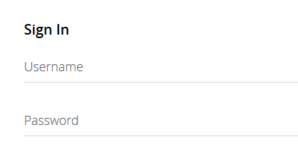
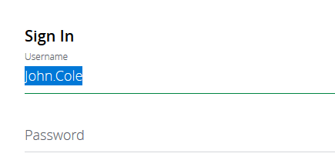
TextInputLayout
This shows the hint within the field itself initially (top image)
The hint moves to the outline box when you start typing (bottom image)

Slide 59
TextInputLayout
XML for TextinputLayout
Note that the layout contains a child TextInputEditText, which does the actual work
<android.support.design.widget.TextInputLayout
android:layout_width="match_parent"
android:layout_height="wrap_content">
<android.support.design.widget.TextInputEditText
android:layout_width="match_parent"
android:layout_height="wrap_content"
android:hint="@string/form_username"/>
</android.support.design.widget.TextInputLayout>

Slide 60
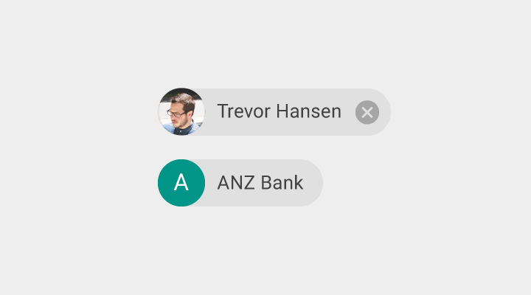
Components – Chips
Chips represent complex entities in small blocks, such as a contact
A chip may contain entities such as a photo, text, rules, an icon, or a contact

Slide 61
Components – Expansion Panels
Expansion panels contain creation flows and allow lightweight editing of an element
An expansion panel is a lightweight container that may either stand alone or be connected to a larger surface, such as a card
They may be used for a variety of tasks, such as:
To edit a setting
To create a tool for ad campaigns

Slide 62
Nine-Patch Images
You may not know how large an image must be
For example, a button that must accommodate multiple languages or images
There are nine pieces to a button: Four corners, four edges, and the center area
For a wider button, the top, center, and bottom would be duplicated
For a taller button, the left, center, and right would be duplicated

Slide 63
Nine-Patch Images
XML:
<?xml version=“1.0” encoding=“utf-8”?>
<nine-patch xmns:android=http://schemas.android.com/apk/res/android
android:dither=“true”
android:src=“@drawable/padding_bg” />

Slide 64
Layer List
This is an array of drawables that creates a LayerDrawable instance
Each drawable can be offset on the left, top, right, and/or bottom by a different amount
The drawables are drawn in the order in which they are declared
They will be scaled to fit available space

Slide 65
Layer List
XML:
<?xml version=“1.0” encoding=“utf-8”?>
<layer-list xmns:android=http://schemas.android.com/apk/res/android>
<item android:drawable=“@drawable/green_screen” />
<item android:drawable=“@drawable/red_screen”
android:left=“64dp”
android:top=“64dp” />
</layer-list>

Slide 66
InsetDrawable
Insets another Drawable by a specified distance
Useful when you have a drawable that you would like to appear smaller than the View, or appear padded

Slide 67
Transitions
ImageSwitcher – Switches between two images with an animated transition
ViewSwitcher – Switches between two views where one is shown at a time
StackView – Stacks multiple views that you can swipe through, similar to the “recents” list
MediaController – Contains views to control media, including play, pause, fast-forward, and a progress indicator

